Slide 1
Predictable Surprises: The Disasters You Should Have Seen Coming
Written by: Michael D. Watkins & Max H. Bazerman
Presented by: Steven Leibovitz

Slide 2
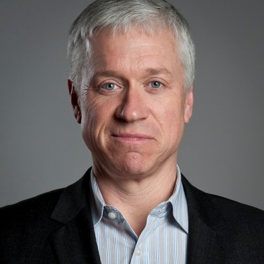

Authors
Michael D. Watkins
  Professor of General Management at IMD
  Co-founder of Genesis Advisers
Max H. Bazerman
  Jesse Isidor Professor of Business Administration
  Harvard Business School

Slide 3
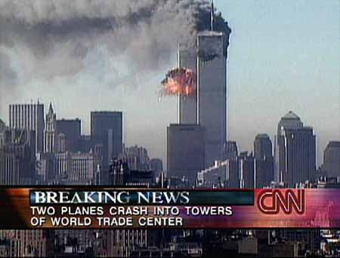
Are Surprises Predictable?
Definition of Predictable Surprise
Example: 9/11
  Had information on terrorists methods
  Could have prevented the attack
  Failure in RPM process

Slide 4

Three Ways to Fail
Did the leader recognize the threat?
  Scan the environment for emerging threats
Did the leader prioritize appropriately?
  Threat is recognized; not given priority
Did the leader mobilize effectively?
  Threat is deemed serious, mobilize it

Slide 5
9/11 The Surprise that Shouldn’t Have Been
1993: Terrorists set off car bomb
1995: Terrorists hijacked Air France plane
U.S. security was full of holes
Easy to bring weapons on planes
Despite signals, precautionary measures weren’t taken
Once again, failure in RPM process

Slide 6
Causes of Predictable Surprises
Cognitive
  Ignore the threat of predictable surprises
Organizational
  Frequently fail to take active steps
Political
  Corrupting political system for own benefit

Slide 7
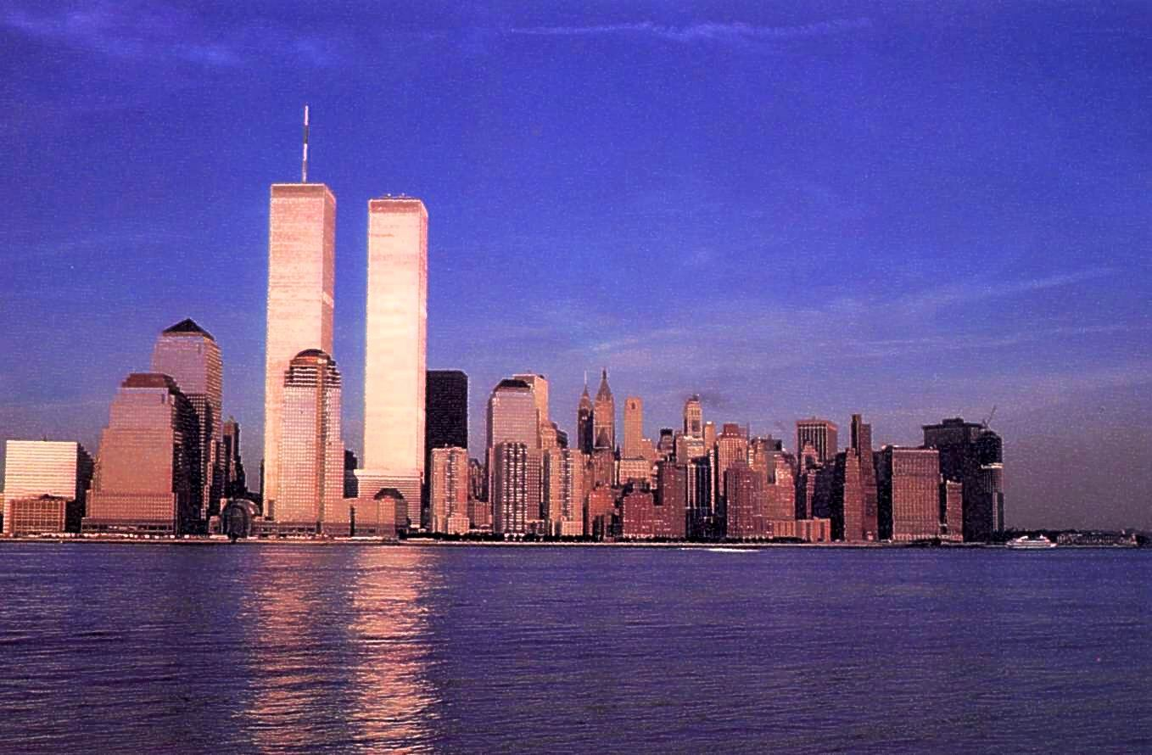
Conclusion
According to Coombs
My opinion

Slide 8
References
Coombs, W. T. (2007, October). Crisis management and communications. Retrieved from: http://www.instituteforpr.org/topics/crisis- management-and-communications/
Watkins, M.D., & Bazerman, M.H. (2003, April). Predictable surprises: the disasters you should have seen coming. Retrieved from: http://hbr.org/2003/04/predictable-surprises-the- disasters-you-should-have-seen-coming/ar/1

