Slide 1
Recovering Unused Meal Credits
Daniel Colbeth, Emily Wylde, Stephen Lauver

Slide 2
BIG Idea
Buy university meal credits at a discounted price
Sell unused university meal credits and earn a profit
Notes:
What is a meal plan?
A meal plan gives students x amount of meal creditss to use at university affiliated dining services on a weekly or per semester basis.
What is a meal credit?
A meal credit is essentially the transactional credit used to redeem meals at university affiliated dining services. Meal credits are rewarded on a weekly or per semester basis and can range from 5-unlimited credits.
Who purchases meal credits/who is required to have a meal plan?
Incoming freshman are required to purchase a meal plan through Temple dining services. Upperclassmen can purchase plans, but are not required by the university.
How/where do you redeem meal credits?
Meal credits can be redeemed at various university affiliated dining service locations, such as J&H, the Student Activities Center, and Morgan Hall.
Who is involved?
Sodexo is the foodservice vendor for Temple University dining services, providing all of the food, food preparation, and staffing for university affiliated dining.

Slide 3
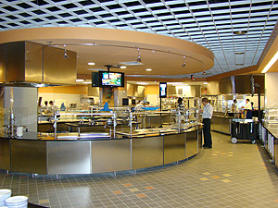
Research
15% of meal credits at US universities go unused each week
7% of college-aged students’ income is spent on dining out
Every student surveyed said that they would use Swipe’d
Notes:
What is interesting about this project, why should we care?
25% of meal plans at universities go unused
Source: http://www.collegemediamatters.com/2012/02/16/college-media-mad-money-thursday-1-how-much-of-your-meal-plan-is-wasted-dailytarheel/
College aged students spend just over 7 percent of their income on dining outside of their apartment or house (this is compared to the 3.8% that most 45-54 year olds spent dining out)
Gives students the ability to reduce that expense
Source: http://www.michigandaily.com/article/college-student-spending-luxury
What does this tell you…..?
There is a demand for a resource that allows students to sell unused meals and buy extra meal credits (as opposed to spending money eating out)
69% of university students have personal loans for college expenses

Slide 4
Pilot at Temple University
Do you have a meal plan?
Do you have extra meals credits at the end of a typical week?
Do you run out of meal credits before the end of a typical week?
Market Exists
Buyers Market
Sellers Market
Notes:
75 people surveyed, 70 said they would use swipe’d if given the opportunity. Those who said they wouldn’t use it don’t have a meal plan
Focus group demonstrates market demand
How will we reach this market? Existing channels (facebook, class pages, word-of-mouth, etc.)
How will this easily transfer to other universities? How will you roll it out?
Contact university’s dining service to obtain meal plan information (number of meal plans sold, most common meal plan, number unused per week - obtained through outside research)
Focus group analysis to get potential size of market (potential users)
Utilize university’s existing marketing channels (universal channels between universities - facebook, class pages, word-of-mouth, etc.)
Obtain frequent user-base over 12 to 24 months, then license application to university to integrate into current system

Slide 5
Implementation Plan
Hold focus group to demonstrate market demand
Reach market through existing channels (Facebook, Twitter, word-of-mouth, etc.)
Contact dining service for meal plan information
Roll-out to other universities once a user-base is established
Notes:
roll out plan
Contact university’s dining service to obtain meal plan information (number of meal plans sold, most common meal plan, number unused per week - obtained through outside research)
Focus group analysis to get potential size of market (potential users)
Utilize university’s existing marketing channels (universal channels between universities - facebook, class pages, word-of-mouth, etc.)
Obtain frequent user-base over 12 to 24 months, then license application to university to integrate into current system

Slide 6
Competitive Analysis
Non-Consumption
Students not recovering unused meals/purchasing additional meals with Swipe’d application
Notes:
Our only competitor is Non-Consumption:
Swipe’d is a New Market disruption, meaning there are no other apps similar to ours on the market.
In order for our app to be successful, we need:
Students who want to recover the sunk cost of their unused meals
Without these people (supply), there’s no way to meet market demand
….from slide 7 (how we’re going to make money) to slide 8 (why it is going to work - competing solely against non-consumption)

Slide 7
Financial Analysis
Cost Structure
Future Revenue Streams
App Development (including API)
~$70,000
App Maintenance/Improved Functionality
~$14,000/year
Other Fees
Google Play fees (takes 30% of the original meal posting price per transaction)
10% transaction fee per transaction
Application Download Fees
Monthly Subscription/Pay-per-post
University Licensing
Notes:
We’re going to frame this presentation from the perspective of our initial pilot program at Temple University
Through our market analysis, we are going to determine the revenue potential at Temple University, then rollout similar financial models to other universities of varying sizes
Future Revenue Streams: as opposed to current revenue streams
…let me explain why we won’t apply a financial model inside the first year of implementation
In order for our app to be successful, we need a student populated market
Without a user-base, the app is useless
Therefore, our number one concern is gaining a strong user-base
In order to gain a strong user-base, all fees associated with using the app must be eliminated (especially when targeting a college demographic)
However, in the future, our financial model will roll-out as follows:
Calculate total student enrollment at University
Through contacting dining services vendor, obtain % with meal plans (assume 20% if info is unavailable/unattainable)
Through contacting dining services vendor, obtain most commonly purchased meal plan (assume 8 meals/week if info is unavailable/unattainable)
Multiply to find the number of meal credits issued on a weekly basis
We know, through research, that 15% of meals go unused each week.
Total number of meals unused each week (multiplied by) the average selling price per meal ($4.50) =
Take 10% (via transaction fees) of total meals sold each week = potential revenue
….and this is only taking into consideration the transaction fee financial model – we have several other models to apply uniquely
See https://www.otreva.com/calculator/#
App maintenance and improved functionality is generally 20% of development costs (per year)
?? temple api
21 million students that go to American universities. If 30% downloaded app, $126,000 could be made from advertisements)

Slide 8
Three Year Analysis
Year 1
Temple University
Gain user-base
No revenue
Year 2
2 of Philadelphia’s 19 Universities
Gain user-base through features
Revenue generation
Year 3
4 additional Universities
Established user-base
Profitability
Pilot Program
Local Expansion
Further Expansion
University Licensing
Notes:
Year 1: Pilot Program
Initial pilot at Temple University – because we’re students here
Gain user-base – through established marketing channels
No revenue – there will be no revenue in year one b/c
No cost to use application
No download fee
No transaction fee
No posting fee
We believe this will gain us the largest user-base and really indicate raw market demand
Year 2: Local Expansion
2 of Philadelphia’s 19 Universities – Drexel and La Salle
Gain user-base through value added features
App won’t be entirely free, but…
We will offer features like:
Post 10 meals = waive transaction fee
Refer a friend = get free posts
Buy 10 meals = purchase your next meal for free
…this will lead to revenue generation – we will still be “in the red”, though…
Year 3: Further Expansion
4 additional Universities
Established user-base – change in strategy:
Now, we will pitch the program to Universities
Offer them a pilot (trial) period program
Utilize Universities network to gain LARGER user-base
This is the first year we expect to see profitability
End goal in each year…..UNIVERSITY LICENSING

Slide 9
Moving Forward
Added Functionality
In-house transaction processing system
Share Meals with Friends
Incentive Program
Avoid 30% Google Play fee per transaction
Feature allowing you to transfer meals at no cost
For buyers and sellers
Delivery system for meals
Meals delivered to your location
Improved features within Swipe’d

Slide 10
Appendix

Slide 11
Architectural Analysis
Devices
Network
Applications
Data
Smartphone (iPhone or Android)
Cloud
API
Temple Dining Data
Tablet
Cellular Network
Google Play
Swipe’d User Data
Swipe’d Application
Notes:
Swipe’d Data: Meals sold data, number of postings data, number of downloads data
Temple Dining Data: Meal plan data
List and analyze the enterprise architecture and systems impact of the solution – what it will mean for other systems? –what will you need from other systems?

Slide 12
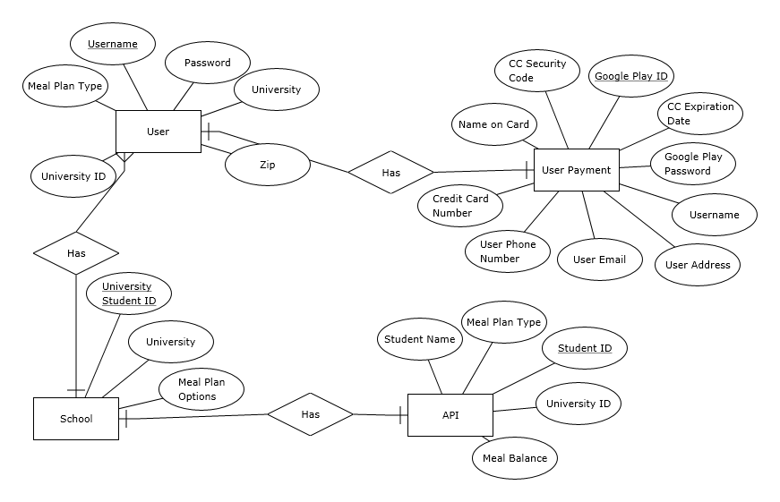
Data Model

