Slide 1
Legit.
Status Report III
Prince Patel, Andrew Min, Jacqueline Henry & Henry Wadsworth
Notes:
We are LEGIT.

Slide 2
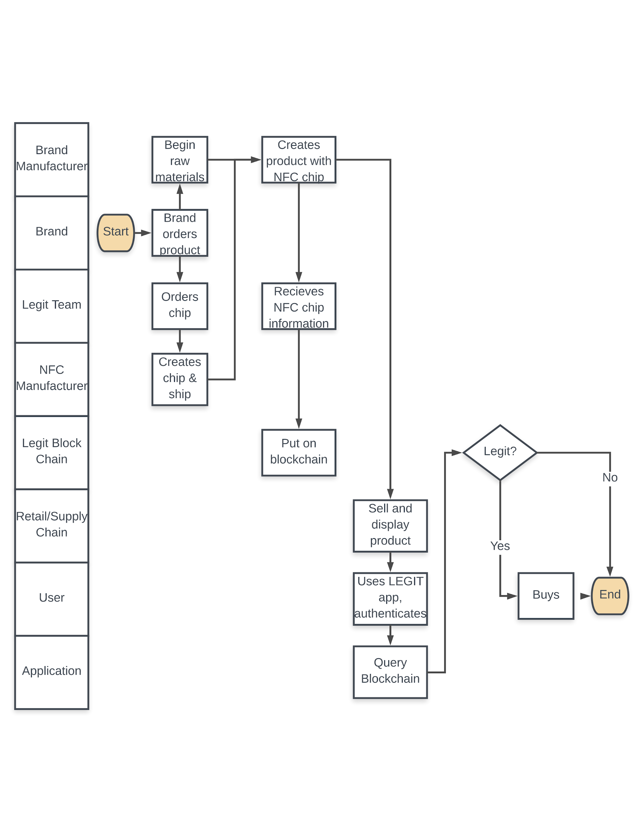
Process Map

Slide 3
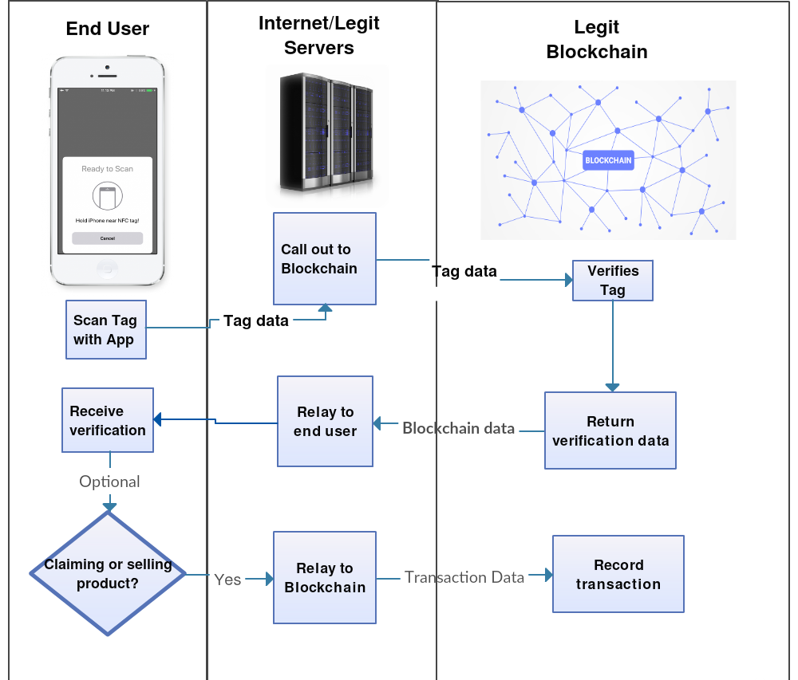
System Architecture

Slide 4
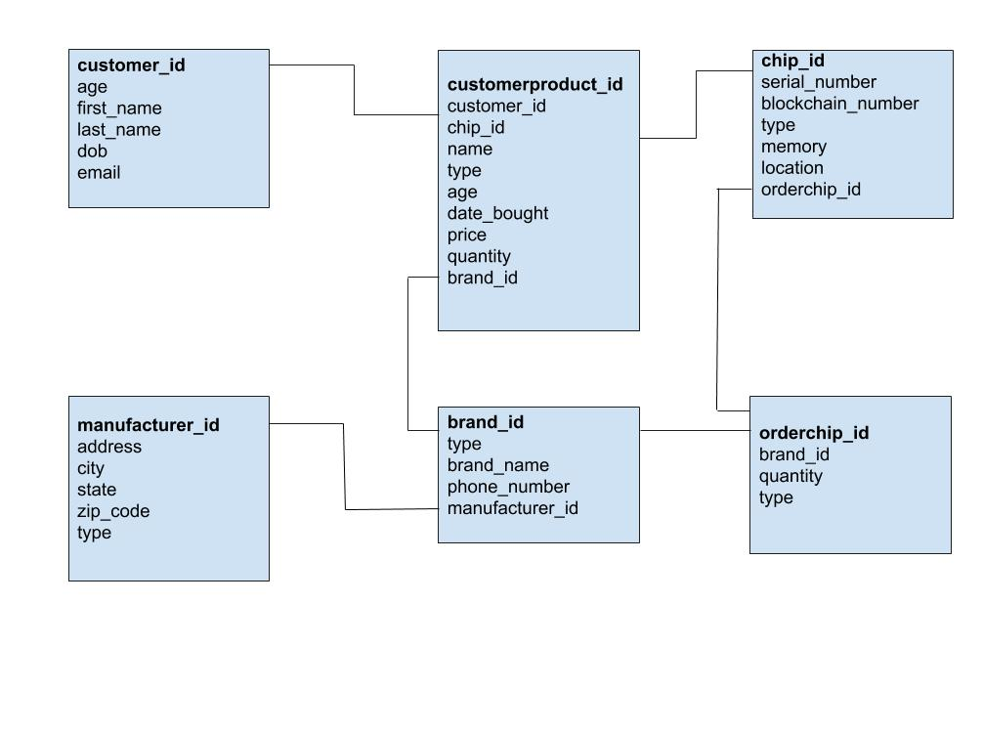
Data Model
Notes:
Our Data Model reflects our process map entities. We are tracking our customers, their products, the chips within those products, the brands were going through, the manufacturers, and the ordering of the chips. If you notice, under chip_id, is the blockchain number. It is important to note that this number will always be changing. It is something we need to further investigate if we are going to include this in our data model because this would mean the model would constantly be changing.

Slide 5
Business Case
Luxury Brands are losing $30.3 Billion annually
60% of the reason why people sell their used items is to earn money
55% of online marketplace sellers have a profit margin of above 20%
49% of the resale market make up apparel - totaling $20 Billion
Brand Exclusivity, Sustained Brand Value
Reduced Depreciation
Notes:
So how can we make money off of ensuring consumers products are legitimate? Brands are losing $30.3 Billion annually due to counterfeits. Many of these consumers believe they are buying the real product, and the brand is losing out on a sale. Brands have incentive to buy our services. The secondhand market is also booming, with profit margins above 20% and the resale apparel market accounting for $20 billion annually. However the drawback of the resale market is the inability to see product authenticity, therefore we can help the sellers authenticate their product so they can easily sell their items.

Slide 6
Competitive Analysis
New Products through brands
Luxury Brands
i.e.: LV, Adidas, Rolex, Hennessy
Owned/Current products through partners
GOAT
Pawn Shops
Antique Stores
Second Hand Sellers
Notes:
We will be working with third party authenticators to verify already owned products and then tag our NFC chips to ensure future protection. This will bring business to these third party authenticators while allowing us as a company to penetrate the preowned product market.

Slide 7
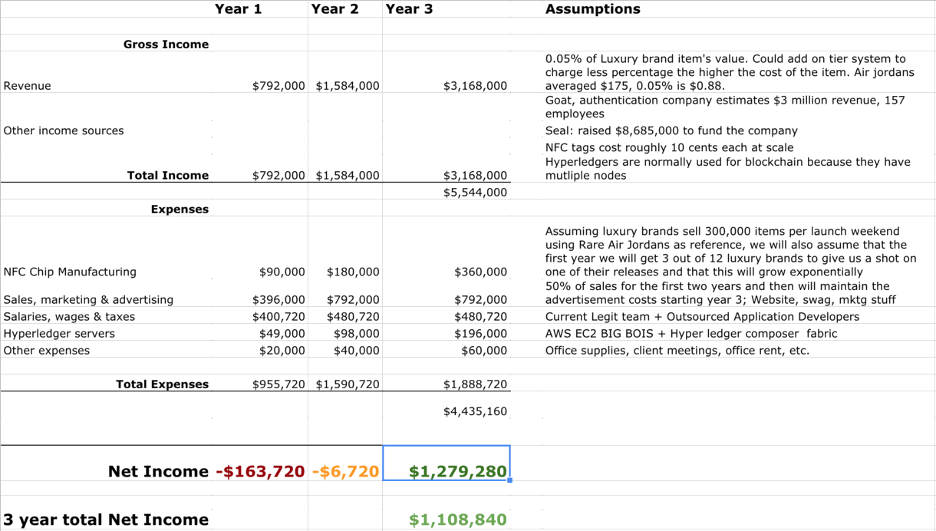
Financial Analysis
Notes:
We will also incur infrastructure costs. Originally we didn’t say what servers we would be using, however we have come to a conclusion that we will be using Amazon EC2 servers. We will be using a large server, and pay per hour. These servers include a hardware the blockchain rungs on which costs is $5.52 an hour, along with software costs that are 5 cents an hour. This software enables us to use blockchain technology, and the hardware provides higher processing power. Combined that equals $5.57 an hour, times that by the hours total for the year and we get $49,000. From there we expect to go, so we will increase the servers. Year two we will use two, and year three 4. Id like to move onto the alst expense, the other expenses. These cover office espenses, coffee for clients and internal miscellanuos expenses.

Slide 8
Labor Costs
Job description | Hourly Rate | Estimated Hours | Total Costs | Reference Source(s) for Rate
General developer | $27.46 | 2080 | $57,116.80 | https://www.payscale.com/research/US/Job=Software_Developer/Salary
Mobile application developer | $23.96 | 2080 | $49,836.80 | https://www.payscale.com/research/US/Job=Mobile_Applications_Developer/Salary
Project Manager | $45.08 | 2080 | $93,766.40 | https://www.payscale.com/research/US/Job=Project_Manager%2c_Information_Technology_(IT)/Salary
Founders |  |  | $200,000

Slide 9
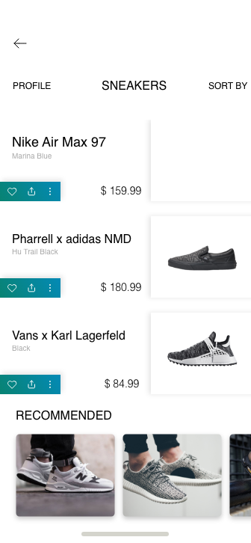
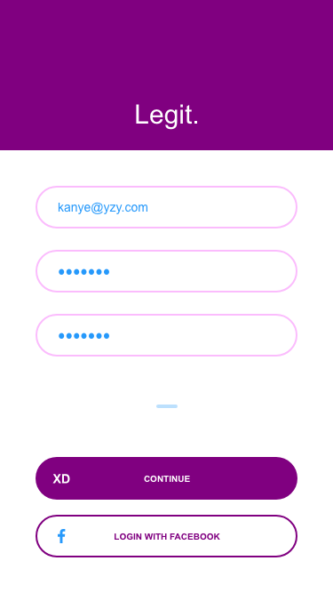
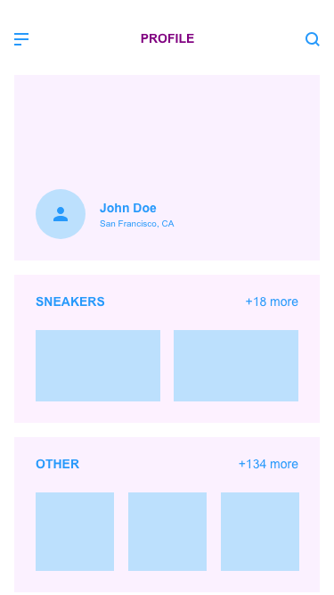
Prototype in Progress

Slide 10
Works Cited
https://www.researchandmarkets.com/reports/4438394/global-brand-counterfeiting-report-2018
http://www.oecd.org/industry/global-trade-in-fake-goods-worth-nearly-half-a-trillion-dollars-a-year.htm
https://www.statista.com/statistics/730675/reasons-us-consumers-sold-used-items/
https://www.webretailer.com/lean-commerce/statistics-marketplace-seller-survey/
https://www.thredup.com/resale

