Slide 1
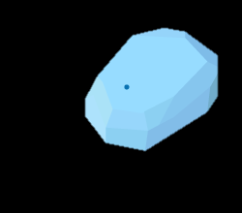
Instagram API Platform
Network Backbone
App Server
Beacon
Bluetooth Low Emittance
The Move Database
The Move Application
Business Profile Module
Internet
Business Advertising Module
Business Analytics Dashboard Module
Geospatial Info
The Move Mobile App
Review Module
Map Module
Web Server
“Discover” Module
DB Server
“Explore” Module

