Slide 1
My Comcast Center Internship
By Trevor Johnson

Slide 2
What is Comcast?
Global media and technology company with two primary businesses
Comcast Cable
NBC Universal
Nations largest video, high-speed internet and phone provider to residential customers under the Xfinity brand
Largest broadcasting and cable company in the world by revenue
Employs over 100,000 dedicated men and women nationwide

Slide 3
Comcast’s Assets

Slide 4
Products and Services
Xfinitty Tv
Digital Starter or Digital Preferred (more channels)
Xfinity High Speed Internet
Performance Internet (25mbps download speed) or Blast Internet (105 mbps download speed)
Xfinity Voice
Xfinity voicemail, caller id on TV, remote access to messages and more
Xfinity Home security and control
24/7 security & Professional Monitoring, remote arm/disarm capability, in home devise control (lighting and thermostat)
Comcast Business
High Speed internet, phone, and television

Slide 5
What is Procurement?
Objective of a world-class procurement organization is to obtain goods and services in response to internal needs. However this is changing to encompass the following objectives:
Support Operational Requirements
Manage the procurement process and supply base efficiently and effectively
Develop strong relationships with other functional groups
Develop integrated purchasing strategies that support organizational strategies, goals, and objectives

Slide 6
Work History (Summer 2014) Procurement Shared Services Intern
Responsibilities
Pulling Inventory, fuel, and maintenance spend data and creating reports for Comcast’s fleet of 34,000 plus vehicles.
Updating Agreement Specifications between Comcast and various vendors resulting in large scale dollar savings as high as 10 Million in previous years
Create reporting of vendor RFQ’s in order for management to evaluate supplier efficiencies and cost savings.
Audit Weekly Capital Authorization Requests (CAR) Approval reports to verify that all CARs are routing to the correct approvers.

Slide 7
Work History (Summer 2015) Procurement Shared Services Intern
Assist in the analysis of Comcast's fleet usage, maintenance costs, and fuel spend
Utilize Oracle Business Intelligence software to monitor invoice approval routes ensuring that all invoices be approved for payment within their terms
-Maintain data consistency and integrity by scrubbing a database of Comcast drivers, ensuring that each active driver has a pin number that corresponds to the records of our 3rd party fleet management service provider
Process vehicle requisition, by division, for Comcast's fleet using Oracle’s CIFA Application (Comcast’s Integrated Financial Application)
-Reach out to different business units, within Comcast, to identify business needs from a functionality aspect with regards to contract management. The end goal is to ascertain a standardized contract management system that can facilitate the needs of each business unit, streamlining the contract approval and creation process.
Oversee the contract creation process from start to finish, obtaining correct approval signatures, logging contract status’ in an excel database, and uploading executed contracts to Comcast’s SharePoint site

Slide 8
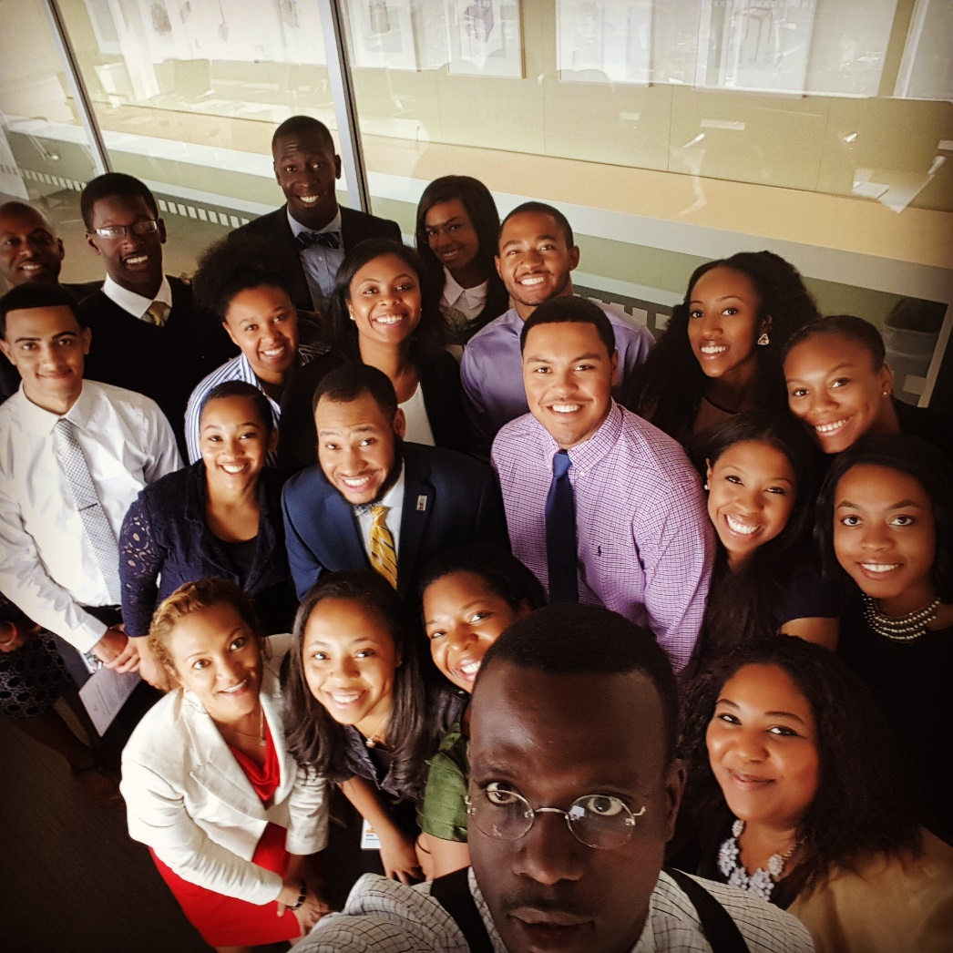
Employee Resource Groups
BPA: Black Professional Alliance
Unidos (Hispanic erg)
YPN: Young professionals network

Slide 9
How do I support the organization?
Contract Management
Ensure that all contracts are accounted for and correct signatures are obtained
Fleet Management
Process, document, and track vehicle requisitions, while producing reporting for Comcast’s 38,000+ Vehicles. (Fuel spend, maintenance spend, inventory reports, driver info)
Document Tracking
Monitor invoice approval routes, performing data audits to make sure approvals route correctly by dollar amount
Contract Management initiative
Support upper level management on a company wide initiative to create a central repository for all agreements, and streamline the approval and storage process

Slide 10
Challenges
Shying away from hiding behind emails and knowing when to pick up the phone to solve a problem
Staying busy – not every intern is flooded with work
Presenting in front of co-workers and senior leaders

Slide 11
How does my coursework relate to my internship work?
Important Note: I have only taken data analytics as an MIS major
manipulated data in excel, using shortcuts and functions that provide relevant and meaningful metadata that is essential for reporting on Comcast’s fleet usage
Presented on the advantages and disadvantages of hosting your data on a cloud as opposed to a dedicated server
Worked closely with various business units, including IT, to collect information on the different document repositories, within Comcast, from a functionality aspect

Slide 12
Opportunities
Networking with Senior Leaders
Intern networking events
Community service events
Comcast Cares Day
Professional Development Workshops
Speaker Series
Meeting involvement and real engagement

Slide 13
Comcast Sights
William Penn on the roof of the Comcast Center
View from the roof of the Comcast Center

Slide 14
Comcast center Internship Post

Slide 15
Trevor Johnson’s E-Portfolio page

