Slide 1
TUnite
Adam Solomon, Chris Nocella, Anthony Havrilla, Matt Johnson

Slide 2
The Problem
Currently there is no Temple University communication hub
GroupMe
Survey Monkey
Doodle
Slack
Outlook
Google Docs

Slide 3
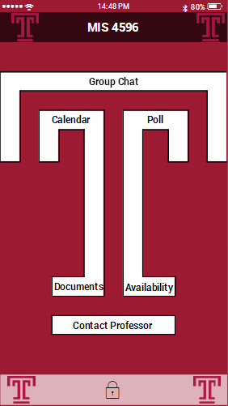
The Solution
TUnite
Seamless group communication
Shared scheduling
Group Availability
Decision making
OWLbox integration
Notes:
This application is interesting and useful because it address the problem of organizing and communicating in group projects.
The abilities of this application already exist but using them to organize a group is extremely inconvenient as you must use the application and distribute it to your group via email. Examples would be GroupMe, Survey Monkey, and Doodle. TUnite offers
these services conveniently in one application.

Slide 4
Demo

Slide 5
Our Competitive Advantage
All-in-one application
Increases group efficiency
Offers students a better experience that is university specific

Slide 6
The Plan
Use Temple as proof-of-concept
Form partnership with Temple to distribute our app
Eventually expand to other Universities
PSUnite, UnitePenn, WCUnite, etc.
Charge universities per student basis ($20/user)

Slide 7
Financials (2016)
Financials (2017)
Costs
App Development- ($10,000)
Maintenance- ($4,500)
Operating- ($20,000)
Costs
App Development- ($0)
Maintenance- ($10,250)
Operating- ($40,000)
Salaries- ($180,000)
Revenue
BYOBB- $80,000
Service to Temple- $0
Revenue
Service to Temple - $0
Service to UPenn- $600,000
Net Profit (loss)- $45,500
Net Profit (loss)- $369,750
Notes:
We eventually plan to branch out from Temple by expanding to other local Universities.
This will ultimately increase costs, but will also increase revenues.
We foresee that the financials will reflect as shown, for the addition of new universities.

