Slide 1
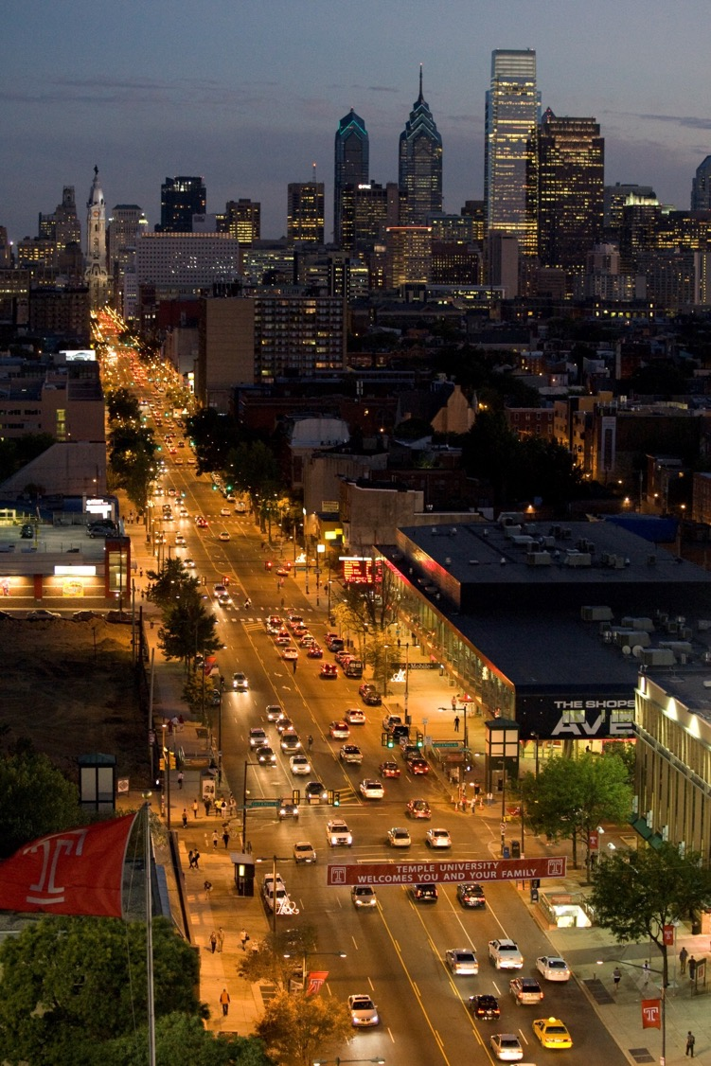
Temple University
TU Study
Amruth
Glenn
Jacky
February 5, 2015

Slide 2
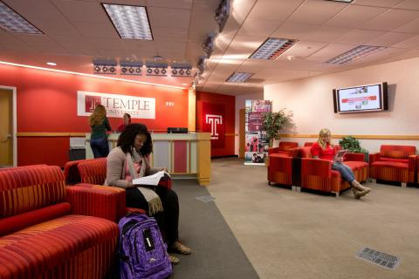
What’s the problem?
Excessive time spent searching/reserving resources on campus.
Surveys show lack of exposure to many Temple resources.
Reservation websites scattered all over the Temple network, which make it a hassle.

Slide 3
What did we do solve this?
Brainstormed potential solutions (Planning)
Gathered data of all resources Temple offers (Analysis)
Understood what end users wanted through Surveys (Analysis)
Met with CIO & Director of Computer Services at Temple for their expert opinion (Analysis)

Slide 4
Solution: TU Study
An one-stop App for students/faculty members to view all Temple resources and reserve them immediately.
Integrates with a live reservation system to provide an update view of resource availability.
Increases resource usage, saves time, and increases efficiency.

Slide 5
System Architecture
LDAP Active Directory
F IREWALL
API
Authorize
Authenticate
TUStudy (App)
Application Server
(Apache/Linux)
Database Server
Live Reservation System

Slide 6
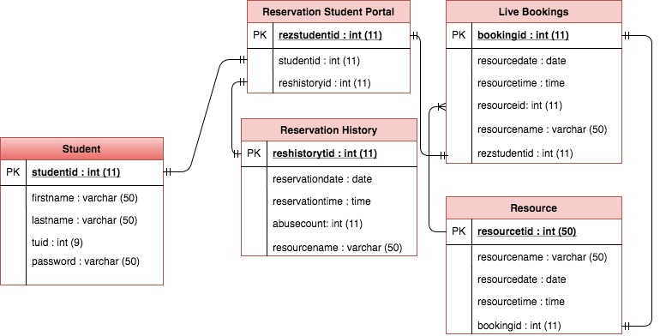
Data Models
Live Reservation System
LDAP Active Directory

Slide 7
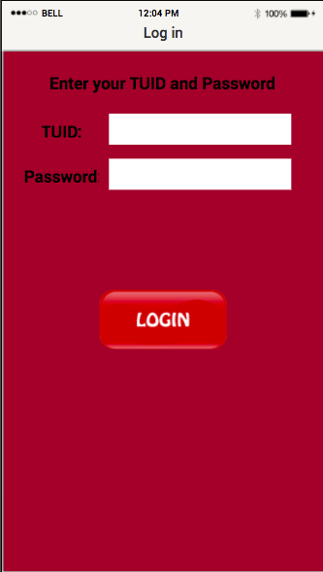
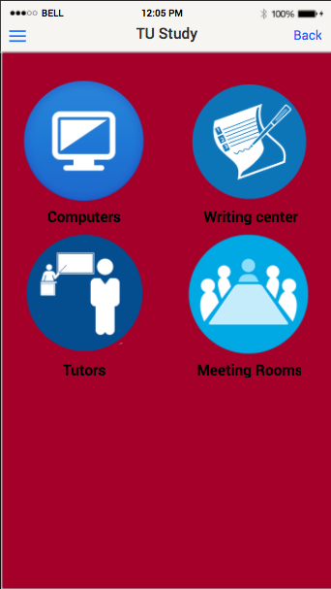
How do we use it? (Design & UX)

Slide 8
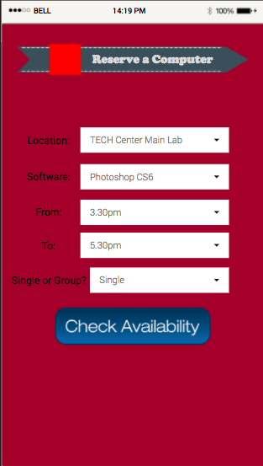
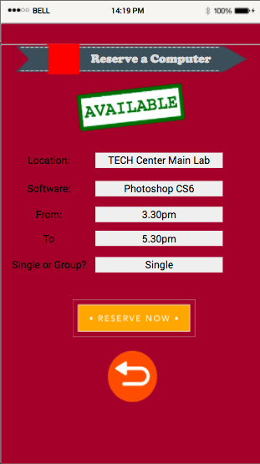
How do we use it? (Design & UX)

Slide 9
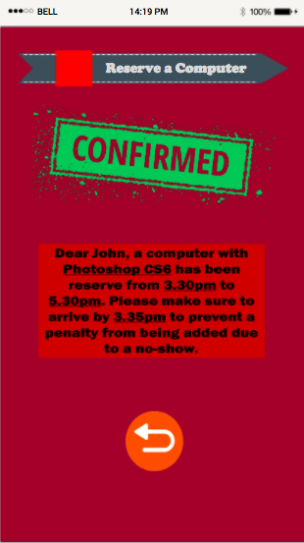
How do we use it? (Design & UX)

Slide 10
This has been done before, what’s different now?
ALL commonly usable Temple resources are accessible at one location.
You can only reserve in a 1 HOUR WINDOW.
Reservation BLOCKS issued for those who abuse the system.

Slide 11
1 hour time window

Slide 12
What’s the purpose of the time window?
The first time, students were given a week to reserve.
This time, 1 hour!
Enables students just enough time to get to computer.
This lowers the chance of changing their minds.
Restricts abuse of the reservation feature.
Increases students’ time management.

Slide 13
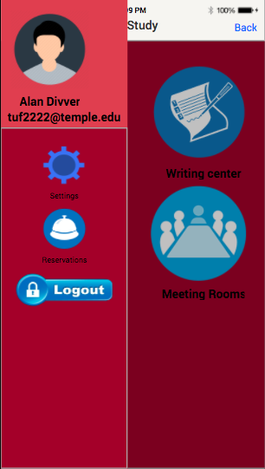
5-day Reservation Block for Abusers!

Slide 14
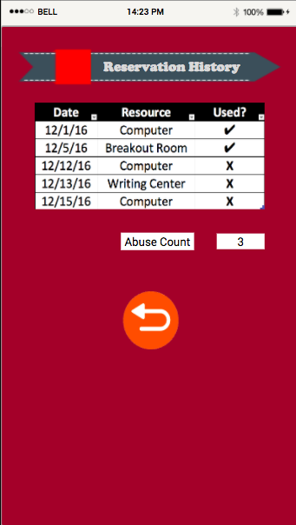
5-day Reservation Block for Abusers!

Slide 15
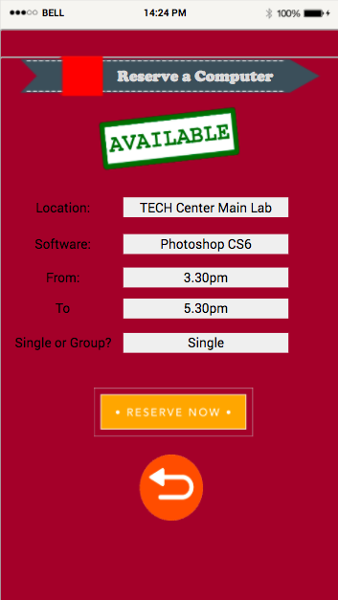
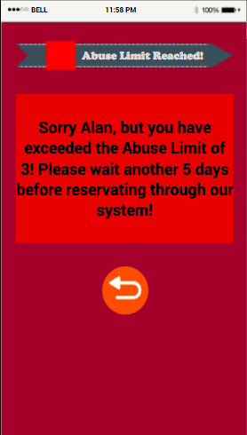
5-day Reservation Block for Abusers!

Slide 16
What’s the purpose of blocks?
To prevent abuse of the reservation system.
Last time, there was no punishment/rule.
It allowed students/faculty to abuse system at their will.
THIS TIME, 3 abuses = block of 5 days.
Increases accountability and efficient resource usage.

Slide 17
Who could create this?
Software Developers at Temple Computer Services.
Technical expertise needed to integrate live system with App.
Would also need to provide maintenance and support.

Slide 18
What is it going to cost?
Around $625,000 ASSUMING we do not use in-house Temple employees for the project. (worst-case scenario projection)

Slide 19
Next Steps?
To Initiate the hiring phase/employee allocation for the project.
Bring forth the idea to the team.
Year 1 would involve Product creation/development.
We would follow a traditional waterfall approach.
Year 2 & 3 would involve maintenance and support.
Planning – Analysis – Design – Development – Testing – Implementation – Maintenance

Slide 20
Conclusion
TU Study – An App that increase exposures and allows one to reserve all of Temple’s main Resources
The rules & regulations increase accountability and efficient usage.
Saves time for students/faculty.
Worth the investment – Increases resource usage and shows us what’s important and what’s not!

