Slide 1
My Experience
By: Tyler Petrides

Slide 2
What We Provide
RM provides it’s clients with a tool to stay connected to their top spheres of influence to help drive repeat and referral business their way.
Clientele
Financial Advisors
Real Estate Agents
Mortgage Lenders
Other

Slide 3
The Tool
High quality 48 page customizable publication
Gets past the trash can onto the coffee table
Keeps our clients on top of their clients minds

Slide 4
How We Sell
Cold Calls
Referrals
(Warm Leads)
Presentations

Slide 5
Fall 2015 Business Development Intern
Daily Functions:
Input new and verify previous customer data within the CRM to help generate new leads for the sales team.
Collect customer data through calling offices to help generate leads for the presentation managers.

Slide 6
Spring 2016 Sales Operations Intern
Daily Functions:
Update and create new offices
Process referrals from customers
Lead Analysis
- Research online for leverage in order to make leads warmer

Slide 7
Manager Presentations
Every department head gave one
Helped show how departments can be important can be to one another even when you don’t notice
Sales Team
Sales Support
Customer Service

Slide 8
How School Prepare Me
Core Courses
The knowledge I have gained in excel at Temple made me realize how much more quickly and efficiently I could generate notes by created a concatenated sentence that simply allows me to swap out the changing variables every time instead of rewriting the whole note every time.
MIS Courses
My coding classes taught me to be extremely attentive to detail which is very important, a mistake in the lead information can throw off a sales caller and cost us sales.
My knowledge of coding also allows me to find hidden data on contacts such as emails which can sometimes be hidden within an “email me button”.
My knowledge of SQL has also allowed me to see how it is used in the business world as SQL scripts are used here often to help make processes easier and faster.

Slide 9
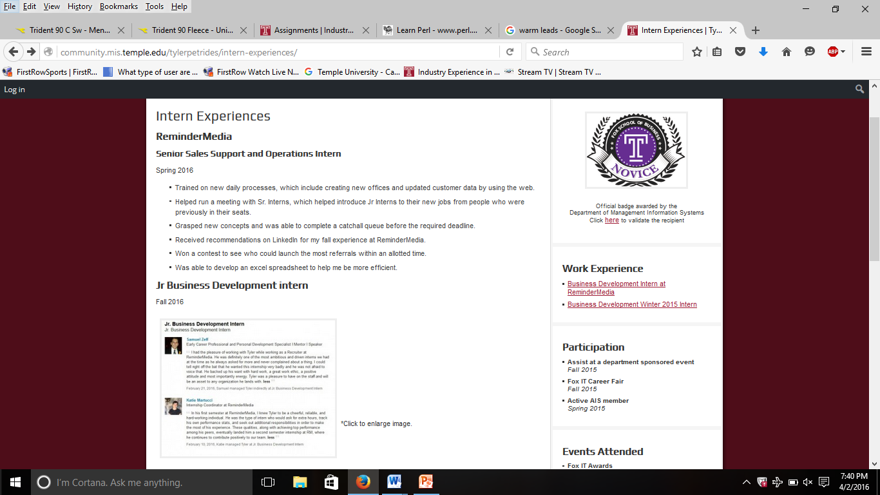
Follow My Journey
http://community.mis.temple.edu/tylerpetrides/

Slide 10
Questions?

