Slide 1

Alex Meyer, Alex Korjeski,
Dom Falco, Louisa CarletoN,
Niraj Patel
Munir Mandviwalla

Slide 2
The Problem
Large amounts of unstructured data are hidden within media uploaded to the internet everyday. Metadata can be very ambiguous, making it difficult to drive decision making.
Current recommendation engines use static filters to generate results. These are a selection of choices, not the individual tastes/preferences of the user.
Users are looking for a more customizable way to search for new and personalized results.

Slide 3
What is Visrecs?
VisRecs is a recommendation engine powered by Watson’s visual recognition system.
Our prototype recommends food, entertainment, and shopping that is tailored to each individual consumer.
Using social media, VisRecs uses deep learning algorithms to analyze uploads and provide users with quality recommendations.
Users can tag their photos to help Watson learn and improve their experience.

Slide 4
Competitive Analysis and Market
Recommendation Service
Competitors:
  Yelp
  Google
  Grubhub
Target Market: Philadelphia
Competitors use keywords to filter recommendation results. Our service is dynamic based on continuous user inputs from social media.

Slide 5



Enterprise IT Architecture Overview
API
Corpus
Watson
Pictures from Social Media
Recommendations

Slide 6
Implementation Plan
Phase I
  Jumpstarting the corpus of Watson
  Training Watson to recognize patterns in “baby’s first” library
Phase II (current phase)
  Opening the corpus of Watson to the public
  Further training Watson using people’s social media pictures
  Allowing the public to fine-tune through tag customization
Phase III
  Start selling analytics to local Philadelphia vendors and restaurants as well as the City of Philadelphia

Slide 7
Financials
During Year 1 we are financially sponsored by IBM.
We will begin generating ad revenue during Year 2
The final phase of the project in Year 3 is when we will begin to market data to potential clients.

Slide 8
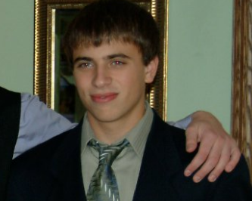
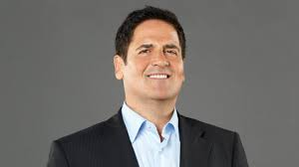
Personas
Carl Williams
Benjamin Steeler
College Freshman at Temple
Big food buff, but new to the city and not familiar with the local restaurants
Favorite food: Sushi
Uploads his Instagram and Facebook photos to VisRecs
Middle aged man from Philadelphia
Thinks he knows what shoes he wants, but not where to get them
Likes certain brands more than others
Uploads Instagram to VisRecs

