Slide 1
WDYWTE
“What do you want to eat?”
Group Members: Andrew Tauskey, Allen Dowling, Jada Goodwin, Simranjit Kaur, & Zachary Cehelsky-DeAngelo,

Slide 2


Choosing where to eat can be difficult.
58% of Americans eat out once per week =
185 million people
On average three people eat out at once.
964 Restaurants exist within in Center City Philadelphia alone
Vegan
Gluten Free
Adventurous
There is no tool that efficiently simplifies this decision.
Notes:
Sources:
Eating Out: http://www.rasmussenreports.com/public_content/lifestyle/general_lifestyle/july_2013/58_eat_at_a_restaurant_at_least_once_a_week
Restaurant Stat: Center City Only : http://philadelphiaretail.com/demographics.aspx

Slide 3
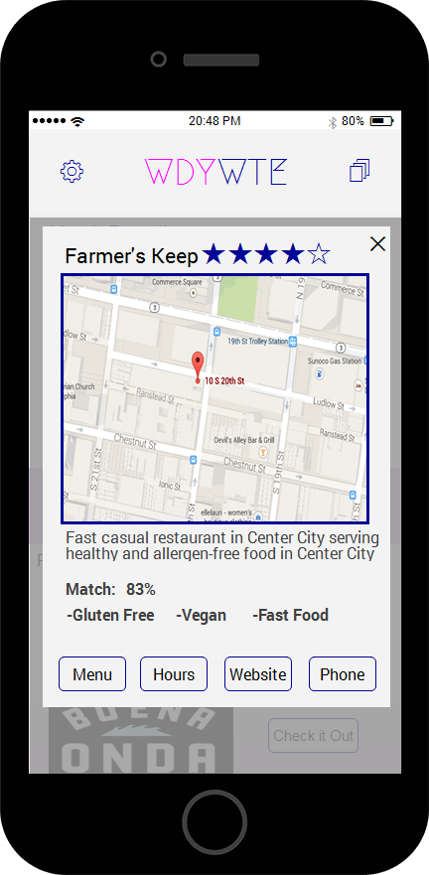
The Solution: WDYWTE
Download
Login with Facebook
Complete the Questionnaire
Add Friends
Get Matched!
WDYWTE simplifies complex decisions by completely automating the search process for the user.
Value for Users
Qualified Matches
Make Reservations or Order Out
Value for Restaurants
Free Qualified Leads
Featured Subscription
Restaurant Discounts

Slide 4

Our Competitors
What do we uniquely offer?
GrubHub
EAT24
FourSquare
Personalized Suggestions
Social Media Integration
Reservation Integration via OpenTable

Slide 5
Here’s how it works.

Slide 6
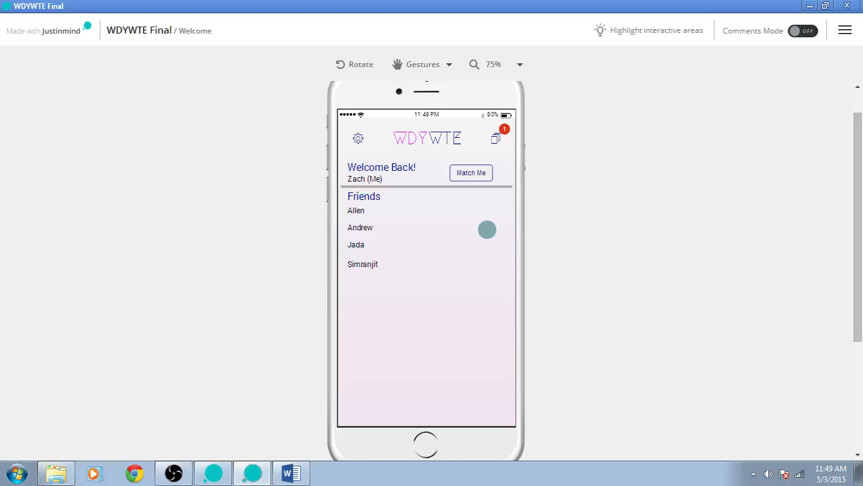

Slide 7
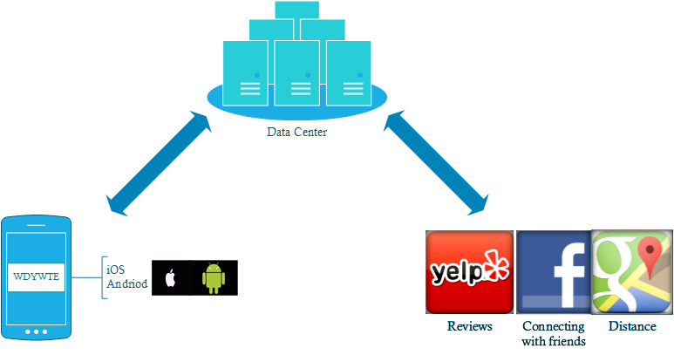
IT Architecture

Slide 8
Revenue Streams and Funding

Slide 9
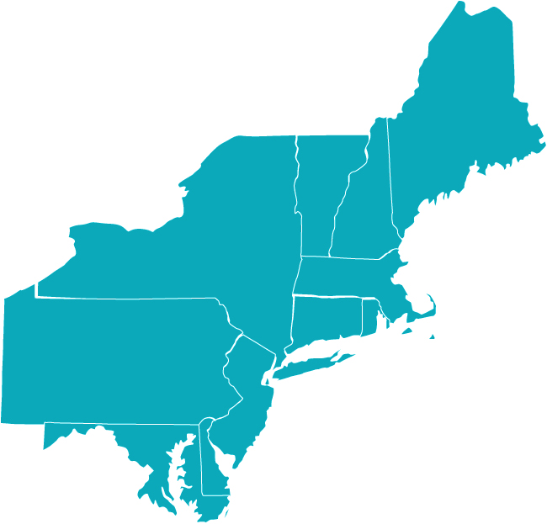


Implementation
48% Identify as ‘Foodies’
Year 3:
New York City Area
Years 1 & 2:
Greater Philadelphia Area
Year 3:
DC Metro Area
Notes:
Millenial Stat: http://nrn.com/advertising/millennial-dining-behavior-hard-define

Slide 10
So,
WDYWTE
“What do you want to eat?”

