Slide 1
WorkFit
Jon, Matt, Thompson, Sara

Slide 2
The Problem
Decreased Productivity due to Inactivity
Rising Cost of Healthcare
Presentee-ism in the Workplace
Unhealthy Eating Habits and Food Options
Bad Habits Include:
7.5 Hours or More Sitting at a Desk
1 Hour or More of Driving
Poor Food Options in Cafeteria
Lack of Exercise
Lack of Stretching
Notes:
Problem – what is the problem you are trying to solve? Why is it important? Why should we care? (use the materials from the project charter)
There has been an overwhelming emergence of decreased productivity from employees due to not getting enough exercise and having bad eating habits.
After discussing the problem and the bad habits that the problem comes from list some of this statistics.
These problems cost companies money. On average health insurance costs $5,200 per employee and increasing at 6% per year according to the latest research done by Fortune and Brookings EDU; employees take on average 8 sick days a year on top of their time off, and the average task takes 10 hours to complete for an employee with poor health habits. This relates to lethargic behavior, tiredness, and lack of motivation to do work or eat healthy.

Slide 3
The Solution
Health and fitness application that is tailored to the organization
Features for this application include:
Personal Profile
Team Profile
Competition (personal and team)
Food Suggestions
Customized workouts
Networking Options
How would this application all help the organization in the long run?
Notes:
Solution – description of the solution – what is it? how does it work? (use the materials from the project charter)
After discussing the application and all of the features that it offers go into the statistics
With the implementation of this app we are going to work to
reduce healthcare cost for employers by $100 dollars per
employee by getting them up and active as well as giving
them healthy food options. We are aiming to have employees
only sit at their desk for no longer than 6.75 hours a day.
We are also hoping to get employee productivity up by
decreasing the regular task time from 10 to 8.5 hours, reduce
sick days from 8 days to 6 days.
GO TO THE PROTOTYPE

Slide 5
Competitive Analysis
GetHealth
Point system and competition element
FitBit
Expensive
Fitness and food tracking
Endomondo
Fitness and workout tracker
MyFitnessPal
Fitness tracking
Elevate
Gamifying the fitness tracking
Alta, Charge, Blaze, Flex
Encourages friends to meet their goals
Free application
Free application
Focused on calories and food tracking
Free Application
Teaching the users about fitness and food options
Only organization wide
Expensive
Notes:
Competitive analysis and market – who are the competitors? which market does it fit in? who are the clients? (use the disruption innovation material)
GetHealth Application:
Focuses on the three M’s, munch (diet and nutrition), move (activity), mind (mental health). They use a point system that gives points when a user logs in to a task on mind, move, or mental screens. The goal is to beat your last 7-day best. They do have a leader board where people can compete against friends and co-workers and achievements are given based on real health successes.
Cost?
FitBit:
The FitBit is a wearable device that track the users metrics while also being a fashion accessory. They track all day activity, reminds the user to move, auto exercise understanding, call text and calendar events, sleep tracking, clock, tap display, and accessory bands.
Alta - 129.95
Alta HR – 179.95
Charge 2 – 179.95
Charge 2- 149.95
Blaze- 229.95
Blaze- 199.95
Flex- 79.95
One- 99.95
Zip- 59.95
Endomondo:
This is the health application that was developed by under armor. This application is a fitness tracker that also track certain workout that individuals do. You can motivate each other and share your success online. They track running and walking and calories burned. They also suggest improvements that can be made for individuals.
Cost- free
MyFitnessPal:
My fitness pal works very similarly tracking the calories burned and exercises that people do that use this application. They also have the feature of tracking the food consumption and what is in each of the food options that we intake each day.
Cost – Free
Elevate:
This is a more gamified application that teaches people about healthy options as well as tracking the progress from their exercises and diet plans. It is much more focused on the game ascpet and teaching the people that use it to be a more healthy person overall.
Cost- free

Slide 6
Financials
Notes:
Basic financials for years 1, 2, and 3 including income (sales and other sources) and expenses (marketing, salaries, computing, servers, etc). (use the template)
Tell them that we break even between years 1 and 2
Jon

Slide 7
Implementation Plan
Contract
The labor
Outreach
Marketing efforts geared towards employers
Obtain
First client
Implement
Prove that WorkFit works and achieves the business objectives
Gather
Gather more clients
Notes:
Implementation plan – what steps do you need to take to put your solution into operation? How did you get here? (MIS 3535
Thompson

Slide 8
Thank You
Questions?

Slide 9
Appendix

Slide 10
Criteria | Weights | WorkFit | GetHealth | FitBit | Endomondo | MyFitnessPal | Elevate
Price | 10% | 5 | 7 | 3 | 10 | 10 | 10
Ease of Implementation | 10% | 7 | 7 | 7 | 10 | 10 | 8
Ease of use for participants | 20% | 9 | 8 | 7 | 8 | 8 | 5
Compatibility | 10% | 10 | 10 | 10 | 10 | 10 | 10
Lower Health insurance cost | 20% | 10 | 9 | 5 | 5 | 5 | 5
Number of participants | 10% | 10 | 10 | 10 | 8 | 5 | 6
Increased productivity | 20% | 10 | 9 | 7 | 7 | 7 | 5
Totals | 100% | 9 | 7.6 | 6.8 | 7.8 | 7.5 | 6.4
Notes:
Competitive Analysis

Slide 11
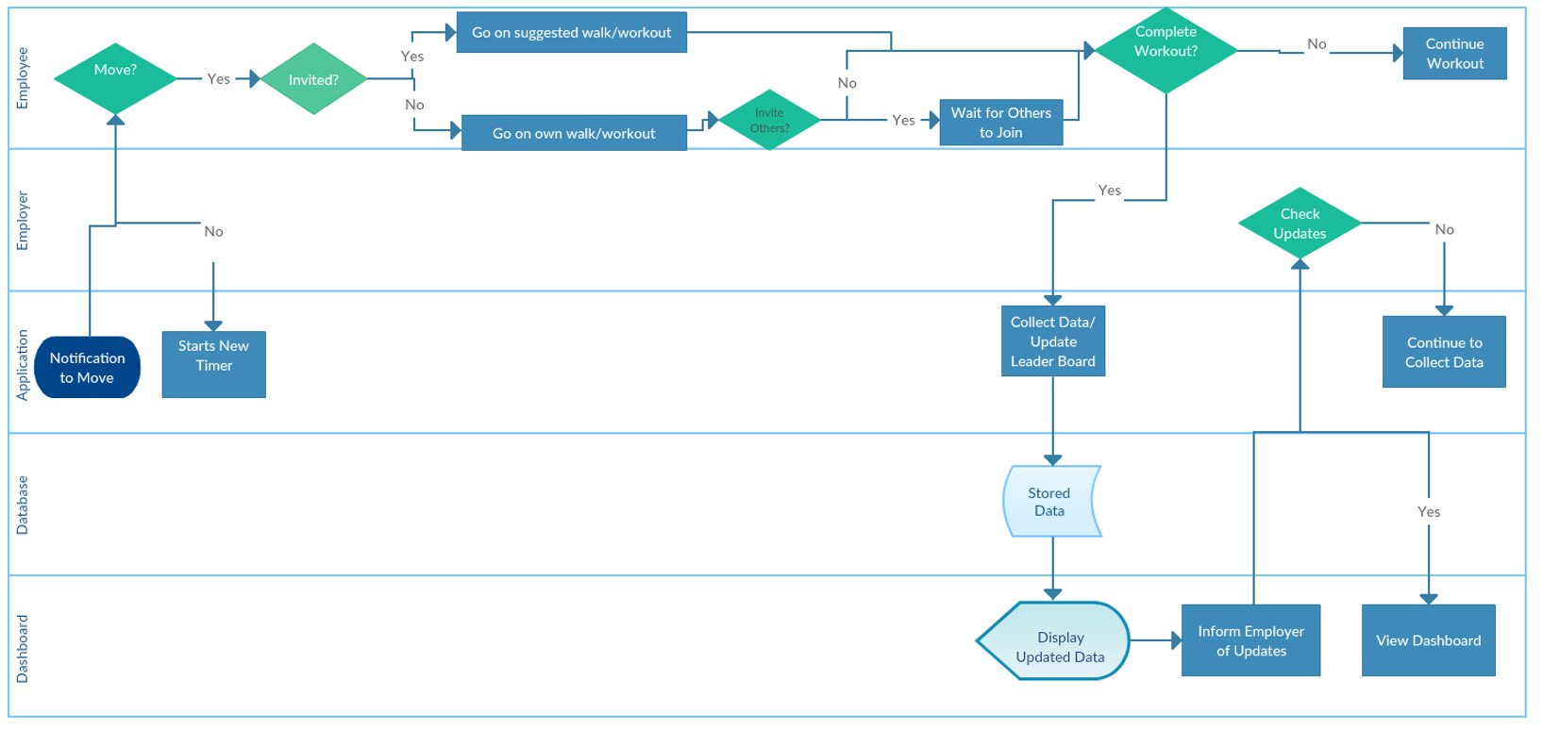
Notes:
Swimlane

Slide 12
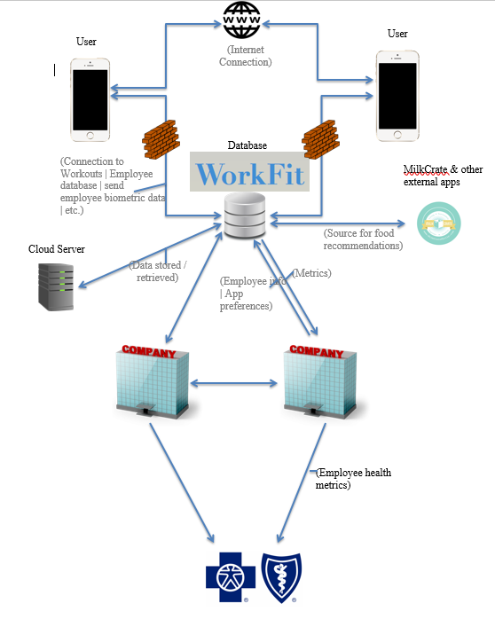
System Architecture
Notes:
System Architecture

Slide 13
Notes:
Data Model

Slide 14
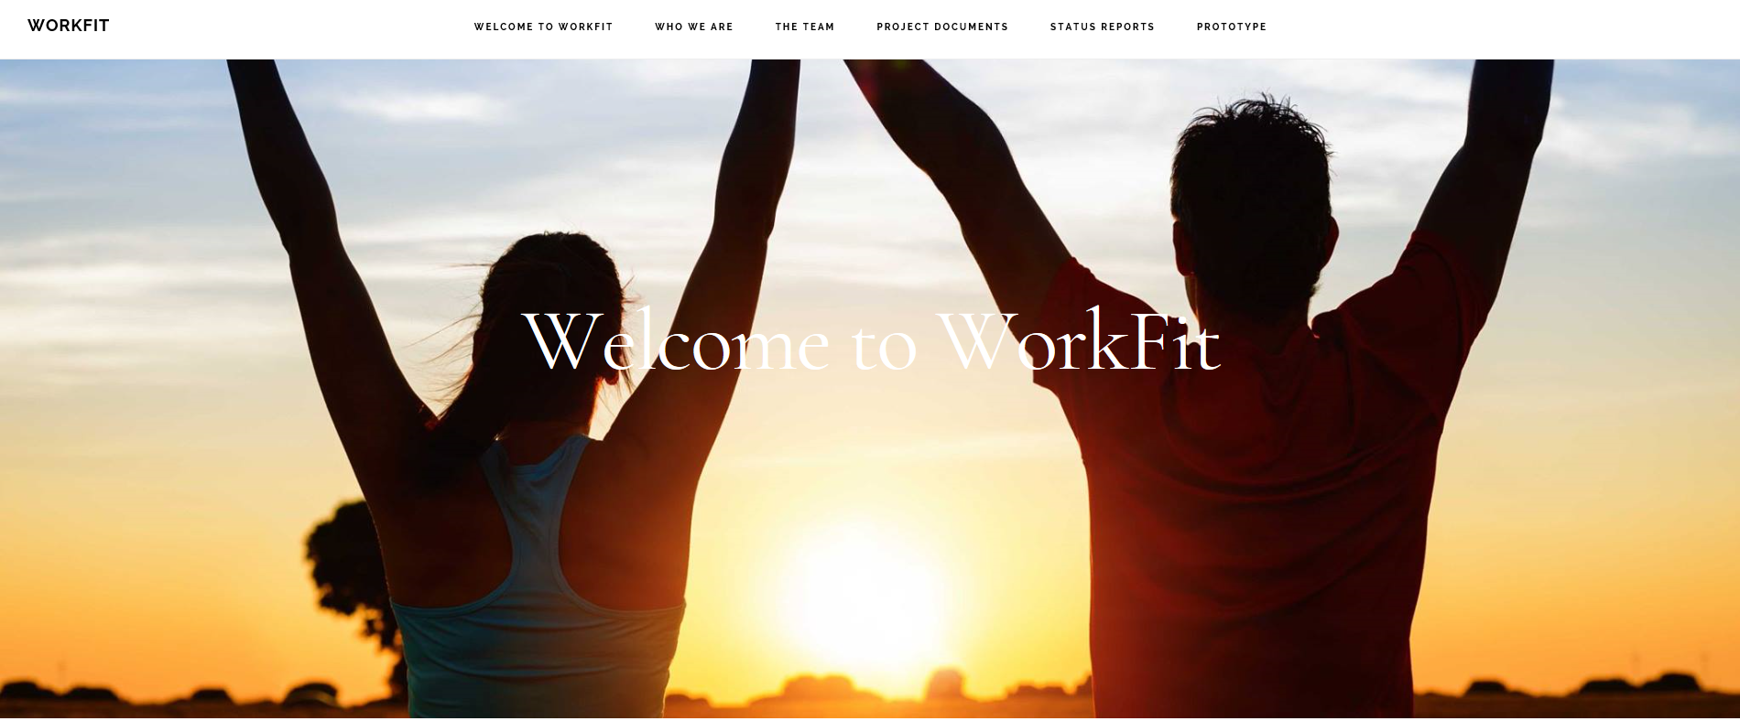
Project Website
Notes:
Website (hyperlink)

