Slide 1
WorkSight
Maria Boggi, Zoe Weiner, Hung Dau and Chi Pham

Slide 2
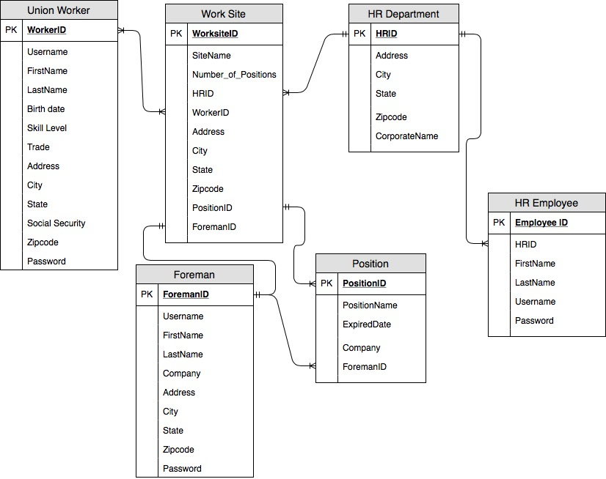
Data Model

Slide 3
Systems Architecture
Application/Web Server
Database
Browser
User Endpoints
HTML
CSS
PHP
JavaScript
SQL

Slide 4
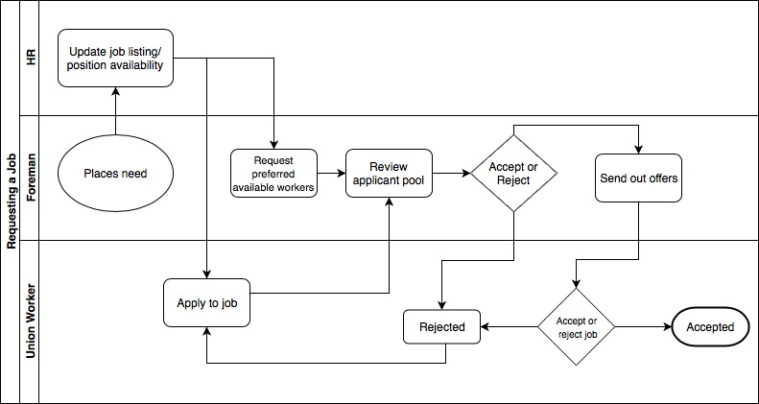
Process Model

