Slide 1
WORKSIGHT
A Solution to Union Job Placement
Maria, Zoe, Hung, Chi

Slide 2
CURRENTLY…
No real-time access to available jobs and workers
Time consuming trips to find open positions
No standardized staffing
Unethical recruitment
Baby Boomers moving out
Notes:
1.15minute 75 seconds
In it’s current situation
There is no real-time access to available job positions or workers. Business agents are required to make time-consuming trips to work sites to seek out vacant positions and need to make multiple phone calls between foramen and available workers to fill openings. Unemployed workers have to call business agents every morning at 5AM before the work day starts to see if there is a job to assign them. This unappealing and inefficient recruitment process has led to workers and foremen using other channels to staff jobs, such as personal calls, text messages, Facebook messaging, and word-of-mouth. The unstructured process enables foremen to leverage recruitment and layoffs as a tool for punishment, manipulation and personal bias.
Lastly there has been a major shift in the average age of union members with the baby boomer generation retiring its cruicial that we stay relevant with the current and future generations

Slide 3
SPENDING
MEMBERS
Representational ( Contracts/Operational Activities)
Year | 2008 | 2015
Members | 2940 | 1924
Notes:
35 sec
We are also spending too much money and losing too many members. Representational activities take up the most of our overall spending at 34% and in 2015 we had 1000 less members than 2008 and with annual member dues at $2500 each that is a 2.5 million dollar loss.

Slide 4
Solution
WorkSight
A real-time communication dashboard to automate staffing worksites
HotSchedules for the Union
Notes:
25 seconds
staffing software that is designed to automate operational challenges like recruiting, training, scheduling, shift communication, and labor
managing these activities is what WorkSight will be for the Union Trade industry

Slide 5
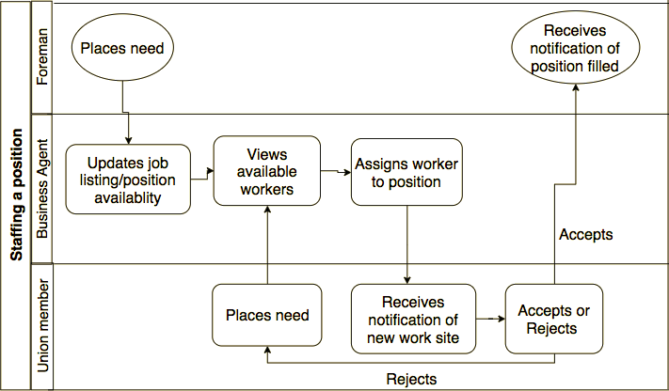
THE WAY IT WORKS
Notes:
40 seconds
Chi is going to go through the technical build of our application

Slide 6
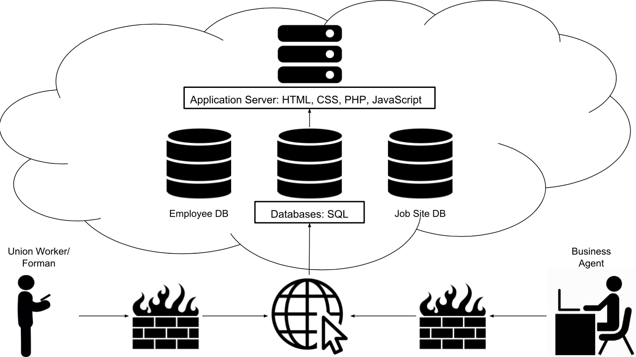
System Architecture
Notes:
20 seconds
Here is our system architecture showing the different devices that users will use to log in
this is where they will access the site which is connected to employee and job site databases
These databases are connected to our application server, which is made through HTML, CSS, PHP, and javascript

Slide 7
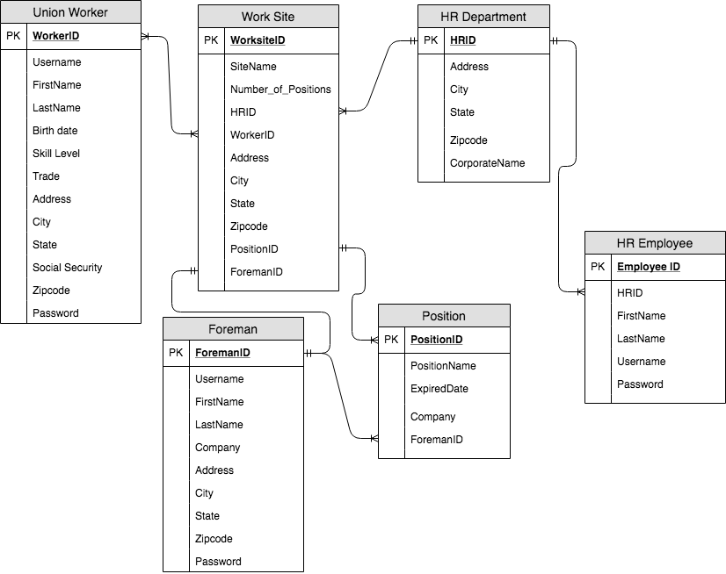
Data Model
Notes:
10 seconds
And this is the data model showing the information we would collect from each entity
As you can see, we will be collecting data about union workers, job sites, positions, and foremen just to name a few.
Next, we are going to show you how WorkSight works

Slide 8
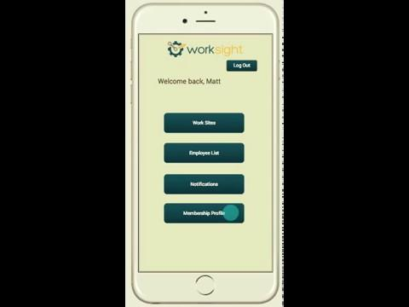
Notes:
55 sec

Slide 9
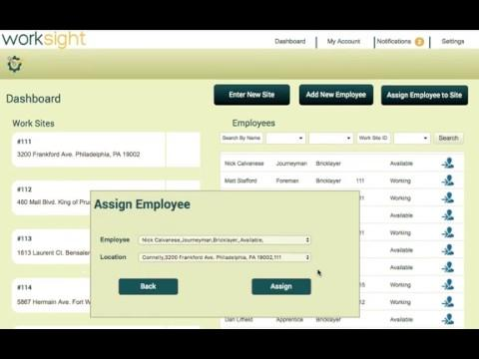
Notes:
1.25 = 85 seconds

Slide 10
HEAR WHAT THE CRITICS HAVE TO SAY...
“This is something we could actually use and would make getting a job easier.”
Anthony Chivorali
Bricklayer Journeyman
“I’d have a lot more time, that’s for sure.”
Matt Stafford
Bricklayer Business Agent
“That’s easy! It’s crazy it hasn’t been thought of before”
Gene O’Brien
Bricklayer Journeyman
“You should really come to a board meeting and present this.”
Nick Calvanese
Bricklayer Journeyman

Slide 11
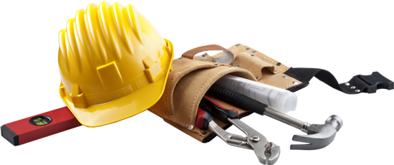
Benefits
Reduce Employment lag times
Increase efficiency and lower costs in representational activities
Standardize and make staffing practices transparent
Attract younger generations
More Time = More Projects = More Money
Notes:
Now we have seen the product. What are the benefits from it?
Real time access and eliminating worksite visits will
reduce employment lag times between projects
increase efficiency and
lower costs in representation activities,
A standardized staffing process that gives more control to the business agent will
increase transparency in staffing and
decrease the ability to staff unethically.
This along with the ease of an app will appeal to the younger generations and lead to an increase in membership.
Lastly, By saving time, we will have more projects, which brings in more money

Slide 12
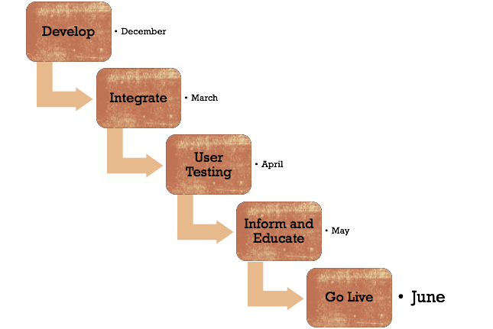
IMPLEMENTATION TIMELINE
Notes:
Now our implementation plan:
We will start developing the app from Dec, this will take 3 months
In March, we will integrate our existing data from the previous system to the new system.
In April, we will roll out the beta version for user testing. Within a month, we will gather feedback and finalize the application
in May, we will inform the union community and do training with the new app.
Finally, in June, this app will go live, being an official part of the staffing process.
Now Zoe will go over our change management and finance plan.

Slide 13
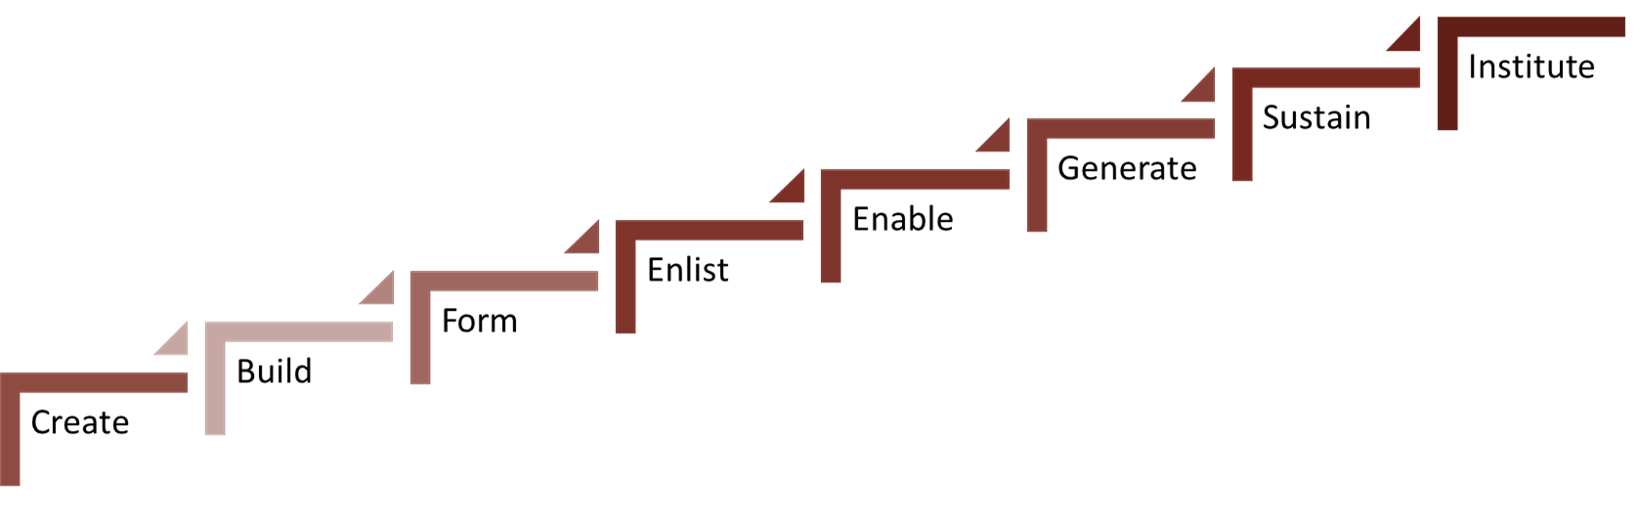
CHANGE MANAGEMENT
Incite the change
Endorsement from Companies, Management, and Authorities
Marketing:
Freebies (T-shirts, mugs,...)
Updates at monthly meetings
Monthly newsletters on new job placements by WorkSight
Enable the change
Training videos
Technology consulting
Sustain the change
Bonuses due to more projects being taken on
Quarterly Surveys
Notes:
Saving and making more money? Why not invest it back into the union? Now we can track duration of projects, job placement rates, and the amount of contractual agreements. We can now incentivize high performance for using the application.

Slide 14
Competitive Analysis
Niche
Long Term
Frequently changing
General
Notes:
15 seconds
In our competitive analysis , there are other job sites out there but there is not any other product specializing in a niche industry with such high turnover with union trade projects so we have the first mover advantage.

Slide 15
Licensing Plan
Annual Service Fee
Paid through Union Dues
Helps pay for initial project
$10
per user per year

Slide 16
Finances
 | Year 1 (0 Licenses) | Year 2 (2000 Licenses) | Year 3 (8000 License) | Year 4 (12000 Licenses) | Year 5 (20000 Licenses)
Development Costs
Software Developer | $85,000 | $15,600 | $15,600 | $15,600 | $15,600
Project Manager | $75,000
Operations Manager | $67,000
Technology Costs
Cloud Storage | $780 | $780 | $780 | $780 | $780
Licensing
Member subscriptions | 0 | $20,000 | $80,000 | $120,000 | $200,000
Total Revenue: | 0 | $20,000 | $80,000 | $120,000 | $200,000
Total Costs: | $227,780 | $16,380 | $16,380 | $16,380 | $16,380
Total Profit: | -$227,780 | $3,620 | $63,620 | $103,620 | $183,620
Notes:
This is what they are just making from the app… not what they are saving from it.
So when it comes to our financial status of WorkSight, we will be making more money from more projects, the increase in membership means more dues to the union, and on top of that the app itself is financially beneficial

Slide 17
CONCLUSION
Spending too much money
Taking up too much time
Losing members
Unethical staffing
More jobs filled
Transparency in staffing
Decrease in spending
Increase in membership
With WorkSight
Now isn't working
Notes:
20 seconds

Slide 18
THANK YOU!
Questions?

Slide 19
Hendrickson, C., & Au, T. (2008). Project management for construction: Fundamental concepts for owners, engineers, architects, and builders. Pittsburgh, Penn.: Carnegie Mellon University
Bricklayers, Local 1 - Pa/de | Profile, Membership, Leaders, Political Operations, etc. (2016). Retrieved from https://www.unionfacts.com/lu/531788/BAC/1/#basic-tab
Calvanese, J. (2018, September) .Steps of staffing through the eyes of a retired bricklayer [Interview by M. Boggi].
Stafford, M. (2018, October). Steps of staffing through a business agent [Interview by M. Boggi].

