Slide 1
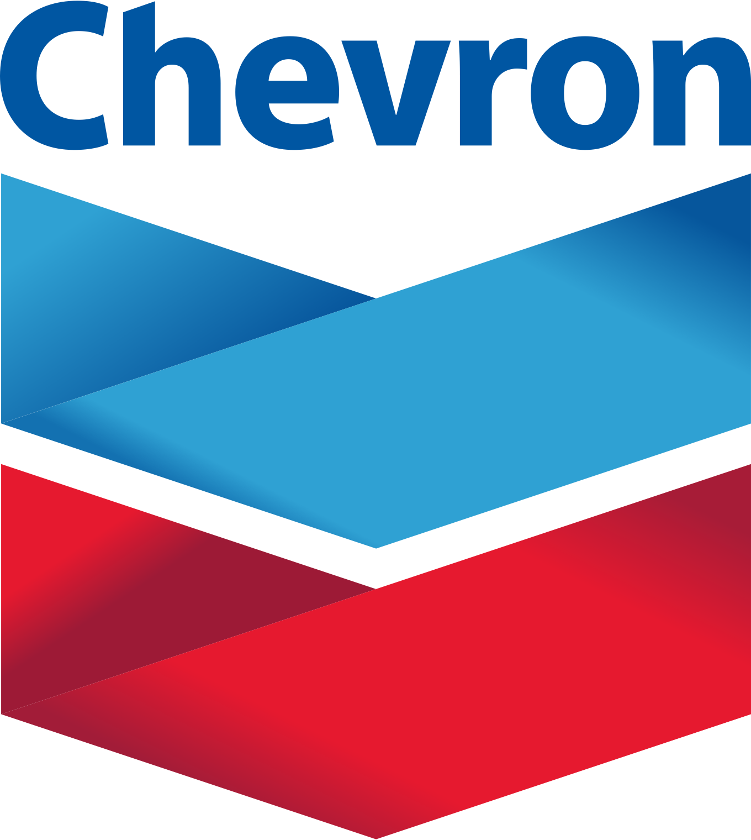
Chevron Corporation
Chevrybody Wants Some
Nick Anstadt, Aditya Singh, Sameen Farooki, Jake Guller, and Zach Ramirez
23 April 2021

Slide 2
Table of Contents
I | Investment Summary | 3
II | Company & Business Overview | 5
III | Industry Overview | 7
IV | Valuation Analysis | 9
V | Catalysts & Drivers | 11
VI | Risks to Investment Thesis | 14
VII | Comparable Companies | 16
VIII | Financial Analysis | 18

Slide 3
I. Investment Summary

Slide 4
Investment Summary
We believe Chevron Corporation (CVX) is well positioned to catch the uptick in demand for LNG mainly in Australia and Asia, as well as increase in demand for oil products by capitalizing on existing holdings in Permian Basin and the acquisition of Noble Energy.
Potential Drivers/Catalysts
Price Target Overview
Demand in Australia is expected to increase at a CAGR of ~4% between 2021 and 2026
The IEA expects LNG demand to increase by ~15% between 2021 and 2030.
Acquisition of Noble Energy added ~92,000 acres to CVX’s Permian holding
CVX has one of the best balance sheets compared to peers. In addition, CVX has the lowest dividend breakeven compared to all US competitors.
Current Price:
$102.13
Target Multiple:
7.7x NTM EV/EBITDA
NTM EBITDA:
$7,115mm
Price Target:
$121.55
Target Return:
+18.1%

Slide 5
II. Company & Business Overview

Slide 6
Company & Business Overview
CVX dominates the energy industry as one of the largest integrated energy companies in the world. The Company generates 60.8% revenue from international markets and is expected generate more in the coming years.
Upstream (28% of FY’20 Revenue)
Engages in the extraction of oil and natural gas in deep-water regions
Uses Gas-to-Liquids technologies for more efficient midstream operations
Noble Energy increased CVX’s year-end proven gas reserves by ~18%
Gorgon Project can generate ~2.3 bcf/d of natural gas
Contracts to supply 1,136 bcf of natural gas to third parties in the US
Upstream
Downstream (72% of FY’20 Revenue)
Midstream
Refines 1.8 mmb/d of crude oil with its 12 refineries every day, primarily benefiting from exports to Asia-Pacific region.
Markets under brand names “Chevron”, “Texaco”, and “Caltex,” supplying and owning thousands of gas stations in the US.
Only integrated company with fully integrated, wholly owned lubricants business
Downstream

Slide 7
III. Industry Overview

Slide 8
Liquefied Natural Gas and Oil
The LNG market is heating up and it’s not slowing down anytime soon.
Global LNG Demand
Safety of LNG compared to other fossil fuels
Extreme demand growth in Asia Pacific
~170 MT of LNG capacity being constructed
LNG demand still grew during COVID
Oil or Natural Gas?
Companies are going to be faced with the decision to stay in oil or move forward with alternatives.
Integrated oil majors with net-zero emission goals
European majors focus on cleaner alternatives
Increase in available market share in oil
OPEC+ production cuts Demand increase

Slide 9
IV. Valuation Analysis

Slide 10
Chevron Corporation Valuation Analysis
Chevron trades at a 6.9x one-year NTM EV/EBITDA multiple, which represents a ~12.2% discount to its one-year average of 7.7x. We see CVX having a target of $121.55, representing an 18.1% upside.
Undervaluation Thesis
One-Year Average NTM EV/EBITDA
Being a cyclical company, CVX took a big hit during COVID-19
Production output fell sharply due to decreases in demand
Decreases in revenue resulted in negative EPS in all quarters of FY’20
CVX implemented various strategies to help ease the damage
Oil and LNG will recover to pre-pandemic demand levels
CVX will be able to capitalize and fully utilize its assets
7.7x
6.9x

Slide 11
V. Catalysts & Drivers

Slide 12
Potential Down Under
Australia
CVX owns and operates Gorgon and Wheatstone LNG facilities in Western Australia
Currently the biggest producer in Australia, accounting for more than 50%
The IEA projects an increased demand in LNG of ~4% CAGR between 2021 and 2026 in Australia
Asia
By 2040, Asia is expected to drive 75% of LNG demand
During FY’20, CVX acquired a lot of LNG assets through the Asia-Pacific
Capitalizing on LNG growth will be a main driver in increasing revenue by 50% between FY’20 and FY’22
IEA

Slide 13
Harnessing the Carbon Rebound
Lifting pandemic restrictions means higher demand for liquid fuels
Efficient Investments
U.S. Gulf of Mexico
CVX has significant infrastructure in place to capitalize on the oil & gas rebound
Investments and opportunities will be expanded where CVX has competitive advantages and can generate high returns
22 mcf/d at Jack & St. Malo Fields
Development at Ballymore
Permian Basin
Current holdings total ~2.2mm acres
Mineral rights for 85% of leases
Noble Energy
92,000 adjacent Permian acres
Assets from Acquisition
1mmb/d production goal
Generate $3bn in FCF by 2025
336,000 acres at DJ Basin

Slide 14
VI. Risks to Investment Thesis

Slide 15
Risks to Investment Thesis
Natural Gas NYMEX 3-Year ($/Mmbtu)
Dependence on Oil Demand
LNG market has had various price fluctuations for a long time now.
Demand in the market is still not stable
Supply is not a problem
Transportation without Insurance
Increase in transportation expected
No commercial insurance
Policies, Policies, Policies
New oil and gas leases on federal land
Limited options to explore and produce

Slide 16
VII. Comparable Companies

Slide 17
Comparable Companies
Chevron’s peer group contains other large integrated energy companies that focus on Upstream and Downstream business segments.

Slide 18
VIII. Financial Analysis

Slide 19
Revenue Analysis
Chevron’s revenue in recent quarters has been held back due to decreased oil demand and low profit margins from COVID-19, while the reopening of economies across the world and increased oil demand will be key for growth moving forward.
Revenue Analysis
CVX’s Full-Year Revenue Analysis & YoY Growth
FY’20 revenue of $94.7bn, representing 35.4% decline YoY
Low oil demand and low profit margins
All business segments decreased in revenue
Expected FY’21 revenue of $138.7bn, representing 46.4% growth YoY
Reopening of economies Increased oil demand
Beyond FY’20, we expect revenue growth to continue through FY’23

Slide 20
Margins and Cash Flow Analyses
Margins
Cash Flow
High depreciation and amortization write offs in FY’20
Decreased revenue put profit and EBIT in the red
Strong recovery in 3Q’20
Projected to return to pre-pandemic levels by FY’22
Cutting operating costs by 10% and CapEx by 13% in FY’21
FCF annual growth rate of 10% through 2025
$2bn in share repurchases in 2022, $3bn in 2023
Annual dividend of $5.16/share

Slide 21
Debt and Earnings Analyses
Debt
Earnings
~38.7bn net debt as of FY’20
Still maintains the strongest balance sheet among peers
Aims to reach net debt target of 31bn between 2H’21 and 4Q’22
Successful dividend growth beyond FY’22
High revenue and production rates through 2019
2020 brought lower prices of crude and brent oil
EPS reduction of 2,870% in FY’20
Demand rebound can increase revenue by ~50% during FY’22

Slide 22
Questions

