Slide 1
Microsoft Annual Report
Austin Yun
Rachel Tobias
Aimmee Truong

Slide 2
We Recommend to Invest in Microsoft Microsoft Corp (MSFT)
In 2021 they delivered $168 billion in revenue.
Operating income grew 32% to
$70 billion.
LinkedIn passed $10 billion in annual revenue for the first time.
"To win big, you sometimes have to take big risks.“ – Bill Gates

Slide 3
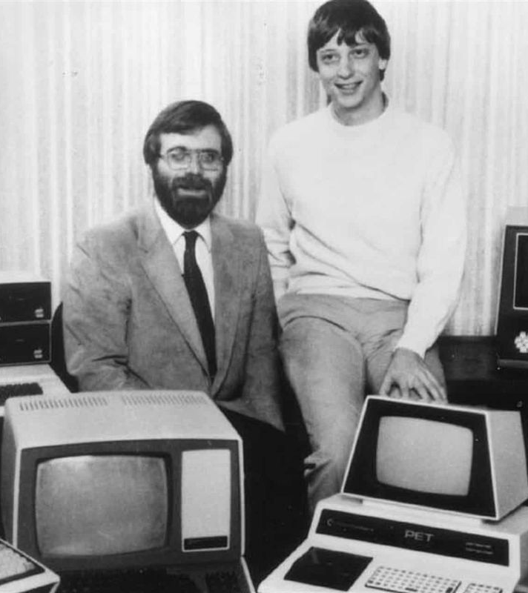
Company Background
April 4, 1975, Bill Gates and Paul Allen founded Microsoft
In 1985, Bill and Allen released Microsoft’s new operating system, Windows
In 1986, Microsoft (MSFT) went public at $21 a share
Currently, 1 share of Microsoft (MSFT) is $287.93 (2/19/2022)

Slide 4
Market Analysis
Microsoft (MSFT) stock has seen a steady increase in gains
Biggest yearly return being 55.26% in 2019
Year | Beginning Price (Dollars) | Ending Price (Dollars) | Gain (+) or Loss (-) | Percent Gain (+) or Loss (-)
2016 | 55.48 | 62.14 | +6.66 | +12%
2017 | 62.14 | 85.54 | +23.40 | +37.66%
2018 | 85.54 | 101.57 | +16.03 | +18.74%
2019 | 101.57 | 157.70 | +56.13 | +55.26%
2020 | 157.70 | 222.42 | +64.72 | +41.04%
2021 | 222.42 | 336.32 | +113.90 | +51.21%

Slide 6
Competition
"Whether it's Google or Apple or free software, we've got some fantastic competitors and it keeps us on our toes.“ – Bill Gates
Apple
2021 Net Income: $94.68 billion
2020 Net Income: $57.41 billion
Google
2021 Net Income: $76.03 billion
Oracle
2021 Net Income: $13.74 billion
2020 Net Income: $10.13 billion
+ 64.9% Increase in Net Income
2020 Net Income: $40.27 billion
+ 88.8% Increase in Net Income
+ 35.6% Increase in Net Income
Microsoft’s 2021 Net Income: Microsoft’s 2020 Net Income : Microsoft’s Increase Net Income :
$44.28 billion
$61.27 billion
+ 38.4%
2021 Net Income: 54.5% more
2020 Net Income: 29.6% more
+ 26.5% Difference in Net Income
2021 Net Income: 24.1% more
2020 Net Income: 9.1% less
+ 50.4% Difference in Net Income
2021 Net Income: 77.5% less
2020 Net Income: 77.1% less
- 2.8% Difference in Net Income

Slide 7
Financial Analysis
Key changes:
Revenue increased $25.1 billion
Gross margin increased $18.9 billion
Operating income increased $17.0 billion

Slide 8
Future Opportunities and Investments
Transforming Business Applications
Dynamics 365
Running Cloud-based Services
Azure
Applying AI
Cortana
Innovating Windows Experience
Surface Duo

Slide 9
Final Recommendations Microsoft Corp (MSFT)
Goal Oriented
Stability
Future Opportunities
"We always overestimate the change that will occur in the next two years and underestimate the change that will occur in the next 10. Don't let yourself be lulled into inaction."– Bill Gates

Slide 10
References
A&E Television Networks. (2015, October 9). Microsoft founded. History.com. Retrieved February 14, 2022, from https://www.history.com/this-day-in-history/microsoft-founded
Alphabet Investor relations. (n.d.). Retrieved February 14, 2022, from https://abc.xyz/investor/
Brandon, J. (2016, February 15). 25 quotes from Bill Gates on how to succeed. Inc.com. Retrieved February 14, 2022, from https://www.inc.com/john-brandon/25-of-the-best-bill-gates-quotes-on success.html
Investor Relations. (n.d.). Retrieved February 14, 2022, from https://investor.apple.com/investor-relations/default.aspx
Investor Relations - Financials. (n.d.). Retrieved February 14, 2022, from https://investor.oracle.com/financials/default.aspx
Microsoft Annual Report 2021. (n.d.). Retrieved February 14,2022, from https://www.microsoft.com/investor/reports/ar21/index.html

