Slide 1

MIS: Special topics
Professor Courtney Minich

Slide 2
Hello x Day 4
你好

Slide 3
Risk Assessment
All organizations have risks and are exposed to factors that cause them not to reach their objectives. Risk assessments are performed to evaluate internal and external factors. Assessments provide reasonable assurance that organizations are managing risks to an acceptable tolerance.

Slide 4
How do we manage risk?
Identify risks
Assess & Prioritize
Develop a plan
Monitor

Slide 5
What type of risks exist?
Internal risks:
  Inherent to the inside of the business or the organization
  Examples include:
    Employee error
    Mismanagement
    Dishonesty
External risks:
Outside of the business or organization; less control to avoid the risk
Examples include:
Economic uncertainties
Industry information
Competitors

Slide 6
What can we do about risk?

Slide 7
Assess & prioritize
You can identify each risk
You should give a unique identifier to each risk in your log
And determine if the risks’ likelihood to occur and the impact of the risk
 | Low Impact | High Impact
Low Likelihood | Monitor the risk | Monitor the risk
High Likelihood | Mitigate the risk | Take immediate action

Slide 8
You can also develop a risk management strategy
There are four strategic responses to a risk that is identified:
  Avoid: remove all access to the risk
  Reduce: Minimize the likelihood of impact
  Transfer: Shift the risk elsewhere
  Accept: Live with low-impact, low-likelihood risks

Slide 9
Risk Management strategy
Strategy | Example
Avoid | If an area is prone to bad weather, do not build your house there.
Reduce | If you have a busy season at work, be sure to train staff. If a staff member is sick, work is not interrupted.
Transfer | Buy insurance or outsource the task to an expert.
Accept | Understand something may happen and live with it

Slide 10
How do we track risk?
A risk register
  A tool used to document and track all identified risks in a project or organization. It is a centralized log.
  A risk register to includes information to help the team understand:
Column | Description
Risk ID | The unique identifier specific to the risk
Description | What the risk is
Category of risk | Type of risk
Likelihood | How likely it is to happen
Impact | The impact of the risk if it did happen
Owner | Who is responsible for managing the risk
Date Identified | When was the risk made aware
Status | Is it an ongoing risk?

Slide 11
Example of a risk register
This is a flood-prone company that a new team is being hired.
Risk ID | Description | Category | Likelihood | Impact | Owner | Mitigation
R001 | Flood damage to office and equipment | Environmental | High | High | Facilities | Install flood barrier and elevate all expensive equipment
R002 | Business disruption due to road closures | Operational | High | Medium | Operations | Enable remote work capabilities to not disrupt the business
R003 | Data loss due to flood-related power outages | IT/Cyber | Medium | High | IT Manager | Daily cloud back ups
R004 | Delays in hiring due to limited access | HR | Medium | Medium | Hiring Manager | Look at different ways to higher people; ask management to help expedite
R005 | New hires lacking necessary training or onboarding | HR/Operational | High | Medium | Manager | Develop onboarding plan and team activities
R006 | Team cohesion due to virtual onboarding | HR | Medium | Medium | Team lead | Weekly virtual meetings
R007 | Reputation damage due to flooding | Strategic | Low | High | CEO/PR manager | Communication to clients

Slide 12
Documentation

Slide 13
Project Documentation reminder
In a project, many documents are created, updated, and shared.
Business Case – rationale, ROI, and alignment with strategy.
Project Scope – objectives, scope, constraints, key stakeholders, high-level timeline.
Stakeholder Register / Matrix – contact details, influence/interest mapping.
Risk Management Plan / Risk Register – identification, likelihood, impact, mitigation.
Business Requirements Document (BRD)
Process Flows, Swimlane Diagrams, Data Flow Diagrams (DFD)
System Architecture / Solution Design Document
Data Model & Entity-Relationship Diagrams (ERD)
Schedule & Gantt Charts
Change Requests & Change Log
Deployment/Implementation Plan
Migration Plan & Data Conversion Docs
Project Closure Report / Lessons Learned

Slide 14
Documentation
Both business analysts and IT auditors use documentation as key parts of their jobs.
Both roles use documentation for :
  Ensuring processes are effective and reliable
  To manage risk
  Accountability and traceability

Slide 15
A business analyst creates documentation at the start of a project. The IT auditor looks at documentation after the project has been completed and is in standard use.

Slide 16
Remember this? The IT Audit Process
Planning & Prep
Risk Assessment
Control Evaluation
Compliance Review
Vulnerability testing
Reporting

Slide 17
Here is the Auditing documentation process
  Understand the audit scope & objectives
  Gather all relevant documentation
  Review for completeness and accuracy
  Compare to standards and best practices
  Test documentation against reality
  Document findings
  Follow-up

Slide 18
Auditing Documentation
Audit Plan: document that outlines the objectives, scope, timeline, resources, and methodology of the IT audit. It acts as a roadmap for auditors and ensures alignment with organizational goals.
Risk Assessment Report: Documentation of identified risks, their potential impact, and likelihood. Helps auditors focus on high-risk areas in the IT environment.
Control Documentation: A table or matrix mapping business processes to IT controls, including their objectives, control types (preventive, detective, corrective), and control owners. Often used to assess effectiveness of controls.

Slide 19
Auditing Documentation
Policies & Documentation: Organizational rules and operational procedures governing IT systems, security, change management, backup/recovery, and other processes. Auditors review these to ensure compliance and adequacy.
Change Management Records: Documentation of proposed, approved, and implemented changes to IT systems. Includes change requests, approvals, testing, and post-implementation reviews.
Audit Evidence: Collected evidence supporting audit findings, including screenshots, reports, logs, emails, and interviews. These form the basis of conclusions and recommendations.
Audit Report: The final document summarizing the audit objectives, scope, methodology, findings, risks, and recommendations. Often includes management responses and remediation plans.

Slide 20
Let’s work through an example
Step | Case: Looking at a Data Backup Policy
Identify | Locate the current data backup policy in the company.
Evaluate | Look for all training manuals, procedures, storage locations, offsite storage, testing procedures
Verify | Confirms all back up logs, procedures, and testing are accurate and in working order
Report | Compare everything against what is currently in policy (i.e. COSO, COBIT)
Recommend | Suggests re-establishing more accurate testing policy and detailed logs for future audits

Slide 21
What happens after an audit is completed?
Change Management
  The process of managing change to a system
  A comprehensive process, team, or even organization that manages all change related to business
  Why is this important?
    Any software, IT, or other update must be reviewed, and thoroughly tested and documented before it is put into place.
      This minimizes risks and business disruption.

Slide 22
IT Controls

Slide 23
IT Controls
They are specific activities performed by a person or system that have been designed to prevent or detect the occurrence of a risk that could threaten your information technology infrastructure and supported business applications.
IT controls are generally grouped into two broad categories:
  • General controls commonly include controls over data center operations, system software acquisition and maintenance, logical security, and application system development and maintenance.
  • Application controls such as computer matching and edit checks are programmed steps within application software; they are designed to help ensure the completeness and accuracy of transaction processing, authorization, and validity.

Slide 24
Management’s use of controls
Controls are put in place to ensure that the Processes, Standards and Guidelines are being followed.
Therefore, they help mitigate the risk that undesired outcomes will occur. These risks are call the control objectives
Types of controls:
  Preventative: tries to avoid a risk or lessen its impact
  Detective: discovers that a risk has occurred and needs to be addressed
  Corrective: takes action to eliminate the problem and restore the environment
  Controls are usually used in combination. This is called layered controls or defense in depth.

Slide 25
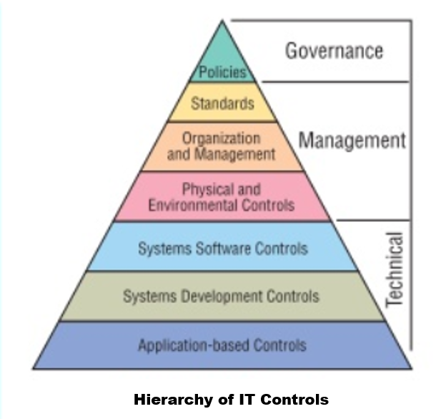

Slide 26
COSO Framework
Control framework:
  Risk Assessment
  Control Activities
  Information & Communication
  Control Environment
  Monitoring Activities

Slide 27
Risk Assessment
All organizations have risks and are exposed to factors that cause them not to reach their objectives. Risk assessments are performed to evaluate internal and external factors. Assessments provide reasonable assurance that organizations are managing risks to an acceptable tolerance.

Slide 28
Control Activities
Control activities are taken to mitigate risk at all levels of the organization. The COSO framework helps to assure that the control activities performed by organization members are effective for the company to achieve its goals and eliminate unnecessary risks.

Slide 29
Information & Communication
  The controls provided by COSO help assure that productive communication occurs. This includes using consistent language and following best practices for sharing appropriate levels of information with the right stakeholders. Formal management business reviews and all-employee meetings, as well as informal chats and emails, fall under this component.

Slide 30
Control Environment
  The control environment creates a top-down approach to drive the COSO Framework throughout the organization. It consists of a set of standards, processes, and procedures which are overseen and enforced by management. Establishing controls across the environment assures that standard practices and ethical values are used throughout the organization.

Slide 31
Monitoring Activities
  Ongoing monitoring and internal audits of all internal control systems identify early signs of trouble and assure effectiveness. Metrics and reports are provided to management and the board of directors for ongoing evaluation. Information gathered and evaluated by regulators and auditors verify control activities. Audits of financial reporting also help with fraud deterrence.

Slide 32
Implementing the COSO Framework
Understand and learn the framework
Develop a plan
Assess the plan’s success and get buy in
Remediation
Test, Inform, and Optimize

Slide 33
Ongoing monitoring & auditing
Management should monitor their controls to see if the desired behavior is being realized.
Audits examine the sufficiency and effectiveness of the controls that an organizations has put in place.

Slide 34
How do organizations set process controls up?
Identify the process in question and its limits.
Identify the process’ expected outcomes and risks
Assure/avoid any unnecessary objectives
Look for evidence to monitor the success of the controls

Slide 35
Management’s use of controls
Controls are put in place to ensure that the Processes, Standards and Guidelines are being followed.
Therefore, they help mitigate the risk that undesired outcomes will occur. These risks are call the control objectives
Types of controls:
  Preventative: tries to avoid a risk or lessen its impact
  Detective: discovers that a risk has occurred and needs to be addressed
  Corrective: takes action to eliminate the problem and restore the environment
  Controls are usually used in combination. This is called layered controls or defense in depth.

Slide 36
COSO Framework
Control framework:
  Risk Assessment
  Control Activities
  Information & Communication
  Control Environment
  Monitoring Activities

Slide 37
Thank you!

