Slide 1

MIS: Special topics
Professor Courtney Minich

Slide 2
Hello x Day 2
你好

Slide 3
Business Rules

Slide 4
Business Rules
Business rules dictate what business activity should occur under which circumstances.
A formal business rule is composed of two fundamental elements:
    A condition, which outlines the situation in which action should occur.
    An action, which defines the thing that should happen in response to a given condition.

Slide 5
Business Rules
Business rules are easy for both technical and non-technical people to understand.
Business rules are declarative.
Business rules "fire" or they do not.

Slide 6
Business Rule Format
Textual statement that defines the rule exactly and unambiguously
Each rule has a unique identifier (ex. BR125)
Usually documented or managed in a separate catalogue or table

Slide 7
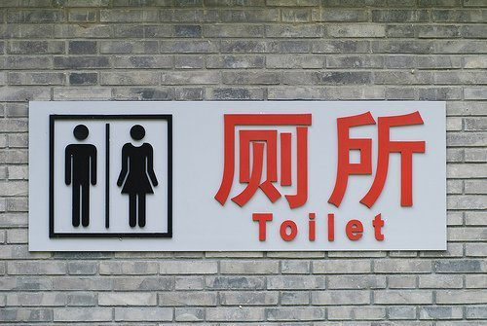
Business Rules in various formats
BR-1 A person will use the bathroom that matches their gender
Person
Gender
Visual
Written
Data
Notes:
Image: https://pagodaprojects.com/cultural-differences-the-wonderful-world-of-chinese-toilets/

Slide 8
How do you write a business rule?
TERM- FACT- TERM2

Slide 9
Business Rule Examples
Term- fact- term
BR1: Customer calls must be returned on the same day.
BR2: Expected contract value is calculated as the probability of signing the contract multiplied by the value of the contract.
BR3: All accounting records must be reconciled within 60 days of receipt.

Slide 10
When writing business rules…
You want to be clear and direct. Do not use “if/then” as it may obscure the subject of the business rule
Which is a clear statement?
If the order is shipped, then we will send the notification.
Notification must be sent when an order is shipped.

Slide 11
Types of Business Rules
Restriction – must or must not happen
  An order must not have more than one ship-to address.
Heuristics – guidance on how to do something
  A customer is delinquent when their account is more than 30 days past due.
Inference – given a condition, assume other conditions
  A generic version of a prescription drug will be used when one exists.
Timing – activity based on elapsed time
  Each open compliant must be deleted when the root cause is identified.
Triggers – cause and effect relationship
  The product ship date must be agreed when an order is taken.

Slide 12
Individual Activity
Spend 15 minutes writing five (5) examples of business rules from your common knowledge:
  Restriction – must or must not happen
  Heuristics – guidance on how to do something
  Inference – given a condition, assume other conditions
  Timing – activity based on elapsed time
  Triggers – cause and effect relationship

Slide 13
What about when business rules are more complex?
We can create something called a decision tree.

Slide 14
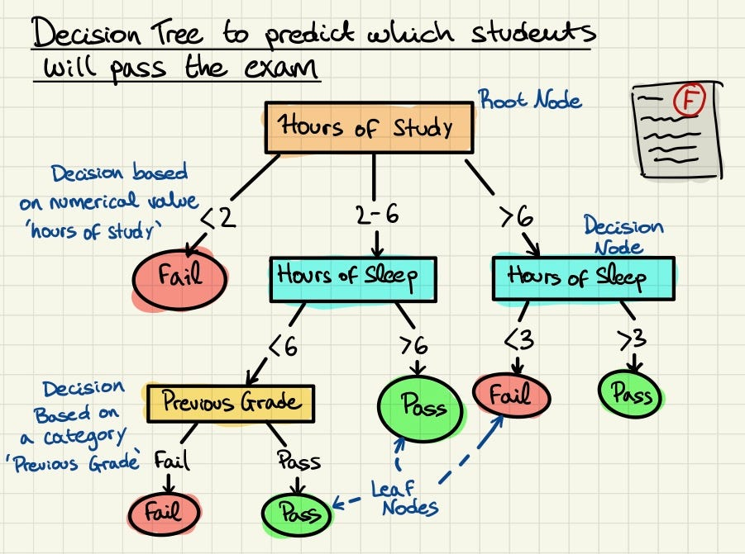

Slide 15
Decision trees
Help the business analyst document the different pathways
Creates a visual map of a rule to be created
Not considered "official" business documentation, but can be stored for future reference

Slide 16
Business rules are defined rules for the business. But what about a specific project?
We gather specific information about a project and the guidelines of the current process. These are called business requirements.
The process of gathering business requirements is called requirements gathering.

Slide 17
The first step in requirements gathering is called elicitation.

Slide 18
Elicitation
To draw, bring out or forth, educe, evoke, or elicit the truth
To elicit a response with a question
This is important for a business analyst, but it is critical for an auditor.

Slide 19
Why is this important?
Elicitation requires a combination of analytical skill, communication skill, and organization skill.

Slide 20
Requirements elicitation
This is a core activity in the pre-planning of a project
It is done to understand the real needs of the problem and not just what people think the real need is

Slide 21
How does a business analyst elicit requirements?
There are a number of ways to elicit requirements.
The important factor is to remember the goal is to accurately capture a business’ current workflow.
  Why not the future workflow?
    The future workflow is the solution.

Slide 22
Elicitation Techniques
Reviewing existing documentation
Observation
Interviews
Surveys and questionnaires
Facilitated sessions
Focus groups
Competitive analysis
Interface analysis

Slide 23
Review existing documentation
This involves analyzing existing materials such as user manuals, design specifications, help files, and previous system requirements to gain insight into the current system’s functionality and interfaces.
  Gather all available documentation from stakeholders.
  Extract information related to UI layout, user flows, system behavior, and pain points.
  Use this as a baseline to compare against user feedback and current system usage.
Observation
Directly watching users interact with the system in their natural work environment.
Conduct contextual inquiries or shadowing sessions.
Take notes on user behavior, navigation paths, and difficulties.
Combine with screen recording tools or usability testing sessions for analysis.

Slide 24
Interviews
One-on-one or small group conversations with users or stakeholders to collect detailed feedback.
  Prepare a semi-structured list of questions focusing on UI experience.
  Interview various user types (novice, power users, admin, etc.).
  Record and analyze the data to detect patterns.
Surveys & questionnaires
Structured forms distributed to a larger audience to gather quantitative and qualitative data.
  Design questions to target UI aspects such as layout, ease of use, and navigation.
  Distribute electronically using tools like Google Forms or SurveyMonkey.
  Analyze aggregated results to guide UI redesign.

Slide 25
Facilitated sessions
Collaborative workshops with stakeholders, designers, and developers to define or refine UI requirements.
  Plan interactive sessions such as design sprints or journey mapping.
  Use whiteboards, mockup tools, or prototyping software.
  Document agreed-upon requirements and features in real-time.
Focus Groups
Structured group discussions with selected users to gather opinions, perceptions, and suggestions.
  Recruit users that represent key segments of your target audience.
  Moderate a guided discussion with specific UI-related questions.
  Record sessions and analyze common themes or divergent views.

Slide 26
Competitive analysis
Evaluating competitor products or systems to identify best practices, strengths, and weaknesses.
    Analyze competitor systems' user interfaces (manually or using UX analysis tools).
    Compare features, workflows, and user feedback.
    Document what works well and what to avoid.

Slide 27
Interface analysis
Interface analysis is the process of identifying and examining the points of interaction between users and a system, or between multiple systems or components. This helps define how data is exchanged and how users interact with software applications. It is a critical part of requirements elicitation and system design, especially for ensuring usability, efficiency, and seamless integration.
Identify all interfaces: These include user interfaces (UI), system-to-system interfaces, device interfaces, and manual interfaces (e.g., printed forms).
Describe interface characteristics: Document data formats, input/output behavior, interaction methods, access control, and error handling.
Collaborate with stakeholders: Engage users, developers, system architects, and third-party vendors to fully understand all integration and interaction points.
Model interfaces: Use diagrams such as context diagrams, data flow diagrams (DFDs), or sequence diagrams to represent how interactions occur.
Assess usability and performance: Ensure the UI supports user needs, and that system interfaces are robust, secure, and efficient.

Slide 28
Processing mapping

Slide 29
Documenting the process

Slide 30
What are the core components of requirements?
People + process
Now we need to document and understand how people do their work

Slide 31
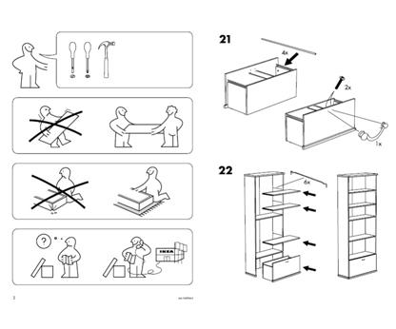
What does this describe?

Slide 32
Workflow diagram
A visual representation of a process or sequence of tasks, showing how workflows from one step to the next. It outlines the activities, decision points, inputs, outputs, and responsible parties involved in completing a business process or system function.
One of a Business Analyst’s key tools, especially for analyzing the as-is situation
Great way to begin to understand the process you are dealing with at high level
Different levels of workflow can be used to explain the process to different audiences
Can document Standard Operating Procedures (SOP’s)
Revising the flow to facilitate improvements is standard design technique

Slide 33
Class example: tea
2 volunteers
Professor Minich will ask 1 student a question about tea. The other student will document the process.

Slide 34
Swimlane diagrams

Slide 35
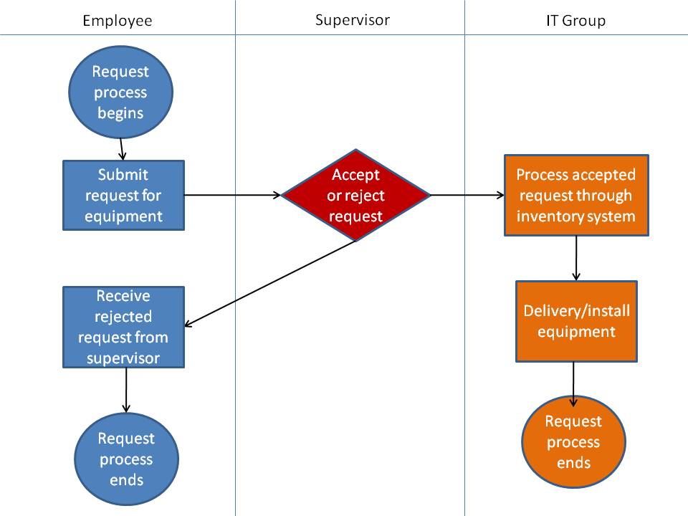
Swimlane diagrams
Advantages of a swimlane diagram:
Identifies who does what & in what order
  Logical & Chronological
  Indicates hand-offs
Versatile
  Applied to other diagrams
  Training tool

Slide 36
Symbols
A circle signifies the starting and ending of an event in the process
A rectangle represents an activity in the process.
A diamond represents a decision that must be made.
Arrows indicate the flow of the process.
A cylinder represents stored data.

Slide 37
Actor
Actor represents a person, role, system, or department that participates in a process. Swimlane diagrams are a type of flowchart where each lane (horizontal or vertical) is assigned to a specific actor. The diagram shows how different actors interact with various steps in a workflow.

Slide 38
Maple Grove Manufacturing is a mid-sized company that produces machine parts. The accounting department still relies on a paper-based invoice approval process. This system has been in place for over 15 years and is now causing delays, errors, and frustration across departments.
The CFO has tasked the business analyst team with reviewing the current process and proposing a streamlined, digital solution.

Slide 39
Current process:
Vendor sends paper invoice via postal mail or email attachment.
AP Clerk prints emailed invoices and attaches them to a physical folder.
AP Clerk logs the invoice in an Excel spreadsheet.
Invoice folder is hand-delivered to the relevant department manager.
Manager reviews and signs the paper invoice.
Folder is returned to the AP department (sometimes delayed for days).
Finance Director signs the invoice for final approval.
AP Clerk processes payment manually via bank software.

Slide 40
Problems Identified:
Delayed approvals due to physical handoffs.
Invoices frequently lost or misplaced.
No centralized tracking of invoice status.
High risk of duplicate payments.
Difficult to audit or generate reports.

Slide 41
Proposed solution:
Steps (New Process):
Vendor uploads invoice directly to the invoice portal.
System automatically logs and assigns invoice to AP queue.
AP Clerk reviews and tags the correct department.
Department Manager receives email notification, reviews digitally, and approves in system.
System routes to Finance Director automatically for final approval.
Once approved, payment is scheduled and processed within the system.
System updates records, sends confirmation to vendor, and logs the transaction for audit.

Slide 42
Break

Slide 43
Project Overview

Slide 44
Project
You will begin working on a final deliverable worth 30% of your grade.
This project will have daily deliverables, and a final due on the last day of class in the AM session.

Slide 45
Project
  The final project deliverables include:
    A comprehensive PowerPoint deck that will be presented in class of your team’s thought process and recommendation.
      It will need to include:
        Swim lane diagram of current process
        Swim lane diagram of proposed process
        ERD of the data involved in the process
        ERD of the data involved in the proposed solution
        List of business rules for the process
        List of control objectives and what controls are recommended
        Presentation is no more than 10 slides of content including all of the above

Slide 46
Project deliverables
Each day from day 2-5, I will give you time in class to work on your project and your final deliverables. You should use this time appropriately to ensure your work is comprehensive and well done.
All final deliverables must be emailed to professor Minich by the final day of class

Slide 47
再见

