Slide 1

MIS: Special topics
Professor Courtney Minich

Slide 2
Hello x Day 3
你好

Slide 3
Which is the most effective?

Slide 4
Interviewing people live
“Live”= an actual session between you and the other person
An interview if a formal consultation, usually to evaluate qualifications
Can you think of a time you have interviewed before?

Slide 5
How to interview
Saffer’s 3 Rules of Doing Design Research
You go to them
You talk to them
You write it down

Slide 6
Rule#1
You go to them.
Why? Trust.

Slide 7
Rule#2
You talk to them.

Slide 8
Interviewing tips
Prepare questions in advance
What do you want to know? Who is best able to tell you?
Executives – Can usually tell you why?
Managers – Can usually tell who? where? And what? Workers – Are usually the only ones who can tell you how?
Ask open ended questions
Ask follow-up questions using the “reflect” technique

Slide 9
Active listening
How do you show that you are listening?
Asking following up questions
Eye contact
General body language

Slide 10
Follow-up questions
Clarification | What do you mean by ? Could you put that another way? Can you give me an examples?
Probing Assumptions | What are you assuming? How did you choose those assumptions? What could we assume instead?
Probing Reasons and Evidence | How do you know? Why do you think that is true? What would change your mind?
Viewpoint and Perspectives | What are you implying by that? What effect would that have? What is an alternative?
Probing Implications and Consequences | How can we find out? Why is this issue important? What generalizations can you make?
Questions about Questions | What does that mean? What was the point of this question? Why do you think I asked this question?

Slide 11
Rule#3
You write it down as it is described.

Slide 12
Taking notes
Best practices:
Prepare questions in advance
Take brief notes on comments people make
If something seems important, highlight it
Review your notes in a quiet place
Add observations, conclusions, ideas in a separate color

Slide 13
Interview exercise (~ 45 minutes)
You are going to interview professor.
You are a junior consultant at a business advisory firm. Your task is to gather insights from a company executive about their recent project to improve operational efficiency. The goal of the interview is to understand the challenges they faced, the strategies they implemented, and the outcomes of the project.
Instructions:
Prepare 5–7 open-ended questions that will help you gather detailed information about the executive’s experience and perspective- each group of 2 will have 15 minutes to prepare
You’ll then take turns interviewing Professor- except she will not be professor. She will be the COO of the company.
After the interviews, you and your group member will spend 20 minutes putting together a summary (3 paragraphs) of what you learned, key insights, and then email it to Professor.

Slide 14
Background
Company: GreenLeaf Packaging Solutions – a mid-sized company specializing in sustainable packaging for food and beverage companies. Background: Courtney has been with GreenLeaf for 8 years. She started in supply chain management and was promoted to COO 3 years ago.
Project Context: GreenLeaf recently implemented a company-wide initiative called “Efficiency 360” aimed at reducing production waste, improving delivery timelines, and optimizing workforce scheduling. The project lasted 12 months and involved cross-functional teams from manufacturing, logistics, and HR.

Slide 15
Interview time

Slide 16
Group Summary Document
20 minutes

Slide 17
We talked yesterday about mapping the process.

Slide 18
Remember swimlane diagrams?

Slide 19
Let’s go one step deeper.

Slide 20
How do we consider the data in the process?
Entity Relationship Diagram
A visual representation of the different data points to describe how the data is related to eachother in the process.

Slide 21
ERD Components
There are a few different ways to document the relationships in an ERD.
Entity- a noun; a person/place/thing you want to store data about
Attribute- a description of the entity
Relationship- how the entities are connected
The credit card that paid for the transaction has my name, the credit card number, the expiry date, and is a visa card.
The credit card that paid for the transaction has my name, the credit card number, the expiry date, and is a visa card.

Slide 22
Let’s draw that out
The credit card that paid for the transaction has my name, the credit card number, the expiry date, and is a visa card.
CC number
Expiry date
Credit card
paid
name
Visa
Credit card
CC number
Name
Expiry Date
Visa
Transaction
??
??
??
??
paid
transaction
ERD Tables* common in business
Chen’s Notation

Slide 23
What are the attributes of the transaction?
The credit card that paid for the transaction has my name, the credit card number, the expiry date, and is a visa card.
CC number
Expiry date
Credit card
paid
name
Visa
Credit card
CC number
Name
Expiry Date
Visa
Transaction
??
??
??
??
paid
transaction
ERD Tables* common in business
Chen’s Notation

Slide 24
Let’s work through an example
Charlie’s Paw Store is a locally owned pet shop that sells a variety of pets, pet food, toys, and supplies. The store also offers basic services like pet grooming and boarding.
The owner wants to digitize the shop's operations and build a simple database system to track:
Pets in inventory
Customer purchases
Grooming appointments
Employee assignments
Supplier information for pet products
The system should also store details about pet types (dogs, cats, birds, etc.), and track which products are bought most often.
Spend 20 minutes drawing out the data tables.

Slide 25
Charlie’s Paw Store-ERD (to start)
Customer
???

Slide 26
Data Modeling + Cardinality
Cardinality: the number of relationships between a database and another database. It shows how many instances of an entity can be related to other entities.
One-to-one (1:1): Each person has one passport.
One-to-many (1:M): One person can drink many drinks throughout the day.
Many-to-many(M:M): A student can have many courses and a course can have many students.

Slide 27



Drawing cardinality
1:1 = a one to one relationship
1:m = a one to many relationship
m:m = a many to many relationship

Slide 28

What does below mean?
Customer
Transaction
Customer
Transaction

Slide 29
For projects, there is a lifecycle that is followed.
Initiation
Planning
Execution
Monitoring & Control
Closure or Completion
IT Auditors come in toward the end of the project, as it transitions to operational activities.
Business analysts’ job is “front” heavy; they are the ones who help in the initial stages of the project.

Slide 30
IT Auditing
IT audit: a systematic evaluation of an organization’s information technology infrastructure, policies, and operations to ensure they are secure, efficient, and compliance with relevant regulations and business objectives.
There are two types of IT audits:
IT Compliance audit: Confirming that the company or organization is following all rules and regulations.
Control Assessment: Confirming that all internal processes and procedures are able to prevent and/or minimize external risk.
Notes:
Source: https://linfordco.com/blog/it-audit-guide/#:~:text=Think%20of%20an%20IT%20audit,compliant%20your%20systems%20really%20are.

Slide 31
IT Auditors
Individual responsible for analyzing and assessing a company’s technological infrastructure to ensure processes and systems are running accurately and efficiently.
Notes:
https://www.cio.com/article/219805/it-auditor-role-defined.html

Slide 32
IT Auditing Skills
Technical knowledge
Business acumen
Communication skills
Risk assessment capabilities
Accounting & forensic skills

Slide 33
IT Audit Process
Planning & Prep
Risk Assessment
Control Evaluation
Compliance Review
Vulnerability testing
Reporting

Slide 34
IT Auditing & Governance
IT Auditing & Governance have multiple frameworks that can be considered throughout an organization
An organization, company, type of organization, all go into consideration on which framework is applied and successful
Common frameworks include:
COBIT
COSO
ISO

Slide 35
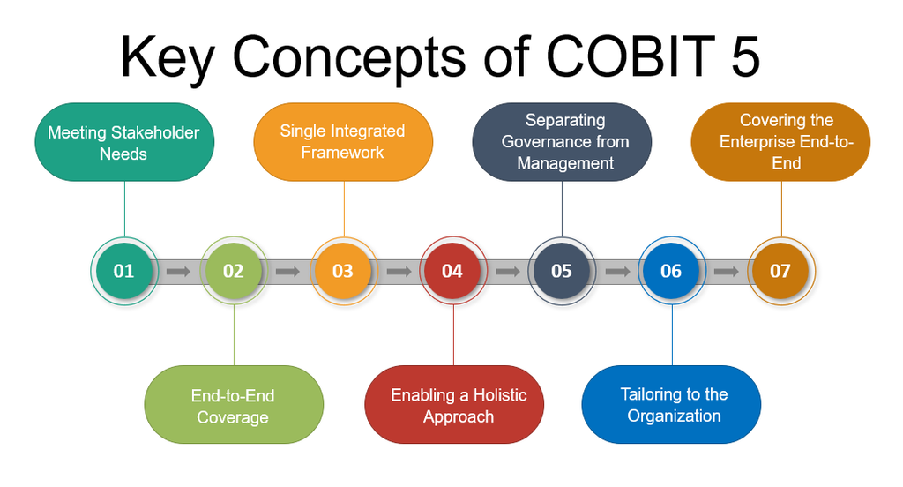
COBIT
Control Objectives for Information and Related Technologies
COBIT 5.0 was released in 2012.

Slide 36
COBIT
Five core principles:
Meeting stakeholder needs
Covering the enterprise end-to-end
Applying a single integrated framework
Enabling a holistic approach
Separating governance from management

Slide 37
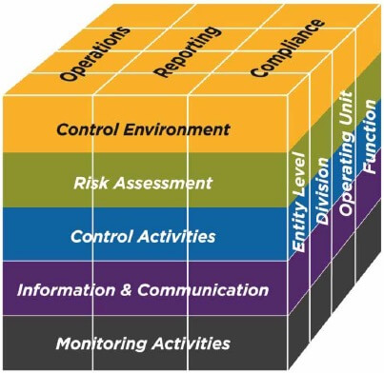
COSO
Committee of Sponsoring Organizations

Slide 38
COSO
COSO compromised 5 interrelated components:
Risk Assessment
Control Activities
Information & Communication
Control Environment
Monitoring Activities

Slide 39
Main differences
COBIT and COSO are both IT frameworks
COSO covers broad enterprise risk, COBIT is more technology focused.
For this class and the group project, you will use COSO framework.

Slide 40
One is linear in process, the other is not.

Slide 41
Benefits of the frameworks
COSO:
Enhanced internal control: It systematically creates and maintains internal control systems that optimize operations and asset protection.
Improved risk management: COSO aids in identifying, assessing, and mitigating risks, leading to informed risk-taking.
Better compliance: Regulatory and compliance requirements are better met, reducing legal risks.
Increased transparency: The framework promotes transparent reporting, fostering stakeholder trust.
COBIT:
Enhanced IT governance: It provides a structured framework for aligning IT strategies with organizational goals, enhancing decision-making.
Improved risk management: COBIT assists in identifying, assessing, and managing IT-related risks effectively.
Optimized resource utilization: Organizations can better allocate and utilize IT resources to achieve business objectives.
Standardized IT processes: COBIT promotes uniform processes and practices across the organization's IT landscape.
Notes:
https://www.theknowledgeacademy.com/blog/coso-vs-cobit/

Slide 42
Analytical skills
Beginning of the cycle:
Business analysis
Requirements gathering
Monitoring the cycle:
IT auditors
Requirements gathering & monitoring
Same skills being used

Slide 43
Business Controls
Controls are defined as the policies, procedures, practices and organizational structures designed to provide reasonable assurance that business objectives will be achieved and undesired events will be prevented.

