Slide 1
Case Competition: Solenis
Team Girard
Dominic Balzer, Ciaran Lamb, Anna Gareis, David Repole

Slide 2
Problem
New revenue streams for products and services via new business models revolving around digital solutions
Overcomes existing issues around the existing model of paying only for chemistry solutions
Looking for ways to innovate by offering new business models
Notes:
Solenis is a global player in fast paced industries ranging from chemical processing, water treatment, and paper and pulp products. With the recent partnership with Diversey, as well as two large acquisitions in 2020, Solenis continues to grow and to branch into new industries and build a larger and more diverse product portfolio. With so much continuing growth, we feel that Solenis’s being issue lies in modernizing your digital platform and

Slide 3
Important Notes
Solenis currently operates in an “old school” manner of purchasing, focusing on purchasing and selling chemistry with expectations on service to add value
Sourcing decisions are made by committee from a wide variety of influencers
Notes:
David

Slide 4
Solutions
Implement ERP or CRM system to provide:
Enhanced customer experience
Improved operational efficiency
Increased responsiveness to fluctuating prices

Slide 5
Option 1: CRM (Customer Relationship Management)
Software for managing company’s relationships and interactions with both current customers and potential customers
Implementing CRM software will increase customer revenue
CRMs increase customer retention and engagement
Customer data profiles greatly assist in sales revenue
Datacor CRM software is our CRM choice

Slide 6
Benefits of a CRM System for Customers
Customer portal
Product Catalogs
Quote Requests
Purchase History
Target Advertising
Product Specifications
Special Pricing
Sample Requests
Order Status
Invoice and AR History

Slide 7
Benefits of CRM for Operational Management
Call Reports
Sales and Margin Analysis
Sales Agent History
Prospect Tracking
Opportunity Tracking
Calendars and Scheduling
Customer Management
Note and Task Management
Price Management
Integrate Credit Upon Proof of Sale Processing
ROI Statistics for CRM Implementation:
Average ROI for Every Dollar Spent: $8.71
Average ROI time: 13 Months
Increase sales by up to 29%
Increase sales forecast accuracy up to 42%
Increase sales rep productivity by 26.4%

Slide 8
Option 2: CRM Timeline
Notes:
David

Slide 9
Potential Problems of CRM Integration
Cost: Poorly planned implementation can run over budget
Implementation: Improper CRM implementation can run over schedule
Proper Setup: Incorrect integration is counterproductive
Internal Issues: New systems can cause internal pushback
https://www.independent.ie/irish-news/onethird-of-council-projects-are-running-over-budget-30031782.html
Notes:
David

Slide 10
CRM Cost of Implementation
Cost Per Person: 100$ per person per month
Training: 100$ per person one time fee
Departments With Access: Sales, Marketing, Accounting, Executives
Total Employees with Access: 2,260
Total Cost Per Month: 100 * 2,260 = $226,000 per month
Total Cost for training: $226,000 one time fee
Total Cost: $452,000 First Month, $226,000 every month afterwards
Notes:
David

Slide 11
Option 2: ERP (Enterprise Resource Planning)
Implementation of a collections of modules based on department
ERP’s increase a company's digital maturity
Datacor ERP is industry focused
Properly managed data allows for operational insight
https://www.datacor.com/

Slide 12
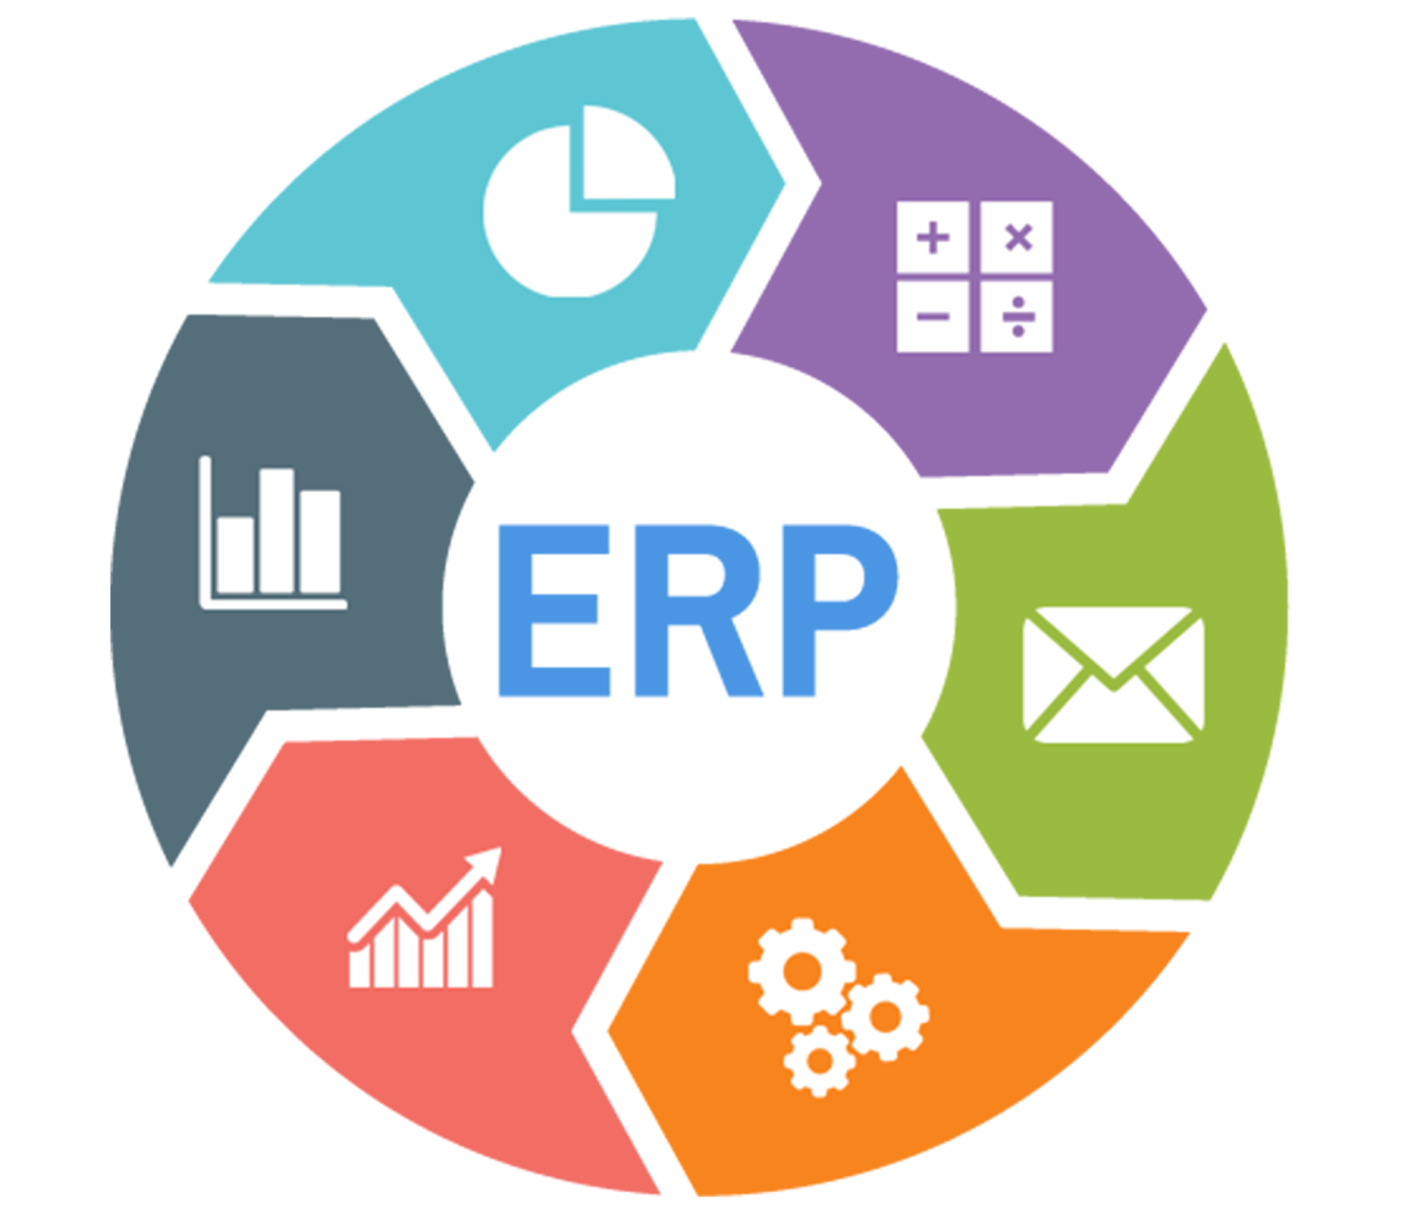
Benefits of an ERP for Customers
Faster Product Delivery
Lower Costs
Empowers sales to provide accurate answers on demand
Manual data entry in every department reduced
Increased Quality Control
Supply chain traceability
Accurate orders
http://krazymantra.blogspot.com/2017/02/choose-best-erp-solution-to-get-maximum.html

Slide 13
Benefits of ERP for Operations Management
Track Performance Across All Departments
ERP usage led to process improvement for 95% of businesses
Manufacturer’s represent 47% of the ERP market
ERP’s reduce IT cost, Inventory Levels, and Cycle Time
Seamless Integration Across Organization
Minimize Repetition in Business Processes and Manual Tasks
Average implementation is 6.6 months
https://www.softwaresuggest.com/blog/benefits-of-erp-guide/

Slide 14
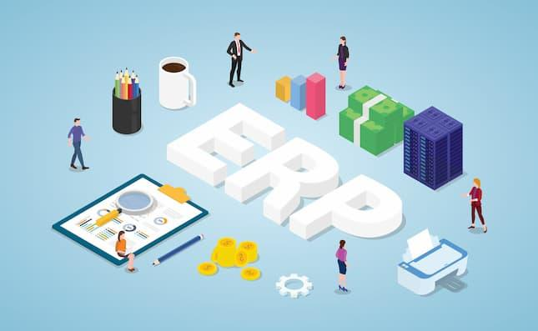
Benefits of ERP for Operations Management
Top 3 areas where ERP produced ROI
Reduced IT costs
Reduced Inventory
Reduced Cycle time
Average ROI for every dollar Spent: $7
Average ROI time: just over 2.5 years
https://www.codeauthority.com/Blog/Entry/Benefits-of-ERP-Software-in-2020

Slide 15
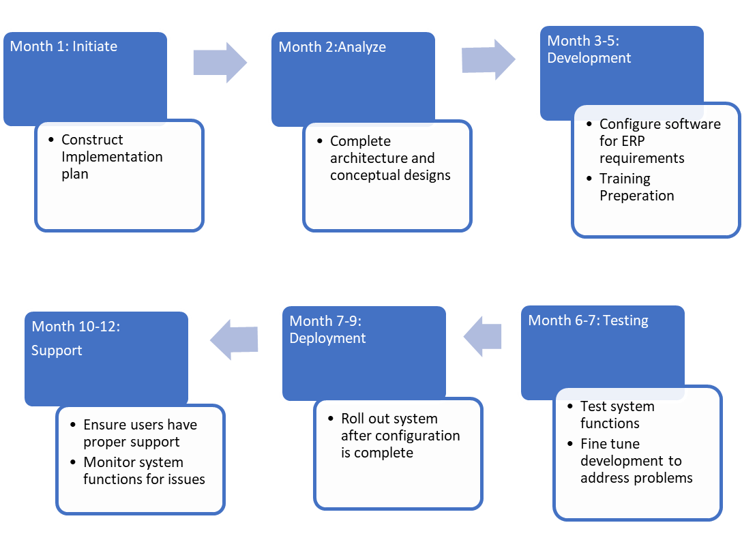
Option 2: ERP Timeline

Slide 16
Potential Problems with ERP system
Resource Constraint
Can cost more than expected budget
Lack of Defined Mission
Employees request for new features, adds more work
Failure to adhere to defined timeline
Inexperience in ERP system implementation
Organizational Issues
Resistance to change from Employees
https://woman.thenest.com/organizational-problems-workplace-15072.html
Notes:
50% of ERP implementations fail the first time around
Most implementations cost three to four times what was initially budgeted
Implementation can take 30% longer than anticipated
51% of companies experience operational disruption when they go live
System modifications needed to improve usability can cause overspending 65% of the time

Slide 17
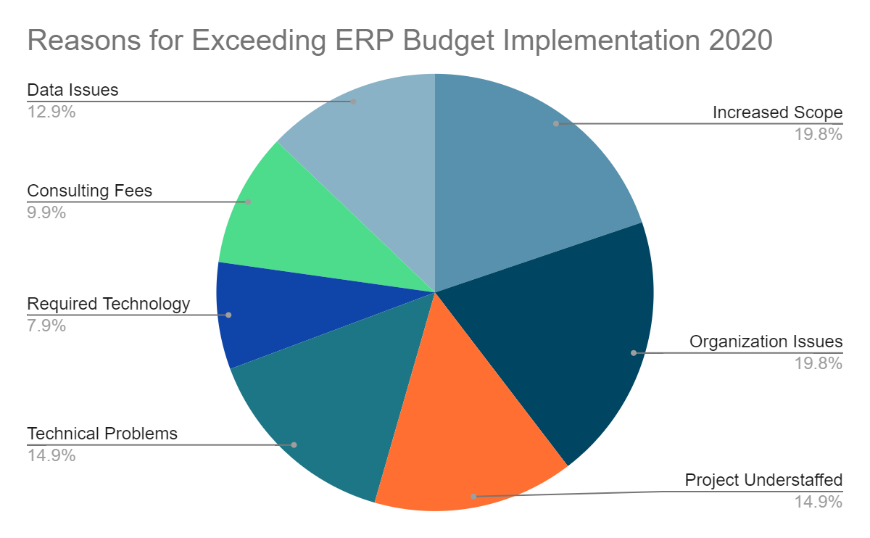
Reasons for Overrun Budget Visualized

Slide 18
Costs of ERP Implementation
62% of companies implementing ERPs remain under budget or on budget
Average actual implementation cost in 2020 was 24% over expected.
Option 1 - Datacor
Implement ERP with Datacor
Cost $21,050,000
1 Time payment
Option 2 - Epicor
Implement ERP with Epicor
Costs 11,170,000 1st year
Costs 10,920,000 annually
Notes:
Each Cost will have 200,000 added due to education, erros, consulting fees, etc

Slide 19
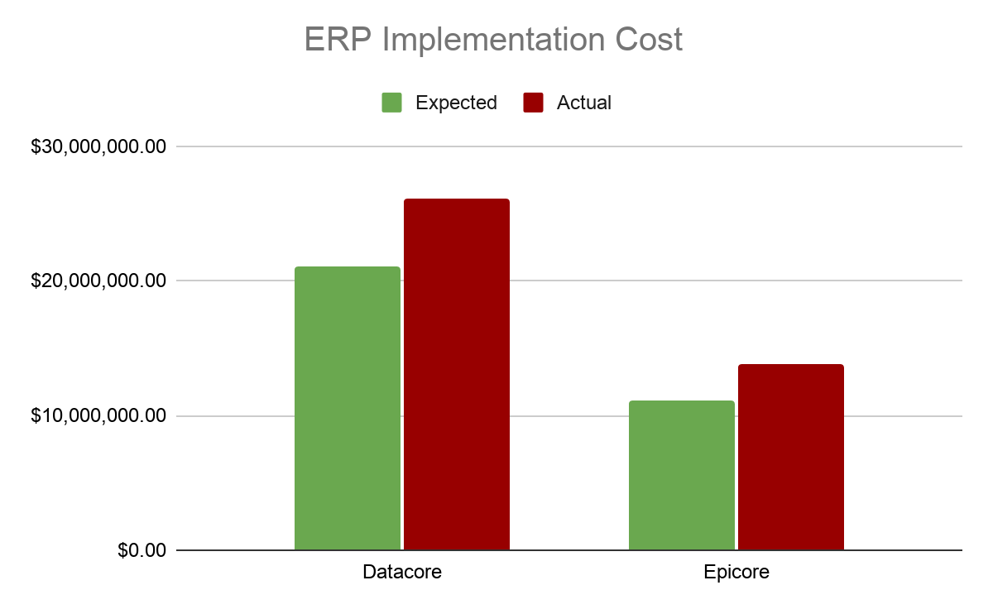
Difference Between Actual and Expected
Notes:
As you can see 1st year will be double the cost of Epicore, but in the long run, Datacore is more effective since it is one time payment

Slide 20
Final Recommendation
As a final recommendation, we recommend the implementation of an enterprise wide CRM system for Solenis. With a lower total cost initially, and the potential to dramatically increase customer revenue as well as a higher ROI. It will change the way Solenis handles their case to case business transactions to focus more on the streamlined convenience for its customers.
ROM (6 Month Timeline)
TAM
The use of a CRM will increase overall market share givin Solenis a higher share of the TAM.
Notes:
Dom
As you can see 1st year will be double the cost of Epicore, but in the long run, Datacore is more effective since it is one time payment

Slide 21
Final Recommendation
Risk Factors
A CRM can run over budget or cause internal pushback due to poor implementation.
This can be mitigated through careful planning while working with Datacor Consultants.
Increased Value
The organized customer data will allow sales representatives to provide higher value for customers.
By providing a higher value of service we can increase customer retention and spending.
Similar Success Stories
Tilley Chemical increased annual sales by 3 times using the Datacor CRM
Whitaker Oil increased profitability with its seamless CRM transition with Datacor
Notes:
David
As you can see 1st year will be double the cost of Epicore, but in the long run, Datacore is more effective since it is one time payment

Slide 22
Questions?

Slide 23
Appendix

Slide 24
Appendix
Notes:
Original Budget: 2651183, actual turns into 4395623
Last year in 2019, overruns were less significant with overrun average being 24%
In 2020 it was down 24%, making actual 3,287,467
Actual Declining overall

Slide 25
CRM - Appendix

Slide 26
ERP - Appendix

Slide 27
Sources
Biel, J. (2020, July 15). 50 ERP Statistics You Need to Know Today. Retrieved February 12, 2021, from https://www.netsuite.com/portal/resource/articles/erp/erp-statistics.shtml#:~:text=After ERP implementation, 49% of,did not improve business processes.
Biel, J. (2020, August 11). Delight Your Customers with CRM. Retrieved February 12, 2021, from https://www.netsuite.com/portal/resource/articles/crm/what-is-crm.shtml
Arthur, P. (n.d.). Improve Profit Margins with ERP Software. Retrieved from https://blog.datixinc.com/blog/profit-margins-erp
Schuval, C. (n.d.). Overview of Epicor ERP Modules. Retrieved February 12, 2021, from https://blog.datixinc.com/blog/overview-of-epicor-erp-modules
Apps Run the World. (2020, August 13). Solenis software purchases and digital Transformation Initiatives. Retrieved February 12, 2021, from https://www.appsruntheworld.com/customers-database/customers/view/solenis-united-states
Enmark Systems Inc. (n.d.). Solenis (sap erp localization). Retrieved February 12, 2021, from https://teamidea.ch/clients/solenis/solenis-erp.html
Open Text Corporation. (2016, November 29). Solenis chooses Opentext to digitize and manage its global b2b supply chain. Retrieved February 12, 2021, from https://www.supplychainmarket.com/doc/solenis-chooses-opentext-digitize-manage-global-supply-chain-0001
Ford, L. (2019, December 12). Solenis takes the path to modern finance With Onestream XF Cloud. Retrieved February 12, 2021, from https://blog.onestreamsoftware.com/solenis-takes-the-path-to-modern-finance-with-onestream-xf-cloud
https://www.netsuite.com/portal/resource/articles/erp/erp-statistics.shtml
Panorama Consulting Group. (2019, December 18). The 2020 ERP Report. Retrieved February 12, 2021, from https://cdn2.hubspot.net/hubfs/4439340/Panorama-Consulting-Group-The-2020-ERP-Report.pdf
Abas USA. (2018, December 09). The 7 reasons erp projects fail and how to avoid the pitfalls. Retrieved February 12, 2021, from https://abas-erp.com/en/news/7-reasons-erp-projects-fail-avoid-pitfalls
Howard, M. (2019, December 17). 17 CRM stats that sales professionals need to know. Retrieved February 12, 2021, from https://www.nutshell.com/blog/crm-stats/
INC, Datacor. “Datacor CRM: Chemical Manufacturing Software: 2021 Reviews.” Software Connect, softwareconnect.com/chemical-manufacturing/datacor-echempax/.
Solenis. “Solenis.” www.linkedin.com, www.linkedin.com/company/solenis/.
nucleusresearch. “CRM Pays Back $8.71 for Every Dollar Spent.” Nucleus Research, 8 Jan. 2021, nucleusresearch.com/research/single/crm-pays-back-8-71-for-every-dollar-spent/.

