Slide 1
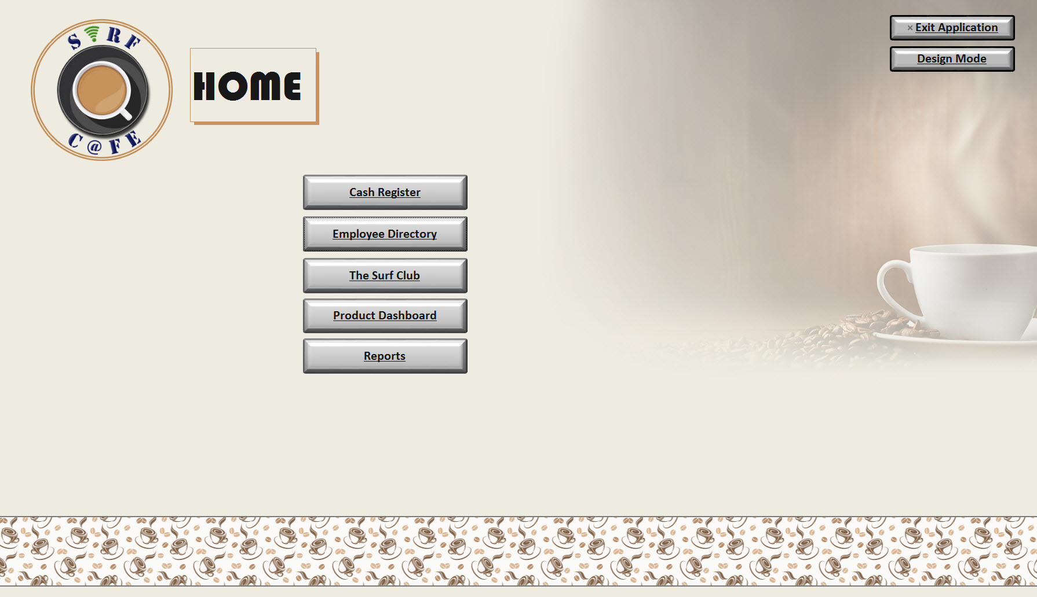
Information Systems Project: The Surf Cafe
As part of an exclusive project, I designed an Access Database application for an Internet Surf Café.

Slide 2
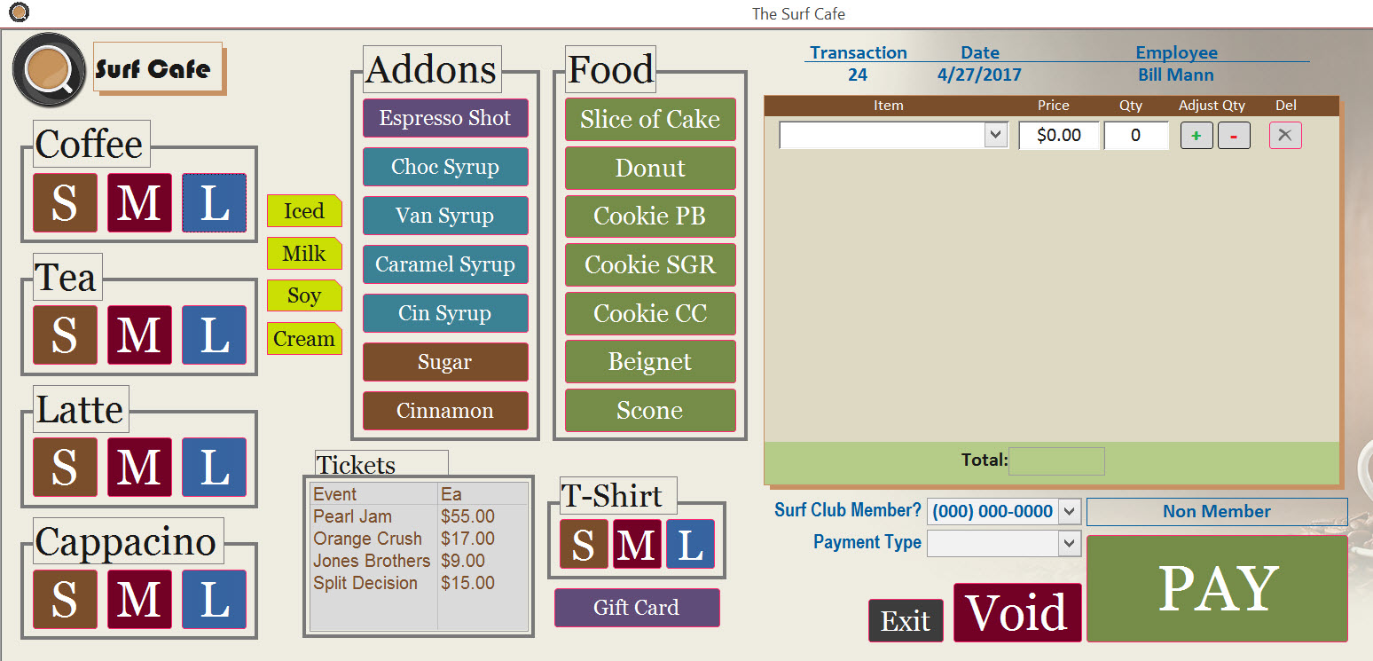
The Surf Cafe: Transactions
Transactions are handled by a push button interface.

Slide 3
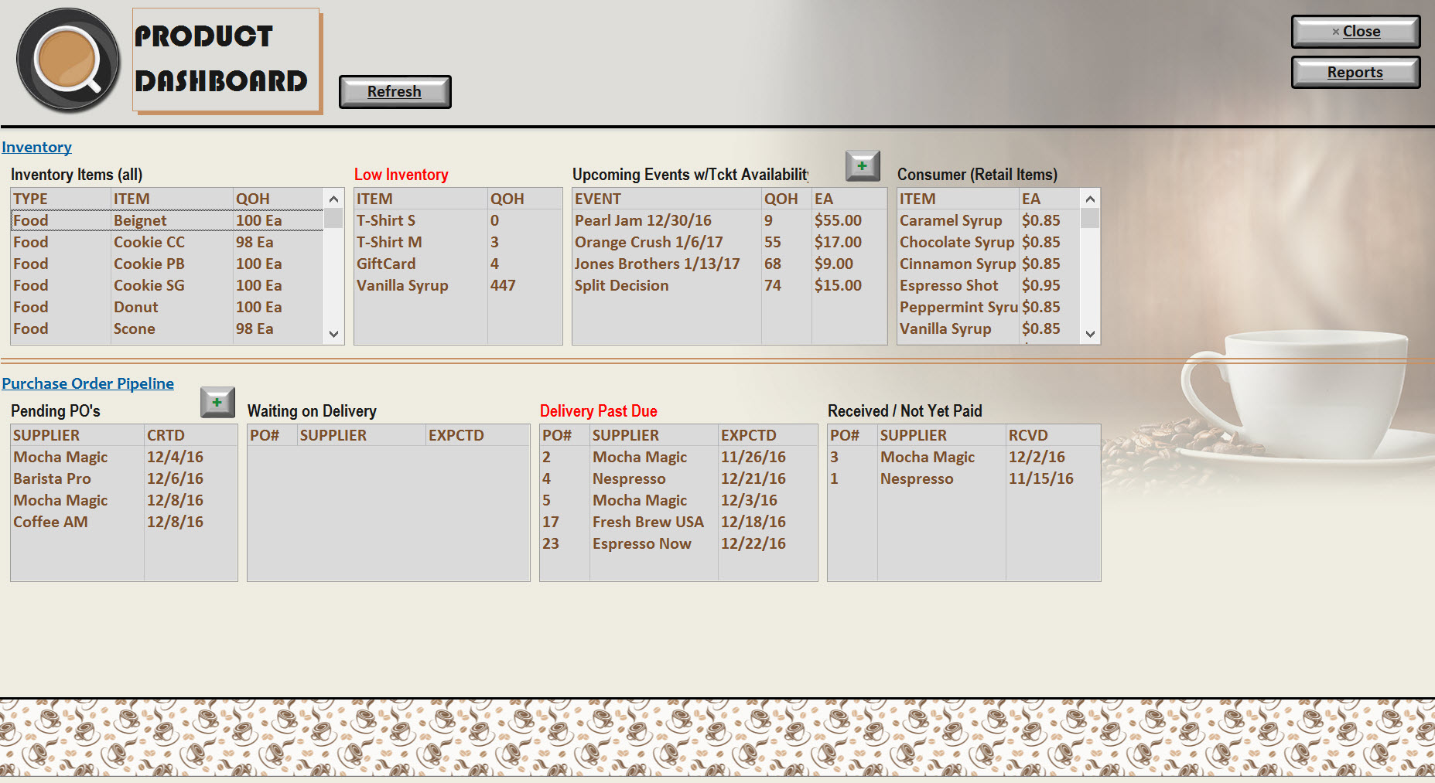
The Surf Cafe: Inventory Dashboard
Track all inventory.

Slide 4
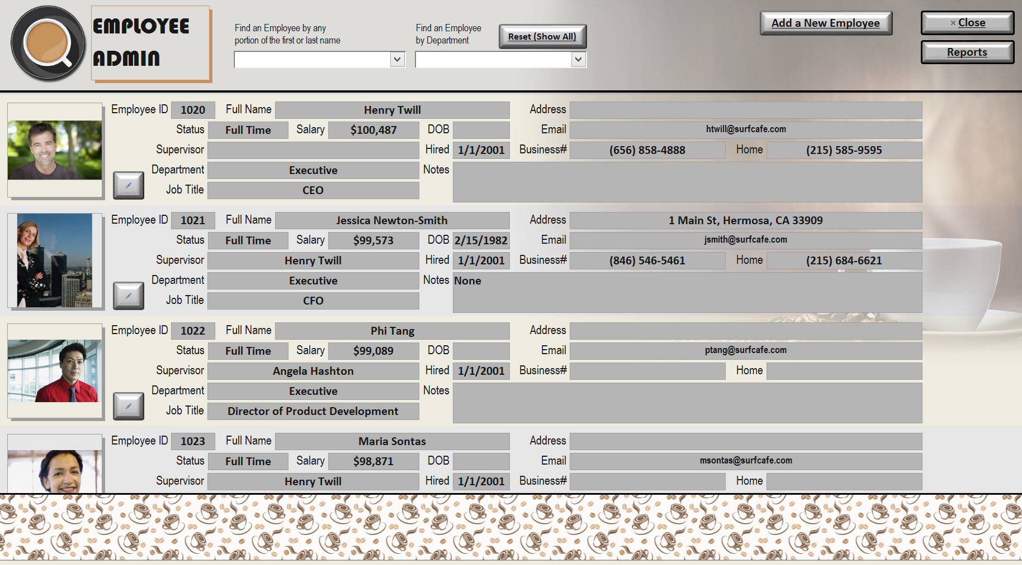
The Surf Cafe: Employees

Slide 5
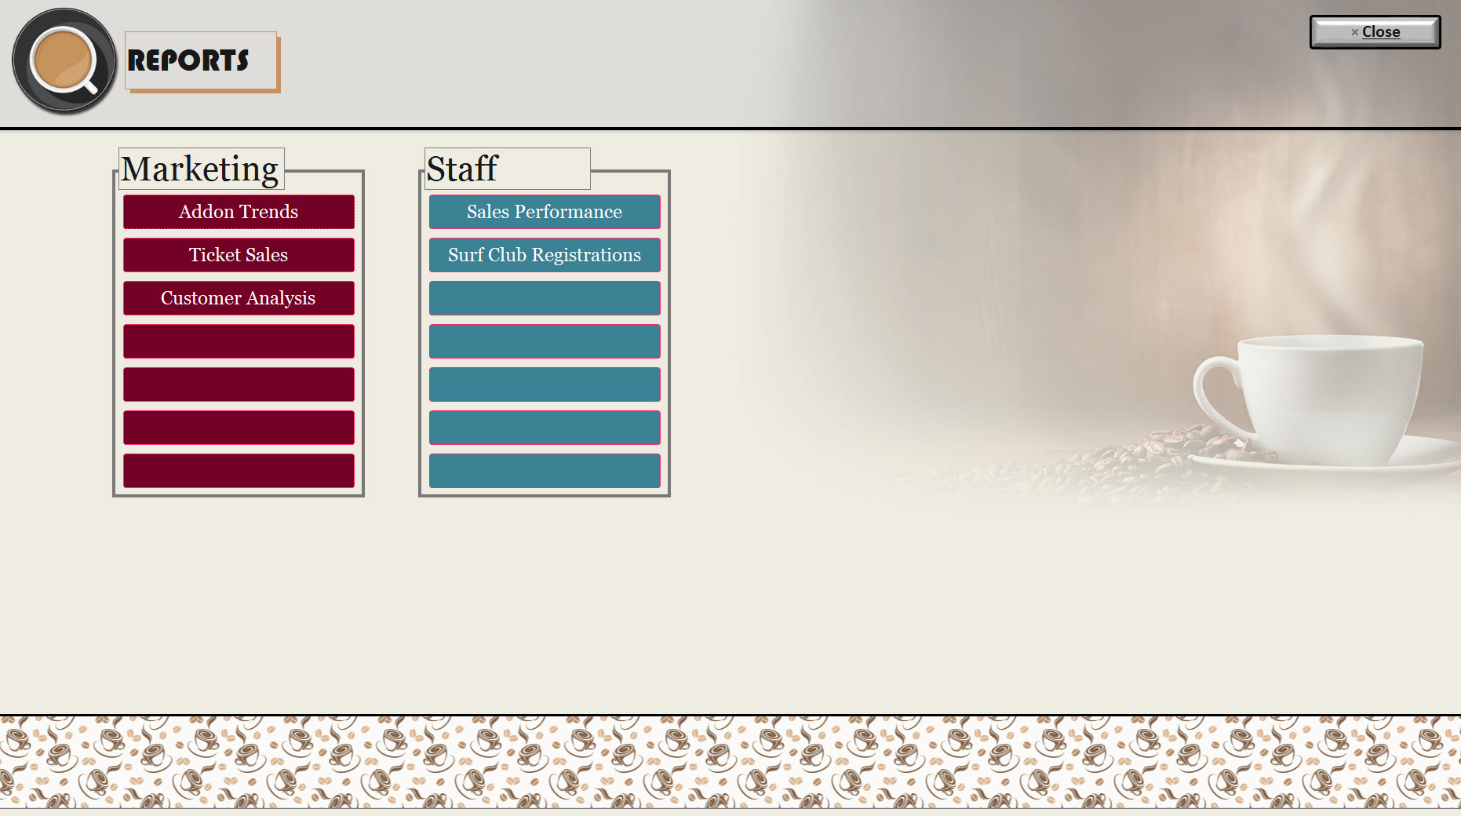
The Surf Cafe: Reports
Trend Analysis & Sales Performance Reports.

Slide 6
Information Systems Project: The Surf Cafe
Surf Café was designed to be a working example so that Temple Fox professors would have a real life database for class demonstrations.
Designed by:
Joseph Haas
MIS Major
Temple Fox School of Business

