Slide 1
Emerging Technology:
Bring Your Own Device
Presented By: Group Four
Annamarie Filippone | Daniel Min | Mansi Paun | Sean Walsh | Shizhong Yang

Slide 2
Agenda
What is BYOD?
History of BYOD
Advantage of BYOD
Key Risks
Key Controls
Future of BYOD
Q&A

Slide 3
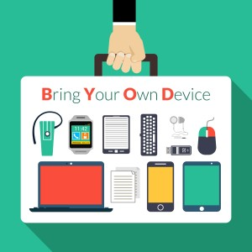
What is BYOD?
Bring Your Own Device (BYOD): Employees to use their own devices for work purposes.
Laptops
Smartphones
Tablets
Other (smartwatch, etc.)
Notes:
Bring Your Own Device (BYOD) is the practice of allowing the employees of an organization to use their own computer, smartphones, or other devices for work purposes.

Slide 4
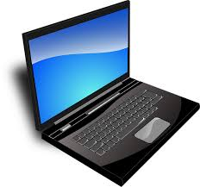
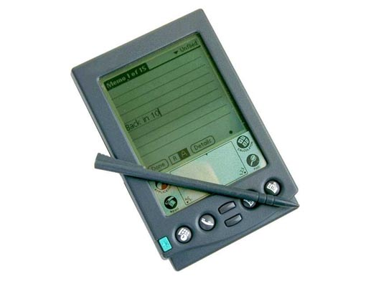
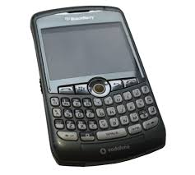
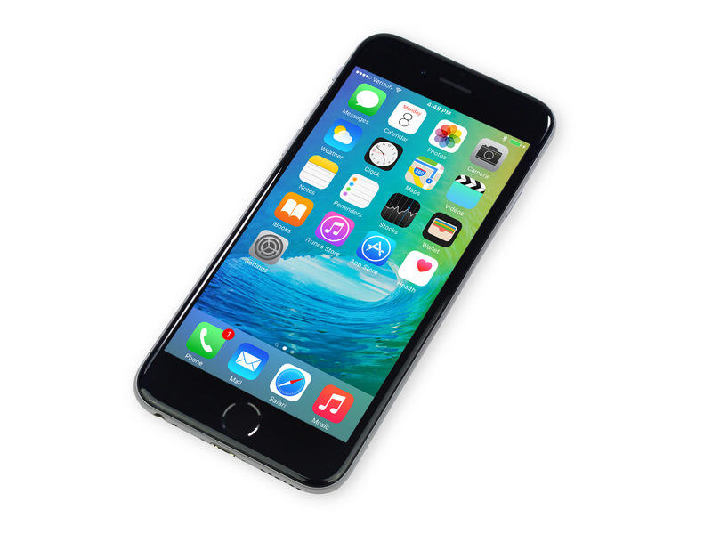
History of BYOD
2000’s Laptop Prevalence
2000’s Palm Pilot and Blackberry
2007 Apple’s iPhone
1997 IEEE 802.11
2009 Policy Needed

Slide 5
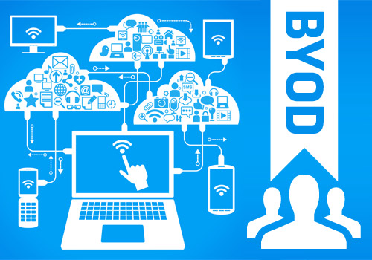
Advantages of BYOD
Reduced Spending
Devices and data plans
Technology Familiarity for Users
Smaller learning curve
Increased Work Flexibility
More after-hours work
Notes:
There are many advantages to BYOD that may appeal to companies, including:
Reduced spending. With BYOD, individual employees are responsible for purchasing their own device and, typically, their data plan as well, which is money the company no longer has to spend.
Technology familiarity for users. By using their own devices, employees will be more comfortable with the technology they are using, which will reduce the time spent learning and allow employees to be productive sooner.
Increased work flexibility. Employees now have the ability to easily take their work with them, which allows them to work even after-hours. This can produce greater output for an organization.

Slide 6
Key Risks
Physical Access to Device
68% of healthcare breaches
End User Device Ownership
225,000 iPhones hacked
Communication Interception
75% of apps unencrypted
Malware Installation
2.3B malicious emails in Q1 2016
Notes:
Counter to its advantages, BYOD presents several major risks that companies should consider. The first risk is that of physical access, meaning that a device used by an employee containing business data is lost or stolen. This allows a malicious user to access the data without having to worry about intrusion-detection or anti-virus software. In fact, a study by data protection company Bitglass showed that 68% of data breaches in the healthcare industry could be attributed to stolen devices.
Another risk with bring your own device policies is end-user device ownership. This means that, since the device belongs to the employee, they have a certain sense of entitlement regarding what they can or cannot do with that device. Users may decide to “jailbreak” or “unroot” their smartphone or not install patches in a timely manner, which can open them to additional security threats. Just last year, over a quarter million jailbroken iPhones had data stolen by hackers in China.
Communication interception is another risk with BYOD. This can be done by malicious users hacking Wi-Fi, especially free hotspots, or even cellular transmissions, to steal data while it’s in transit. A study from HP concluded that around 75% of applications do not properly encrypt data, making it much easier for hackers to intercept and use it.
Finally, by mixing personal and company business on a single device, users open themselves to the risk of malware installation on their device. This can come from a variety of sources, including downloaded apps, web browsers, text messages, and emails. Email and web security firm AppRiver reported that, in the first quarter of 2016 alone, 2.3 billion malicious email messages had been sent, which already surpasses the total level documented in all of 2015.

Slide 7
Key Controls
Controls | Key Risks
 | Lost/stolen devices: Physical Access to Device | Manage devices: End User Device Ownership | Unauthorized access: Communication Interception | Malware Infection: Malware Installation
Mobile Application Manager(MAM) | V
Mobile Device Management(MDM) |  | V
Network Access Control(NAC) |  |  | V
Enterprise Sandbox; Mobile Antivirus |  |  |  | V
Notes:
As Annamarie mentioned in the previous slide, there are many risks embedded in applying BYOD in an organization. In next slides, we will discuss key controls that will address each key risk we’ve identified. Mobile Application Manager will address the problem with lost/stolen devices; Mobile Device Management will explain how to manage devices; Network Access Control will tell you how to prevent unauthorized access; and, lastly, Enterprise Sandbox and Mobile Antivirus are required to combat malware infections on devices.

Slide 8
Key Controls Cntd.
Mobile Application Manager(MAM)
Risk: Lost/stolen devices
Mobile Device Management(MDM)
Risk: Manage devices
Network Access Control(NAC)
Risk: Unauthorized access
Enterprise Sandbox
Risk: Malware infection
Mobile Antivirus
Risk: Malware infection
Notes:
Mobile application management provides granular controls at the application level that enable administrators to manage and secure app data. This will help the organization to protect the data even if the mobile device is lost, a theft or upon a termination of an employee.
Mobile device management solutions can be used to comprehensively manage third party mobile devices using authentication mechanisms, data encryption and enforcing of organizational policies. The MDM server requires that users install a service agent in the device. Then, the server send instruction to the agent to control the device including ability retrieve or remote wipe the contents, and control the functioning of the device to enforce it to be aligned to organizational policies.
Network Access Control allows organizations to identify user devices and apply security policies before granting access to the resources. This will help organizations to secure the mobile device’s network access while it is connected to the main server.
Enterprise Sandbox can create compartmentalized domains within one mobile device. So even if one domain becomes affected by a malware it wouldn’t have access to the data and resource from other domain thereby limiting the damage. This will enhance the security of the mobile devices.
Finally, Mobile Antivirus can help to protect the device from malware and helps to ensure a normal functioning of a system.
Now I will pass it to Mansi to discuss the future of BYOD.

Slide 9
The Future of BYOD
20% growth in BYOD usage world-wide in 2016
Number of devices per person set to increase to 6.8 by 2020
Employee tablet use will see a year-to-year increase of 50% by 2018
Notes:
Thank you, Daniel.
As MIS students in the 21st century, we know that Technological change is shaping the workplace of today and tomorrow. With changing times, BYOD to work is a trend that is increasing. But we need to understand how this trend affects the employment relationship and the workplace landscape – Is it leading to employee satisfaction or frustration or is it making it tougher for employers to ensure productivity and better manage their employees ? Is it still a nightmare for the IT Security teams that deal with the fall-out of security incidents caused by poor BYOD policies.
Some of the feedback surrounding BYOD and workplace practices has been that employers do find it more difficult to manage employees through outdated controls especially since the change is widely resisted by employees. Often times, employers might not be keen on the idea, but resistance was futile and soured the relationship with employees. However with reduced costs of setting up mobility friendly infrastructure, increased average annual productivity, improved employee workplace experience and in turn better ROI , BYOD is clearly the way to go.
Gartner Predicts by 2017, Half of Employers will Require Employees to Supply Their Own Device for Work Purposes. A recent forecast from IDC expects mobile workers will account for 72% of the U.S. workforce by 2020. In the U.S., mobile device split billing solutions will be driving force accelerating the adoption of formal workplace BYOD programs.

Slide 10
Thank You
Questions?

