Slide 1
Emerging Technology: Biometrics
By: Jaspreet, Magaly, Fangzhou, and Paul

Slide 2
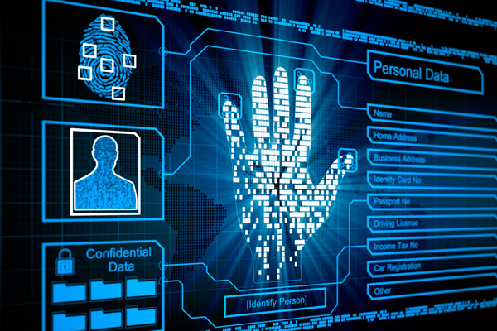
Biometrics Background
Biometrics: The study of human metrics
History dates back to prehistoric times:
Nova Scotia, Babylon, and China have been found bearing markings of ridge patterns, fingerprints, and handprints used for everything from business transactions to criminal evidence.
Centuries Later: professionals began to study the use of fingerprints and other metrics as means of identification.
Fingerprint ID: would be used around the world for identifying criminals, and would become lauded as an important method of forensic science.
Notes:
Today, fingerprint technology in consumer devices is widespread, being used in security systems, home automation, mobile devices, for access control door locks, and time and attendance. In a technologically driven society, emerging and future applications of biometrics seem to have no limits.

Slide 3
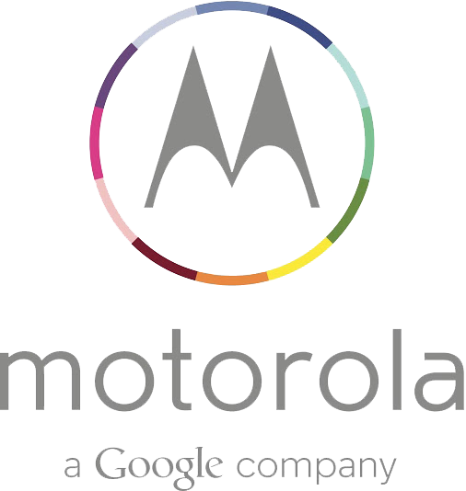
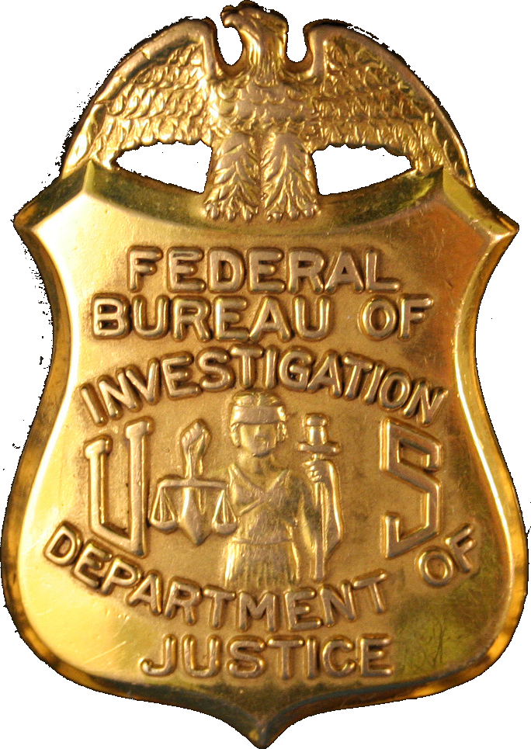
Timeline of Biometrics Technology
Retina scanning technology is pioneered by John Daugman, who developed and patented the first algorithms for computer-aided ID of iris patterns.
Henry Faulds- Scottish doctor and scientist, publishes the first forensic fingerprinting, which covers specific collection methodology and process of fingerprints.
NY State Prison System began the 1st systematic use of fingerprints in the U.S. for criminals.
FingerCheck is founded, making biometric time clock technology accessible within the U.S. and beyond.
The Identification Division of the FBI is established.
Motorola is the 1st company to offer a fingerprint scanner in a smartphone
1800
1892
1903
1905
1924
1964
1994
20th Century
2011
21st Century
2013
Juan Vucetich- Argentine Police Official, created the 1st criminal fingerprint identification based on Galton pattern types
U.S. Dept. Justice forms the Bureau of Criminal Identification to provide a centralized reference collection of fingerprint cards.
Facial recognition technology is pioneered by Woody Bledsoe, Helen Chan Wolf, and Charles Bisson as a part of their collective study on pattern recognition intelligence.
Mechanical time clocks evolve to computer based, electronic time and attendance systems with biometric readers to identify the employee to the systems
Computing technologies more prevalent within laptops; automatic technologies include fingerprint recognition sensors
Notes:
Let’s take a look at some of the most pivotal historical moments in the development of biometrics.Here is a brief history outlining development.
The magic behind biometrics is that we are our passwords. Given the unique weight of this fact, it’s little wonder that the development of this technology has advanced beyond its original forensic purposes into civilian markets and government use.

Slide 4
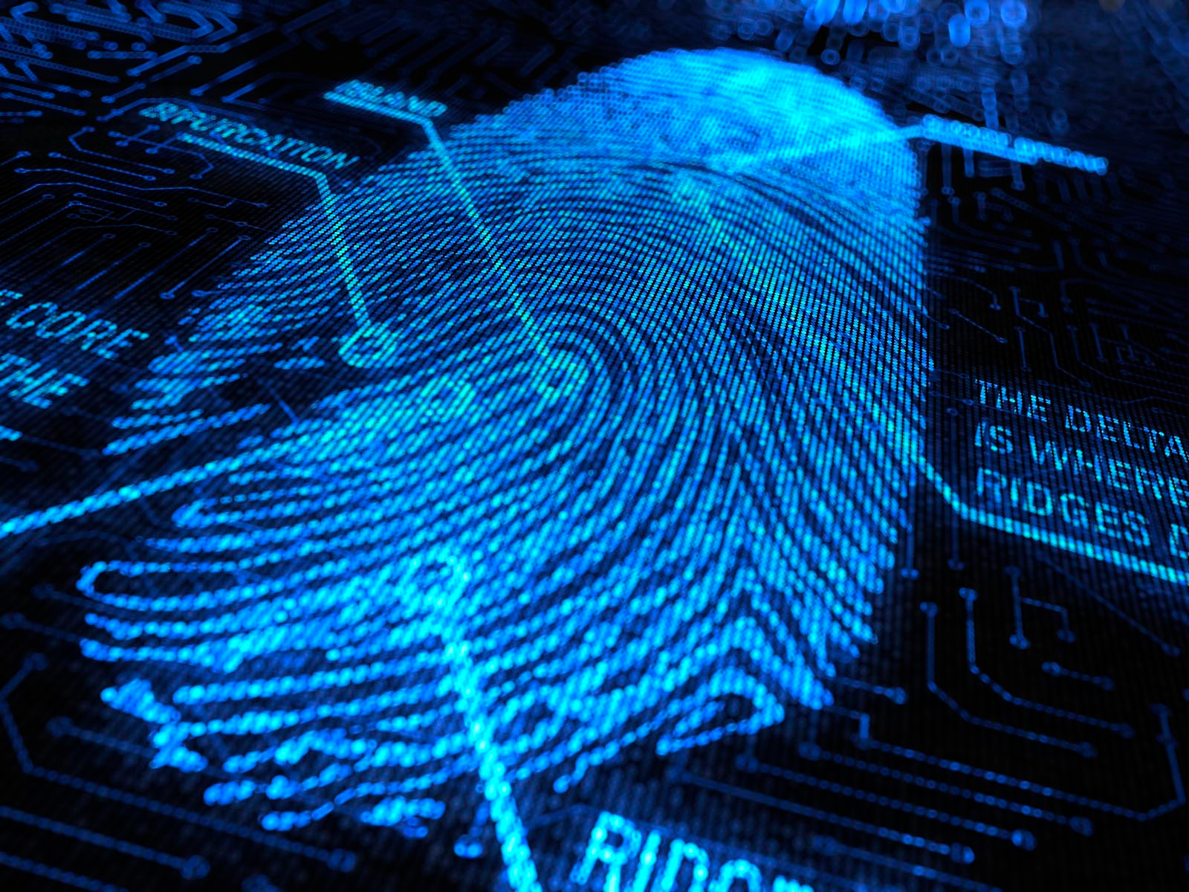
Future
Fingerprint Identification
Credit Card users: directly identify the user information through fingerprint recognition
Public transportation: you don’t need tokens any more
Intelligent housing system: use fingerprint to access in the system.
Multiple recognition to enhance the security and accuracy: facial recognition, voice recognition.
Notes:
https://www.optel.eu/uploads/PDF%20ENG/future%20of%20biometrics.pdf
http://blog.m2sys.com/category/future-of-biometrics/

Slide 5
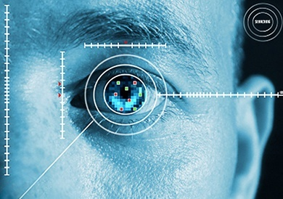
Iris recognition
Features of eye movements
Financial and other transactions requiring authorization.
→ Digital financial transactions
Access and attendance control
→ no need to carry keys, identity cards, personal documents, etc.
→ precluding the possibility of theft or unauthorized use of equipment/technologies

Slide 6
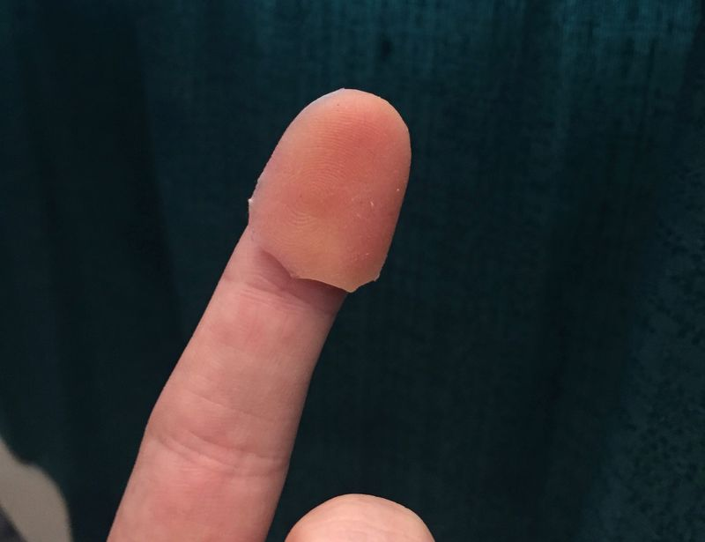
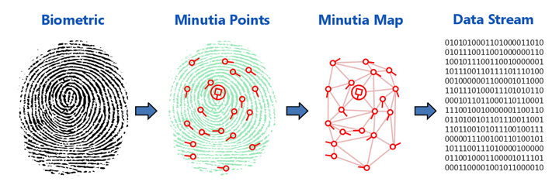
Risks - Affect All Biometric
Risk of Spoofing
Certain forms of biometrics can be spoofed utilizing today’s technology.
Artificial finger can be used to bypass biometric fingerprint scanners
Voice Recordings can be played to bypass voice recognition biometrics
If compromised, it has similar consequences to password being linked where unwanted user has access to system/location.
Fake Template/Data Alterations
Biometric template: Digital reference of distinct characteristics which are used to match the biometrics for biometric authentication.
An attacker can create/alter a fake biometric template on server that houses authentication software.
This creates a new “password” through biometrics.
Users now can get authenticate themselves.
*Note: Might be thinking that if they have access to system why would they need biometric passwords...could be used for other access (physical)
Notes:
http://www.identityone.net/BiometricTechnology.aspx

Slide 7
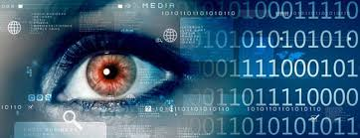
Risks - Affect Certain Biometrics
False Positive / False Negative authentication
Because no system is foolproof authorized users can often have a hard time getting access to a system or non-authorized users can trick the system into thinking their fingerprints or other biometrics match a template on file and be granted access.
Biometric data is not reversible and once compromised can’t be reversed
Once you associate a biometric to a user you cannot disassociate that biometric from that user.
All biometric data is encrypted and stored ‘one-way’ therefore making it hard for someone to dis-associate an image or scan for a particular person. Therefore if you use an iris scan as your mode of biometric authentication
and someone steals your eye, they can access the system as you.
Denial of Service
Changes in physical characteristics
You no longer have the biometric that is needed to authenticate you
For example you loose a finger or burn your finger tip destroying your fingerprint therefore no longer allowing you access to the system.
Noise risk
If you are using voice as a biometric and there is excess noise in the background it could interfere with the authentication and lock you out of your account.
Notes:
Additional Risks that can affect certain biometrics are False positive authentication and false negative authentication. Because no system is fool-proof authorized users can often have a hard time getting access to a system because it thinks their fingerprint isn’t matching a template on file or vice versa non-authorized users can trick the system into thinking their fingerprints or other biometrics match a template on file and be granted access.
Another risk assosciated with biometrcis is biometric data once its compromised cannot be reversed. Since biometric data is encrypted and stored ‘one-way’ therefore making it hard to reverse engineer or dis-associate an image or scan for a particular person. Therefore , in example, I you use an iris scan as your mode of biometric authentication and someone steals that particular eye they may be able to access the system as you.
Another area of risk is Denial of Service … this is for users who are authorized users fo the system.
They may have a change in physical characteristic for example if they burn the fingertip of the finger they use to scan in … their finger print will no longer be valid or match the template on file. There is also a possible noise risk … if you are in an area that has a lot of background noise when you are trying to do a voice authentication this could potentially lock you out of your account.

Slide 8
Controls
Utilize Encryption and an Intrusion Detection System
Prevents an attacker from creating fake templates or altering templates stored on a server.
Encryption of the data for these templates will prevent an attacker from being able to read the data, thus removing the ability to manipulate the templates.
An Intrusion Detection System with a focus on the server storing the biometric data will notify that an intrusion is occurring, potentially notifying IT staff to make changes to prevent tampering of biometric templates.
Vitality Detection within Biometric Reader
Function within biometric fingerprint readers that can determine if biometric sample is alive or not.
Can determine liveliness of sample based on the following
Temperature
Heartbeat
Blood Pressure
Prevents attackers from using fake fingerprints (such as molds) to gain authentication.

Slide 9
Questions?

Slide 10
Sources:
http://www.wseas.us/e-library/transactions/information/2010/89-450.pdf
http://www.identityone.net/BiometricTechnology.aspx
Page 186-189 https://www.isaca.org/Knowledge-Center/Standards/Documents/IT-Audit-Assurance-Guidance-1March2010.pdf
http://www.isaca.org/knowledge-center/research/researchdeliverables/pages/biometrics-audit-assurance-program.aspx
http://www.theverge.com/2016/5/2/11540962/iphone-samsung-fingerprint-duplicate-hack-security
http://www.timesofisrael.com/israeli-bank-becomes-first-to-use-behavioral-biometrics-to-secure-credit-card/

