Slide 1
Quantum Computing
Paul M. Dooley
Tamer Tayea
Wenlin Zhou
Ian M. Johson
Joshua Tarlow
Notes:
Explain the technology your team selected (history, trending , current and future application)
Analyze the risk associated with this technology, preferred to use samples
Key controls that can mitigate risks identified
Each team will give 15 min. to present
Power Point Slides are preferred

Slide 2
Introduction
Radical change how computational processing is performed
Uses Quantum Mechanics
Market expected to surpass 20 Billion by 2020

Slide 3
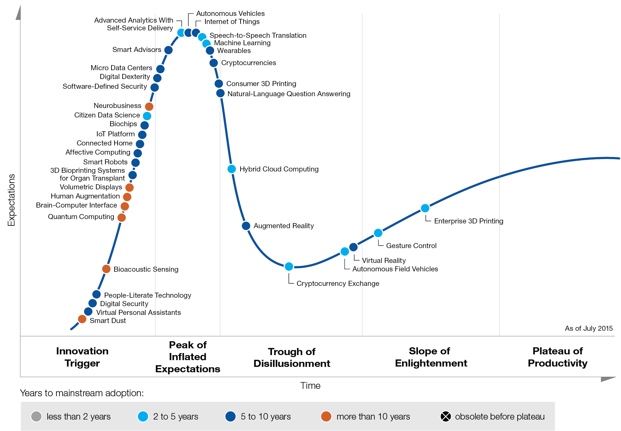
Gartner Emerging Technology Hype Cycle
Expected adoption is over 10 years away
Few if any commercial applications in current use

Slide 4
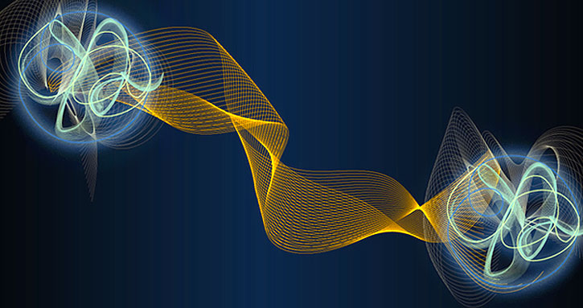
Quantum Mechanic Principles
Superposition
Can be in two places simultaneously until measured
Schrodinger’s Cat
Observation/measurement affects the outcome
Outcome does not exist unless the measurement is made
Entanglement
Maintain connection after interactions
Instantaneous interaction not limited by distance
Not limited by speed of light
Heisenberg Uncertainty Principle: impossible to know both an object's position and velocity -- at the same time

Slide 5
Silicon Valley – Schrodinger’s Cat

Slide 6
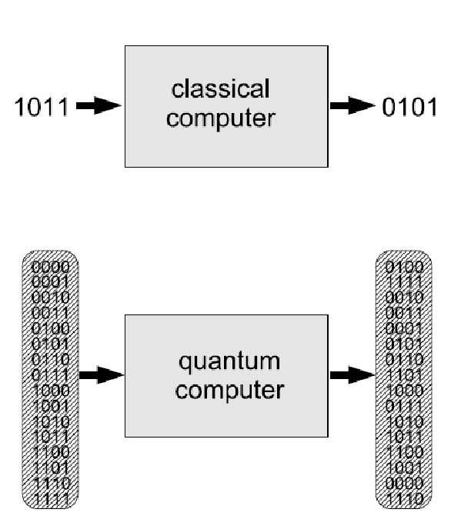
What is Quantum Computing?
Computation Systems that use quantum mechanics to process data
Different than classical computer
No transistors or diodes
Stores information as either 1,0 in Qubits
Quantum superposition of both states
Parallelism: can perform multiple computations simultaneously
2 Qubits = 4 Bits
3 Qubits = 8 Bits
4 Qubits = 16 Bits
10 Qubits = 1,024 Bits
30 Qubits = 107,373,568

Slide 7
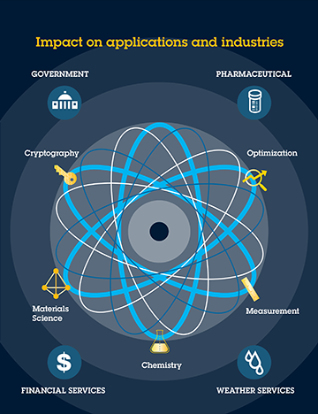
Applications
Encryption
Cryptography
Artificial Intelligence
Teleportation
Quantum Communication
Big Data
Pharmaceuticals

Slide 8
Risk: Encryption
Theoretically capable of breaking modern encryption
Superposition allows simultaneous attack of different parts of code
Current encryption standards are vulnerable
Based on prime numbers
Large prime numbers difficult to factor
Easy to multiply large prime numbers
Difficult to reverse for current computers
Still over a decade away

Slide 9
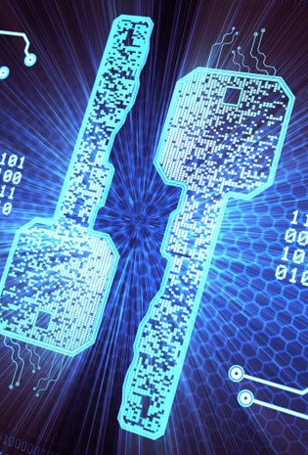
Control – Quantum Key Distribution
Only known method for transmitting a key long distances proven secure under Quantum Mechanic laws
Relies on:
Mathematics (Public Key Encryption):
Quantum Mechanics (Quantum Cryptography)
Randomly generates keys
Transmits data through photons (light)
“Man-in-the-Middle” attacks impossible
Notes:
Mathematics (Public Key Encryption): computational difficulty of certain hard mathematical problems
Quantum Mechanics (Quantum Cryptography): Relies on laws of Quantum Mechanics

Slide 10
Why is Quantum Key Distribution Secure?
Heisenberg Uncertainty Principle
Alters photons
Attempts to re-emit photons introduce unacceptable level of error into communication
Entanglement
Creation of 3 entangled photons from two
Decreases strength of each photon (detection)
Impossible re-emit both photons and:
Measure entangled photon
Disrupt other photon
Notes:
Heisenberg Uncertainty Principle: The act of measurement is an integral part of quantum mechanics, not just a passive, external process as in classical physics. So it is possible to encode information into some quantum properties of a photon in such a way that any effort to monitor them necessarily disturbs them in some detectable way. The effect arises because in quantum theory, certain pairs of physical properties are complementary in the sense that measuring one property necessarily disturbs the other. This statement is known as the Heisenberg uncertainty principle
Entanglement: It is a state of two or more quantum particles, e.g. photons, in which many of their physical properties are strongly correlated. The entangled particles cannot be described by specifying the states of individual particles and they may together share information in a form which cannot be accessed in any experiment performed on either of the particles alone. This happens no matter how far apart the particles may be at the time. Entanglement is crucial for long-distance quantum key distribution.

Slide 11
Questions?

