Slide 1
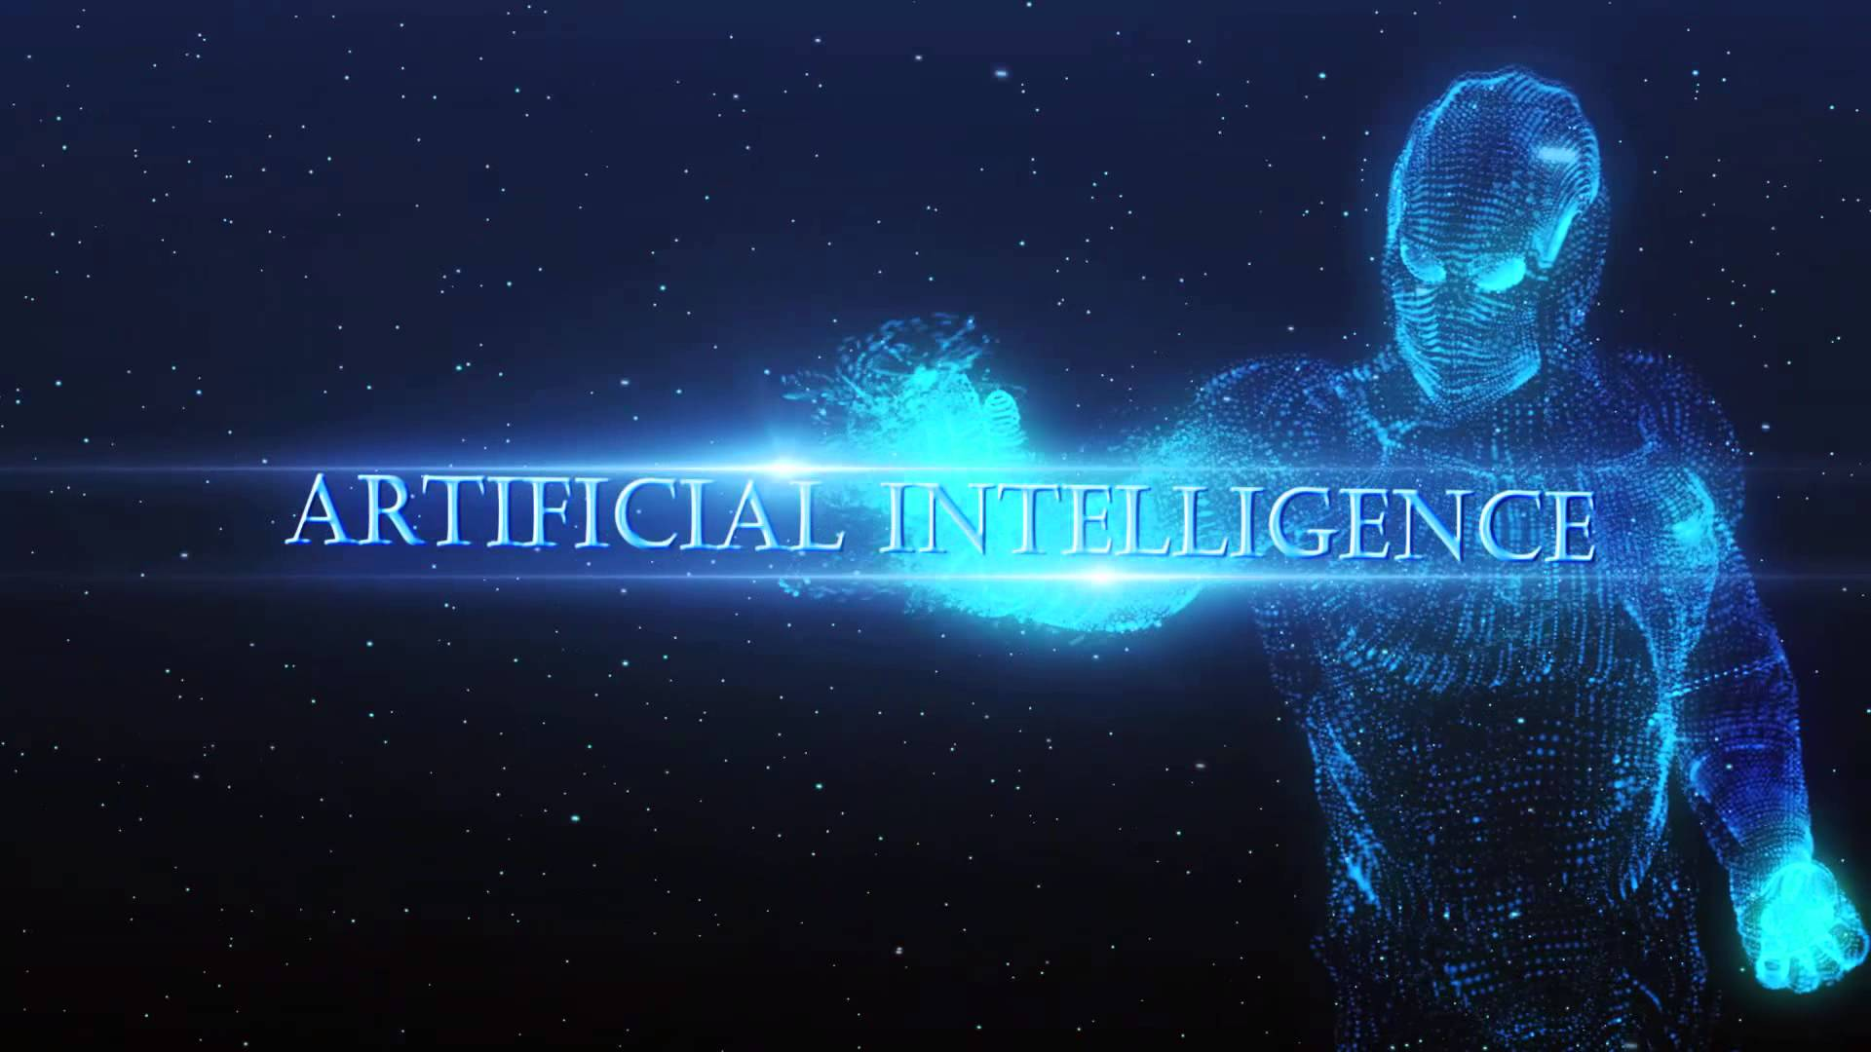
Fred, Priya, Wen Ting, Yulun, Yu Ming

Slide 2
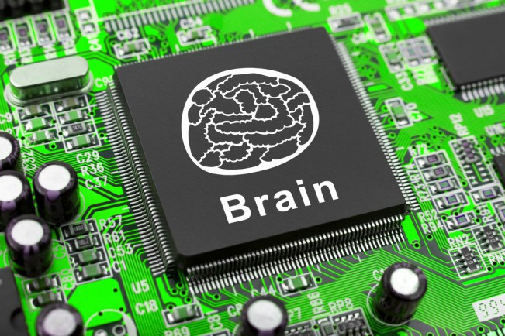
What is Artificial Intelligence?
The study of computer systems that attempt to model and apply the intelligence of the human mind.
Intelligence is the computational part of the ability to achieve goals in the world.
Goals of A.I
To make computers more useful by letting them take over dangerous or tedious tasks from human.
Understand principle of human intelligence

Slide 3
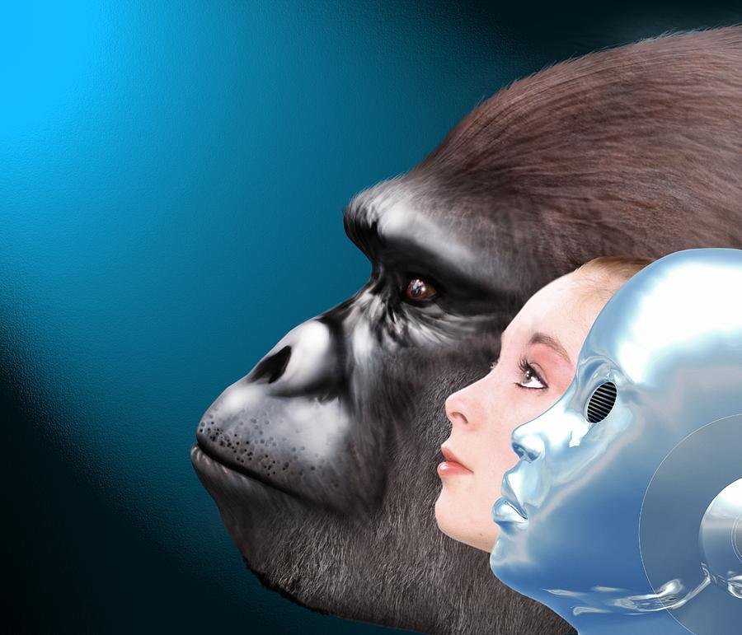
The Evolutionary Process
How Artificial Intelligence Began
Pre WWII | 1950 | 1960 | 1970 | 1980 | 1990 | 2000 | 2010
-Greek Mythology -Wizard Of Oz -Science Fiction Books | -Turing test -Birth of A.I -General Problem Solver | -Industrial robot -ELIZA & The First Expert System -MacHack Chess playing program | -Knowledge based medical diagnosis program | -Commercial expert system | -Polly: Behavior based robotics | -Recommendation Technology | -Mobile Recommendation APPS: Siri, Now, Cortana -Machine Learning, Deep learning
Notes:
The beginnings of artificial intelligence are traced to philosophy, fiction, and imagination. Early inventions in electronics, engineering, and many other disciplines have influenced AI.
Science Fiction
Greek Mythology - Scriptures of Zeus speaking of a bronze man who can protect the beaches of Crete.
iRobot - Isaac Asimov published a series of stories about machine AI,
“Three Laws of Robotics” included risks and mitigation techniques to prevent machines from becoming smarter than humans.
http://www.bbc.co.uk/timelines/zq376fr
http://aitopics.org/topic/history
http://www.aaai.org/ojs/index.php/aimagazine/article/view/1848/1746

Slide 4
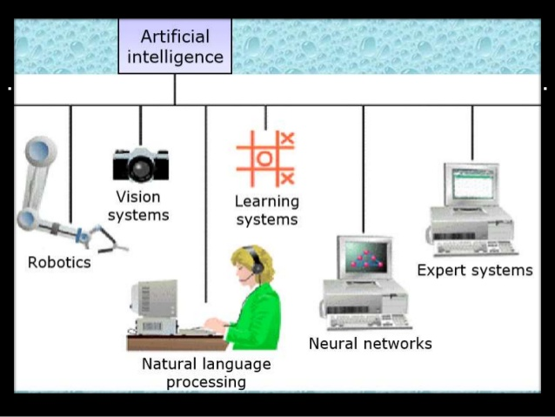
Application of A.I
Expert Systems
Natural Language Processing (NLP)
Speech recognition
Computer vision
Robotics
Automatic Programming

Slide 5
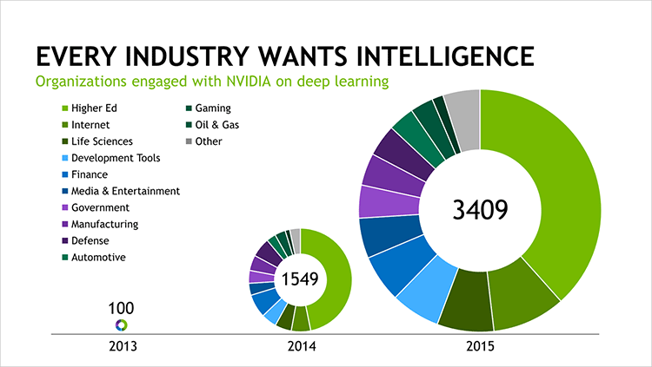
The demand of A.I has increasing over years...

Slide 6
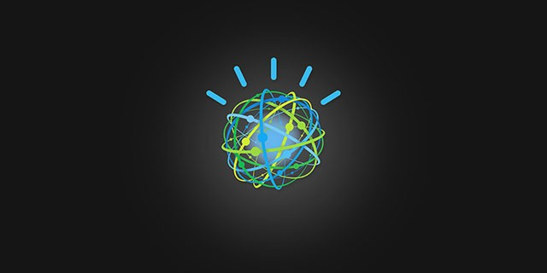
IBM Watson
What is Watson?
Understanding The Question & Answering The Question
System
Cluster - 10 Racks, 90 Servers
Processor(s) - 2880 cores w/ DeepQA software
Storage - 1,000,000+ books (World Book Encyclopedia, Wikipedia, Public)

Slide 7
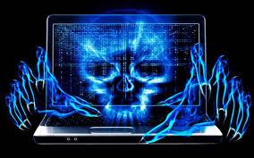
Risk with IBM Watson Technologies
In the hands of the beholder
Premeditated - The Perfect Weapon
Autonomous Weapons
Unpredictable - Too Smart For Our Own Good
Literal / Figurative / Metaphor

Slide 8
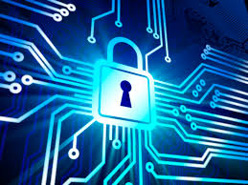
Keeping Society Safe
Security - More or Less?
Mitigation Procedures
Laws & Liabilities - NATO, WSO
Privacy- Surveillance, phones, emails
Ethics - Developers, Scientist
Policies & Controls - Goals & Kill Switch

Slide 9
Risks with Self-driving Car
Self-driving car is a vehicle that is capable of sensing its environment and navigating without human input.
Mobile WI-FI system risk
Allow a car to fold wing mirrors when it changes lanes whilst driving, and brake the car when in motion
Personal information lost
Hackers control vehicle to vehicle communication technology
Notes:
Even millions of self-driving cars are likely to be taking to the road in a few years, they are also providing millions of targets for hackers.
Those attacks would put human lives at immediate risk, whereas other hacks do not
(personal information)Consider how passengers in self-driving cars, they will spend their travel time on watching movies, TVs, or working. But some will be shopping, banking, and others, and those sensitive data may be transferred via a potentially hackable wireless connection.
(vehicle-vehicle communication technology) alerts vehicles to avoid accidents. However, if hackers use this technology, that will become a weapon for people

Slide 10
Controls with Self-Driving Cars
Stronger WI-FI security will mitigate risks that associated with security vulnerabilities with the mobile WI-FI system
The use of sophisticated passwords
The use of Enterprise(802.1X) security
The use of Wireless Intrusion Prevention System(WIPS)
In the future, 5G will be ultra-reliable and higher speed for network connections.
Notes:
1) the use of sophisticated passwords can secure wireless network and prevent hackers from attempting to attack passwords;
2) the use of Enterprise (802.1X) security can provide better security because it is more complex and requires a RADIUS authentication service; 3) the use of Wireless Intrusion Prevention System(WIPS) can help detect rogue Aps, denial-of-services(DoS) attacks, and other network security issues

Slide 11
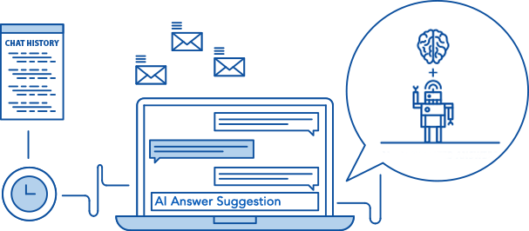
Customer service
AI customer service provides a human-like, conversational, consistent, relevant tool to direct customers with the right information before customers got help from a real customer representative.
optimize case handling time
improve agent satisfaction
drive service quality and customer satisfaction
reinforce the call center for peak activity

Slide 12
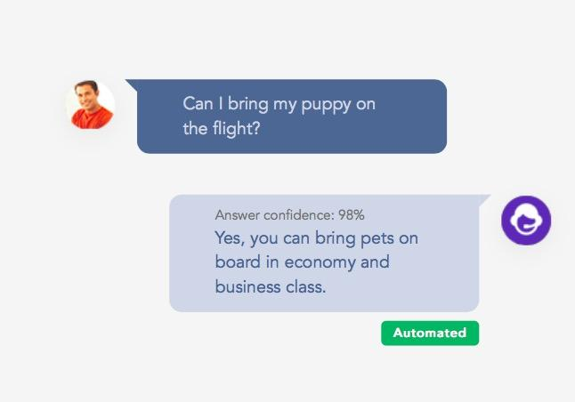
How it works?

Slide 13
Risk with Customer Service
Poorly developed and scripted bot
Take customers to the wrong path
Don’t fully understand what customers want
Lack of soft skills
Thousand of ways to ask the same questions
Easily become a target for hackers by connecting the AI customer service software to the main network domain of the company

Slide 14
Controls to mitigate the risk of artificial intelligence
1. Monitoring the automated customer service in general
2. Invite AI experts and scientists to well-test automated customer service
3. Conduct customer satisfaction survey after the service is finished
4. Update firewall, encryption security
5. Monthly scan for unauthorized access and malware installation

Slide 15
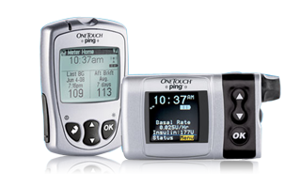
Artificial Intelligence in smart infusion pumps
AI is used in making medical devices smart to make patient life easy
Smart infusion pumps are used by individual patients or hospitals
Smart pumps deliver fluids, medicines, nutrients depending on
Library of medications
Patient history
Patient Current condition
Dosage guidelines

Slide 16
Risks
The device and controller are connected over wifi
Messages to each other are unencrypted
Attackers can spoof and alter the clear text messages
Potentially forcing pump to deliver unauthorized injections
Attackers can change the medical history or medical library by exploiting the controller
Attackers manipulate the firmware by entering the network or physical access to the pump controller

Slide 17
Controls
The softwares that the devices used must be thoroughly checked for vulnerabilities by performing penetration testing and timely risk assessment.
Communication between pumps and monitors and other devices that it communicates to must be encrypted.
Patch management for the softwares, operating system of the medical devices must be up to date.
Strong monitoring mechanism for medical devices on the general network
Ensure medical devices are segregated from the primary local area network and the Internet

Slide 18
Residual risk - Encouraging the thought of AI safety
Destructive methods, exploiting power of AI
Researchers and scientists like Stephen Hawking, Bill Gates, Elon Musk are seriously considering the possibility of superintelligence in our lifetime which can cause hazards
Machines growing smarter than humans
Would systems behave as they are expected to, or behaviour can be unexpected?

