Slide 1
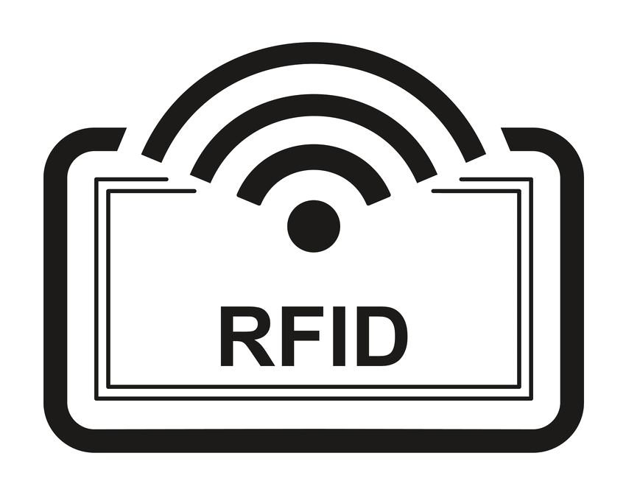
Risk & Controls Associated with
Alexandra Adje ~ Vu Do ~ Deepali Kochhar ~ Yang Li Kang ~ Said Ouedraogo

Slide 2
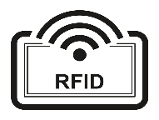
Background
Architecture
History
&
Trending
Current & Future
Applications
Risks
-Security Risks
-Privacy Risks
Controls
-Security Controls
-Privacy Controls

Slide 3
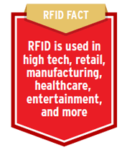
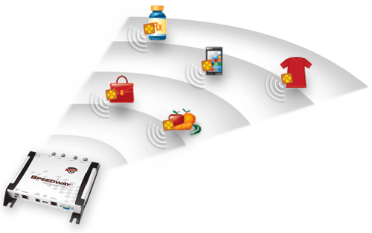
What is RFID?
Radio frequency identification (RFID) is a form of wireless communication that uses radio waves to identify and track objects.
CONCEPT: Uses barcoding concept and digitizes it for the modern world providing the ability to:
Uniquely identify an individual item beyond just its product type
Identify items without direct line-of-sight
Identify many items (up to 1,000s) simultaneously
Identify items within a vicinity of between a few centimeters to several meters
HOW:
An RFID system has readers and tags that communicate with each other by radio. This can tell you what an object is, where it is, and even its condition.
RFID use is rapidly increasing with the capability to “tag” any item with an inexpensive communications chip and then read that tag with a reader.

Slide 4
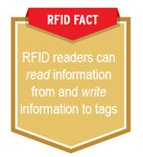
RFID Architecture
In a basic RFID system, TAGS are attached to items that are to be tracked.
TAGS: Made from integrated Circuits (IC)
Contains memory to store the product’s electronic Product code (EPC) and other variable
An RFID reader is a network connected device (fixed or mobile) with an antenna that sends power, data and commands to the tags. The RFID reader acts like an access point for RFID tagged items so that the tags' data can be made available to business applications.

Slide 5
History and Trending
1950’s
Inventor DB Harris creates a different variation of the technology with a passive responding chip
Recent Trends
2000’s
Over 1000 patents have been submitted using the RFID technology
1973
Mario Cardullo developed a passive radio transponder with memory which was the first true ancestor of modern RFID
Late 1940’s
Radar technology was first used to identify enemy and friendly aircraft
1970’s
Testing and production of RFID devices and technology becomes increasingly popular
1987
The first toll road RFID payment system is introduced in Europe
2014
World RFID market is worth US$8.89 billion
1980’s
RFID becomes a commercial success and begins to become a mainstream product
2003
Walmart announces to use RFID to its supplying vendors by the year 2006
1948
Inventor Harry Stockman creates
RFID
1990’s
RFID truly becomes a part of everyone’s daily lives. With Toll road payment collection devices implemented in the United States and Rail road cars implement RFID detection system
1960’s
Security checkpoint and security tags/ anti- theft devices using RFID
Present
Securing RFID data is being worked on by companies to design a secure data transmission through RFID technology

Slide 6
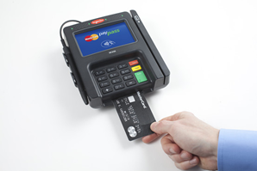
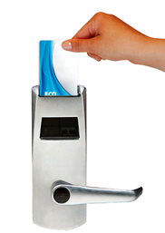
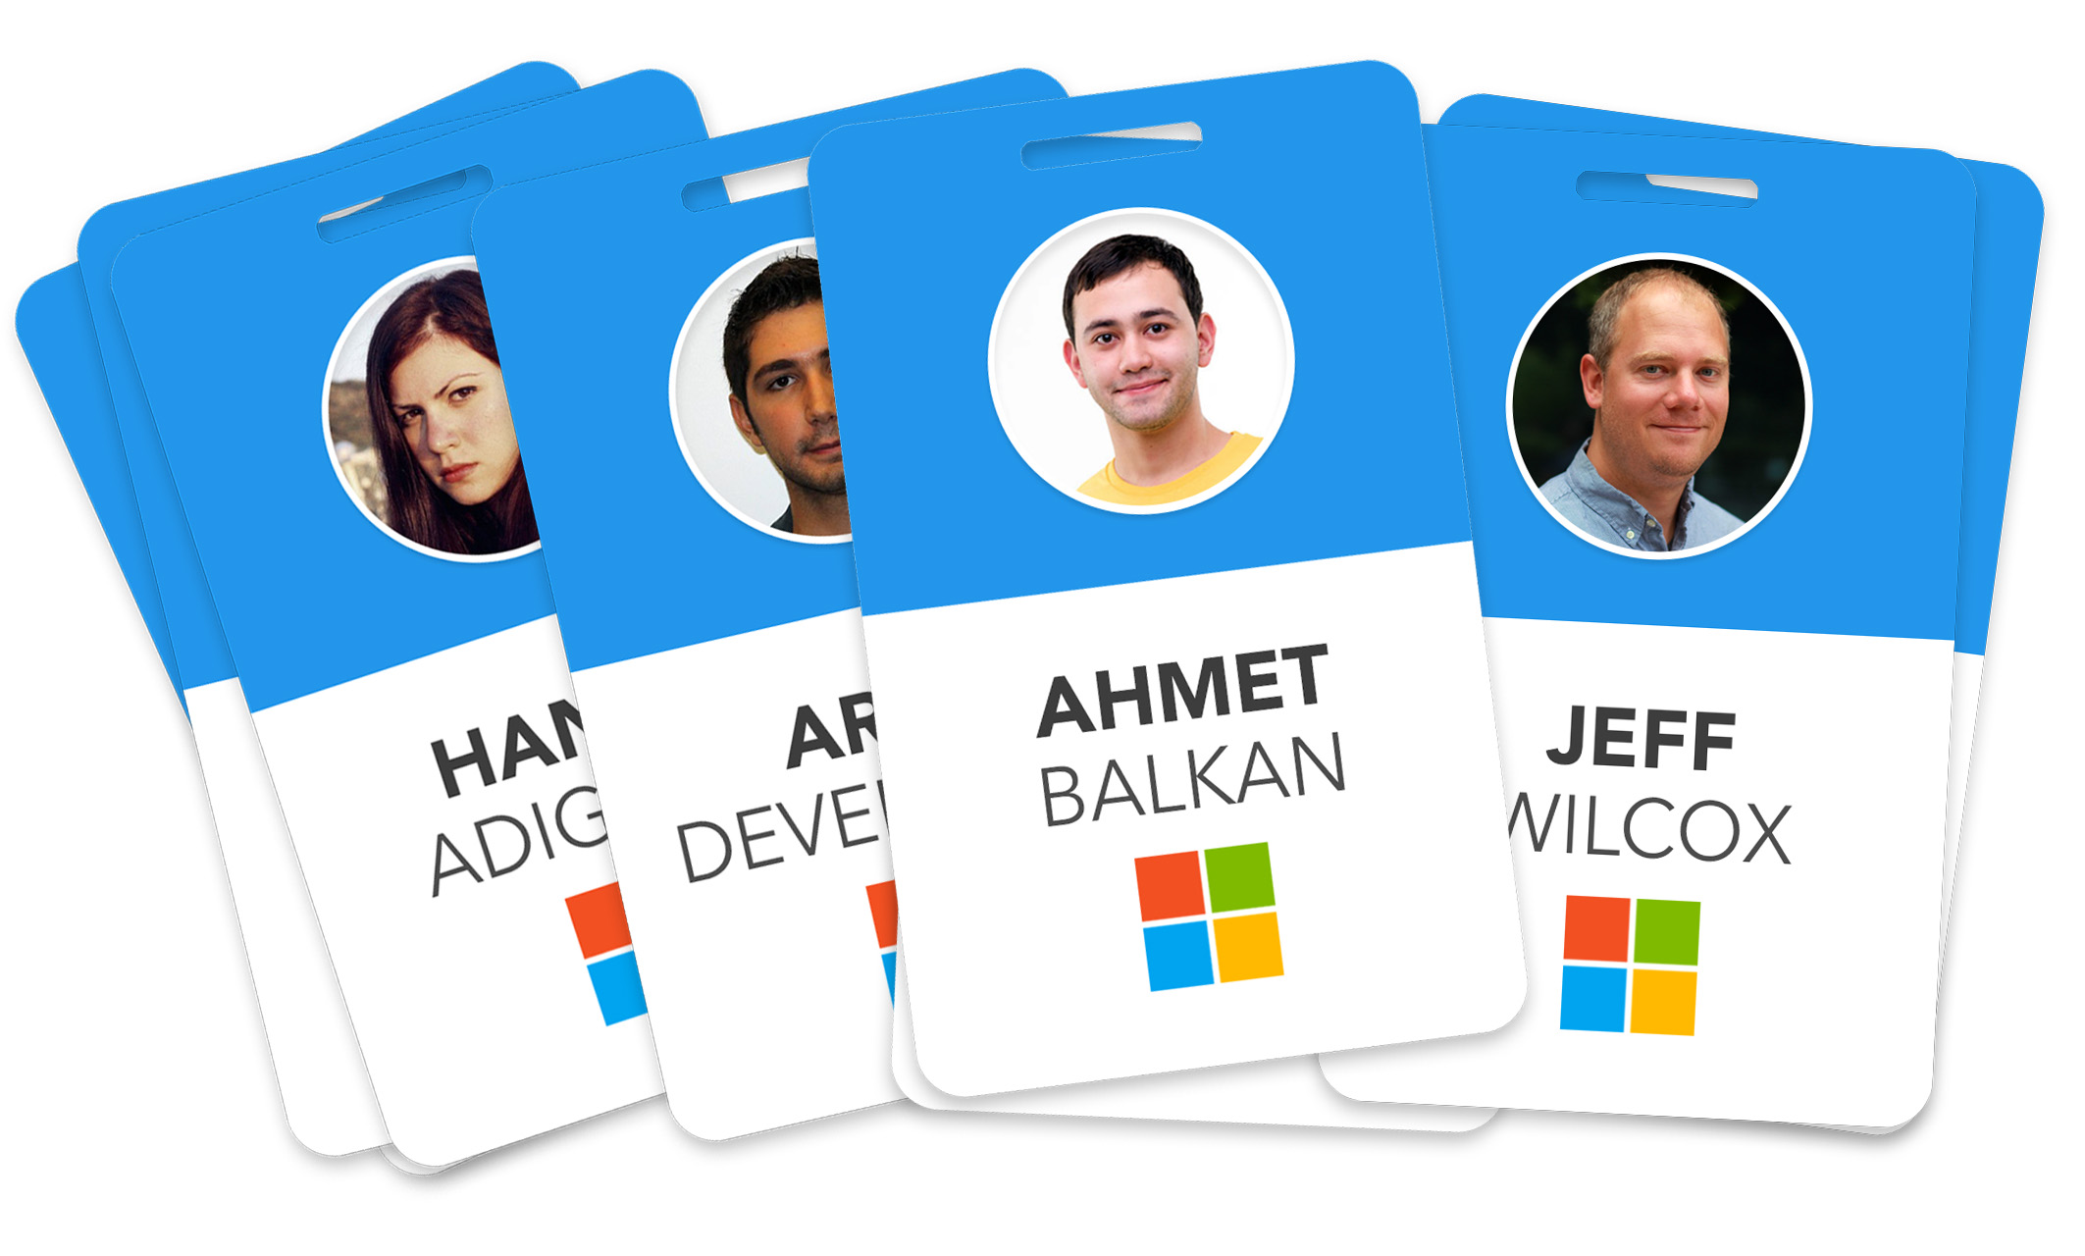
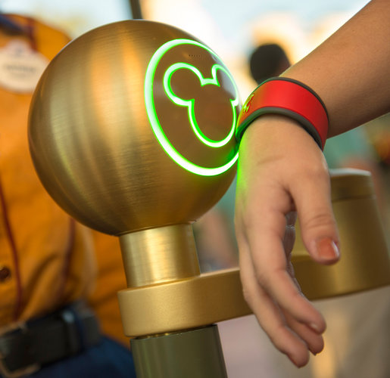
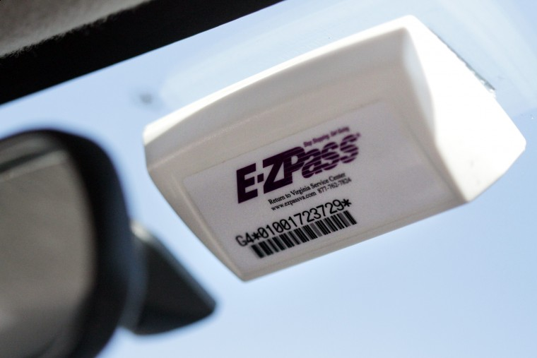
Current Applications of RFID
Common use
Credit cards
Key card
Hotel room access card
Access card
Employee badge
Prepaid Transportation Pass
E-ZPass
Train pass
Human tracking
Wristbands in amusement parks
Patients in hospital
House arrest

Slide 7
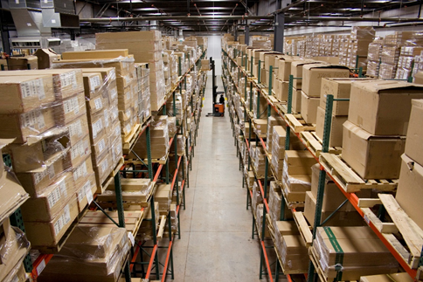
Current Applications of RFID
Warehouse Inventory Management
•Factories box and tag inventory before placing in warehouse.
•Warehouse is equipped with RFID scanners which tracks the location and inventory level.
•Application can be setup to automatically issue production order and alert once inventory reaches a specified level.
•Saves time in manually finding and counting inventory.

Slide 8
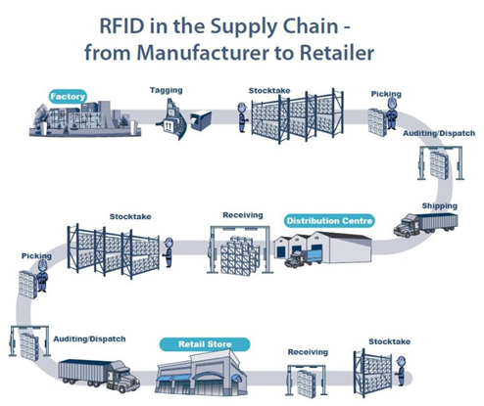
Current Applications of RFID
Supply Chain and Logistics
•Manufacturers attach RFID tags on their boxed shipments to track it at every pass off point until it reaches the retailer.
•Every pass off point have large RFID scanners where shipments pass through and updates the location of the shipment.
•Gradually updates both manufacturer and retailer of location and condition of shipment; retailers can coordinate the management of inventory space.

Slide 9
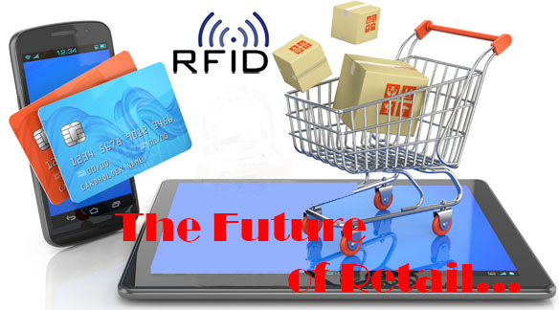
Future of RFID
RFID in retail is currently prevalent within manufacturer.
RFID can be utilized by retailers in the future.
Development of extremely small and cheap RFID tag will allow individual items to be tagged.
Retail product switch from using barcodes to RFID tags.
Retailers can fully utilize this technology to develop the next generation retail stores.

Slide 10
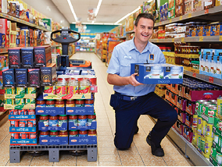
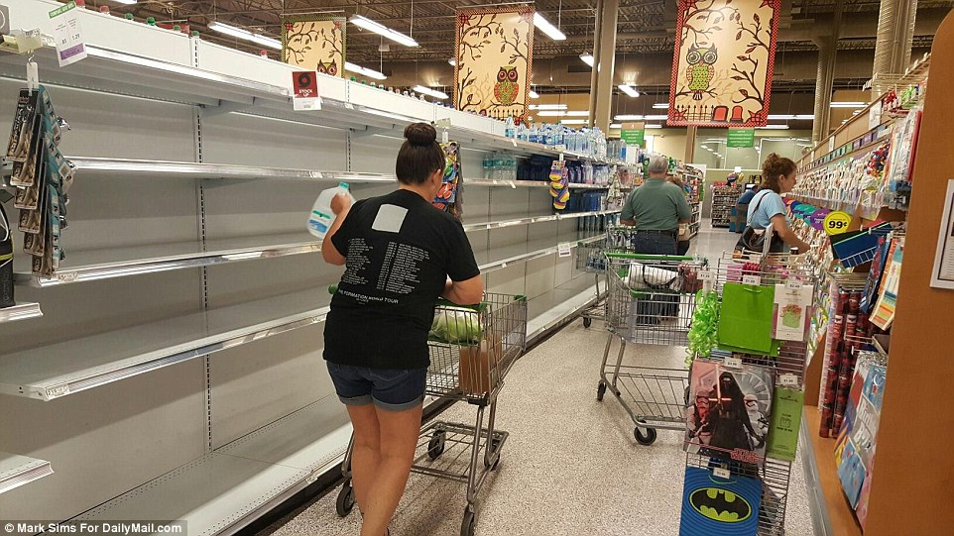
Future of RFID
Retail Inventory and Shelf Management
Individual items on store shelves tagged with RFID’s can be tracked and managed in real-time.
Certain jobs can be eliminated
Application can be setup to send notification at certain levels
When shelf items are getting low, issue re-stock alert.
When inventory is getting low, issue order alert.

Slide 11
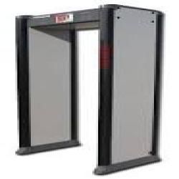
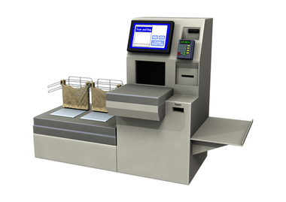
Future of RFID
Customer check-out
The next level of self-service checkout
Customers can walk their cart with items tagged with RFID’s through a scanner.
Items will be listed on the bagging and payment counter.
Cashiers can be removed and replaced.

Slide 12
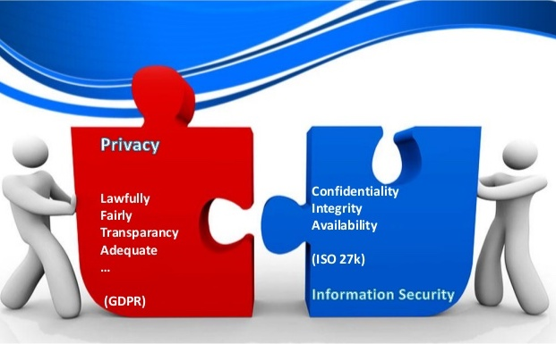
Security vs. Privacy
Data Security
The confidentiality, availability, and integrity of data
All the practices and processes that are in place to ensure data isn't being used or accessed by unauthorized individuals or parties.
Ensures that the data is accurate and reliable and is available when those with authorized access need it
Data Privacy
Defined as the appropriate use of data
When companies and merchants use data or information that is provided or entrusted to them, the data should be used according to the agreed purposes

Slide 13
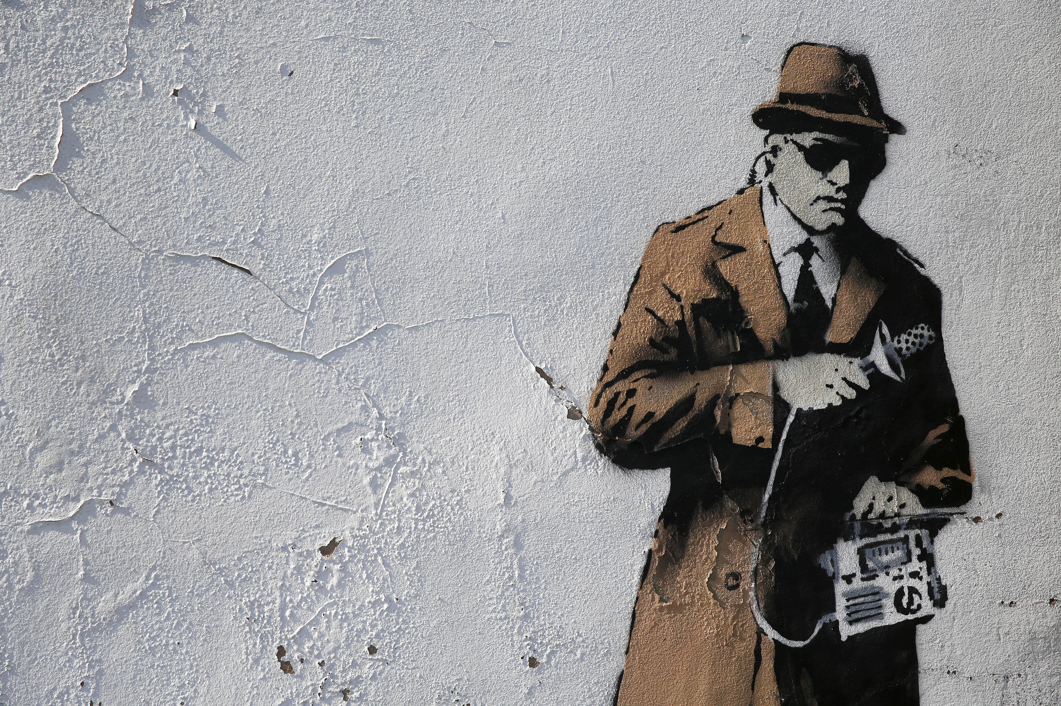
Security Risks
Eavesdropping
Occurs when an unauthorized RFID reader listens to conversations between a tag and reader then obtains important data about customers and organizations
Industrial espionage :
A store labeled inventory may be monitored by competitors conducting secretive scans→ Sales data may be gleaned by correlating changes over time
A competitor capable of reading tags in shops or warehouses can gather business intelligence regarding the turnover rate of stocks, the shopping patterns of customers etc.
Somebody could derive sales, inventory data and offer his services to business adversary as a corporate spy
Notes:
The idea is Radio signals transmitted from the tag, and the reader, can be detected several meters away by other radio receivers. It is possible therefore for an unauthorized user to gain access to the data contained in RFID tags if legitimate transmissions are not properly protected. Any person who has their own RFID reader may interrogate tags lacking adequate access controls, and eavesdrop on tag contents.

Slide 14
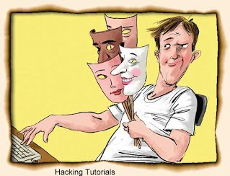
Security Risks
Spoofing
Attacker masquerades as a legitimate user of the system.
The attacker can pose himself as an authorized user.
If successful → attacker gets access to the system with his spoofed credentials→ possibility to respond to invalid requests, change RFID id, deny normal service or even write malicious code in the system.
Theft:
By spoofing valid tags, a thief could fool automated checkout or security systems into thinking a product is still on a shelf.
Alternatively, a thief could rewrite or replace tags on expensive items with spoofed data from cheaper items.
Saboteurs could disrupt supply chains by disabling or corrupting a large batch of tags

Slide 15
Security Risks
Denial of Service
Refers to unauthorized tag disabling.
An attacker causes RFID tags to assume a state from which they can no longer function properly.
→ tags become either temporarily or permanently incapacitated
Example of DOS attacks include:
An attacker kills tags in the supply chain, warehouse, or store → business operations disruption → loss of revenue
A shoplifter can carry a blocker tag that disrupts reader communication to conceal the stolen item
An attacker with powerful reader can jam the reader by creating a more powerful return signal than the signal returned from the tags → system unavailable to authorized users
.

Slide 16
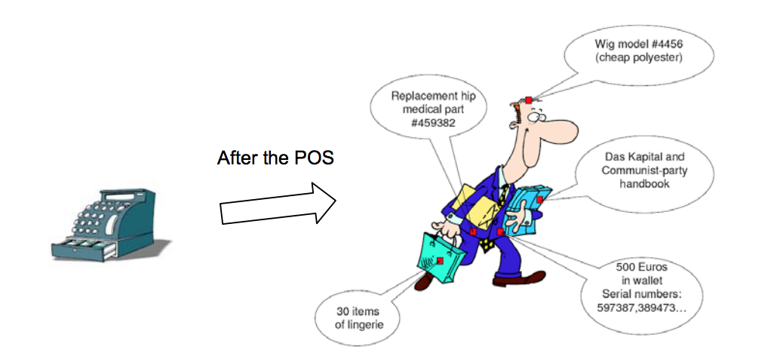
Privacy Risks
Information Leakage
Attackers hack systems to get to users personal information that they do not want to get out through various objects around them.
RFID tags are on everything from credit cards to clothing.
People carry many items that contain RFID tags that they do not know about.
Attacker use radio transmission to get users information when it is being transfer through the frequency from the reader to the main portal.
Everything is being transfer over-the-air between software for communication and those information can be intercepted by hackers.
Notes:
Privacy Risk,
With the growth in technology now a days we are prone to attackers who try to steal our personal information.
Information Leakage,
Attackers can hack systems to get to our personal information that we do not want to get out through objects they we carry on hand.
RFID chips are on many of our belongings now a days that we are un aware about.
Some examples are the credit card we carry in our wallet contains an RFID chip and the clothing's we wear could contain chips. We constantly being monitor without knowing it.
Attackers could also use radio transmission to get our information while it is being transfer thru the frequency between the reader.
Everything is being transfer over-the-air between software for communication and those information can be intercepted by hackers.

Slide 17
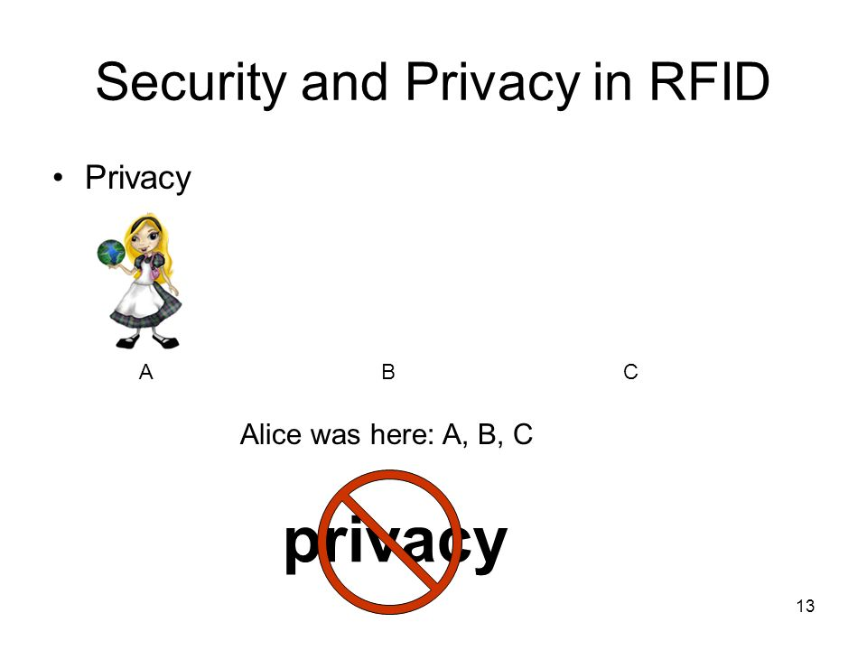
Privacy Risks
Traceability
Individuals can be track by their RFID tags when passing through a tag reader location.
Examples: Credit Cards, Labeled clothes, etc
Attackers can hack the system and use the tag reader information to find where users are.
They could also get the following information from users through the reader:
Track movements
Social interactions
Financial transactions
Notes:
Traceability is the next risk,
We are constantly being monitor with the growth of new technology being introduced.
We can now be track by the RFID chips when passing thru a reader and not be aware of it,
Attackers can trace where we are everytime we pass one of the readers and know how long we been there for example a clothing store, we walk by the reader on the way in and it captures the RFID chip and if an attacker hack that reader they could know that we were there.
They could also use the reader to get the following informaiton on us
Trace movements,
Social interactions
Financial transactions
All of these can be race by our RFID chip.
These are the privacy risk

Slide 18
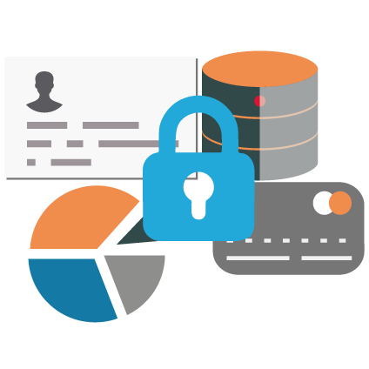
Security Controls
Eavesdropping or Skimming
Establish a secure channel and/or encrypting the communication between tag and reader
Write the tag with enough information to identify the object. The identity is used to look up relevant information about the object in a back end database, thus requiring the attacker to have access to both the tag and the database to succeed in the attack
Spoofing
Implement an RFID authentication protocol and data encryption (Authentication of the “Author”) ⇒ The author or owner of the tag encrypts the tag data with his own private key
Reader protection⇒ Readers can reject tag replies with anomalies in response times or signal power levels which don’t match the physical properties of tags
Password protection⇒ Passwords can be used to protect tag data, preventing tags from being read without the original owner’s permission
Password changes after every use

Slide 19
Security Controls
Denial of Service
Detective controls:
Detect tags whose transmission exceeds a predefined volume⇒ block them
Detach tags from the targeted items

Slide 20
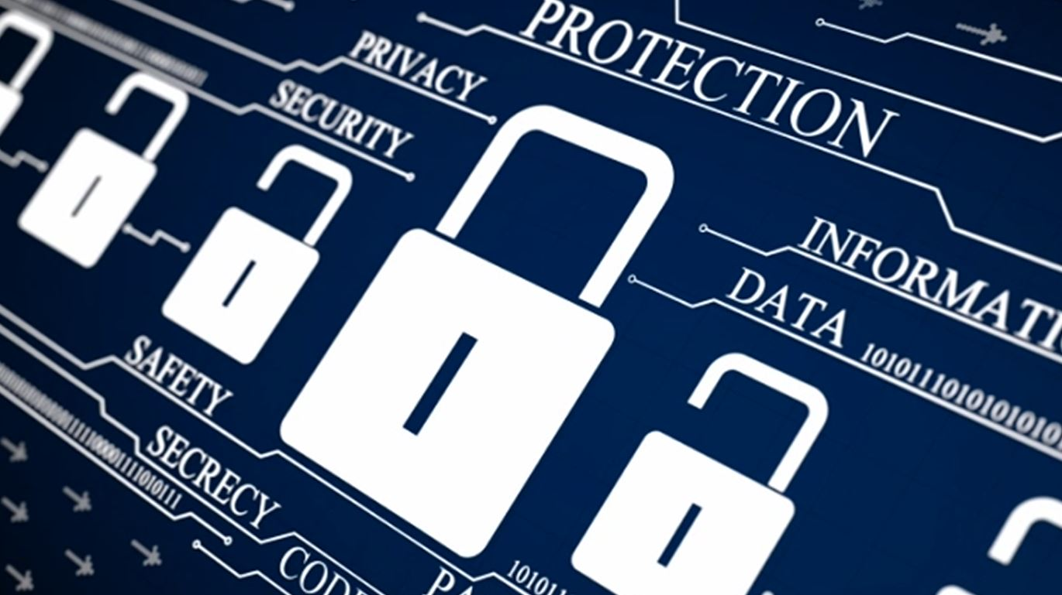
Privacy Controls
Information Leakage
Active Jamming⇒ refers to the use of a device that actively broadcasts radio signals in order to disrupt the operation of any nearby RFID readers
Reduce working range⇒ reduce minimal distance useful for an interaction by removing a portion of the tag antenna
Block tag
Wallet with RFID blockers
Use materials (Faraday cage or Tyvek) impenetrable to radio-frequency waves
Traceability
Kill tag⇒ kill command with kill password
Deactivate tag by making it impossible to read

Slide 21
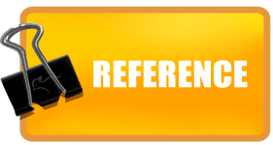
http://www.technovelgy.com/ct/Technology-Article.asp?ArtNum=4
http://www.cbsnews.com/news/protect-credit-cards-from-wireless-theft/
https://us.norton.com/yoursecurityresource/detail.jsp?aid=rfid
http://www.infosec.gov.hk/english/technical/files/rfid.pdf
https://ec.europa.eu/jrc/sites/jrcsh/files/jrc78156_report_rfid_en.pdf

Slide 22
