Slide 1
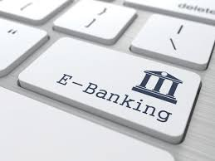
Mobile payment/ Internet banking
Jianhui Chen
Ming Hu
Abhay Kshirsagar
Ariana Levinson
Victoria A. Johnson
Binu Anna Eapen

Slide 2
Agenda
Background: history, trending, current and future application ---Jianhui Chen
Risk associated with mobile payment/ internet banking
Security risk and key control-- Ming Hu
Reputational risk and key control--Abhay Kshirsagar
Compliance and key control--Ariana Levinson
Money Laundering risk and key control--Victoria A. Johnson
Operational risk and key control--Binu Anna Eapen
Residual risk-Jianhui Chen

Slide 3
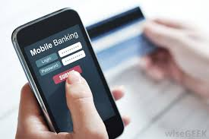
Background
Internet banking refers to systems that enable bank customers to access accounts and general information on bank products and services through a personal computer (PC) or other intelligent devices.

Slide 4
History (Timeline)
1983- Bank of Scotland offers Nottingham Building Society customers the first internet banking services in the UK and call it “Home Links”
1994- Online banking is built into Microsoft Money personal finance software. 100,000 household begins access bank accounts online.
2001-19 million households are accessing bank accounts online
2005-FFIEC begins to announces rules and regulation for online banking regarding customers awareness programs and security measures
Direct Bank begins to offer their services primarily online: ING Direct, PC Financial, First Direct, HSBC Direct, and eTrade Direct.

Slide 5
History (Timeline)
Direct Bank begins to offer their services primarily online: ING Direct, PC Financial, First Direct, HSBC Direct, and eTrade Direct.
2007- Apple launches iPhone and a shift from banking via PC to via smartphone begins
2009- 54 million house are accessing bank accounts online
2012- Patco falls to a keyloggers and many fraudulents are made. Bank is able to block some transfer but not all. Court ruled bank provided reasonable protections. This decision was overturned and full of amount was paid back.
2015- the increase in mobile banking usage has reduced the need for bank branches, and more than 1600 branches shut down

Slide 6
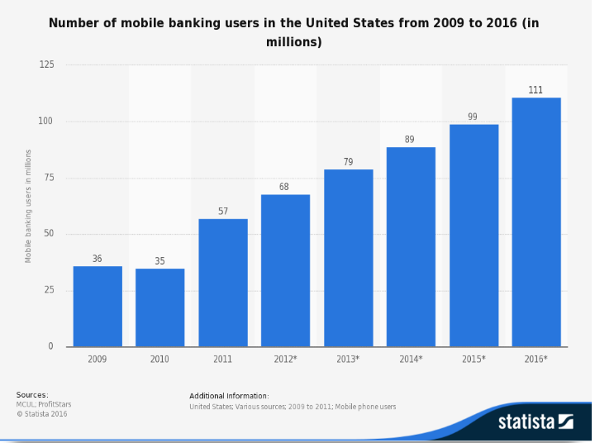

Slide 7
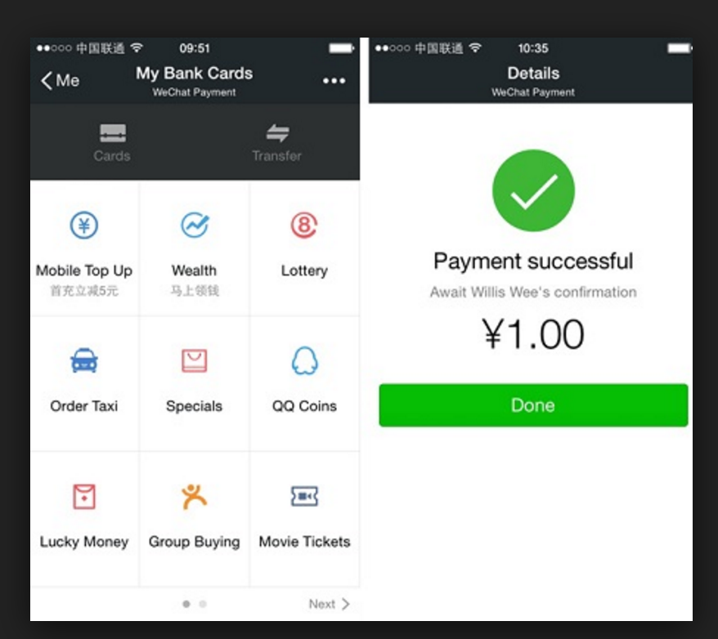
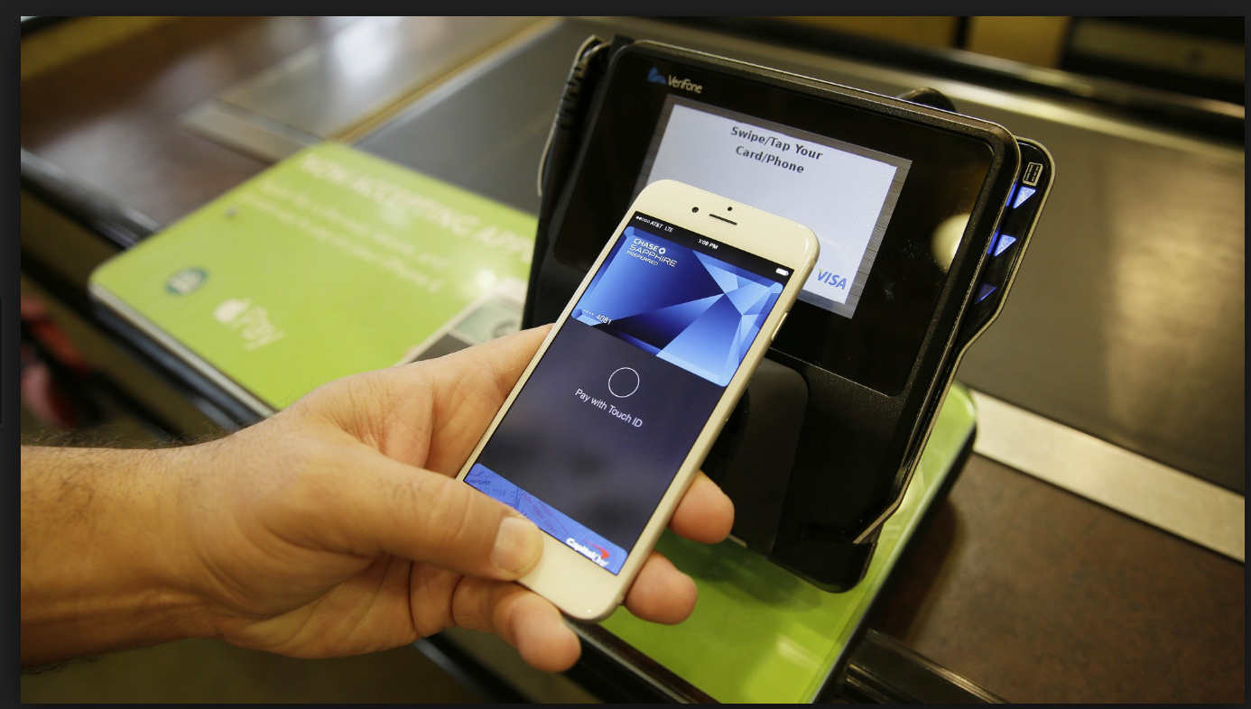
Trending
An opportunity for the growth and promotion of internet banking/ mobile payment lies in chip-enabled EMV cards, as both store staff and consumers can become frustrated by how long it takes to complete a transaction with an EMV card — creating an opportunity to promote the speed of mobile payment services such as Apple Pay, Samsung Pay, and something others.

Slide 8
Security Risk
A major challenge for the adoption of mobile banking is the perception of insecurity.
In the survey conducted by the Federal Reserve 2016, 73% consumers with mobile phone and bank accounts who don’t use mobile banking is that they concerned about security

Slide 9
Security Risk
Mobile devices have a smaller form factor and therefore are more susceptible to loss or theft
Mobile devices are more personal and therefore there’s a tendency for users to store personal and sensitive information
Security controls and tools available have not matured adequately

Slide 10
Security Risk
Mobile devices are susceptible for loss or theft | Implementation of remote wipe, passcode and automatic lock out Customer education
Users more likely to store personal and sensitive information on mobile device | Device encryption Ensure apps don’t store customer sensitive data
Malware | Don’t download apps from untrusted sources Don’t jailbreak your cellphone Mobile malware detection tools
SMS vulnerabilities | Don’t use SMS as a channel for money movement or any other high risk transactions

Slide 11
Security Risk
Hardware and OS vulnerabilities | Ensure that software updates are being pushed to devices
Privacy violation | Internal and external audit Security testing of apps and data handling
Wireless carrier infrastructure | Vet the security of the carrier infrastructure and services Don’t use mobile banking on public Wi-Fi
SMS vulnerabilities | Don’t use SMS as a channel for money movement or any other high risk transactions

Slide 12
Reputational Risk
Meaning: “Risk to income and investment caused by unenthusiastic public view”
Examples:
Data security breaches in the bank's computer system, which houses sensitive financial data of hundreds of thousands of customers
An unethical board member who leaks confidential information to a family member just days prior to a major announcement of a company acquisition
Noncompliance with and violations of laws could lead to issuance of civil money penalties, if published in the local or national media and could ultimately tarnish the bank's image.
Other factors: bad customer service or costly lawsuits and litigation
Notes:
It is the Greatest threat to a company's market value
The public can also mistakenly interpret certain data, affecting its view of an institution.
Other factors like bad customer service or costly lawsuits and litigation could all bring an organization's reputation spiraling downward

Slide 13
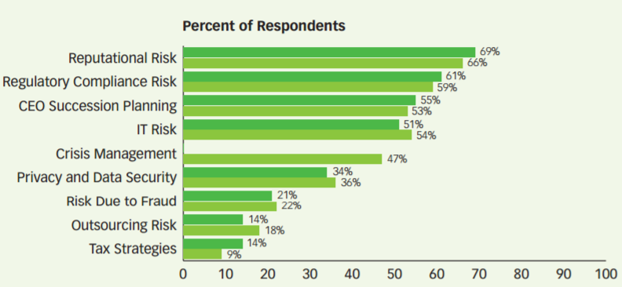
Reputational Risk
Damage to reputation and/or brand has moved up to No. 4 from No. 6 among the Top 10 risks identified in Aon’s 2014 Global Risk Management Risk Ranking.
Question to EisenAmper’s third annual Board of Directors survey:
“aside financial risk, which of the following areas of risk management is most important to your boards?”
Reputational risk was of the highest concern.
Notes:
EisnerAmper LLP’s, USA third annual Board of Directors survey was designed to gain insight into the risks being discussed in American boardrooms. In response to a question, “aside financial risk, which of the following areas of risk management is most important to your boards?” A majority responded that reputational risk is of the highest concern to them

Slide 14
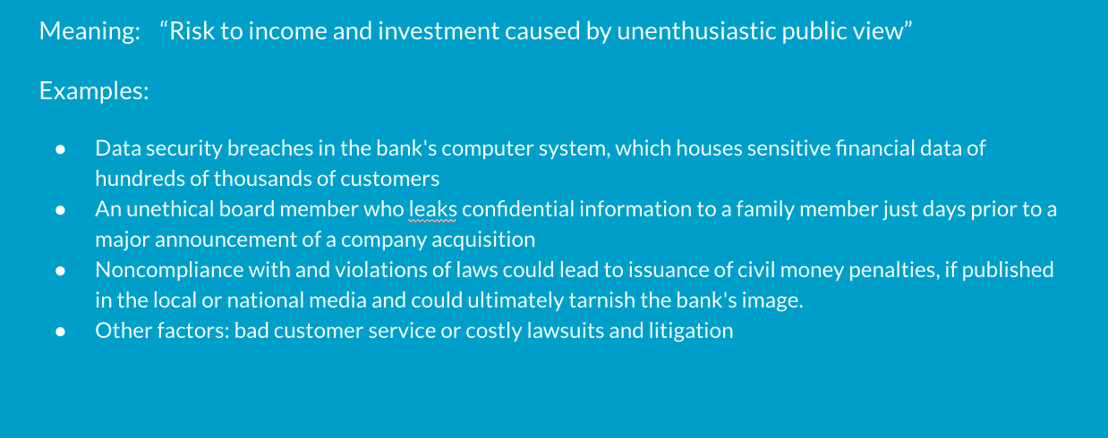
Managing Reputational Risk
Notes:
Preserving a strong reputation revolves around effectively communicating and building solid relationships. Communication between a bank and its stakeholders can be the foundation for a strong reputation.
Timely and accurate financial reports, informative newsletters, and excellent customer service are important tools for reinforcing a bank's credibility and obtaining the trust of its stakeholders.
Reputational risk is managed through strong corporate governance. Setting a tone of strong corporate governance starts at the top; an institution's board of directors and senior management should actively support reputational risk awareness by demanding accurate and timely management information.

Slide 15
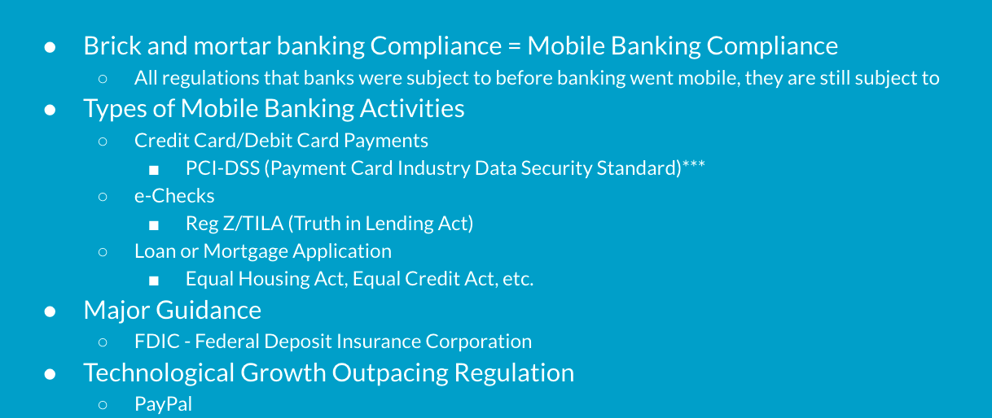
Compliance
Notes:
Many of the regulations that banks must adhere to when it comes to mobile banking are the same ones they must follow for regular banking. The trick comes in making sure the mobile systems are supportive of those regulations i.e. your method of credit card payment via mobile is PCI complient as it would be walking into a bank.
The FDIC has issued guidance on mobile banking security and a list of recommended security controls, however as of right now there is no official legal standard that applies only to mobile payments.
PayPal is a company that acts like a bank but isn’t a bank and is not subject to the same types of regulations that banks are. Technology is outpacing regulation

Slide 16
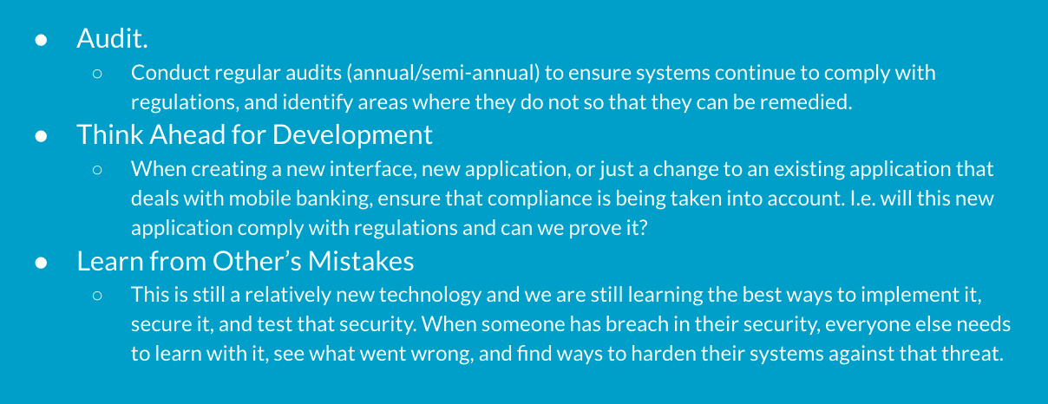
Staying Ahead of Compliance

Slide 17
Money Laundering Risks
Causes: Money laundering is the practice of engaging in financial transactions in order to conceal the identity, source, and/or destination of money.
Banks face these money laundering risks:
Placement - placing through deposits or other means, unlawful proceeds into a financial system.
Layering - separating proceeds of criminal activity from their origin through the use of layers of complex financial transactions.
Integration - using additional transactions to create the appearance of legality through the purpose of assets.
Notes:
This slide was completed by Victoria Johnson.

Slide 18
Controls - Money Laundering
Conduct periodic compliance reviews
Development of audit trails
Frame policies and procedures to spot and report suspicious activities
Notes:
This slide was completed by Victoria Johnson.

Slide 19
Operational Risk
Operational risk is the risk of incurring financial loss due to human or technical errors and fraud. Operational Risk is Enterprise Wide
Causes: Operational Risk arises from fraud, processing errors, system disruption, and other unanticipated events which result in the organization’s inability to deliver product or services.
Banks face mainly 3 types of Operational Risks:
Volume forecasting
Management of Information Systems
Outsourcing

Slide 20
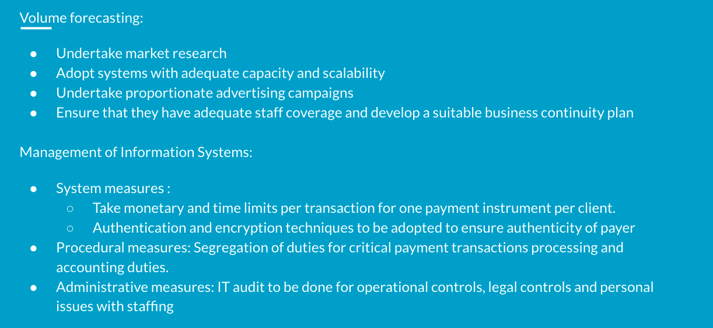
Controls

Slide 22
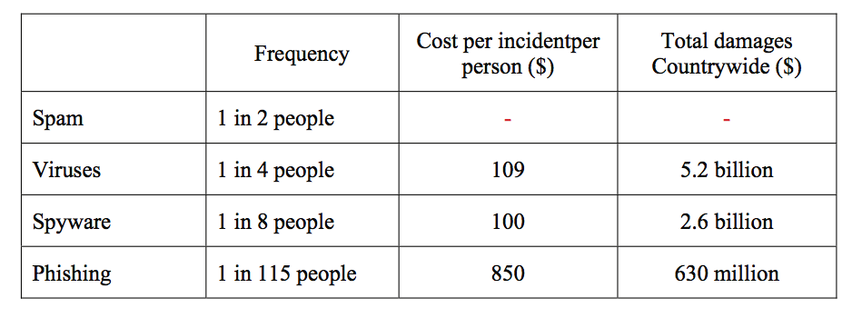
Residual Risk
Phishing was one of the nine most common online frauds concerning the banks and financial institutions of the developed world.
The balance between the security of an online transaction and convenience.

Slide 23
Thanks

