Slide 1
Wells Fargo Identity theft incident
Vu Do
Yang Li Kang
Deepali Kochhar
Said Ouedraogo
Alexandra Adje

Slide 2
Background
Background
Issues
Root Cause
Impact
Control
Recommendations
Wells Fargo - Financial Services Company
Headquarter in San Francisco, CA
Founded March 18, 1852
Provide service in banking, mortgage, investing, credit card, insurance, and consumer and commercial financial services.

Slide 3
Issues
Agenda
Background
Background
Issues
Issues
Root Cause
Root Cause
Impact
Impact
Control
Recommendations
Recommendations
Managers hound employees to meet unreachable quotas
Employees had access to customer’s personal information
Employees subscribed customers to products
Forge Data
Enroll into Online Banking & Bill-Paying products
Open credit card account
Receive compensation for each new enrollment
2 million ghost deposit & credit card accounts were opened
Drove customer to purchase identity theft protection
Fired 5,300 employees link to the scandal

Slide 4
Root Cause: Unreasonable corporate expectations
Agenda
Background
Background
Issues
Issues
Root Cause
Root Cause
Impact
Impact
Control
Recommendations
Recommendations
Banks turned into “stores”
→ Customers seen as potential upsell opportunities
Number of daily meeting between managers and bankers doubled
→ pressure to have new sales to report very hours
Bad sales were punished with:
→ forced attendance at 7 a.m. conference calls
→ several hours of cold-calling random people after the close of business
Bankers encouraged to sell to friends and family as perfect strategy to meet sales goal
→ even low credit profile customers were pushed to apply for credit card
Notes:
Unreasonable corporate expectations pushed employees to break the rules

Slide 5
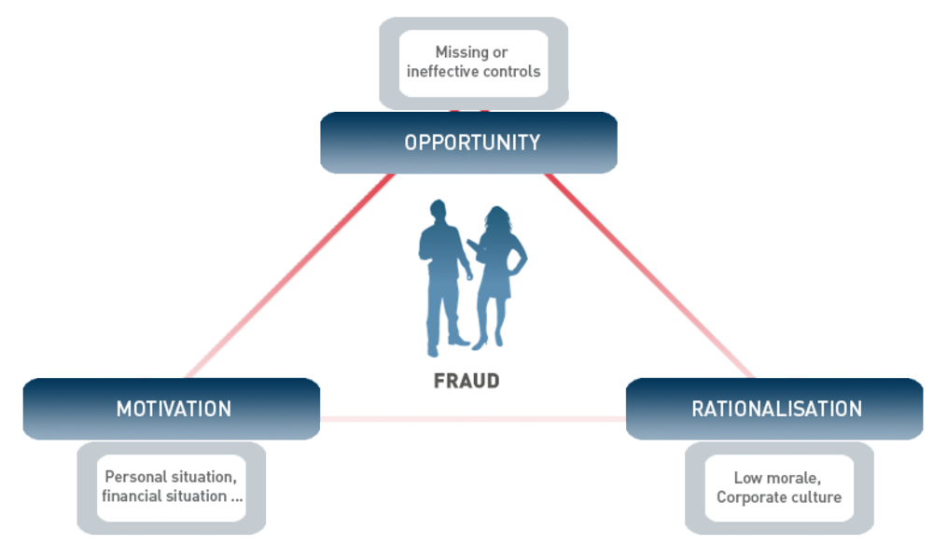
Triangle Fraud
Agenda
Background
Background
Issues
Issues
Root Cause
Root Cause
Impact
Impact
Control
Recommendations
Recommendations
Opportunity: salespersons have access and monitor customers accounts
Motivation: meet sales goals or get fired
Rationalization: It is normal, managers approve it (Corporate culture)

Slide 6
Impact
Agenda
Background
Background
Issues
Issues
Root Cause
Root Cause
Impact
Impact
Control
Recommendations
Recommendations
CUSTOMER LOSS
California suspended ties with Wells Fargo for at least a year
FINANCIAL LOSS
Wells Fargo is fined $185 million for opening unauthorized accounts between 2011 and 2015
Wells Fargo can lose an estimated $99 billion in deposits and $4 billion in revenue over the next 18 months
Customers can flee as a result of loss of trust
BUSINESS LOSS
Number of credit card application fell by 30 percent and new opening account checking balance fell by 25 percent

Slide 7
Apology
Agenda
Background
Background
Issues
Issues
Root Cause
Root Cause
Impact
Impact
Control
Recommendations
Recommendations
https://www.youtube.com/watch?v=mn0ZopfoKNY

Slide 8
Background
Issues
Root Cause
Impact
Control
Recommendations
Ignoring Warning
Ignoring and punishing employees who reported the fraud
As far back as 2005, multiple employees have reported the fraudulent activities either to their supervisors or anonymously through the EthicsLine.
Multiple employees who reported the issue was terminated.
Supervisors who knew about the complaint did nothing.
“Boiler Room” mentality was widespread and long-term as part of Wells Fargo’s culture.
Notes:
http://fortune.com/2016/10/12/wells-fargo-fake-accounts-scandal/

Slide 9
Background
Issues
Root Cause
Impact
Control
Recommendations
Lack of Control
SEC failed to enforce disclosure requirements
Purpose of SEC’s corporate disclosure is to forewarn investors about major issues that could affect a company’s well-being.
SEC allowed Wells Fargo to exclude shareholder proposals from New York’s comptroller which would have provided investors with information on the risky business behaviour of sales incentive bonuses.
Wells Fargo CEO John Stumpf and his four top lieutenants’ large bonuses tied to sales measures.
Notes:
http://fortune.com/2016/10/18/wells-fargo-sec-john-stumpf/

Slide 10
Background
Issues
Root Cause
Impact
Control
Recommendations
Strict Control of Sales Quota
“Gr-eight initiative”
Add-on eight products per household.
Wells Fargo regional managers gave their branch offices daily quotas to “cross-sell” financial products to existing customers.
Employees who missed sales quotas would have to work weekends, stay late to catch up and also threatened with firing.
Huge enforcement of meeting quotas but not how quotas are met.
Notes:
http://www.thefiscaltimes.com/Columns/2016/09/13/Real-Scandal-Wells-Fargo-Execs-Got-Rich-Sandbagging-Clients

Slide 11
Recommendations
Eliminate product sales goals (root cause)
Implement new metrics to measure employee effort and rebuild trust
Audit committee that will rewiew customers accounts on a quarterly based
Check customer account for irregularities
Take a closer look to dormant accounts
Send a confirmation letter to customers when they open new accounts
Daily new accounts summary report send to manager
Reinforce bank EthicsLine
Agenda
Background
Background
Issues
Issues
Root Cause
Root Cause
Impact
Impact
Control
Recommendations
Recommendations

Slide 12
Any Questions?
Thank you!

