Slide 1
Sony Pictures
2014 Data Breach
Tamer Tayea | Paul M. Dooley | Ian M. Johnson | Joshua Tarlow | Wenlin Zhou

Slide 2
Background
100 terabytes of data (unconfirmed)
Destroyed 3,000 computers
Network offline for one week
Leaked
Sensitive data
Films: In theatres & unreleased
Film & TV show scripts
Emails
Theatrical release of The Interview canceled

Slide 3
Timeline
November 21:
Email threatening Sony Pictures
November 24:
Employees locked out of computers
Attackers threaten to release data if demands were not met by a deadline of 11:00 PM
Demands not clear
November 27:
5 unfinished films leaked
December 1
First document leak
47,426 unique Social Security Numbers (SSN)

Slide 4
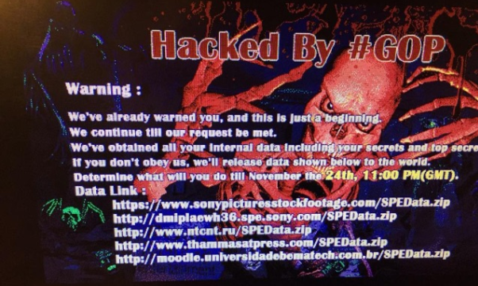

Slide 5
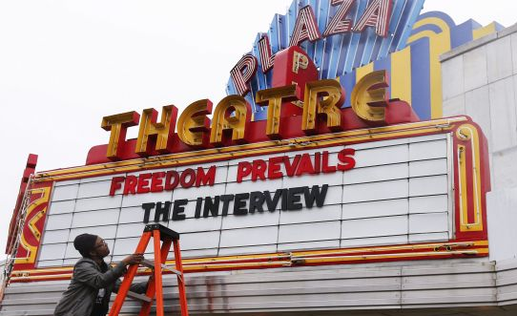
Timeline
December 3:
Second Document Leak
Contained: Full security certificate information, internal/external account credentials, authentication credentials
December 8
Hackers demand Sony cancel The Interview release
Threaten terrorism
December 9
Sony Executives’ email boxes leaked
Included embarrassing information
December 19
US blames North Korea for attack

Slide 6
Christmas Eve DDoS Attack
PlayStation & Xbox networks brought down by DDoS attack
“Lizard Squad” claimed responsibility
Allegedly sold Sony username/passwords to Guardians of the Peace
“Finest Squad” hacked Lizard Squad to assist law enforcement
Kim Dotcom brokered a truce between Finest Squad and Lizard Squad
Offered 300,000 in MegaUpload credits to end the attack
Upset because he could not play Destiny

Slide 7
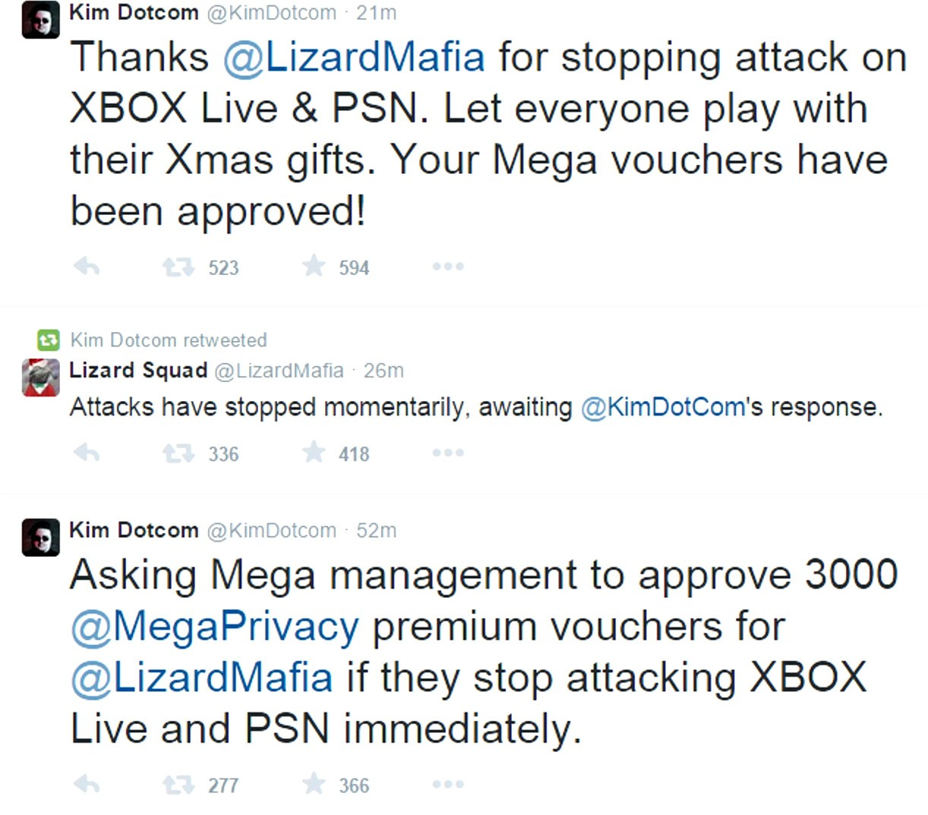
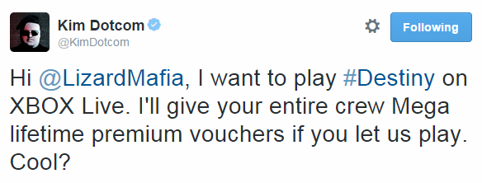

Slide 8
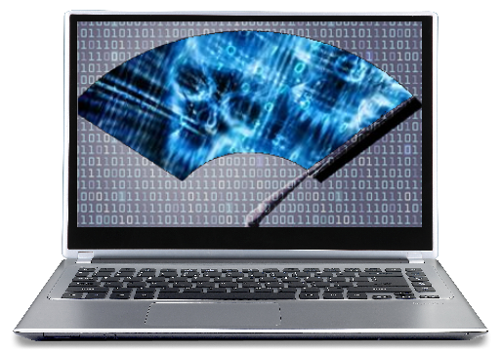
How?
Stole credential from a system administrator
Planted “Wiper” malware on network
Malware designed to destroy data
Used to collect data instead
Used Microsoft Windows Management and Network file-sharing to spread through the network
Malware then transmitted information back to hackers

Slide 9
Root Causes - Culture
Business operated in silos
Few improvements from 2011 attack
Movie studio isolated
Lack of InfoSec training
11 employees on information security team
Jason Spaltro 2007 Interview
“valid business decision to accept the risk of a security breach”
Would not invest "$10 million to avoid a possible $1 million loss“
Executive Director of Information Security

Slide 10
Root Causes - Security
Weak passwords: "12345," "ABCDE" and "password“
Passwords sometimes not used
Encryption not used for sensitive data
Plaintext documents: PII and Payroll
Improper Filenames
“Usernames&Passwords”

Slide 11
Who?
Guardians of Peace claimed responsibility
United States concluded North Korea was responsible
Reused code from a previous North Korean attack
Mostly circumstantial evidence
Similar encryption algorithms, data deletion methods, IP addresses
DarkSeoul: hackers associated with North Korea

Slide 12
Why?
Still unconfirmed
Possible retaliation for the release of The Interview
Not motivated by
Money
Trade Secrets/Intellectual Property
Espionage/Intelligence
First significant cybercrime on freedom of speech

Slide 13
Business Impact
Sony cancelled the release of The Interview after hackers threatened to attack theaters.
Criticism from Whitehouse, actors, and industry peers
Reputation damage
Resignation of the Sony CEO Amy Pascal
Stock price declined

Slide 14
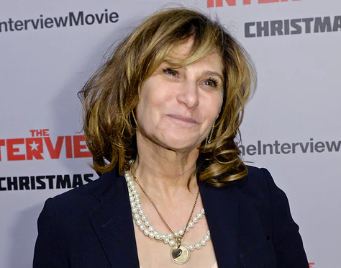
Business Impact
Losses from leaked films estimated at $80 million
Over $100 million in direct losses
Hardware
Investigation
Employee labor
Business Interruption
$30 million loss for The Interview
$8 million to settle employee lawsuit
Amy Pascal

Slide 15
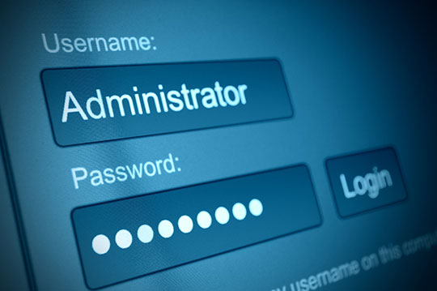
Control Improvements: Access Management
Inventory of Authorized and Unauthorized Devices
Inventory of Authorized and Unauthorized Software
Continuous Vulnerability Assessment and Remediation
Institute application Software Security using RBAC methodology.
Malware Defenses using inside and perimeter network listeners.
Administrative Privileges
Incident Response and Management

Slide 16
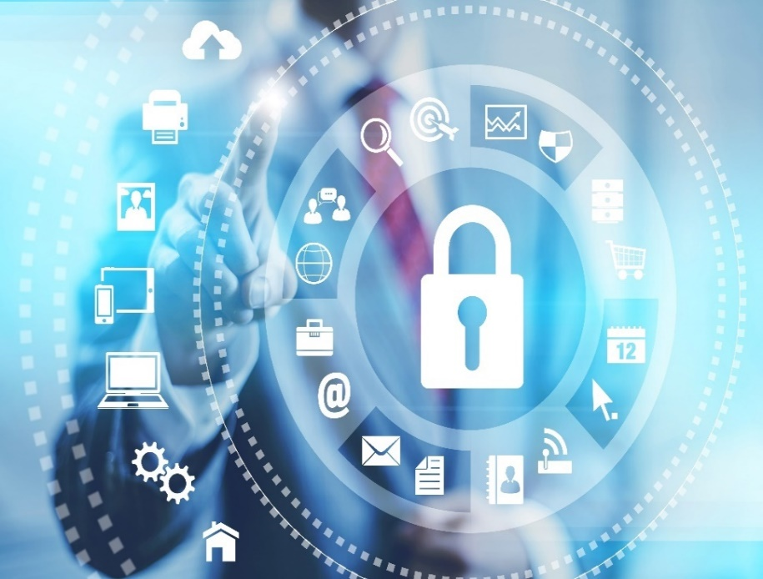
Control Improvements: Audit and Monitor
Implement IPS/IDS/DLP protection to detect account/network anomalous data access patterns .
Monitor computer resource utilization and investigate anomaly (CPU/Memory/Network).
Encourage self-audit capabilities to enable the end user report any anomalies.
Continuous Vulnerability Assessment and Remediation

Slide 17
Control Improvements: Strengthen Infrastructure
Do not allow incoming connections to user’s systems or any backend processing systems. Once Malware controls IT assets, it notifies outside BOT, BOT initiates connection back to the compromised system. (2FA and contextual security)
Solidify Access policy ( Strong password, regularly change password)
Set alerts on suspicious activity or when communicating with unknown IP addresses.
Include more firewalls in the network, if not , take advantage of next-generation firewall.

Slide 18
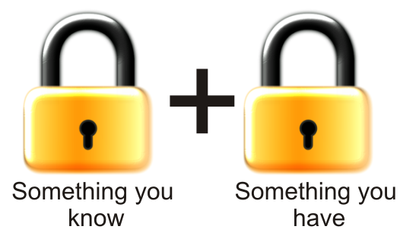
Control Improvements: Strengthen Infrastructure
Use two factor authentication and/or contextual security on critical systems like databases, ERP
Apply data masking which removes sensitive information by applying sophisticated data transformation techniques to non-production environments

Slide 19
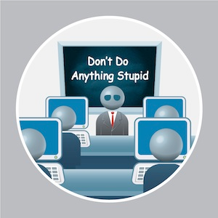
Control Improvements: Security Awareness
Provide regular user awareness training.
Regularly test internal users on phishing attacks (i.e.: send spam emails).
Award those employees who become aware of the risks .

Slide 20
Questions?

