Slide 1

2013 Target Data Breach
Team 4
Annamarie Filippone | Daniel Min | Mansi Paun | Sean Walsh | Shizhong Yang

Slide 2
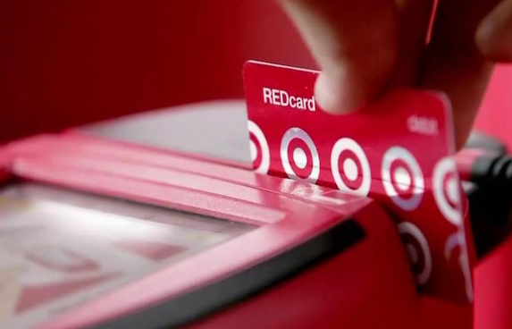

AGENDA
What happened?
How did it happen?
What were the consequences?
How could it have been prevented?

Slide 3
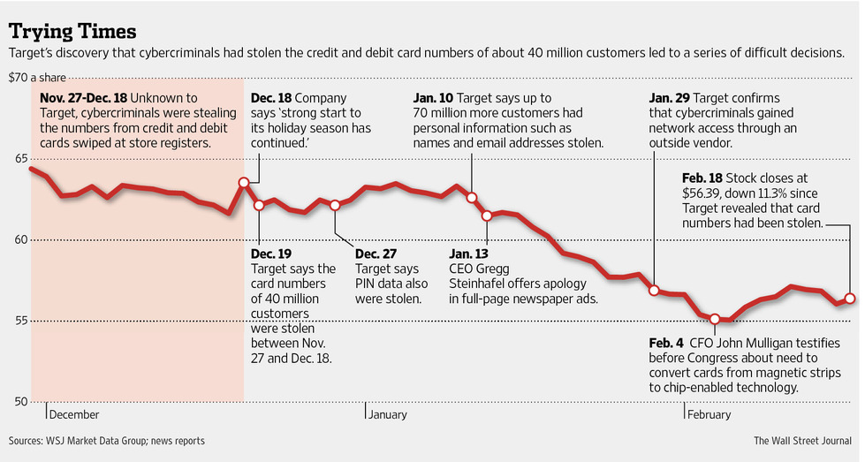
TIMELINE
Notes:
1. What happened?
a. Timeline of events (source #1)
i. Nov. 27th to Dec. 18th 2013 – Customer data stolen of 40 million customers (PII, CC#’s, DC#’s, etc.)
ii. Dec. 13th, 2013 – Target executives meet with DOJ (DOJ tells Target they’ve had their data stolen)
iii. Dec. 14th, 2013 – Target hires 3rd party forensics team.
iv. Dec. 15th, 2013 – Target confirms data has been stolen, and removes malware used from practically all POS devices.
v. Dec. 18th, 2013 – Security Industry blogger breaks story about Target breach
vi. Dec. 19th, 2013 – Target informs public about the hack of customer data. Does not suggest PIN #’s have been compromised.
vii. Dec. 27th, 2013 – 3rd party forensics teams indicates encrypted CC pins may have been accessed, but Target believes they are still secure.
viii. Jan. 10th, 2014 – Target informs public that an additional 70 million customers’ data was stolen.

Slide 4

2013 DATA BREACH
Phishing email sent to Fazio Mechanical
Trojan Malware “Citadel” steals login credentials
SQL Injection attack
Custom malware installed on POS machines
Data sent to middle-man servers to await download
Notes:
1. How did it happen? (source #2)
a. Phishing email sent to employees at Fazio Mechanical (3rd party HVAC vendor for Target) that delivered “Citadel” Trojan malware.
b. Fazio Mechanical’s vendor credentials were the stolen by attackers and used to access Target’s network.
c. Attackers then exploited a web application vulnerability with an SQL injection method of attack.
d. Once the backdoor was created, the attackers took their time conducting reconnaissance to locate the servers they wanted to steal data from.
e. After the servers were located the attackers probably used a “pass-the-hash” attack to steal an Admin access token to use to create a new Admin account.
f. Next 70 million customers PII was stolen, but the servers did not store credit card #’s or associated info so attackers had to go after point-of-sale (POS) machines.
g. Attackers next installed malware onto POS machines to copy all credit and debit card data used for purchases.
h. After copying the data from the POS, the data was then forwarded to servers in America and Brazil to wait for the attackers to retrieve it at their convenience.

Slide 5
EFFECTS OF THE BREACH
Reputational
Lose customer trust and business
Financial
Sales discounts that lower profit margins
Holiday sales fall
Reduced stock price
Costs exceed $300M
$116M spent in settlements
Operational
Layoffs and hiring freeze
CEO resigns
Notes:
a. Target offered 10% discounts immediately after hack disclosed to public to entice shoppers which cost the business profit.
b. Target’s sales fell 3-4% during Christmas holiday period 2013 compared to 2012 while other retailers saw strong increases in sales.
c. Target revised 4th quarter results lower causing drop in stock price.
d. Target lays off almost 500 employees at HQ and around the world while leaving 700 positions unfulfilled within the business.
e. By February 2014, costs had already topped $200M for Target
f. Target commits an additional $100M to update security technology and chip cards and chip readers
g. May 2014, CEO Gregg Steinhafel resigned
h. March 2015, $10M settlement with Target customers for losses
i. August 2015, $67M settlement with Visa for losses
j. December 2015, $39M settlement with MasterCard and other banks for losses

Slide 6
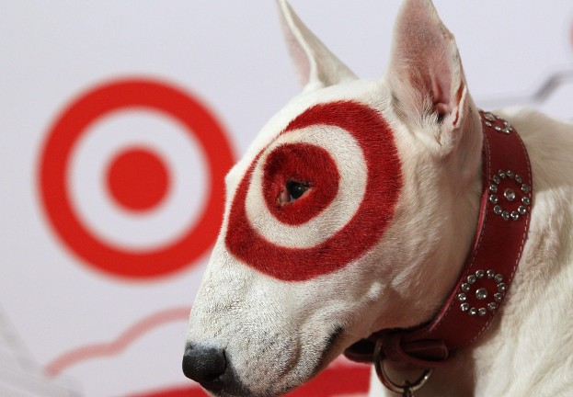
CONCLUSION
3rd party vendor access to network
  What went wrong?
  How to prevent it?
FireEye Security System
  What went wrong?
  How to prevent it?
Security Team Personnel in Bangalore
  What went wrong?
  How to prevent it?
Notes:
a. What Target did wrong? (source #4 and #5)
i. Target allowed 3rd party vendors to access its internal network without proper segmentation as required by PCI standards.
ii. FireEye security system flagged hacker activity as early as Nov 30th 2013, but was not set to intercede.
iii. Security team personnel in Bangalore sent notification of attack to HQ in Minnesota on Nov 30th, 2013, without any action taken.
b. What should Target have done instead?
i. Should have properly segregated networks so the portion of the network 3rd party vendors access would not allow attackers access to other critical networks.
ii. Set FireEye security system to enact corrective intervention techniques and actions when suspicious activity is detected, and not just send notifications.
iii. Take security notifications seriously and treat the notifications as a top-level priority when received.

Slide 7

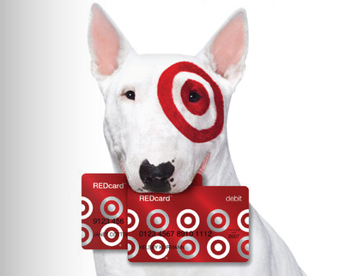
Q&A

Slide 8
WORKS CITED
Clark, Meagan. "Timeline of Target's Data Breach And Aftermath: How Cybertheft Snowballed For The Giant Retailer." International Business Times. IBT Media, Inc., 05 May 2014. Web. 05 Nov. 2016. <http://www.ibtimes.com/timeline-targets-data-breach-aftermath-how-cybertheft-snowballed-giant-retailer-1580056>.
Olavsrud, Thor. "11 Steps Attackers Took to Crack Target." CIO. CXO Media, Inc., 02 Sept. 2014. Web. 05 Nov. 2016. <http://www.cio.com/article/2600345/security0/11-steps-attackers-took-to-crack-target.html>.
Garcia, Ahiza. “Target Settles for $39 Million Over Data Breach.” CNNMoney. Cable News Network, 02 Dec. 2015. Web. 05 Nov. 2016. <http://money.cnn.com/2015/12/02/news/companies/target-data-breach-settlement/>.
Vijayan, Jaikumar. “Target Breach Happened Because of Basic Network Segmentation Error.” Computerworld. Computerworld, Inc., 06 Feb. 2014. Web. 05 Nov. 2016. <http://www.computerworld.com/article/2487425/cybercrime-hacking/target-breach-happened-because-of-a-basic-network-segmentation-error.html>.
Riley, Michael, Benjamin Elgin, Dune Lawrence, and Carol Matlack. “Missed Alarms and 40 Million Stolen Credit Card Numbers: How Target Blew It.” Bloomberg. Bloomberg, L.P., 13 Mar. 2014. Web. 05 Nov. 2016. <http://www.bloomberg.com/news/articles/2014-03-13/target-missed-warnings-in-epic-hack-of-credit-card-data>.

