Slide 1
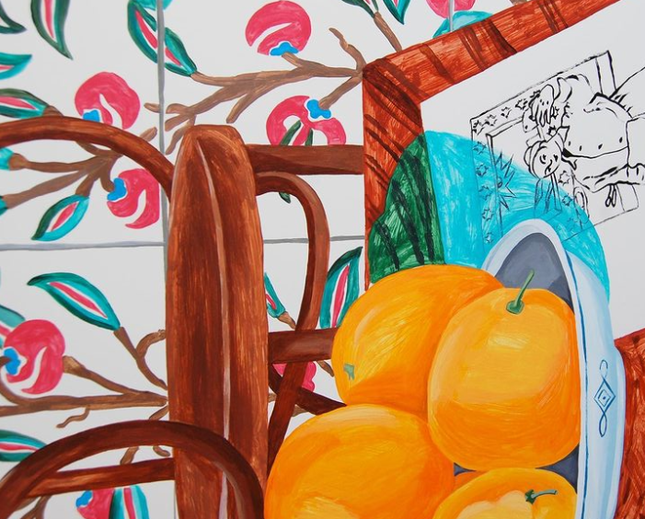
Feb. 23, 2022
—
Cameron Dillon
Jane Kobylinski
Thuy Quynh Nguyen
Mingtao Xia

Slide 2
Agenda:
Company overview
Critique of digital presence
Competitor Analysis
Statement of objectives
New Digital Marketing Strategy
Implementation plan
Overall value to client
Campaign Schedule

Slide 3
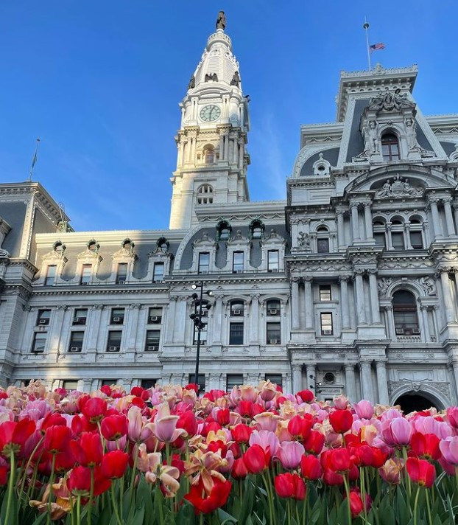
Company Overview

Slide 4
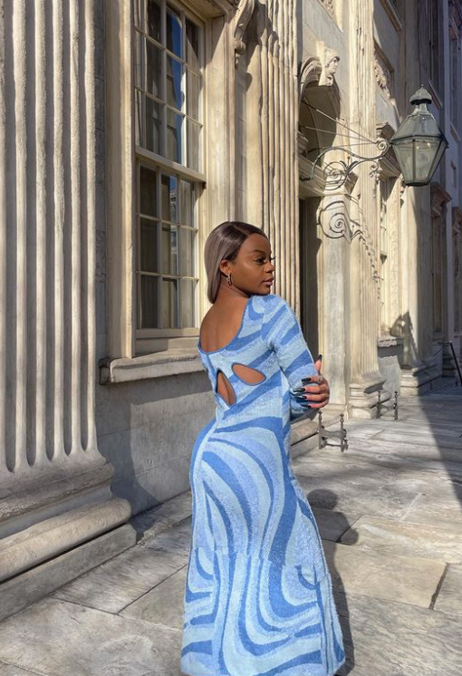
Company Overview
Midnight Lunch is an artistic, carefully curated boutique in Old City Philadelphia
Combines art and fashion
Targets a city-dwelling, young, successful, artistic woman
Challenged by:
Communicating boutique atmosphere online
Keeping up with large scale online retailers

Slide 5
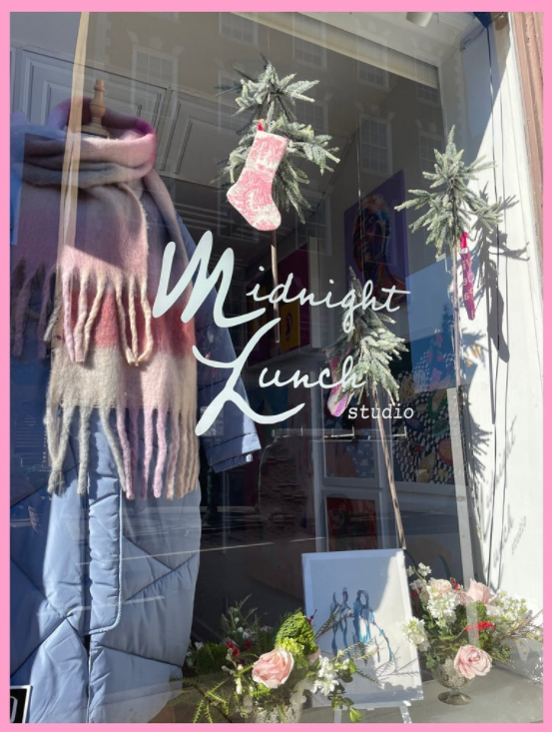
About
Midnight Lunch is an artful boutique selling:
Clothing
Artwork
Homewares
Philosophy:
“Midnight Lunch stands at the intersection of art & fashion to present our consumers with unique & deliberate designs and products”
Brick + mortar location in Old City
20 S 3rd Street, Philadelphia, PA 1916

Slide 6
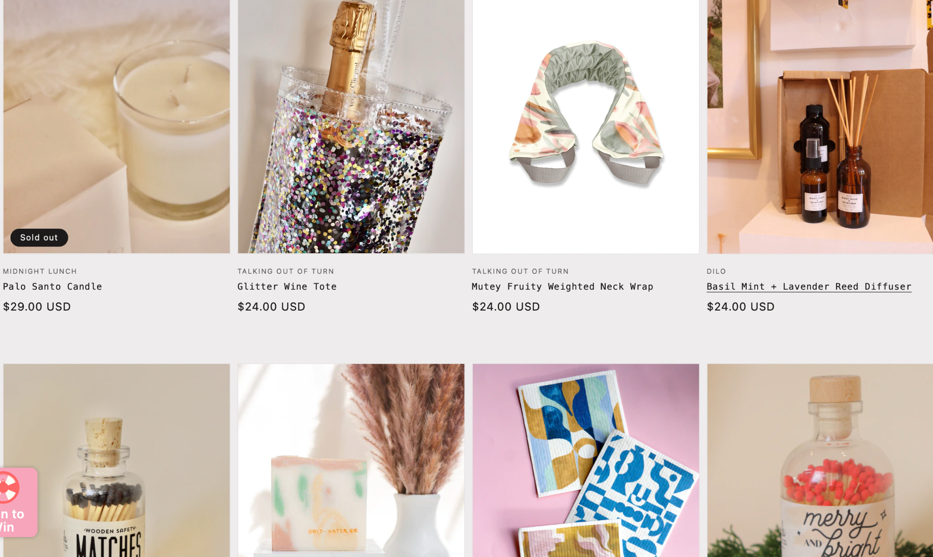
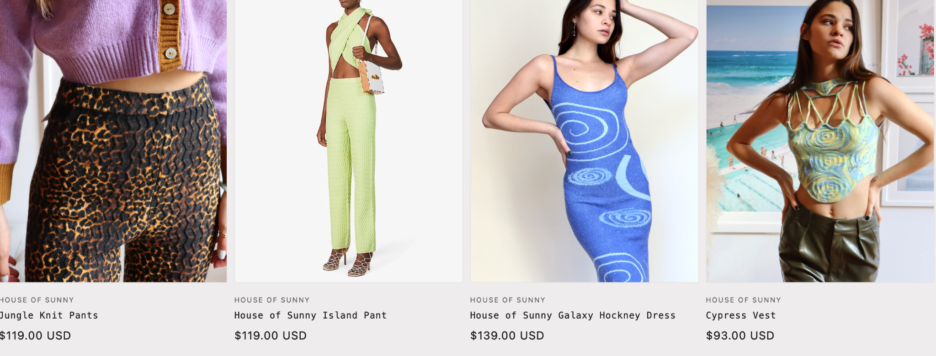
Brand Image
Artistic, modern, sophisticated
Artwork and homewares from emerging artists and makers
Features artfully-curated selection of clothing + accessories from independent labels
Notes:
Midnight Lunch stands at the intersection of art & fashion to present our consumers with unique & deliberate designs and products.

Slide 7
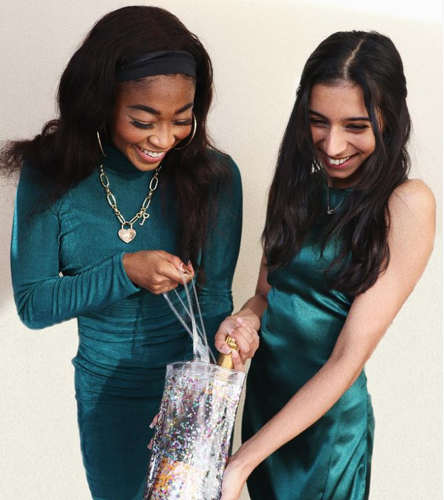
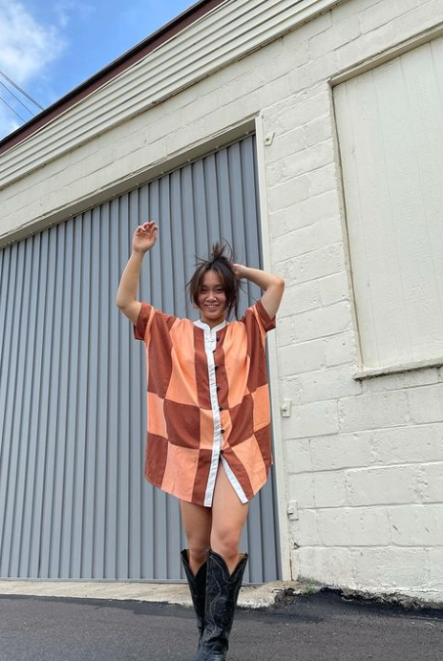
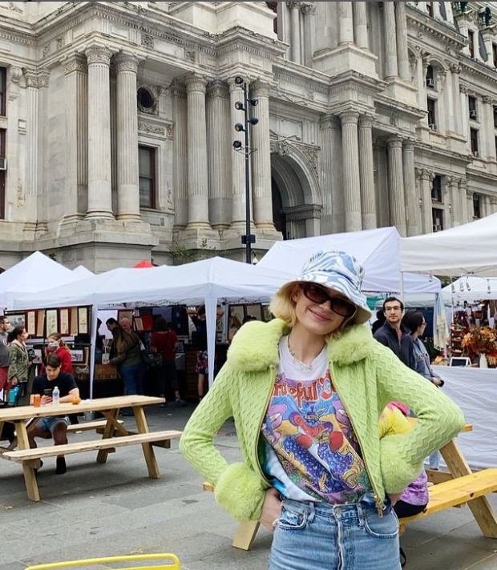
Target Market
Philadelphia Residents
Between 16–29 years old
She attends parties & events
Shoppers who are inspired by vintage patterns, modern and artistic trends
Flamboyant, eccentric dressers
Independent, working women, with disposable income for clothing
Notes:
The stylish city women from their late teens through their late twenties with a mid and mid-upper social class.

Slide 8
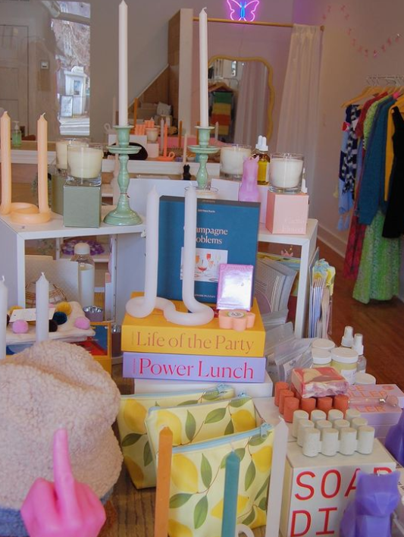
Challenges
Pandemic has caused issues for brick and mortar storefronts
Lack inventory capacity to operate online
Hard to convey quaint atmosphere of the boutique online
Rise of ultra-fast fashion hinders small businesses

Slide 9
Digital
Presence Critique

Slide 10
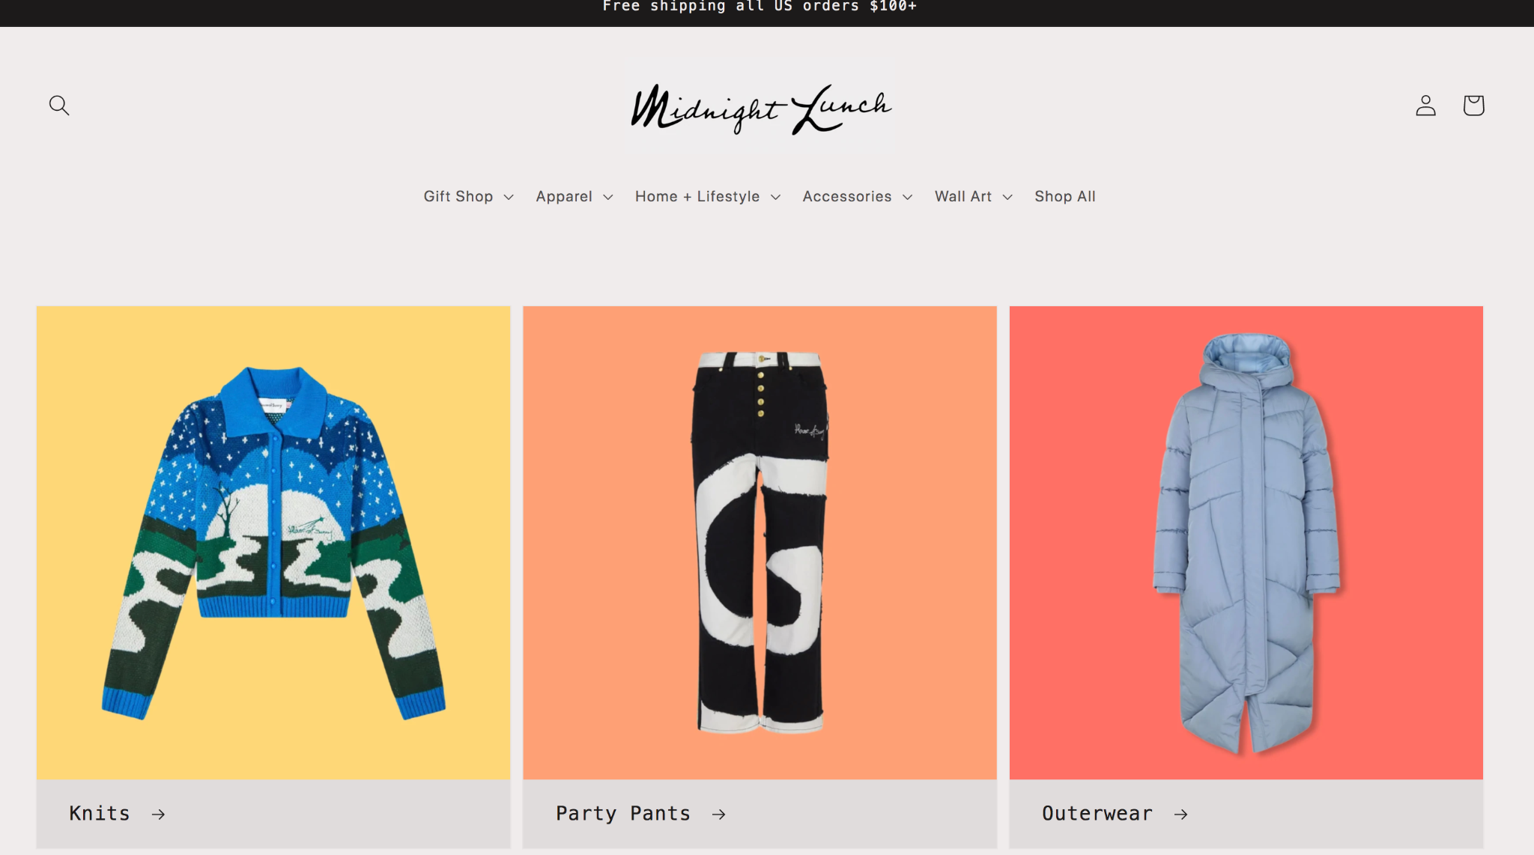
Website - 7 C’s Framework
Context
Aesthetically pleasing set up
Various CTA buttons
Reviews accessible on every page
Product categories displayed across top
Community
Review tab
Does not promote social media on website
Encourages visiting in store

Slide 11
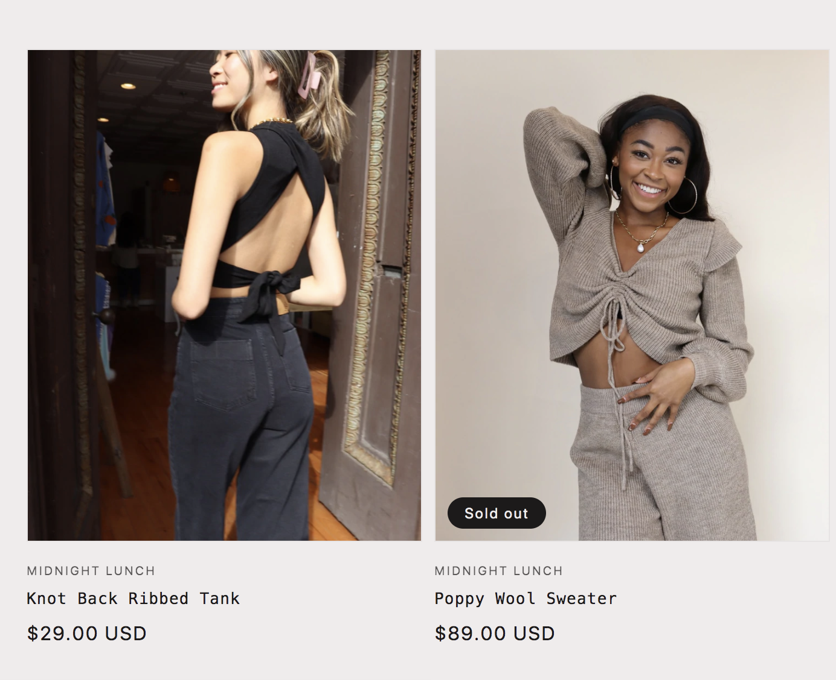
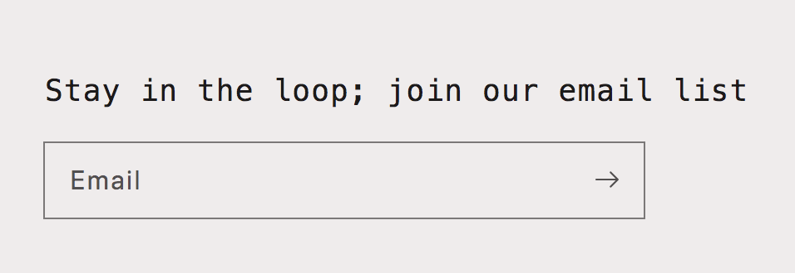
Website - 7 Cs Framework
Content
Inconsistent photo styles
Simple, modern, neutral toned background
Easy to read font
Communication
Encourages through “join our community” pop-up to join email list
Quick links section to contact store & info on shipping & returns

Slide 12
Website - 7 Cs Framework
Connection
Lists “brands we love” but does not provide any links to those sites
Does not facilitate any connection to Philadelphia area boutiques/sellers
Commerce
Heavy focus on in-store commerce
Offers payment plan options, add to cart, and add to wishlist options
Customization
N/A

Slide 13
@abagail.midnightlunch
Views | Highest: 117K Average: 200-300
Likes | Highest: 10.3K Average: 15-30
Comments | 0
Shares | 0
Frequency | 1-3 posts weekly
Followers | 373
Aesthetic content, consistent with brand
Behind the scenes look into boutique
Follows trends
Recommend a change in username
Lacks engagement

Slide 14
@shopmidnightlunch
Aesthetic content, consistent with brand
Showcases clothing and artwork in-store
Promotes in-store events
Posts according to holidays/seasons
Consistent engagement
Followers | 3086
Likes | 45
Comments | <10
Highlights | 11
Frequency | 5-6 posts weekly

Slide 15
What is SEO?
SEO stands for Search Engine Optimization
SEO is a digital marketing tool that improve sites to increase its visibility when people search for products or services related to businesses (especially small businesses) in search engines, like Google.
SEO is crucial because it makes businesses website more visible which means more traffic and more opportunities to convert prospects into customers.

Slide 16
Search Engine Optimization
 | Keywords | Google Search | Bing Search
Accidental Search | 1. Local boutique 2. Women’s fashion 3. Clothing store near me 4. Francesca’s (competing store) 5. Shopping stores near me | 1. >10 2. >10 3. >10 4. >10 5. >10 | 1. >10 2. >10 3. >10 4. >10 5. >10
Intentional Search | 1.Philadelphia boutique 2.Old City clothing boutique 3.Midnight lunch 4.Fine art gallery Old City 5. Boutique on 3rd street Philly | 1. >10 2. >10 3. >10 4. >10 5. >10 | 1. >10 2. >10 3. >10 4. >10 5. >10

Slide 18
Competitor Analysis

Slide 19
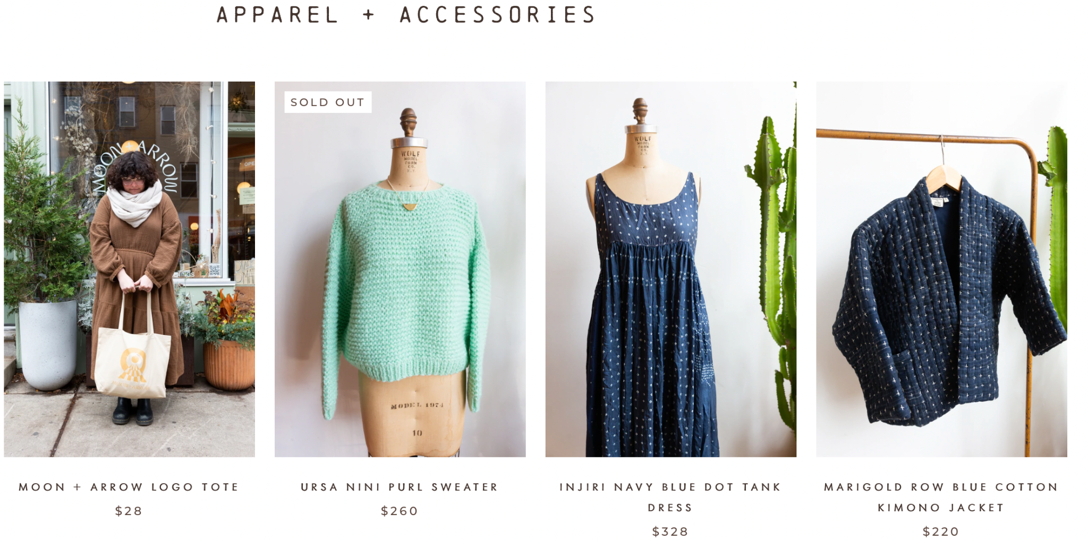
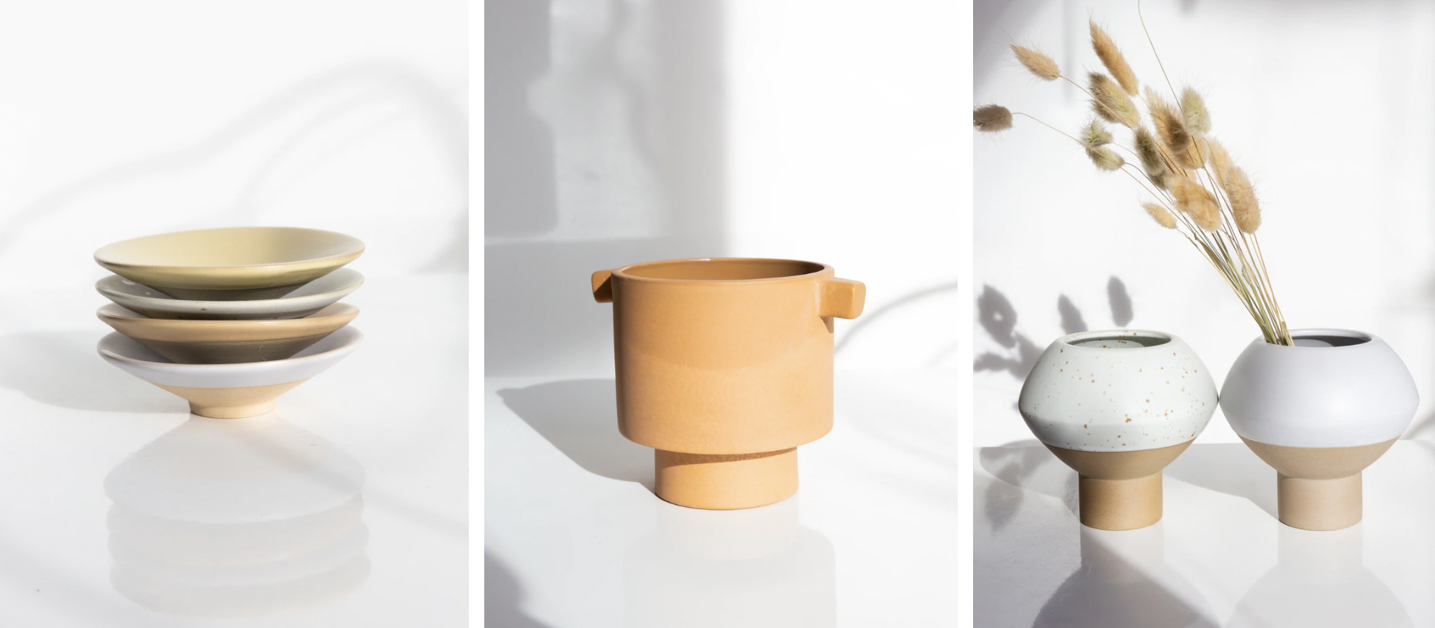
Competitor Analysis
https://moonandarrow.com/collections/apparel-accessories
Minimalistic Modern aesthetic
Focus on in-store selling
Has a strong community of consumers
Well-crafted site
Interpersonal
Connects with other local retailers
through “visiting artists”
“A socially-responsible and environmentally conscious boutique for handmade and vintage jewelry, clothing, accessories, home-furnishings, decor, and apothecary”

Slide 20
Competitor Website - https://moonandarrow.com/collections/apparel-accessories
Moon + Arrow
Site is more pleasing to the eye with minimalistic, simple design
Photos are more cohesive
Displays in-depth brand values and philosophy
Feels more intimate and purposeful than Midnight Lunch
Connects more with local artists and vendors
Has connection between site and social media
Clearly has strong community built of consumers

Slide 21
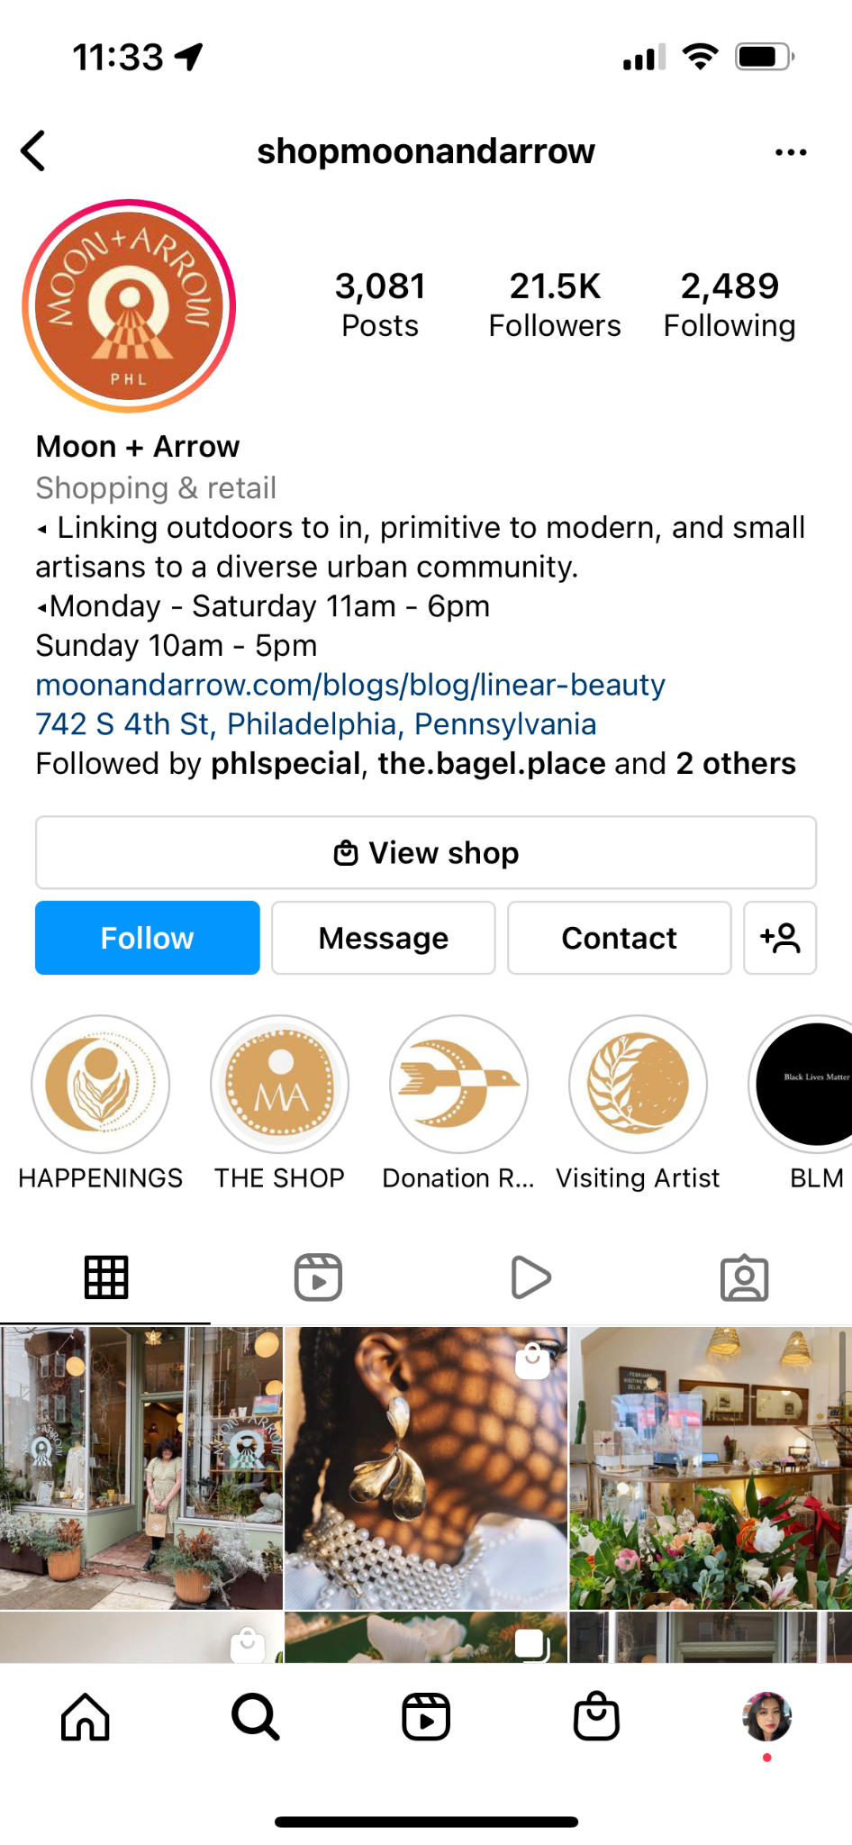
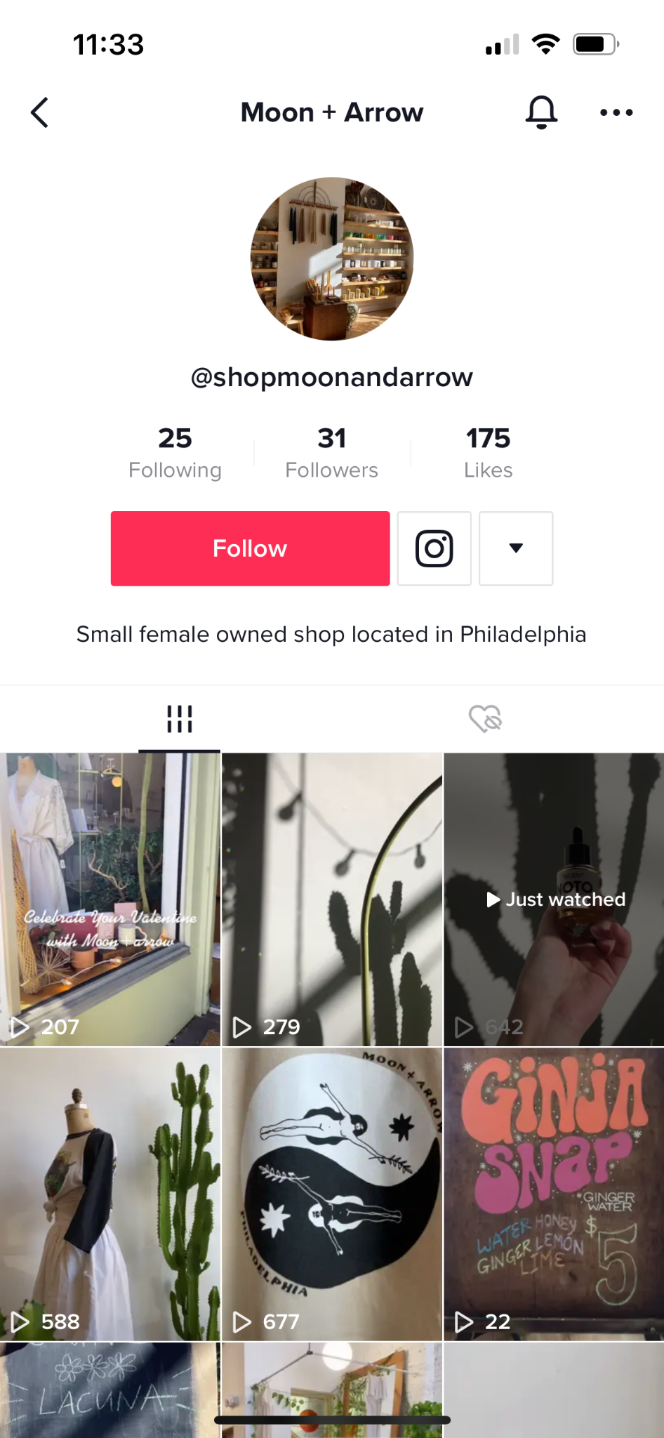
Competitor Social Media
@shopmoonandarrow
@shopmoonandarrow
views
-Range from 16-671
-Most just below 200
Likes
-Most posts between 0-15
-One post has 43 likes
Comments
- Comments are rare
Shares
- Most posts have 0 shares
- Some posts have up to 3 shares
Post Frequency
-14 posts since 3/6/2021
- Large gaps between
Followers
- 31
Followers
21000
Likes/Avg
90
Comment/Avg
<10
total post
3081
Post frequency per day
0.4
story themes
6

Slide 22
Competitor Summary
Homepage
Instagram
Tiktok
- Context
- The homepage layout creates a simple and clean atmosphere for the user
- Offers discount for email sign-up upon opening
- No major ad on the homepage- Top of pages clearly indicate the hours of operation
- Conclusion:
- Clean shopping experience
- Consist format
- Instagram homepage
- More relative reference to the consumer
- The most popular postings are often related to clothes sales
- More oriented towards lifestyle- Competitive amount comments or retweets. This indicates more traffic & owned media
- Conclusion:
- Good engagement
- More exposure
- Clear lack of engagement
- Rarely comments, the boutique fails to interact
- Unable to gain a large following with consistent amounts of engagement from consumers
- No consistency in posts
- Conclusion:
- Less engagement
- Less awareness
Notes:
Add more link toward Ins& tik

Slide 23
Campaign Objectives

Slide 24
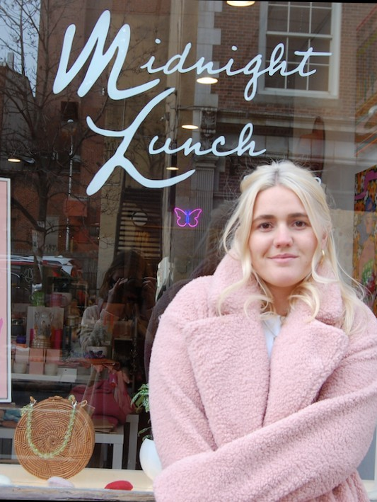
Campaign Objectives
Drive brand awareness through SEO and Google Ads
Increase engagement with more frequent and more purposeful social media content
Create a better brand philosophy by utilizing website in a more professional manner
Notes:
KPI, strategy (come back to objective )

Slide 25
New Digital
Marketing Strategy

Slide 26
Drive Brand Awareness
Increase brand awareness by purchasing keywords, whether for accidental or intentional search
Increase organic pagerank so that they are in top 5 results within the next 3 months through paid search and SEO
Use Google Ads to increase traffic to website
Be featured in blogs and reviews to increase chances of accidental search findings

Slide 27
Increase Engagement
Increase social media following on Tik Tok and Instagram by 25% in next 3 months
Post at least 5 times per week on both social media platforms
Use influencers from Philadelphia area and colleges to spread awareness
Stay relevant with social media trends to cater to target audience interests
Engage with followers through direct messaging, CTA on Instagram Stories & Reels, and comments
Measure these social media advancements through KPIs:
Follower count, likes, shares, comments, views

Slide 28
Build Brand Philosophy
Midnight Lunch needs a brand value page on website to build professionality
Add a page on site that explains who the owner is and why she decided to open this store in Philadelphia
By having a section that explicitly states the company’s mission, values, and inspirations - it will make Midnight Lunch more attractive to consumers
Especially while using local artists in the shop, Midnight Lunch needs to explain why they care about the hand crafted, unique pieces that they sell

Slide 29
New Digital Marketing Strategy
Brand awareness | Engagement | Brand philosophy
Using keywords such as: “Philadelphia boutique”, “Clothing store” | Post more frequently on IG, Tik Tok & utilize reels, stories, trends | About us section on website to make more personal
Create Google Ads to put Midnight Lunch on higher pagerank | Interact with followers through comment replies, dm, stories | Share values and information on the owner

Slide 30
Implementation Plan

Slide 31
Drive Brand Awareness
Midnight Lunch | Shop Women’s Boutique Clothing & Fashion
Ad*https://shopmidnightlunch.com/
Are You Ready For Spring Break? Shop Our New Arrivals Today! Discover New Womens Apparel And Accessories For Your Vacation. Stop In To Visit Us In Old City Philadelphia 11-5. Free Shipping On Orders Over $250
Create Google Ads that use keywords related to the boutique
Contact local bloggers to be featured in stories and drive traffic to website

Slide 32
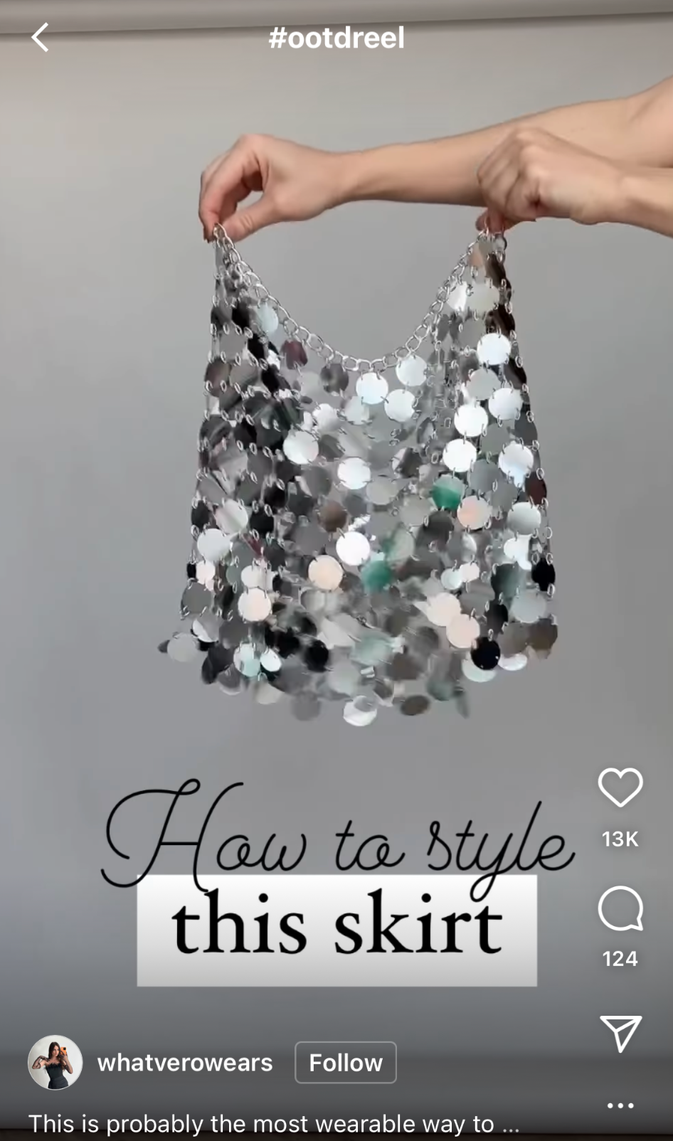
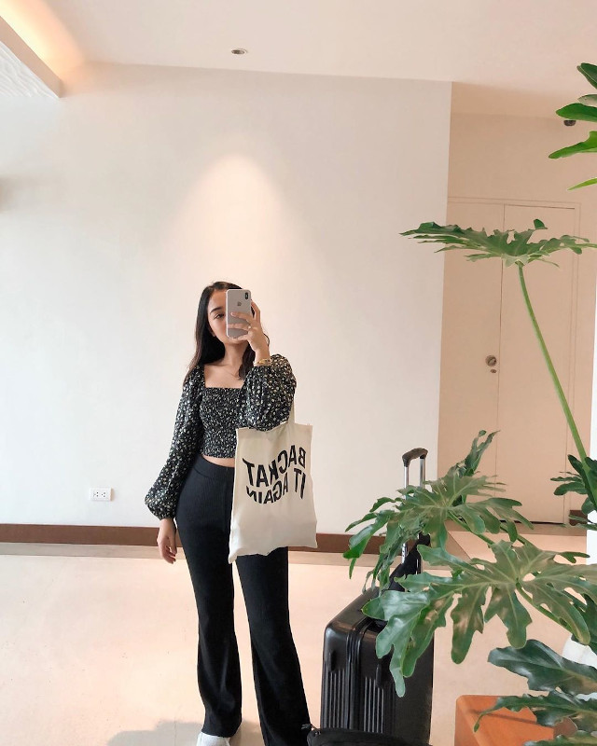
Increase Engagement
Be consistent with posts - at least 5 per week on IG & Tik Tok
Post Instagram Stories daily
Outfits of the day (OOTD) IG story wearing at least one item from brand
Styling tips and tricks using clothing from the store

Slide 33
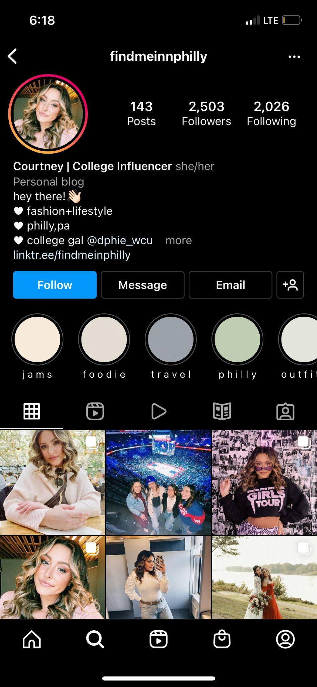
Increase Engagement
@findmeinphilly
Use local Philadelphia influencers
Provide discount code links for their followers
Have them promote pop-up events at universities
Provide them with post ideas for Stories, Reels, Tik Toks
@katherinewg_

Slide 34
Increase Engagement
Use trending audio on Tik Tok to stay relevant with target audience
Use high quality displays and photo quality to maintain aesthetic
Promotions
Giveaways on Instagram
Referral discounts
Brand partnerships with other Philly small businesses
Notes:
This will be the implementation plan I will be going further in depth with each of the objectives that were just mentioned, starting off with Drive Brand Awareness. Midnight Lunch should contact local bloggers to be featured in stories as shown here as an example. Our team had also created a Google Ad that included keywords relating to the boutique, as shown here. The next objective is to increase engagement. One way is to post instagram stories daily, those can include outfits of the day showing a model wearing at least one item from the brand and also any styling tips and tricks, here is an example of this. Another way to increase engagement is to use local philadelphia influencers, and to provide them with discount code links for their followers and have them promote pop up events at universities. This is Katherine, she is a temple student and is a representative for a lot of local brands. And the last suggestion on how to increase engagement is to offer promotions such as giveaways on social medias or through brand partnerships with other small businesses in Philly.

Slide 35
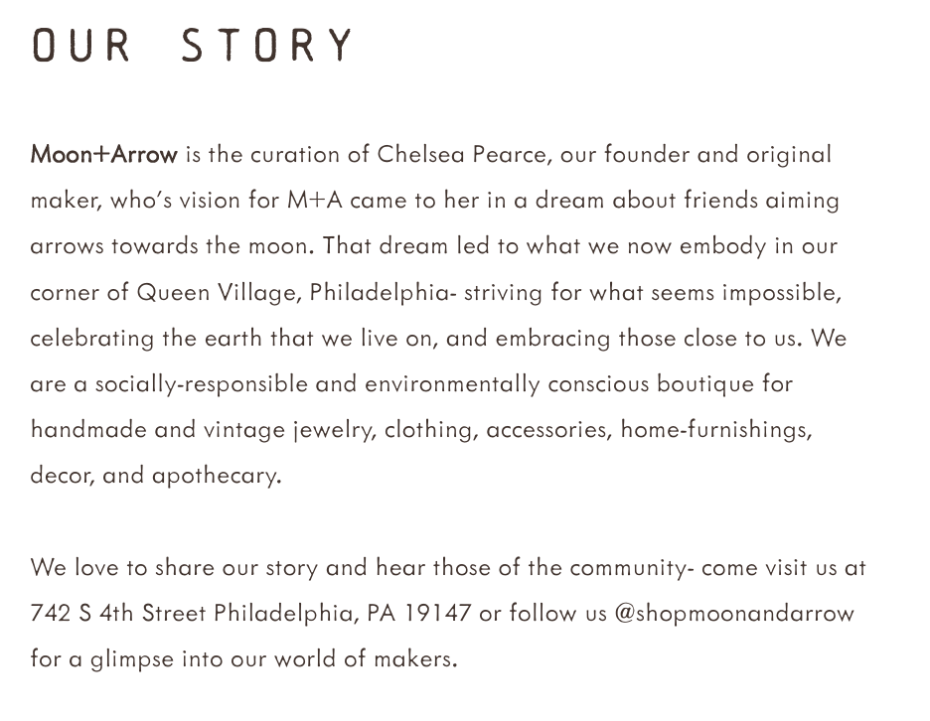
Build Brand Philosophy
Add an “Our Story” section to website that showcases what Midnight Lunch believes in, who the founder is, and how to be involved in the community that the brand creates
(Example from competitor Moon + Arrow)

Slide 36
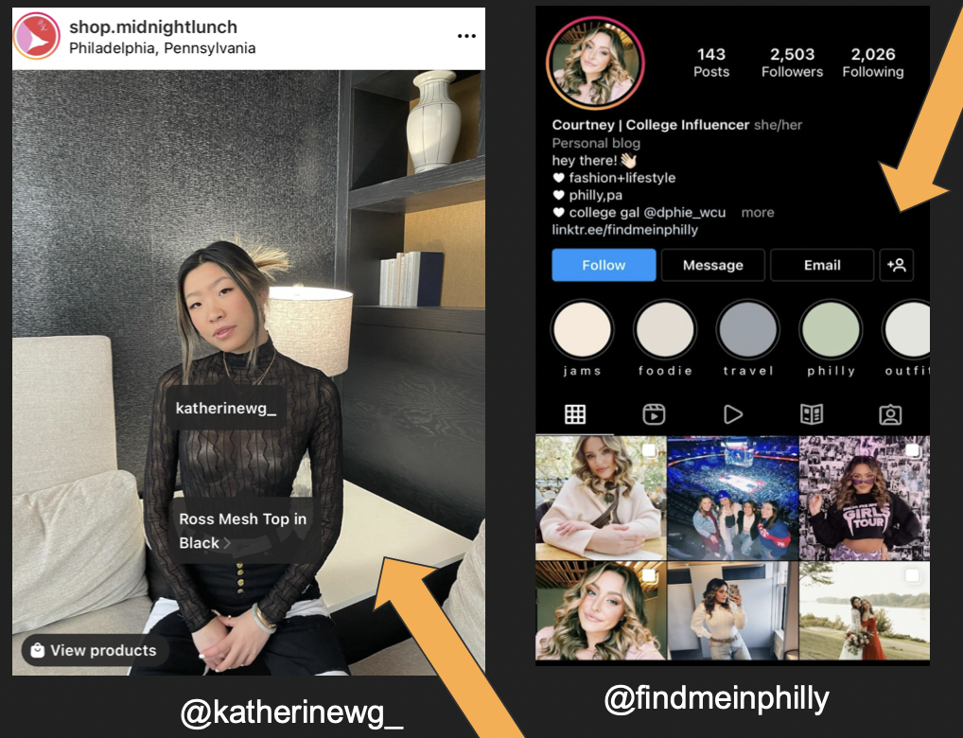
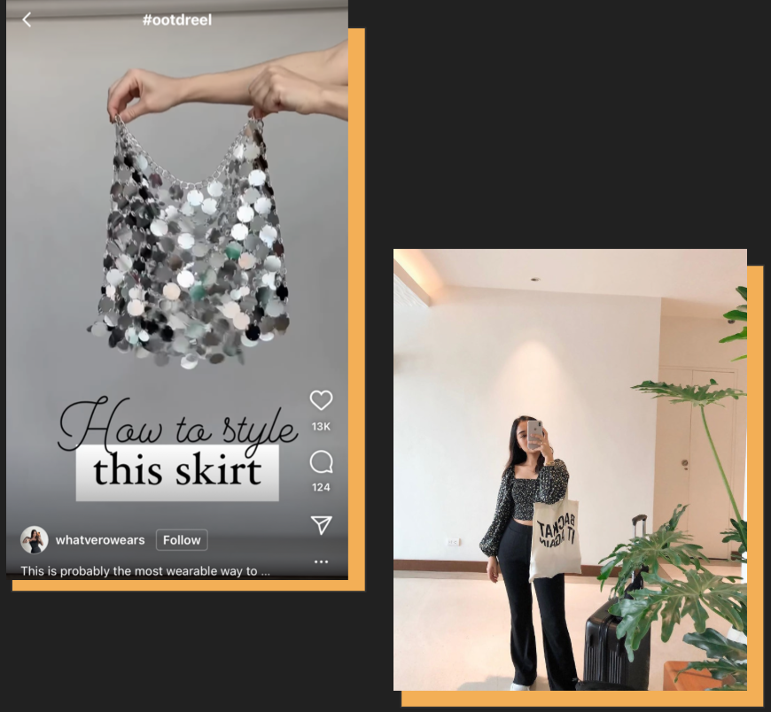
Summary of Implementation Plan
Increase Engagement
Brand Drive Awareness
Build Brand Philosophy
Notes:
This will be the implementation plan I will be going further in depth with each of the objectives that were just mentioned, starting off with Drive Brand Awareness. Midnight Lunch should contact local bloggers to be featured in stories as shown here as an example. Our team had also created a Google Ad that included keywords relating to the boutique, as shown here. The next objective is to increase engagement. One way is to post instagram stories daily, those can include outfits of the day showing a model wearing at least one item from the brand and also any styling tips and tricks, here is an example of this. Another way to increase engagement is to use local philadelphia influencers, and to provide them with discount code links for their followers and have them promote pop up events at universities. This is Katherine, she is a temple student and is a representative for a lot of local brands. And the last suggestion on how to increase engagement is to offer promotions such as giveaways on social medias or through brand partnerships with other small businesses in Philly. The third objective is to build brand philosophy, through that, Midnight Lunch can add a more indepth “Our Story” section to the website that showcases what MidnightLunch believes in and who the founder is, like how their competitor brand Moon and Arrow did as shown in this picture.

Slide 37
Overall Value to the Client

Slide 38
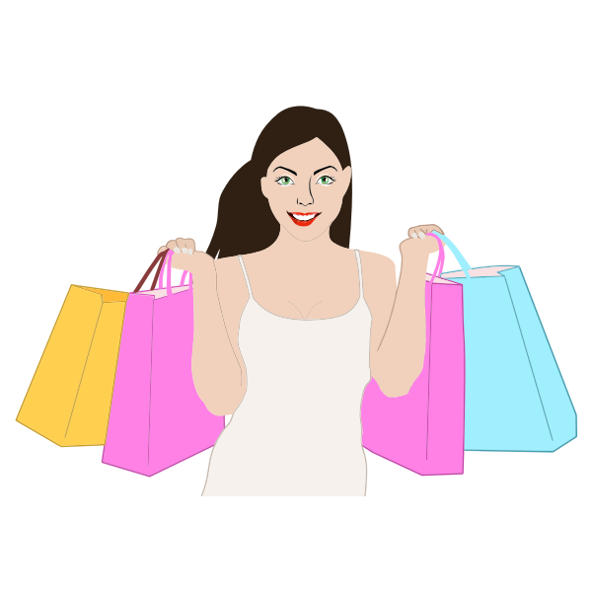
Overall Value to Client
Implementation of our suggestions will (in 3 months):
Increase social media following by 25%
Increase online sales by 10%
Increase pagerank to being in top 5 results
Midnight Lunch will also have a better foundation on its purpose, philosophy, and messaging so that it can build a community of repeat customers who love to share this adoration to their network. In turn, the company will build a personal connection between buyers, inspired by their brick and mortar beginnings.
Notes:
As a result of implementing the 3 objectives which is to drive brand awareness, increase engagement, and build brand philosophy,this will be implemented over the course of 3 months. Midnight lunch will also have a better foundation on its purposed… etc.

Slide 39
Campaign Schedule

Slide 40
 | March | April | May
Website | -Use A/B testing to choose appropriate home page layout -Create an about page that shows core values -Use more cohesive photos | -Implement new home page layout -Add influencer promotion code section after gaining viable influencers -Allow reviews to be seen for each item particularly | -Check progress with home page, make changes when holidays/events arise -Add section of photos of local consumers/influencers wearing items
SEO/Google Ads | -Create two ads per top keywords | -Check performance, make changes as needed -Contact local bloggers/reviewers and gain presence on sites | -Continue monitoring of ads, create holiday/deal specific ones -Add top keywords of competitors to increase views
Social Media | -Post at least 5 times per week -Use IG Reels/Stories daily -Engage with followers in comments/DMs/replies -Create Tik Toks according to trending audio | -Contact local influencers to promote brand & provide promo codes -Show influencers with items on all platforms | -Monitor engagement and promo code progress -continue engagement & attract new followers

Slide 41
Thank you for your time! Please contact us with any questions.
—
Cameron Dillon - camerondillon@temple.edu
Jane Kobylinski - jane.kobylinski@temple.edu
Thuy Quynh Nguyen - thuyquyhnguyen@temple.edu
Mingtao Xia

