Slide 1
x TU-AMA
Cherry Consulting Project
Spring 2022
Jane Kobylinski
Karolina Leleniewski
Jamy Mershon

Slide 2
“The wheel is an amazing feature that gets rid of my indecisiveness and I just watch whatever Queue tells me to”
-Nick
Project Goals

Slide 3
Increase awareness and understanding of Queue among students

Slide 4
Collaborate with on-campus events

Slide 5
Create giveaway ideas for the prospective target audience

Slide 6
“Queue has pretty much any movie or tv show you have watched, or want to watch”
-David
Events

Slide 7
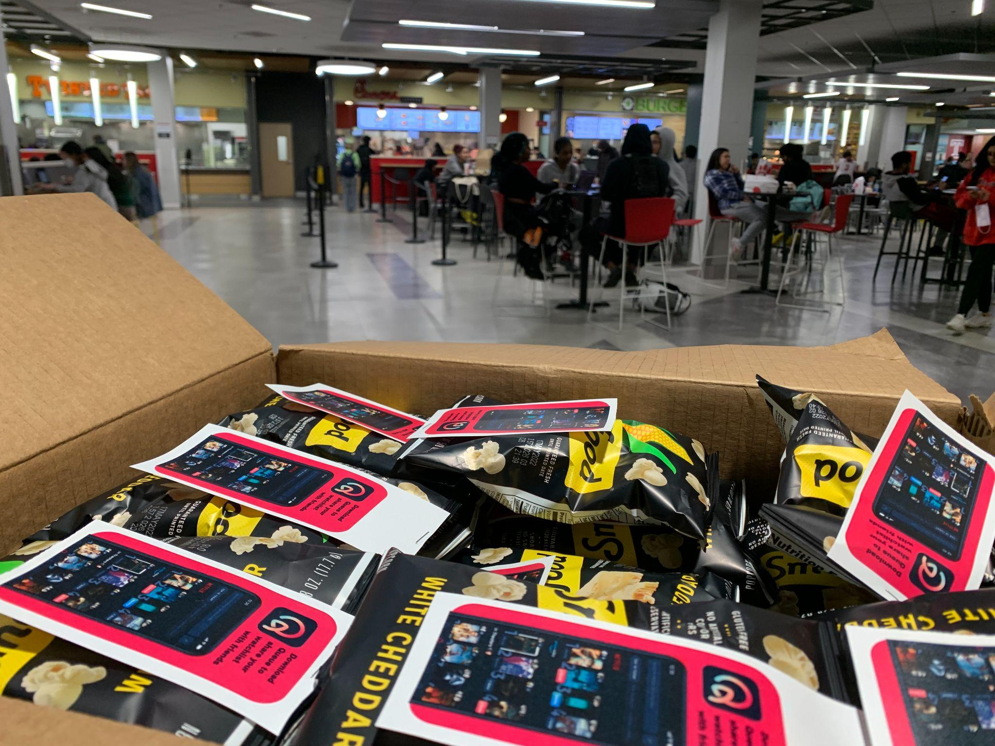
Popcorn Handout–Awareness
Exposed students to the Queue app through handing out popcorn bags branded with the Queue logo and app store link at popular spot on campus.
Increased awareness and understanding among students.

Slide 8
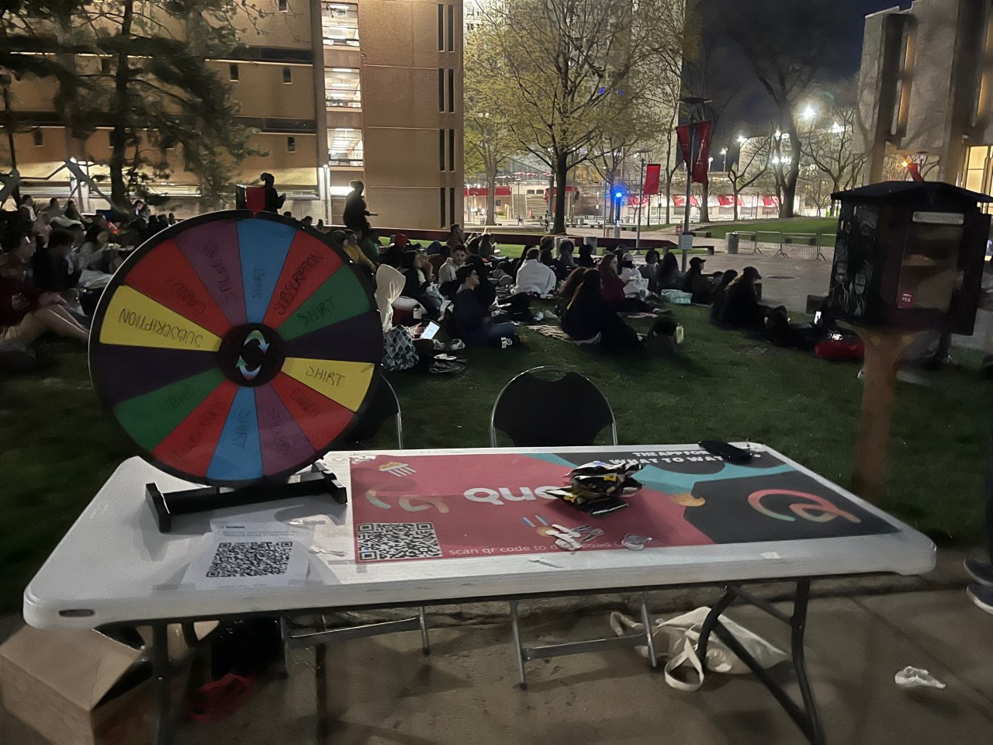
Movie Night–Collaboration
Collaborated with Temple organization–Main Campus Programming Board–to host a movie night for students. Gave away merch, popcorn, and information about app.
Collaborated with on-campus events.

Slide 9
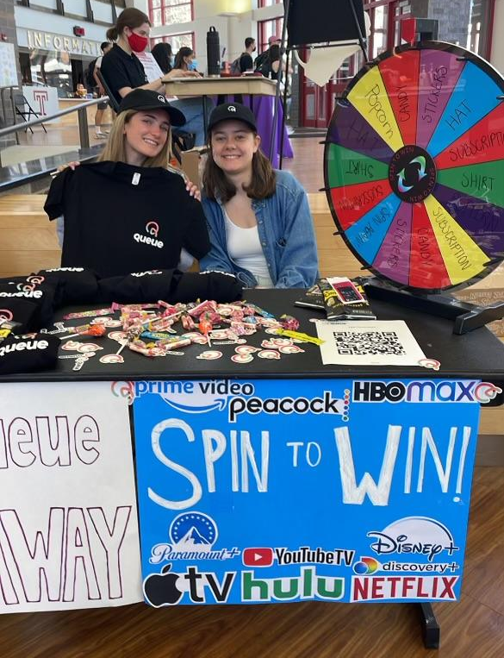
Wheel Table–Giveaway
Tabled a giveaway event in Temple’s student center featuring a wheel. Students were intrigued by Queue app as well as the chance to win a free year subscription to the streaming service of their choice.
Created giveaway ideas for the prospective target audience.

Slide 10
“If you have no idea what to watch, Queue allows you to see what your friends are currently watching”
-Karen
Deliverables

Slide 11
Outreach
We included the following outreach sheets for current and future contacts at Temple University
Notes:
Three influencers have expressed interest in collaborating with Queue, we will forward the email correspondence

Slide 12
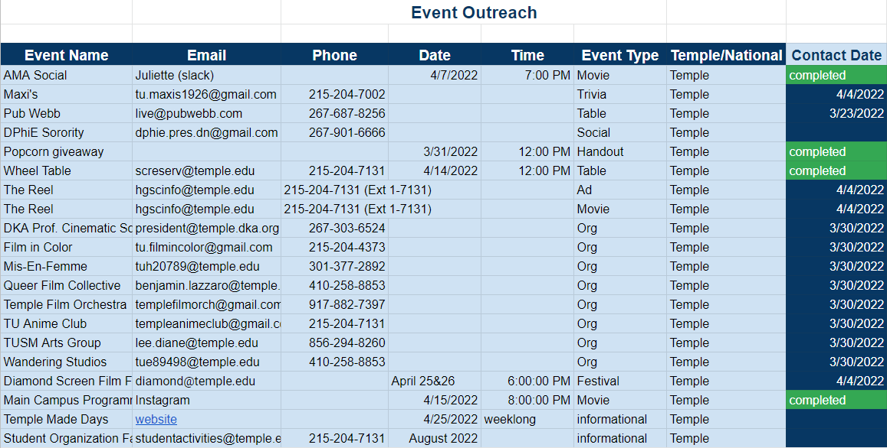
Outreach

