Slide 1
BRAND REVIVAL OF
ANDORA
TEAM 4
Colin Ambrose
Jane Kobylinski
Sydney Noble
Notes:
Sydney

Slide 2
Fun Facts
Executive Summary
Short Video
Brand History & Timeline
Current Marketing Situation
Financial Performance
Competitive Analysis
Competitors
Perceptual Map
PADR
Social Media
Brand Prism
Marketing Strategy
Brand Problems
Recommendations
References
AGENDA
Notes:
Sydney

Slide 3
FUN FACTS
Pandora uses over 450 attributes to predict the next song you might like
Pandora has integrations with over 2,000 connected products
Pandora had no marketing budget in the first 5 years
Pandora is the largest ad-supported audio entertainment streaming service in the US
When the Pandora app launch in the iPhone App Store in 2008, growth virtually doubled overnight
Pandora is used by 25% of the United States music streamers
Notes:
Sydney

Slide 4
EXECUTIVE SUMMARY
Pandora was founded in early 2000s with a Unique Selling Point of music discovery
Revenue climbed steadily until 2020, but profits were negative
Joined streaming game late, falling behind main competitors
Became a reactor in the music market, no longer holding power or high market share after losing Unique Selling Point
Stagnant subscribers leads Pandora to focus on advertising revenue
Recommend international expansion, lower streaming prices, and social features to expand audience and number of subscribers
Notes:
Sydney

Slide 5
SHORT VIDEO
https://www.youtube.com/watch?v=oC3LMcbAOT8
Notes:
Sydney

Slide 6
HISTORY & TIMELINE
2000
Founded as "Music Genome Project"
2001
Ran out of funding, employee lawsuit
2005
Changed company name to Pandora
2011
Pandora goes public on NYSE
Notes:
Sydney

Slide 7
HISTORY & TIMELINE
2013
70% of all internet radio listening
2016
Launch of
Pandora Plus
2019
Sirius XM aquistion & new CEO
2020
COVID-19 leads to decline in listening
Notes:
Sydney

Slide 8
There is nothing so powerful as a team united behind a shared sense of music and passion. We remain steadily focused on making your music experience better.
TIM WESTERGREEN, 2016
Notes:
Sydney

Slide 9
CURRENT MARKETING SITUATION
Increasing marketing dollars spent
Attract customers with low cost listening
Pandora chose to focus on their fremium market, bringing in revenue from advertisements rather than subscriptions
Allows users to listen to ads to unlock the premium listening services
Added podcasts to allow users to discover new podcasts as they would music
Added Stories which shares insights about song lyrics from artists
Trying to keep up with Spotify with the addition of these features

Slide 10
FINANCIAL PERFORMANCE
Copyright rules changed in 2007, causing double the royalty rates for Web-based radio
Purchased by SiriusXM for $3.5 billion in 2018
16% year-over-year revenue growth that year
Pandora had their first profitable year in 2019 making $938 million
A year later profits fell by 86%, $131 million profit for 2020
Notes:
Collin

Slide 11
Pandora's main competitor since the late 2000s
Over 180 million paying subscribers
Spotify Premium costs
$9.99/ Month
Spotify holds 31% market share
A newer competitor, released in 2018
Over 50 million paid subscribers
Subscriptions cost $9.99/ month
YouTube Music holds 8% market share
Entered the music streaming game in 2015
In 2019 Apple Music had 60 million users
Apple music costs $9.99/ month or $99 per year
They also hold 15% market share
COMPETITORS
Notes:
Collin

Slide 12
PERCEPTUAL MAP
HIGH QUALITY
EXCLUSIVITY
MASS MARKET
LOW QUALITY
Notes:
Collin

Slide 13
PROSPECTOR:
ANALYZER:
Holds 31% of market, known as THE music streaming service
First to offer music streaming subscription
Social feature to see what friends listen to
Curates playlists based off of interests
Includes song radio feature to hear similar songs and artists
Offers podcasts and exclusive Spotify podcasts
Already had music for sale through iTunes, but followed Spotify's streaming concept with subscription based listening
Social feature, can follow friends
Users can create playlists or listen to curated playlists but curated playlists are not as appreciated as Spotify's
Discount for bundling with other apple services or paying for full year
Compatible with apple products
PADR
DEFENDER:
REACTOR:
Soundcloud Go subscription offered for $9.99/ month featuring 200 million songs
USP of promoting independent artists and sharing audio through streaming
Emphasis on music discovery
Unreleased songs by popular artists
Secondary listening platform, niche
Added subscription feature later than competitors
Lost USP of music discovery in trying to keep up with competition
Added podcasts after competitors, again straying from USP
Users cannot share their profile with followers, lost opportunity
Notes:
Collin

Slide 14
SOCIAL MEDIA
lnstagram @pandora
414K followers
Spotify @ 7.8M followers
Twitter @pandoramusic
543.6K followers
Spotify @ 5.2M followers
Pandora's social media presence is very small compared to competitors
Notes:
Collin

Slide 15
BRAND PRISM
WHAT?
FOR WHOM?
Free and Subscription-based music streaming service
Platform to classify individual songs by musical traits
A more approachable music streaming platform compared to competitors
Music lovers aged 25-34 and above 55
Open-minded individuals who are curious about new artists and songs
Individuals who are tired of listening to the same music
English speakers (as the app is only offered in English)
WHEN?
AGAINST WHOM?
Commute to work
Social gatherings
Parties
Road trips
At the gym
People who like to control what they listen to
Younger listeners who enjoy making playlists
Loyal artist fans who want to listen to a new album release
Notes:
Jane

Slide 16
PRODUCT
PLACE
Music
Curated radio stations
Playlists
Podcasts
Pandora is only offered in the United States due to licensing restrictions
Can listen on:
www.pandora.com
iOS and Android devices
Amazon devices
Google Home devices
Roku Devices
PRICE
Free Pandora: ad-supported radio service
PROMOTION
Pandora Plus ($4.99/ month): ad-free personalized stations, offline listening, higher quality audio
Xbox One
XFINITY X1
90 day free Pandora Premium trial
Fuel Rewards - get 25¢/gal at Shell when converted to paid subscription
T-Mobile Tuesdays partnership
enhanced Pandora experience on weekends (ad-free music, special playlists, early access to podcasts)
Pandora Premium ($9.99/ month): unlimited offline listening, fully customizable playlists, search and play songs on demand
Discounted plans for students, family, and military
Notes:
Jane

Slide 17
LACK OF INTERNATIONAL REACH
PROBLEM #1
Pandora operates strictly in the United States
Spotify is actually a Swedish company and is available in 180+ countries
Apple Music launched in 100 different countries, now available in 167
Missing out on world market
Notes:
Jane

Slide 18
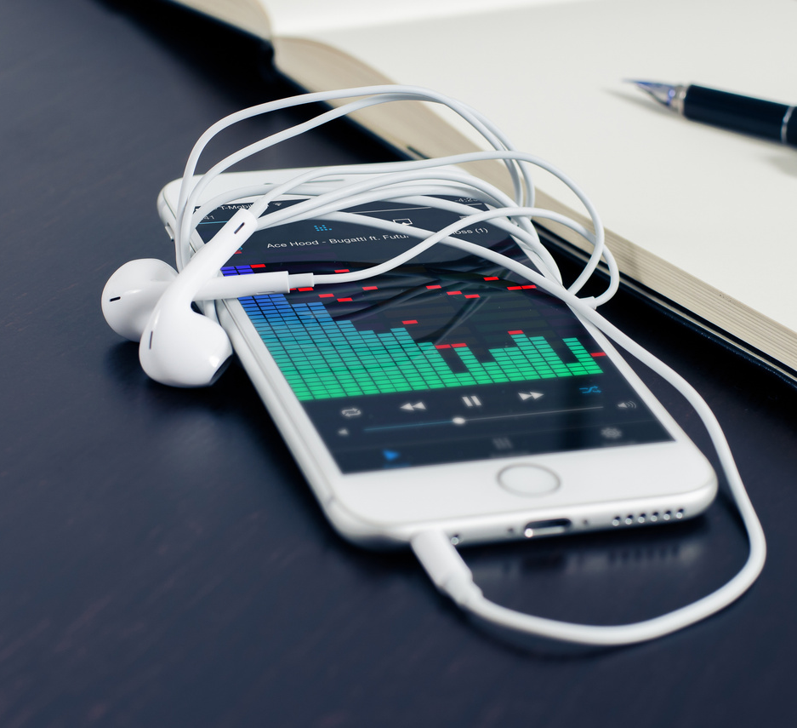
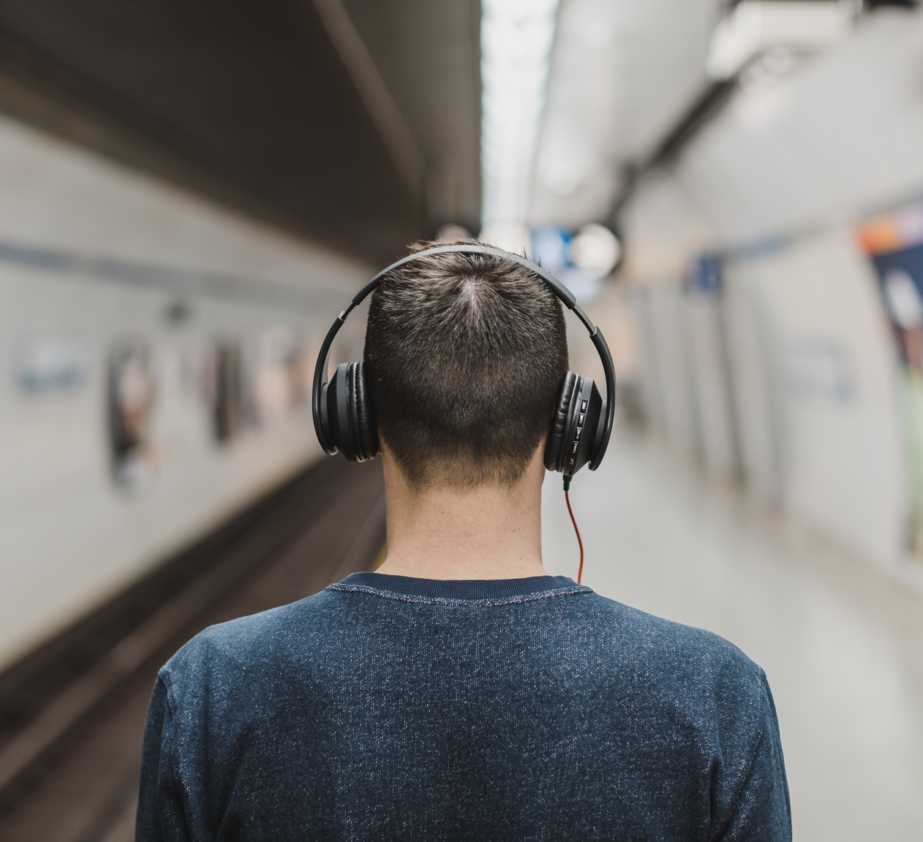
LATE TO SUBSCRIPTION SERVICE ZEITGEIST
Pandora was one of the first music streaming platforms
Did not institute paid subscription services till 2016
Apple Music started in 2015
Spotify started subscriptions in 2011
PROBLEM #2
Notes:
Jane

Slide 19
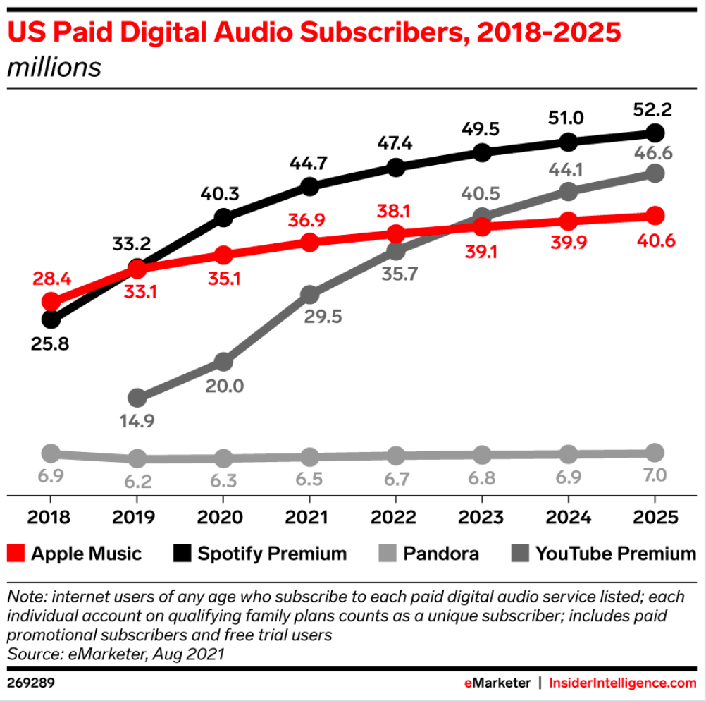
PROBLEM #3
STAGNANT SUBSCRIBERS
Main music providers increasing paid subscriptions
Pandora has not had significant change in subscriptions
Creates massive missed revenue

Slide 20
PROBLEM #4
LOST UNIQUE SELLING POINT
Overly fixed on Radio as unique selling point
Idea of discovering new songs based on interests
Fell behind when on-demand streaming became popular
Spent $75 million in 2015 to add Pandora Premium streaming feature

Slide 21
LACKS SHARING FEATURE
Spotify allows users to follow playlists and profiles
Apple allows users to have friends
Lacking a network of followers discourages sharing and users will not be as engaged or listen as frequently
Sharing acts as word of mouth advertising
PROBLEM #5

Slide 22
ACQUIRE INTERNATIONAL MARKETS
Invest into acquiring license for international markets
Competitors are already in the international markets
Music is universal and the majority of people have the Innate need to listen to music every day
Pandora is successful in the United States why wouldnt it be successful internationally
RECOMMENDATION #1
Notes:
Jane

Slide 23
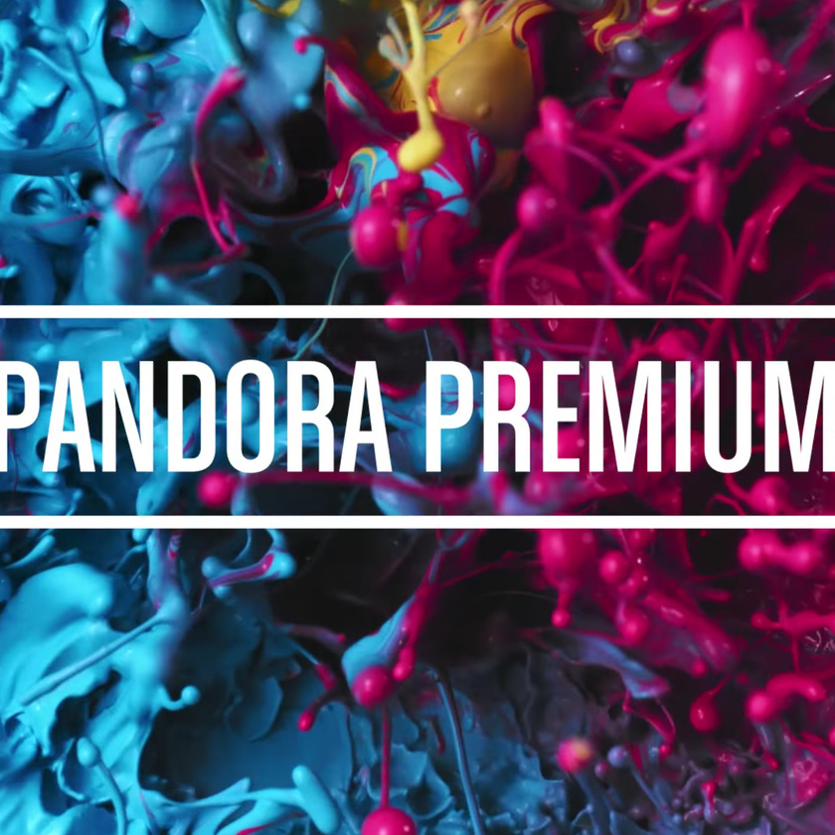
DISCOUNT SUBSCRIPTION SERVICES
Being an early adopter of the subscription service Zeitgeist, Apple Music and Spotify have become very successful
Offer Pandora's subscription at a discounted price
Many consumers are price sensitive and will use the cheaper option
A $6.99 subscription would attract more customers
RECOMMENDATION #2
Notes:
Jane

Slide 24
INCORPORATE SOCIAL ASPECT
Allow users to share their profile, have followers, and interact with each other's radios
Encourages listening and subscriptions through word of mouth
Multiple subscriptions per household since listeners can have their own profile while still sharing music with family/friends
Reaches new target audience of younger listeners (14-25) as well as their parents (40-55)
RECOMMENDATION #3

Slide 25
RECOMMENDATION #4
NEW USP - VIRTUAL CONCERTS & ACCESS TO LIVE MUSIC
Apple has a Unique Selling Point that only Apple product owners and use their service
Spotify's Unique Selling Point is their vast selection of podcasts along with wide selection of music
Pandora had a failed Unique Selling Point selecting the next song based off of the previous songs you listened to
Pandora's new USP can be virtual concerts and access to live music right on your personal device

Slide 26
IMPROVE SHARING FEATURE
Other platforms like Spotify and Apple Music allow users to share playlists
Sharing playlists connect current and potential users to interact with the platform
This simple addition can boost usership and premium membership sales
This does not Differentiate the platform but better Positions it in the eyes of the consumer
RECOMMENDATION #5

Slide 27
REFERENCES
https://www.theverge.com/2022/1/20/22892939/music-streaming-services-market-share-q2-2021-spotify-apple-amazon-tencent-youtube
https://music.youtube.com/music_premium
https://musically.com/2022/02/03/spotify-apple-how-many-users-big-music-streaming-services/#:~:text=Apple%20Music%3A%2060m%20subscribers%20(but,for%20an%20Apple%20Music%20subscription.
https://www.spotify.com/ca-en/premium/
https://www.statista.com/statistics/244995/number-of-paying-spotify-subscribers/
https://www.fool.com/investing/general/2013/11/30/3-things-you-didnt-know-about-pandora-media.aspx
https://www.youtube.com/watch?v=oC3LMcbAOT8
https://blog.pandora.com/us/back-at-the-helm/
https://www.theverge.com/2017/3/13/14889122/pandora-premium-music-streaming-service-preview-interview
https://www.fuelrewards.com/fuelrewards/pandora
https://www.t-mobile.com/news/offers/first-of-its-kind-pandora-experience-gives-t-mobile-customers-exclusive-benefits

