Slide 1
Blockchain Technology
Blockchain Technology Utilization in Health-care Industry & Disruptive Innovation Theory Application
MIS4596 Sec001 Fall 2017
John, Kevin, Liang, Taiki

Slide 2
Agenda
Scope of Analysis
Case Summary
Disruptive Innovation & Industry Summary
How will Blockchain Affect the Healthcare Industry?
Evaluation & Key Takeaways
John, Kevin, Liang, Taiki - MIS4596 Sec001 Fall 2017

Slide 3
Scope of Analysis
“The blockchain is an incorruptible digital ledger of economic transactions that can be programmed to record not just financial transactions but virtually everything of value”
By Don & Alex Tapscott, authors “Blockchain Revolution”(2016)
“Technologist and health-care professionals see blockchain as a way to streamline the sharing of medical records in a secure way, protect sensitive data from hackers, and give patients more control over their information”
By Mike Orcutt, Who Will Build the Health-Care Blockchain? (2017)
John, Kevin, Liang, Taiki - MIS4596 Sec001 Fall 2017
Notes:
Question: Define the scope of analysis – choose a concentration of blockchain. This is the most important aspect of the case. Narrowing it down will allow you to focus.
Answer:
We focus on the potential usage of blockchain technology in healthcare industry and how the disruptive innovation theory can be applied.
Currently, healthcare industry doesn’t have the effective method to share the important record of their patients. Their current Electronic Health Record (EHR) is inefficient in sharing and creating data, disencouraging many doctors to keep using it. Considering how the blockchain technology can be used as the tool to bridge the gap between creating and sharing data in such situation, we will explain how it can work and what kind of effect it may have not only in the industry but also the entire economy.

Slide 4
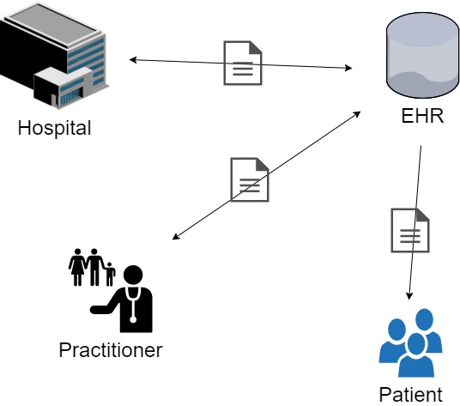
Case Summary
Current Electronic Health Record System
Pros:
Space utilization
Mitigated risk of losing data
Cons:
Security risk
Reliability of data
High operational cost
Inefficient technology burdens practitioners and poses security risks and unreliability
John, Kevin, Liang, Taiki - MIS4596 Sec001 Fall 2017
Notes:
Question: Conduct research and provide a one – two page power point summary to describe the topic and provide an issue question or main thesis of your report.
Answer:
Currently, healthcare industry uses Electronic Health Record (EHR), which is the third-party’s centralized database. This system has several advantages as the above slides shows. However, this system structure poses the issues and risks to the practitioners, patients, hospitals and other related entities. In addition to the issues and risks indicated above, according to the research of the Mayo Clinic (MN), 45 - 50% of the practitioners are tired of the current system because the system requires them huge amount of data. Also, at the hearing on January 24th, Tom Price told that the system makes practitioners be mere data input officers. Considering these aspects of the current system, there seems to be space for blockchain technology to be utilized.

Slide 5
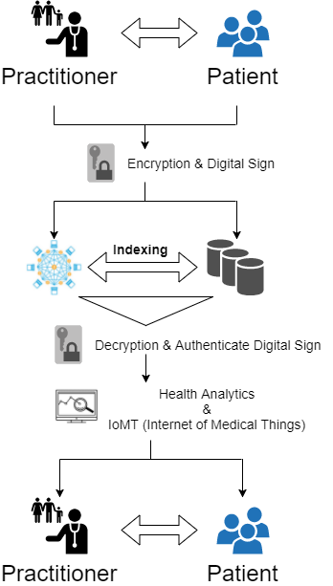
Case Summary
Healthcare Blockchain
How is it beneficial?
It can create…
Easy health data exchange and interoperability
Transparent billing management
Drug supply chain
Blockchain
John, Kevin, Liang, Taiki - MIS4596 Sec001 Fall 2017
Notes:
Question: Conduct research and provide a one – two page power point summary to describe the topic and provide an issue question or main thesis of your report.
Answer:
Blockchain-enabled health IT systems can solve various issues. “Data that is stored on blockchains can be shared in real time across a group of people or organizations, so any event or transaction that happens is time-stamped as a permanent record...” This will ultimately give health data exchange systems to have the ability to access patient data and cut down on risks and costs because the events or transactions cannot be tampered with.
5-10% of healthcare costs are fraudulent because of people billing unperformed services. In 2016, medicare fraud caused the US $30 million in losses. There were 3 people indicted by the US Department of Justice for $1 billion medicare fraud and money laundering. One person (Philip Esformes) had operated a network of over 30 nursing homes and assisted living facilities which gave him the access to thousands of Medicare and Medicaid beneficiaries. However, these beneficiaries did not qualify for these nursing homes or facilities but they were still admitted to the network that Philip owned where the beneficiaries received medically unnecessary services that were billed to Medicare and Medicaid. With blockchain technology, it can help decrease criminal activity like this because it will be able to automate bill processing and eliminate intermediaries.
Pharmaceutical companies are incurring an annual loss of $200 billion due to counterfeit drugs. A blockchain-based technology or system can make a chain-of-custody log that “tracks every step of supply chain at individual product level.” The log is used to prove that the integrity of the drug has been maintained. This will eliminate the number of counterfeit drugs because it can then see the “ownership of drug source at any point in the supply chain.”

Slide 6
Disruptive Innovation & Industry Summary
5 key players in healthcare blockchain market（Keyless, PokitDok, Gem Health, Patientory, iSolve)
Revolutionizing the healthcare system today
A big data healthcare network
Transfer: volume of data → data value
Optimistic prospect of a healthcare blockchain
35% - Companies are planning to deploy blockchain
In the next five to 10 years, it will emerge with AI, IoMT, machine learning and mHealth.
Blockchain technology will revolutionize the healthcare industry by 2025 and it can save billions of dollars by optimizing current workflows.
John, Kevin, Liang, Taiki - MIS4596 Sec001 Fall 2017
Notes:
Question: Describe the evolution of the “market” based on the disruptive innovation cycle. Appropriately defining, scoping, describing the market(s) so that it is consistent with your focus is a key challenge.
Answer:
Blockchain innovations will improve healthcare functions in data interoperability. There are five key players in the healthcare blockchain market.
A keyless signature infrastructure platform. It means all hospitals and doctors have access to check patient records in order to improves accuracy and security in patient records.
PokitDok is a software development platform. It can facilitate business processes such as appointment scheduling, pharmacy benefits and claims submissions.
Gem Health is a network that partners with healthcare companies to improve the development of new Internet of Things and revenue cycle management solutions.
Patientory is a blockchain-based storage platform for patient information.
iSolve is a platform that supports drug development by connecting pharmaceutical companies to investors and service providers through a decentralized marketplace
Blockchain technology could revolutionize the healthcare system today. Blockchain technology can create a big data healthcare network. It can be realistic solution that removing each point. Using single network, data intelligence transfer from volume of data to value of data. It can bring stability and ease to data storage. For example, before websites and files are stored across hundreds sites around the world. There is no entire storage network.
There is a optimistic about the prospects of a healthcare blockchain. According to Deloitte research indicated that there is 35 percent of health and life sciences respondents saying their company plans to deploy it within the next year. Also, some organizations are putting big investment behind the projects. Blockchain technology can increase security, interoperability of health data and privacy data. It can improve efficiency in health information exchanges with electronic medical records in order to put the patient at the center of the healthcare ecosystem.
In the next five to 10 years, healthcare blockchain technology will involve health data exchanges, payment solutions, assets management and insurance. It will emerge with artificial intelligence, Internet of Medical Things and machine learning in order to provide a decentralizes health care interactions.
Notes:

Slide 7
How will Blockchain Affect the Healthcare Industry?
Eliminates the “middleman”
Blockchain will be able to access patient databases on a large population scale no longer requiring a third party.
Reduces Fraud in the insurance industry
Lack of available information allows the industry to lose billions of dollars every year, Blockchain provides continuous stream of information, reducing the cost of operation for providers
Lowers Administrative costs for Healthcare Providers
Transparency, automation, and greater efficiency will lead to faster claims and less money wasted.
More Americans will be able to obtain Healthcare due to the overall reduction of cost of Healthcare that Blockchain gives the industry.
John, Kevin, Liang, Taiki - MIS4596 Sec001 Fall 2017
Notes:
Notes:
Eliminates the “middleman”
Healthcare providers no longer have to rely on health information exchanges or other ways to aggregate data. Companies can access patient records now with Blockchain allows continuous access to accurate and up to date patient records.
Reduces Fraud in the insurance industry
NHCAA estimates that insurance fraud costs total “in the tens of billions of dollars each year. One of the main factors of this high level is the lack of available information when it comes to patience health and claims. Blockchain will eliminate a significant amount of fraud, reducing the costs of operation for healthcare providers.
Lower Administrative costs for healthcare providers
When a health plan and patient are dealing with a contract, the blockchain can automatically verify and authorize information and the contractual process. There will no longer be any “back and forth” about what was paid, why it was paid, or whether it should have been paid.

Slide 8
Evaluation & Key Takeaways
Evaluation
Pros:
Cost-efficient for entire economy
Cons:
Need adjustment and collaboration between related entities
Key Takeaways
Blockchain in Healthcare still needs more clear vision and has some challenges, but it can revolutionize the industry
John, Kevin, Liang, Taiki - MIS4596 Sec001 Fall 2017
Notes:
Question: How will you cost-justify / evaluate the use of blockchain in the context of the above recommendations? Be specific with regard to both tangible and intangible costs/ risks and benefits.
Answer:
As the previous slide indicate, the operational cost for hospital will decrease, leading the cost reduction for patients as well. Except for the EHR provider and those in the chain (provider side), the use of blockchain technology can benefit most of the economy. The core is who will create and manage the healthcare blockchain, which most likely to be government, we believe. In case the managing entity being the government, people will incur the cost. So, in this sense, there should be the cost-benefit analysis based on what the entire economy can get out of it and what the economy will incur. Also, if the technology will be in place, in a wide-scale, hospitals, businesses and government need adjustment and collaboration to truly and most efficiently utilize the system.
In conclusion, even though there are several challenges and needs for more clear vision on how it can be utilized, the use of blockchain technology can revolutionize and benefit the industry and nation-wide healthcare.

Slide 9
References
https://blockgeeks.com/guides/what-is-blockchain-technology/
https://www.technologyreview.com/s/608821/who-will-build-the-health-care-blockchain/
https://www.beckershospitalreview.com/healthcare-information-technology/9-things-to-know-about-blockchain-in-healthcare.html
https://www.forbes.com/sites/reenitadas/2017/05/08/does-blockchain-have-a-place-in-healthcare/#47e066781c31
http://www.mayoclinicproceedings.org/article/S0025-6196(15)00716-8/abstract
https://www.disruptordaily.com/blockchain-stands-poised-disrupt-healthcare-supply-chain/
https://www.upwork.com/hiring/for-clients/3-benefits-of-blockchain-in-healthcare/
https://www2.deloitte.com/us/en/pages/public-sector/articles/blockchain-opportunities-for-health-care.html
https://www.beckershospitalreview.com/healthcare-information-technology/frost-sullivan-5-key-players-in-healthcare-blockchain-market.html
http://data-informed.com/how-blockchain-technology-could-revolutionize-the-healthcare-industry
http://thessigroup.com/healthcare-blockchain-on-its-way/
John, Kevin, Liang, Taiki - MIS4596 Sec001 Fall 2017

Slide 10
Temple Course Scheduling
Strategic Course Scheduling and Faculty Planning & Hiring
MIS4596 Sec001 Fall 2017
John, Kevin, Liang, Taiki

Slide 11
Agenda
Project Overview
Current Process & Issues
Strategic Solution
Business Case
Suggestion & Implementation Plan
John, Kevin, Liang, Taiki - MIS4596 Sec001 Fall 2017

Slide 12
Project Overview
Overview:
Dean’s office at Fox School of Business struggles to accurately predict section demand and hire faculties. This causes additional expenses for the school.
Scope of project:
Dean’s office process improvement including faculty planning & hiring
Out of scope:
Departments process & faculty planning
Student-side process
John, Kevin, Liang, Taiki - MIS4596 Sec001 Fall 2017
Notes:
IMPORTANT NOTES:
Please declare and clarify that our project sponsor is Dean’s office and We are gonna provide solution in focus of Dean’s office. In other words, we are NOT giving any course scheduling process improvement from the perspective of Department and Student
Explanation:
Simple and brief explanation of project overview including project scope and scope exclusion

Slide 13
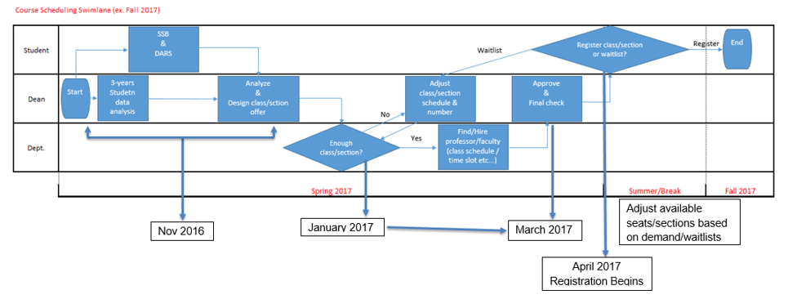
Current Process & Issues
Current Process - Course Scheduling Planning
Decreases the efficiency of the Dean's Office and decreases accuracy of course scheduling
John, Kevin, Liang, Taiki - MIS4596 Sec001 Fall 2017
Notes:
IMPORTANT NOTES:
Current course scheduling process issue is the concentration of workload for Dean’s office right before the student registration (in this chart, it’s January - March). Communication iteration for course adjustment with Departments takes lots of time and lessens efficiency of daily tasks. Also, this cause the difficulty in assigning faculty because of the short time period before the next semester.
Please inform audient that due to the inefficiency of the overall process structure and communication iteration process right before the semester decrease the efficiency of workload. As well, it reduces the accuracy of course scheduling before the semester.
Also, emphasize that currently Dean’s office’s system only utilizes the historical student data to predict the student demand. - this is also the issue because the number of students is increasing and only historical data analysis cannot include this aspect, which causes the inaccuracy of course & section planning.
Explanation:
Even though current course & section planning is 99.9% accurate to predict student demand, the rest 1% cost Dean’s office & Department in terms of last-minutes course adjustment & faculty hiring. Also, looking at the process as a whole, it is not efficient to do the repetitive communication with departments to adjust the course & sections offers.

Slide 14
Current Process & Issues
Current Process - Faculty Hiring Planning
Takes more time and cost more money
John, Kevin, Liang, Taiki - MIS4596 Sec001 Fall 2017
Notes:
IMPORTANT NOTES:
Issue: Dean’s office faces the needs of reactive hiring, which cost time & money, basically right before the semester. This is caused by the inaccuracy of the student demand prediction & Dean-dept. Communication’s timing (right before the semester).
Result: cost money and time
Explanation:
(This is the supplemental slide for current course scheduling process)
Dept: Conduct the proactive & reactive hiring whole year
Dept: Check the eligibility and approve the faculty and assign the faculty before offering course & sections to students - Conduct reactive hiring after the course & section adjustment to the actual student demand
Faculty: contract is full time & adjunct

Slide 15
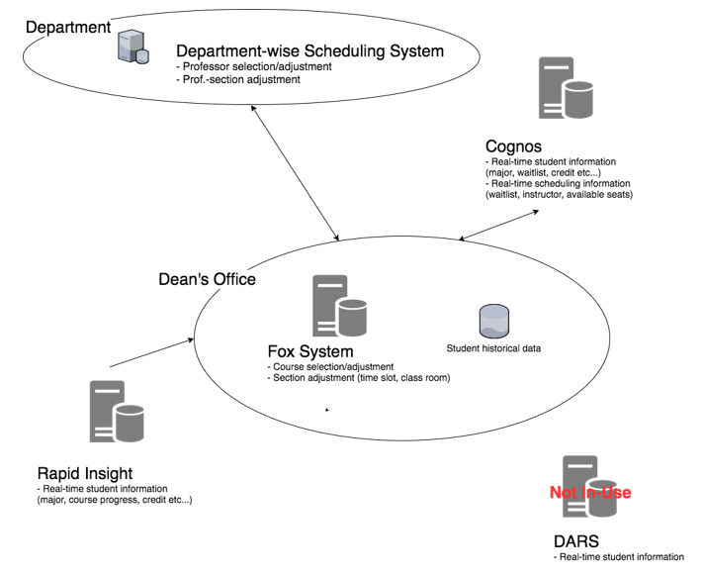
Current Process & Issues
Current System & Data Interaction Overview
Fox System Only utilizes historical data to predict demand.
Real-time data is manually reflected and implemented from Cognos & Rapid Insight.
John, Kevin, Liang, Taiki - MIS4596 Sec001 Fall 2017
Notes:
IMPORTANT NOTES:
Dean’s office currently owns Fox System, which only utilizes the historical student data to predict the student demand.
Real-time student data is given to Dean’s office from Rapid Insight, another system own by Fox, which has the current student status such as student class progress and class dependencies
Once the Dean’s office designed course & section in terms of projected student demand, number of classroom, & seats available for classroom, Dean peovides data to dept and dept make request for adjustment (more/less class).
Explanation:
As the slide indicates...

Slide 16
Current Process & Issues
Issues
Course scheduling dependencies
Communication with related entities
Faculty hiring
Reliance of historical data
Change in process & data flow can improve situation
John, Kevin, Liang, Taiki - MIS4596 Sec001 Fall 2017
Notes:
IMPORTANT NOTES:
Explanation:
As the slide indicates

Slide 17
Strategic Solution
Solution - Course Scheduling & Faculty Planning
Takes the burden off of the Dean's Office by enabling the departments with real time data
John, Kevin, Liang, Taiki - MIS4596 Sec001 Fall 2017
Notes:
IMPORTANT NOTES:
Major change in solution from current process is:
Divide course scheduling workload into two aspects - course/section (time & location) designing and student demand prediction/faculty hiring
Assign student demand prediction/faculty hiring to departments as dept should know more about student status and possibility of taking next class
Start the both process at the same time
Let depts to access more broad data such as real-time student data
Make course designing process agile (in the chart, as the red circle arrow indicates: communicate more frequently)
Benefit of the solution
Less concentrated workload for both Dean & dept in a specific limited time period
More accurate student demand prediction (as the dept will involve in the planning process at the earlier stage)
Improve efficiency by reducing the communication iteration of specific time period
Reduce in last-minutes reactive faculty hiring cost (admins, dept admins) by more accurately projecting student demand
Explanation:
As the slide indicates...

Slide 18
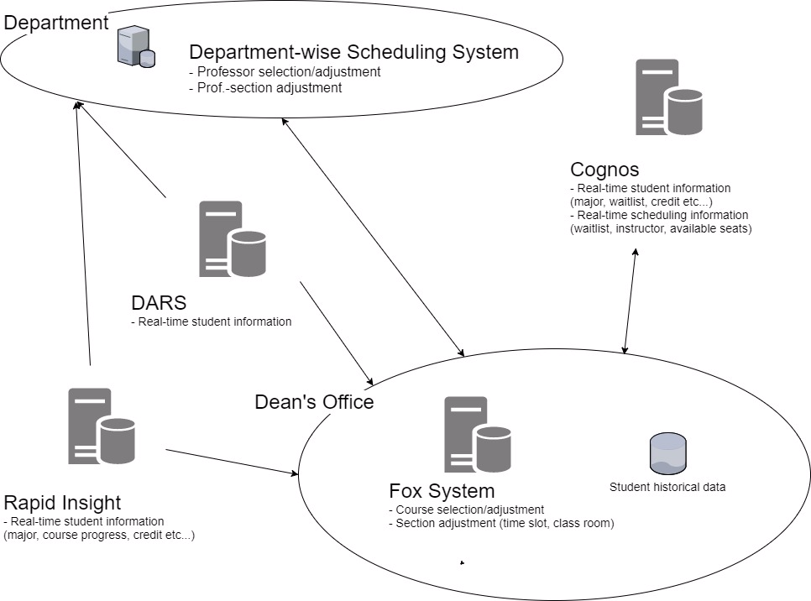
Strategic Solution
Solution - System & Data Interaction Overview
Collect data from DARS to Fox System.
Let department use DARS & Rapid insight to draft initial dept.-level course scheduling (faculty & student size).
John, Kevin, Liang, Taiki - MIS4596 Sec001 Fall 2017
Notes:
IMPORTANT NOTES:
Please emphasize that in the solution, Dean’s office has the access to DARS
Also that dept has access to Rapid Insight and DARS.
Explanation:
Others are as slide indicates

Slide 19
Business Case
“To-Be Process” would save each administrator 5 hours a week.
Dollar amount for each administrator’s saved time equals $7,500 a year.
Based on average administrator salary of $60,000
What would the administrator do with extra 5 hours a week?
John, Kevin, Liang, Taiki - MIS4596 Sec001 Fall 2017

Slide 20
Business Case
Time Savings
Administrators will focus on proactive hiring versus reactive hiring.
Reactive hiring is more costly
Administrative Costs
Saving time will reduce administration costs. Administrators will use time to focus efforts on being more strategic with their hiring process.
The new process will save money and allow administrators to focus on what is important to them.
John, Kevin, Liang, Taiki - MIS4596 Sec001 Fall 2017

Slide 21
Suggestion & Implementation
Final Suggestion
Change data access authority to be open to dept
Change Dean & dept course scheduling process
Spread out workload over scheduling process
Implementation
Conduct meeting with each dept. at start of scheduling process
Make scheduling parallel and agile
Develop Fox System to be more dept. inclusive
John, Kevin, Liang, Taiki - MIS4596 Sec001 Fall 2017
Notes:
IMPORTANT NOTES:
Explanation:
Just as slides indicates...

