Slide 1
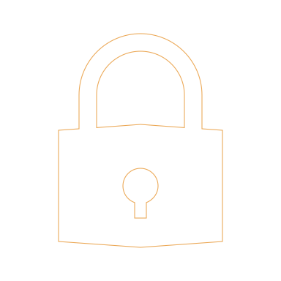
The Role of UX in Cybersecurity
Miray Bolukbasi

Slide 2
AGENDA
What should be protected?
Security Pillars and Trends
Privacy by Design
Norman’s Concepts

Slide 3
WHAT DATA SHOULD BE PROTECTED?
As a product designer, you probably think it is programmers’ job to code and design security systems for your design
You should bring it to user’s notice first that their data will be used
You should get approval by your design
You should have encryption for user data
You should implement strong access control system
When users trade personal data in exchange for service/product, they expect you to handle their information.

Slide 4
SECURITY TRENDS
Focusing on microinteractions
Maximizing user privacy
Privacy policies

Slide 5
1 – Focusing on Microinteractions
Microinteractions:
“meant for a single purpose or task They help guide users through the interface and gives them visual feedback about whether their actions were successful or not”
UX designer can use microinteractions to better security by communication.
If you can explain why passwords must be certain length or guide them through security measures when creating an account.
Use these interactions to also celebrate the user when they complete the security requirements that you designed.

Slide 6
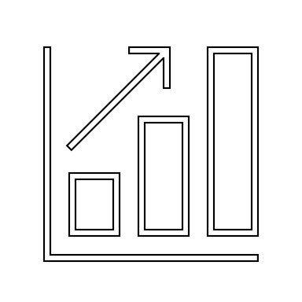
2- Maximize User Privacy by only asking for essential data
More data means harder to protect user privacy. Checking all the information that asked to user can help UX designer to eliminate unnecessary fields of forms or registration.
You can also improve user experience by making the signup process easier and less-time consuming.

Slide 7
3 - Simply Privacy Policies
As a UX designer, you should be aware of the legal requirements. When you request data from user to keep and use it, you Should get permission.
Ensuring these privacy policies should be clear and simple for user to understand and accept.

Slide 8
Norman’s Concepts
1. Feedback
Simple measure that can enhance security of an application.
When user enters wrong information, we should provide them with feedback about the error in the login credentials.
2. Visibility
User should know what all are the options are
You need to make it visible to see security solutions that you provide for users. That way they will feel confident about trusting your design and application.
3. Affordance
The relationship between what something looks like and how it’s used
Users have their knowledge in head can be different than yours as a designer. You should briefly explain the security questions or data privacy to user in order to maintain clarity of affordances.

Slide 9
Norman’s Concepts
4. Mapping
Relationship between control and effect
User should know the limits, if they have limitless possibilities when they login to system, their trust will be damaged, and it will make your jobs harder to secure the system.
5. Constrains
Limiting range of interaction possibilities for user to simplify interface & guide the user to the appropriate next action
Banners, scroll bars should be easy to use so user will be convinced to use your login, data entry or two-factor authentication. They should be sure and reported what they just did.
6. Consistency
limiting range of interaction possibilities for user to simplify interface & guide the user to the appropriate next action
Your security related design should perform in same way every time user engages with it. It will affect the user’s trust and demand on how much they are willing to share their data.

Slide 10
References
https://www.rossul.com/2018/blog/the-role-of-ux-in-cyber-security/
https://usabilitygeek.com/user-experience-and-security/
https://dev.to/natasa_lane/why-ux-is-an-essential-element-of-cybersecurity-3901

