Slide 1
DATA SCIENCE MIS0855 Communicating Using Data

Slide 2
Discuss
The Davenport article was about analysis, not specifically data visualization, but…
Why is it important to think of the story when creating a visualization?
Talk about what the rules for storytelling mean for visualization? (see Davenport article or slide 4)

Slide 3
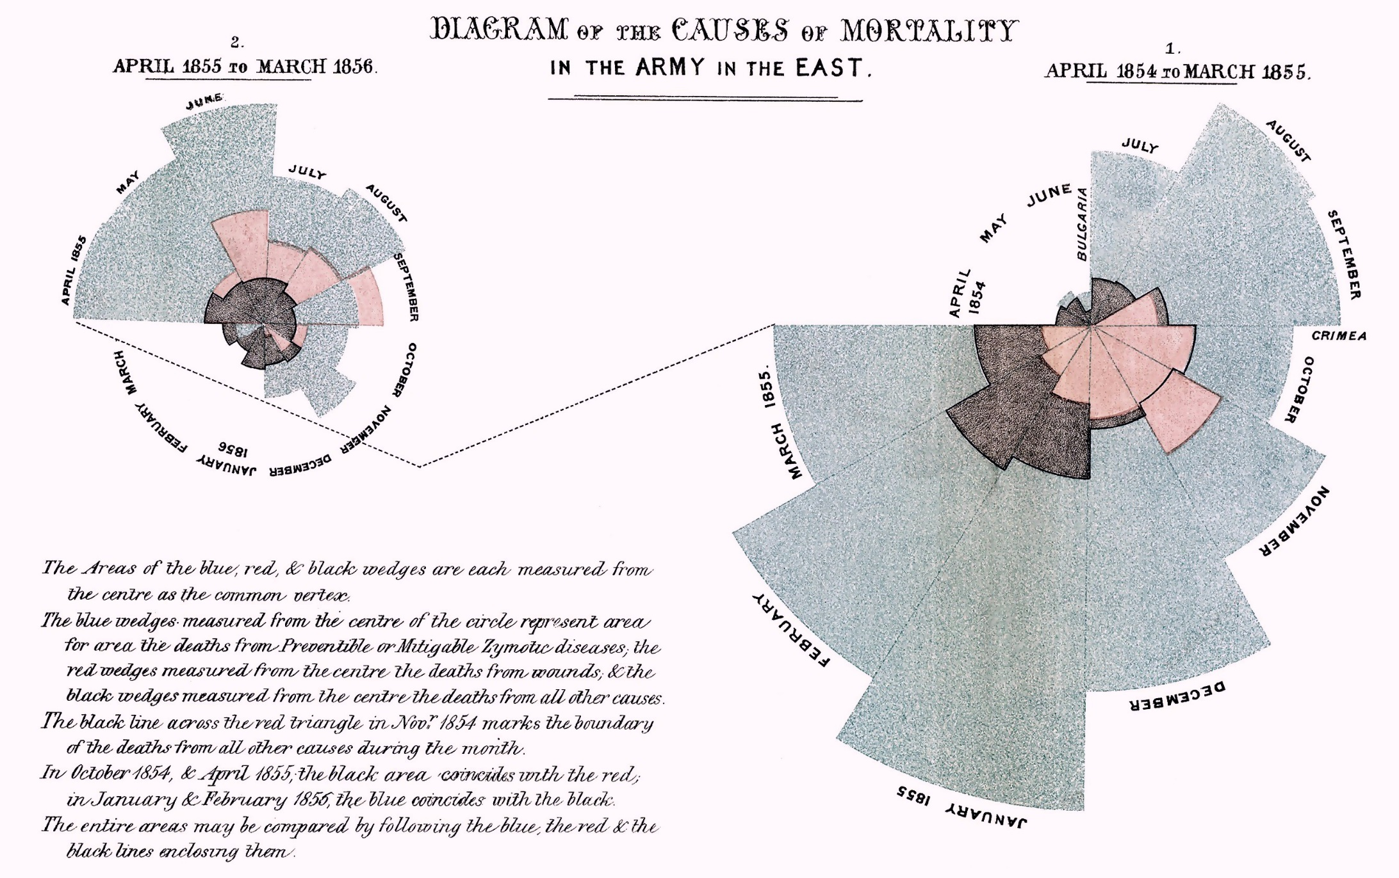
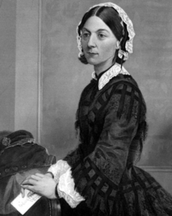
Florence Nightingale, data scientist?
What story does this tell?
Causes of death in the Crimean war:
Blue – preventable diseases
Red – wounds
Black – other
http://en.wikipedia.org/wiki/Florence_Nightingale

Slide 4
Coats’ rules for storytelling (paraphrasing…)
Keep in mind what is interesting to the audience
Come up with the ending before figuring out the middle
Put it on paper
Find the essence of the story and the simplest way to tell it
https://www.flickr.com/photos/jasonpratt/6071684609
From: Davenport, T. (2013). Telling a Story with Data. Deloitte University Press.

Slide 5
Roumeliotis’ steps for communicating an analysis
My understanding of the [business] problem
How will I measure the [business] impact?
What’s the available data?
The initial solution hypothesis
The solution
The [business] impact of the solution
But avoid communicating:
Technical terminology
Step-by-step methodology
Complex statistics
To some extent, these can all be part of the visualization.
From: Davenport, T. (2013). Telling a Story with Data. Deloitte University Press.

Slide 6
Evaluate this diagram’s story
What is the problem?
How is impact measured?
What is the data?
What solution (conclusion) is implied?
Causes of death in the Crimean war:
Blue – preventable diseases
Red – wounds
Black – other
http://en.wikipedia.org/wiki/Florence_Nightingale

Slide 7
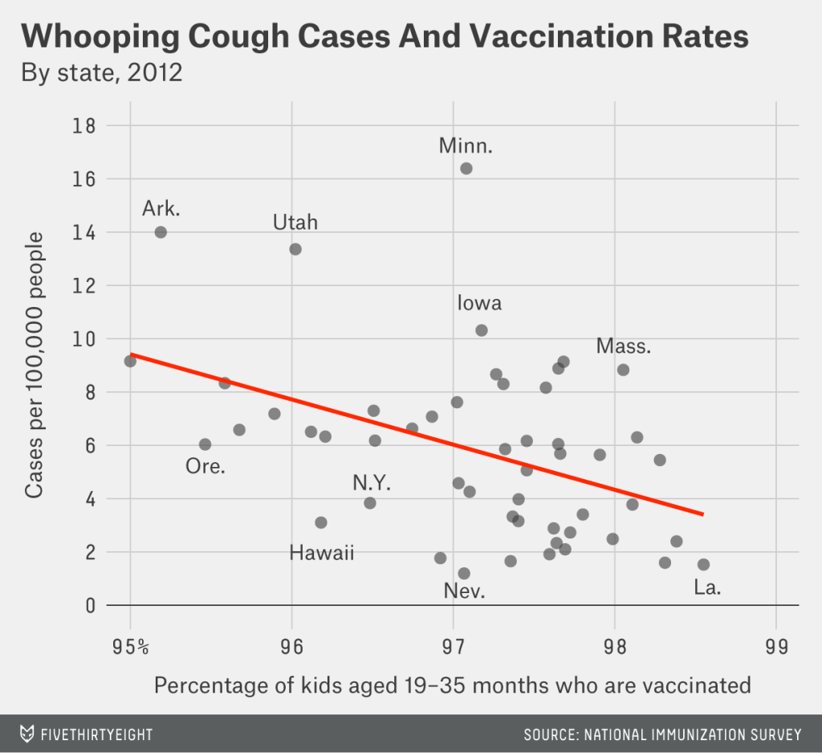
Evaluate this diagram’s story
What is the problem?
How is impact measured?
What is the data?
What solution (conclusion) is implied?
http://fivethirtyeight.com/features/why-states-should-aim-for-100-percent-vaccination/

Slide 8
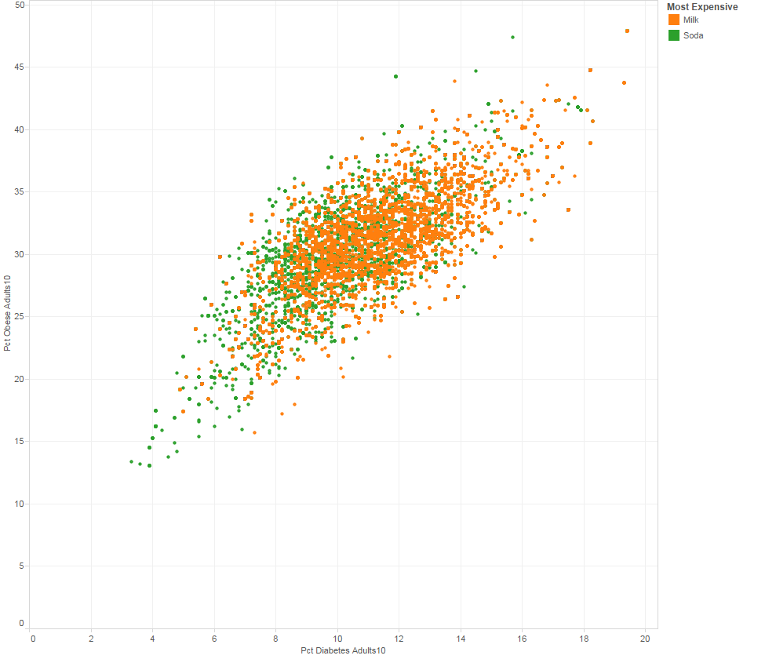
Evaluate this diagram’s story
What is the problem?
How is impact measured?
What is the data?
What solution (conclusion) is implied?

Slide 9
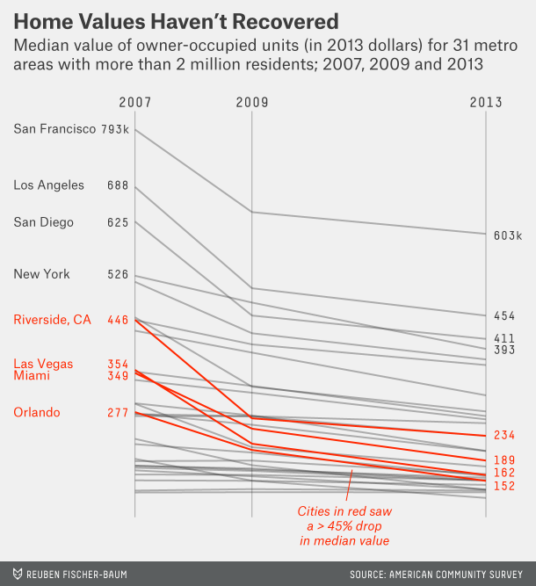
Evaluate this diagram’s story
What is the problem?
How is impact measured?
What is the data?
What solution (conclusion) is implied?
http://fivethirtyeight.com/datalab/most-of-the-u-s-saw-little-recovery-in-2013/

Slide 10
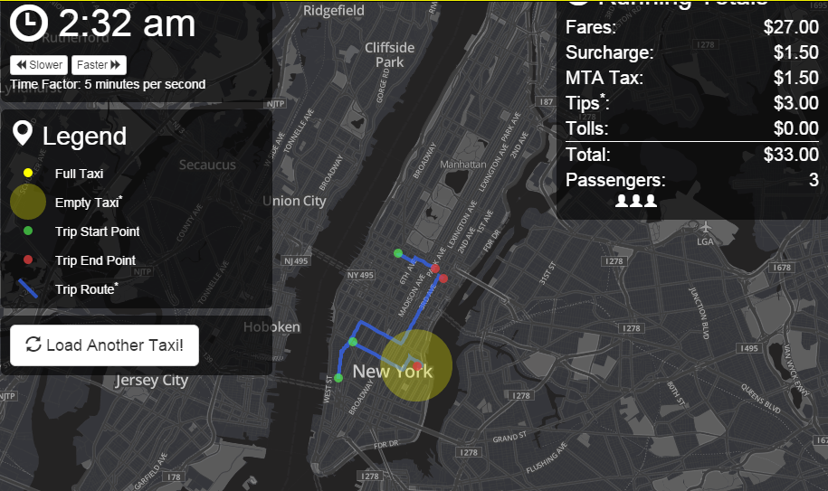
Evaluate this diagram’s story
What is the problem?
How is impact measured?
What is the data?
What solution (conclusion) is implied?
https://chriswhong.github.io/nyctaxi/

