Slide 1
DATA SCIENCE MIS0855 Storytelling with Infographics

Slide 2
Discuss
How are infographics different from data visualizations?
Infographics can contain data visualizations but data visualizations stand on their own
When should you use infographics?
When should you stick to data visualizations?
Infographics contain more information and can be used for an audience that may not have knowledge of the topic. Data visualizations give one view of data without a lot of other info.

Slide 3
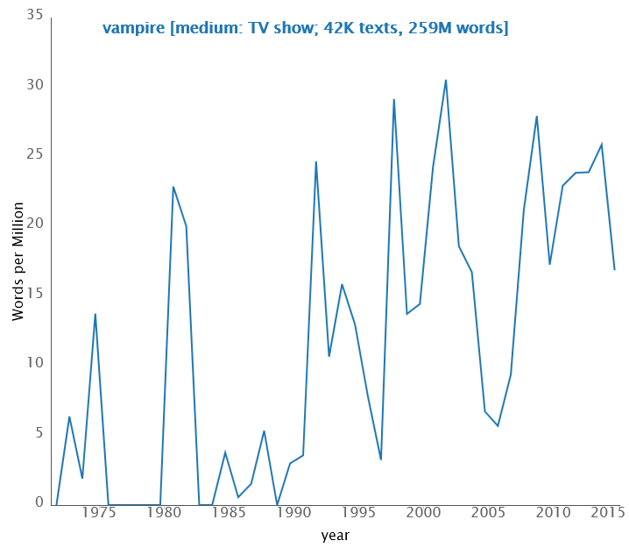
Infographics versus Data Visualizations (Krum, 2014)
Infographic –data visualizations, text, images to tell a complete story
Data visualization – a visual representation of data
http://infographics.idlelist.com/how-vampires-are-sucking-the-life-out-of-social-media/
Occurrences of the word “vampire” in TV Show Dialog (1970-2014) from movies.benschmidt.org

Slide 4
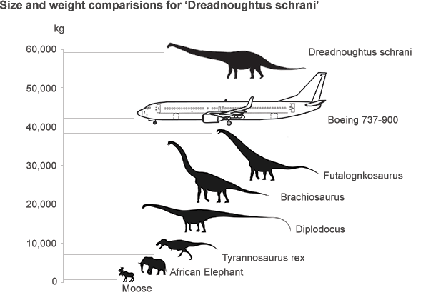
The value of infographics
How do infographics help us deal with big data?
Can’t show a giant database-infographics allow for the visualization of a lot of data
How about dealing with Information overload?
Helps to sort through all of the data and present specific aspects of it
Pattern recognition Context Picture superiority effect
http://dailyinfographic.com/preparing-your-home-for-a-natural-disaster-infographic
http://www.bbc.com/news/science-environment-29050114

Slide 5
Storytelling through infographics
Not different from the storytelling tips from before, but from a slightly different angle…
Introduction/Foundation
Ah-Ha!
The Main Event
Conclusion/Call-to-action
From: Krum, R. (2014). Cool infographics: Effective Communication with Data Visualization (Figure 1-21).

Slide 6
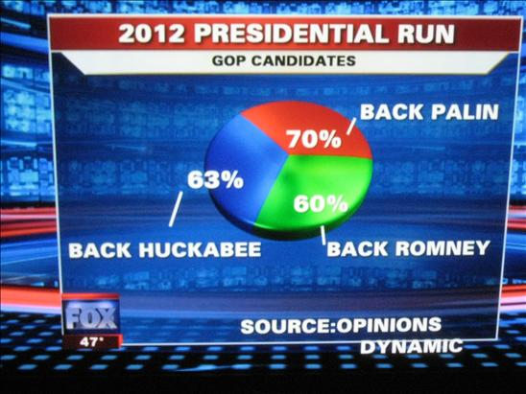
Design Tips for Infographics: Be Accurate (These are all good for data visualizations too!)
vs.
http://flowingdata.com/2009/11/26/fox-news-makes-the-best-pie-chart-ever/
Adapted from Krum, R. (2014). Cool infographics: Effective Communication with Data Visualization.

Slide 7
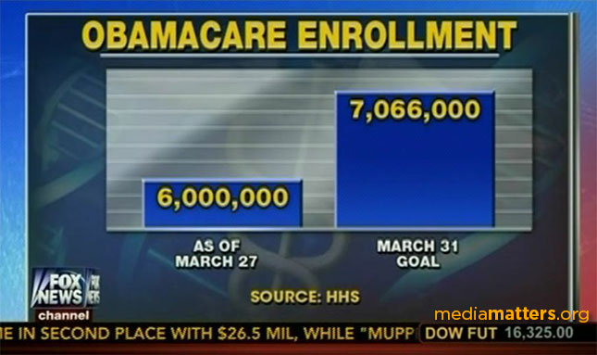
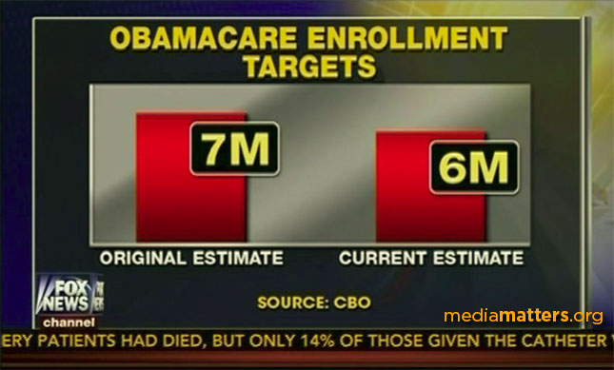
Design Tips for Infographics: Axes should include 0
vs.
vs.
http://mediamatters.org/blog/2014/03/31/dishonest-fox-charts-obamacare-enrollment-editi/198679
Enables accurate representation of the difference between data points

Slide 8
Design Tips for Infographics: Visualizing Area
A $500
A $500
B $250
B $250
WIDTH of A is twice width of B, but AREA of A is 4x area of B!
Overstates relative value by factor of two!
WIDTH of A is 1.4x width of B, so area of A is now 2x area of B!
Adapted from Krum, R. (2014). Cool infographics: Effective Communication with Data Visualization.

Slide 9
Other Design Tips for Infographics from Krum
5-second rule
Tell one story really well
Minimize text – visualize when possible
Eliminate legends when possible
Be data transparent (cite your sources)
http://en.ilovecoffee.jp/posts/view/79
Adapted from Krum, R. (2014). Cool infographics: Effective Communication with Data Visualization.

