Slide 1
Digital Systems
4.1 Learn IT! #1 Kickoff
FOX
MIS

Slide 2
ROADMAP
Week 1:
Introduction & Systems Analysis
Course Description
Systems Thinking
Assignments #01 & 02
Week 2:
Digital Product Management & Introduction to Process Mapping
Max Labs 1a & 1b
Systems & Processes
Swim Lane Diagrams
Assignment #03
Week 3:
Data Modeling with Entity Relationship Diagrams
Swim Lane Diagrams
ERD Diagrams
Assignment #04
Week 4:
Digital Systems – Learn IT! #1
ERD Diagrams
Learn IT Kickoff
Assignment #05
Week 5:
Exam #1,
Max Labs & Information
Systems: Part I & II
CRM & ERP
*Exam: check course site
Assignment #06
START
Week 9:
Exam #2 & JavaScript Unit #1
Parts I & II
Hello World, Variables
*Exam: check course site
Week 8:
Information Systems & Cybersecurity
Protection Protocols
Artificial Intelligence
Assignment #08
Week 7:
Platforms & Digital Business Models: Part I & II
Platforms & Digital Models
APIs
Week 6:
Information
Systems: Parts I - III
Data Analytics
SCM
Assignment #07
Week 10:
JavaScript Unit #2 Functions
Values & Variables
Operator types
Strings
Assignment #9
Week 11:
JavaScript Unit #3 Logical Operators & Conditional Logic
Logical Operators
Conditional Types
Week 12:
JavaScript Unit #4 Loops
Intro to Loops
While and Do
Assignment #10
Week 13:
JavaScript Unit #4 Working with Loops &
HTML & CSS Unit
Writing the code
HTML & CSS Basics
Week 14:
HTML & CSS Unit
(continued)
HTML & CSS Basics
Course Reflection
Assignments #11
*Final Exam: check course site
FINISH

Slide 3
Learn IT! #1
Digital Product Management
FOX
MIS

Slide 4
Learn IT! #1 Kickoff
What?
Learn what Learn IT! #1 is all about
Why?
Position yourself for success in Learn IT! #1
FOX
MIS

Slide 5
Steps #1 & #2:
What is your personal brand?
Step #1: As a young business professional, list five prescribed images or impressions that you want others to have of you.
Step #2 : Discuss your lists in small groups
FOX
MIS

Slide 6
Steps #4 & #6:
During our discussion take notes so that you can fill out steps #4 & #6
Source:https://www.pewresearch.org/global/wp-content/uploads/sites/2/2017/11/GMD_17.10.03_Foreign-Students_Featured-Image.jpg
FOX
MIS

Slide 7
Learning Goals
TOPICS
Individual branding and reputation management
TECHNOLOGIES
Digital identity and portfolio
Search neutrality
Communities of practice
Community platform
Cloud system architecture
E-portfolio
Web analytics
SEO
Privacy
FOX
MIS

Slide 8
What is a digital identity?
Personal relationships FACEBOOK
Purchase history TARGET
Credit history EQUIFAX
Ideas DROPBOX
Finances WELLS FARGO
Likes and dislikes NETFLIX
Daily commute IPHONE
GOOGLE Your identity is the product
Grades and Graduation TEMPLE
Source: The next revolution will be reclaiming your digital identity by Nik Milanovic, https://techcrunch.com/2017/10/17/the-next-revolution-will-be-reclaiming-your-digital-identity/
FOX
MIS

Slide 9
What can you do about it?
FOX
MIS

Slide 10
AUTHENTICATION Prove who you are
PRIVACY Control what others can access
SECURITY Prevent and recover from theft
REPUTATION Personal and professional brand
NETWORKS Connect with relevant others
PROMOTION Help others find you
Digital identity management
FOX
MIS

Slide 11
Active digital identity management
Shape professional reputation
Connect with relevant others
FOX
MIS

Slide 12
Discussion
Who owns your digital identity?
How do you measure an individuals digital brand?
FOX
MIS

Slide 13
Community Platform
Cloud based platform built on WordPress
social exchanges,
open co-creation,
Website
E-portfolios
Professional achievement program
Courses
digital branding
Only platform that integrates web, professional development & coursework.
Proprietary to the nationally ranked Fox School’s MIS department.
FOX
MIS

Slide 14
Digital Identity Management Assignment
Digital identity & profile
Digital portfolio &
E-portfolio
Build a professional network
Assess with analytics
Professional achievement program (MIS majors only)
FOX
MIS

Slide 15
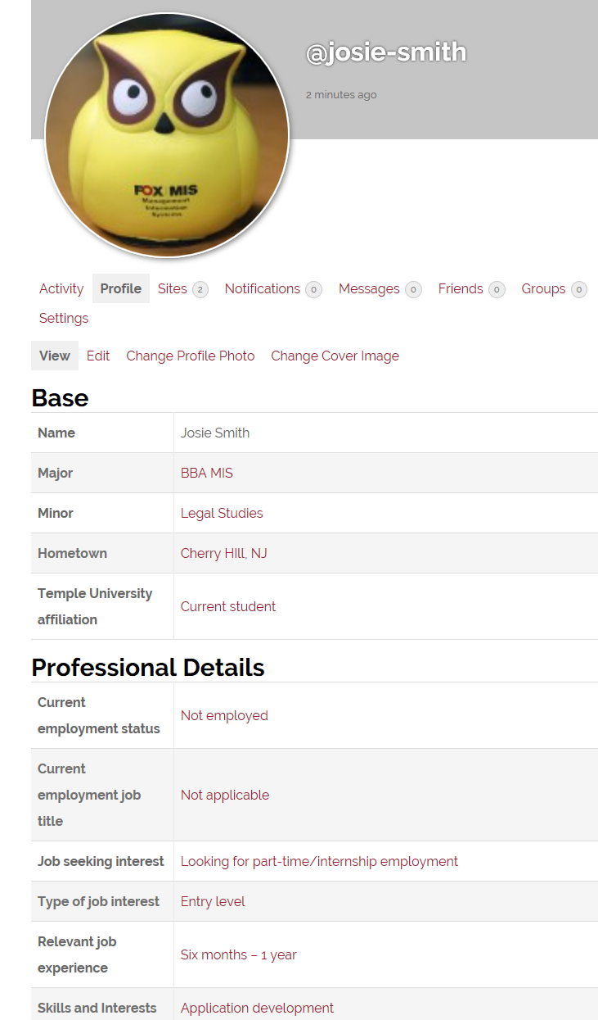
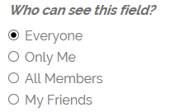
Profile
Major
Hometown
Skills and Interests
Avatar
Find others
Digital Identity
Question: Is the concept of individual privacy at odds with the need to create a public brand and remain accessible to others?
FOX
MIS

Slide 16
Digital Content
☺
☺
☺
☺
☺
☹
☹
☺
☺
☹
The WordPress editor
☺
☺
FOX
MIS

Slide 17
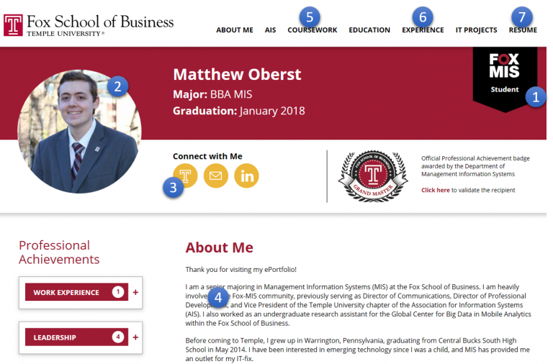
MIS major e-portfolio design requirements
Student e-portfolio
Professional picture
Profile fields
About me (home) page
Coursework
Experience and/or Interests
Resume as a PDF
FOX
MIS

Slide 18
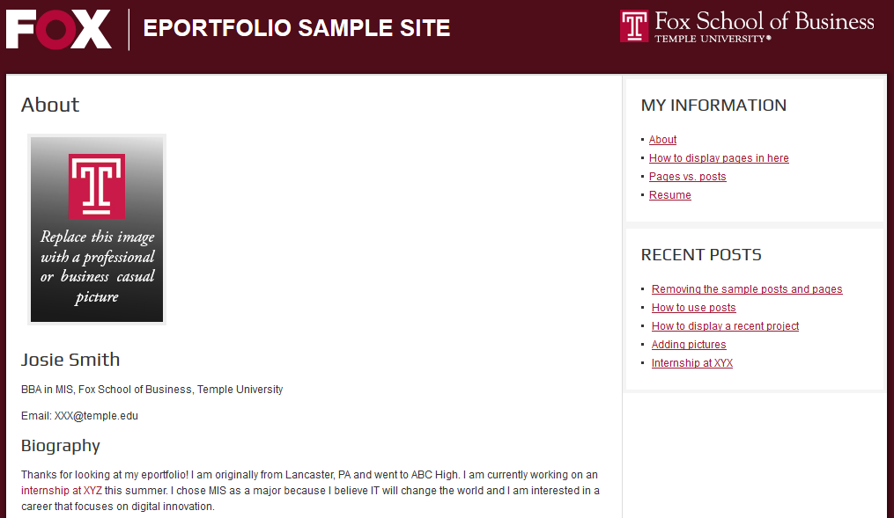
Fox major e-portfolio design requirements
Professional picture
About me (home) page
Three pages including “My Interests”
Remove all extra posts and pages
2
3
1
FOX
MIS

Slide 19
E-portfolio tips
DO’S
Help Google: Include full name in the site title.
Sample work. This is your digital portfolio!
Describe work experience.
Involvement in non-profits.
Pictures of professional experiences.
Proofread
Google and Mobile friendly formatting.
DON’TS
Inappropriate photos
Inappropriate content
Private information
Broken hyperlinks
Word documents
Don’t password protect or close the site.
Don’t use custom formatting or CSS.
FOX
MIS

Slide 20
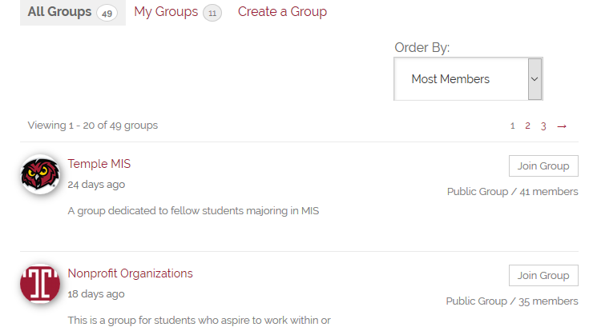
Communities of practice
A group of people who share a profession or interest.
Slickdeals.net is a community of practice for people interested in deals.
Professional communities of practice and networks are a critical resource for entry level workers
Get started with joining or creating a group!
Source: http://en.wikipedia.org/wiki/Communities_of_practice
FOX
MIS

Slide 21
All Fox Majors (excluding MIS majors)
Fox Majors assignment
http://eportfolios.fox.temple.edu
Sites automatically removed at the end of the term
MIS Majors (only)
Complete Fox MIS major assignment
http://community.mis.temple.edu
Start professional achievement program
Sites are permanent
Next…
FOX
MIS

Slide 22
More to Come
Prepare with Readings & Videos before our next class!!!

