Slide 1
Digital Systems
13.1 HTML and CSS Basics
FOX
MIS

Slide 2
There are Many “Right” Answers with Nhi Nguyen

Slide 3
HTML & CSS Basics
Digital Product Management
FOX
MIS

Slide 4
HTML is all about displaying content. CSS is all about making content look good. JavaScript adds the interactivity.
You need all three to create nifty looking sites.
FOX
MIS

Slide 5
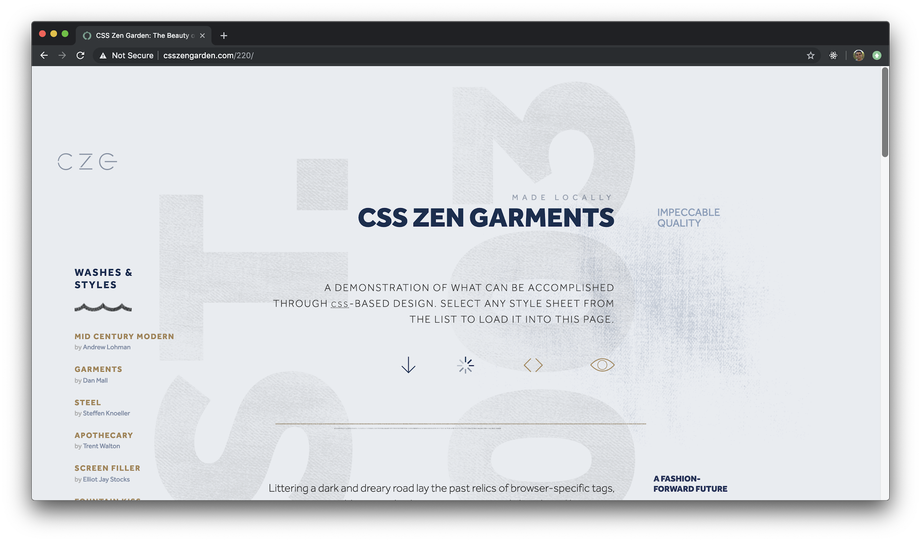
Source: JavaScript Absolute Beginner’s Guide by Kirupa Chinnathambi
FOX
MIS

Slide 6
What you can’t do using just HTML and CSS is provide interactivity. That’s a problem. This means you can’t have...
FOX
MIS

Slide 7
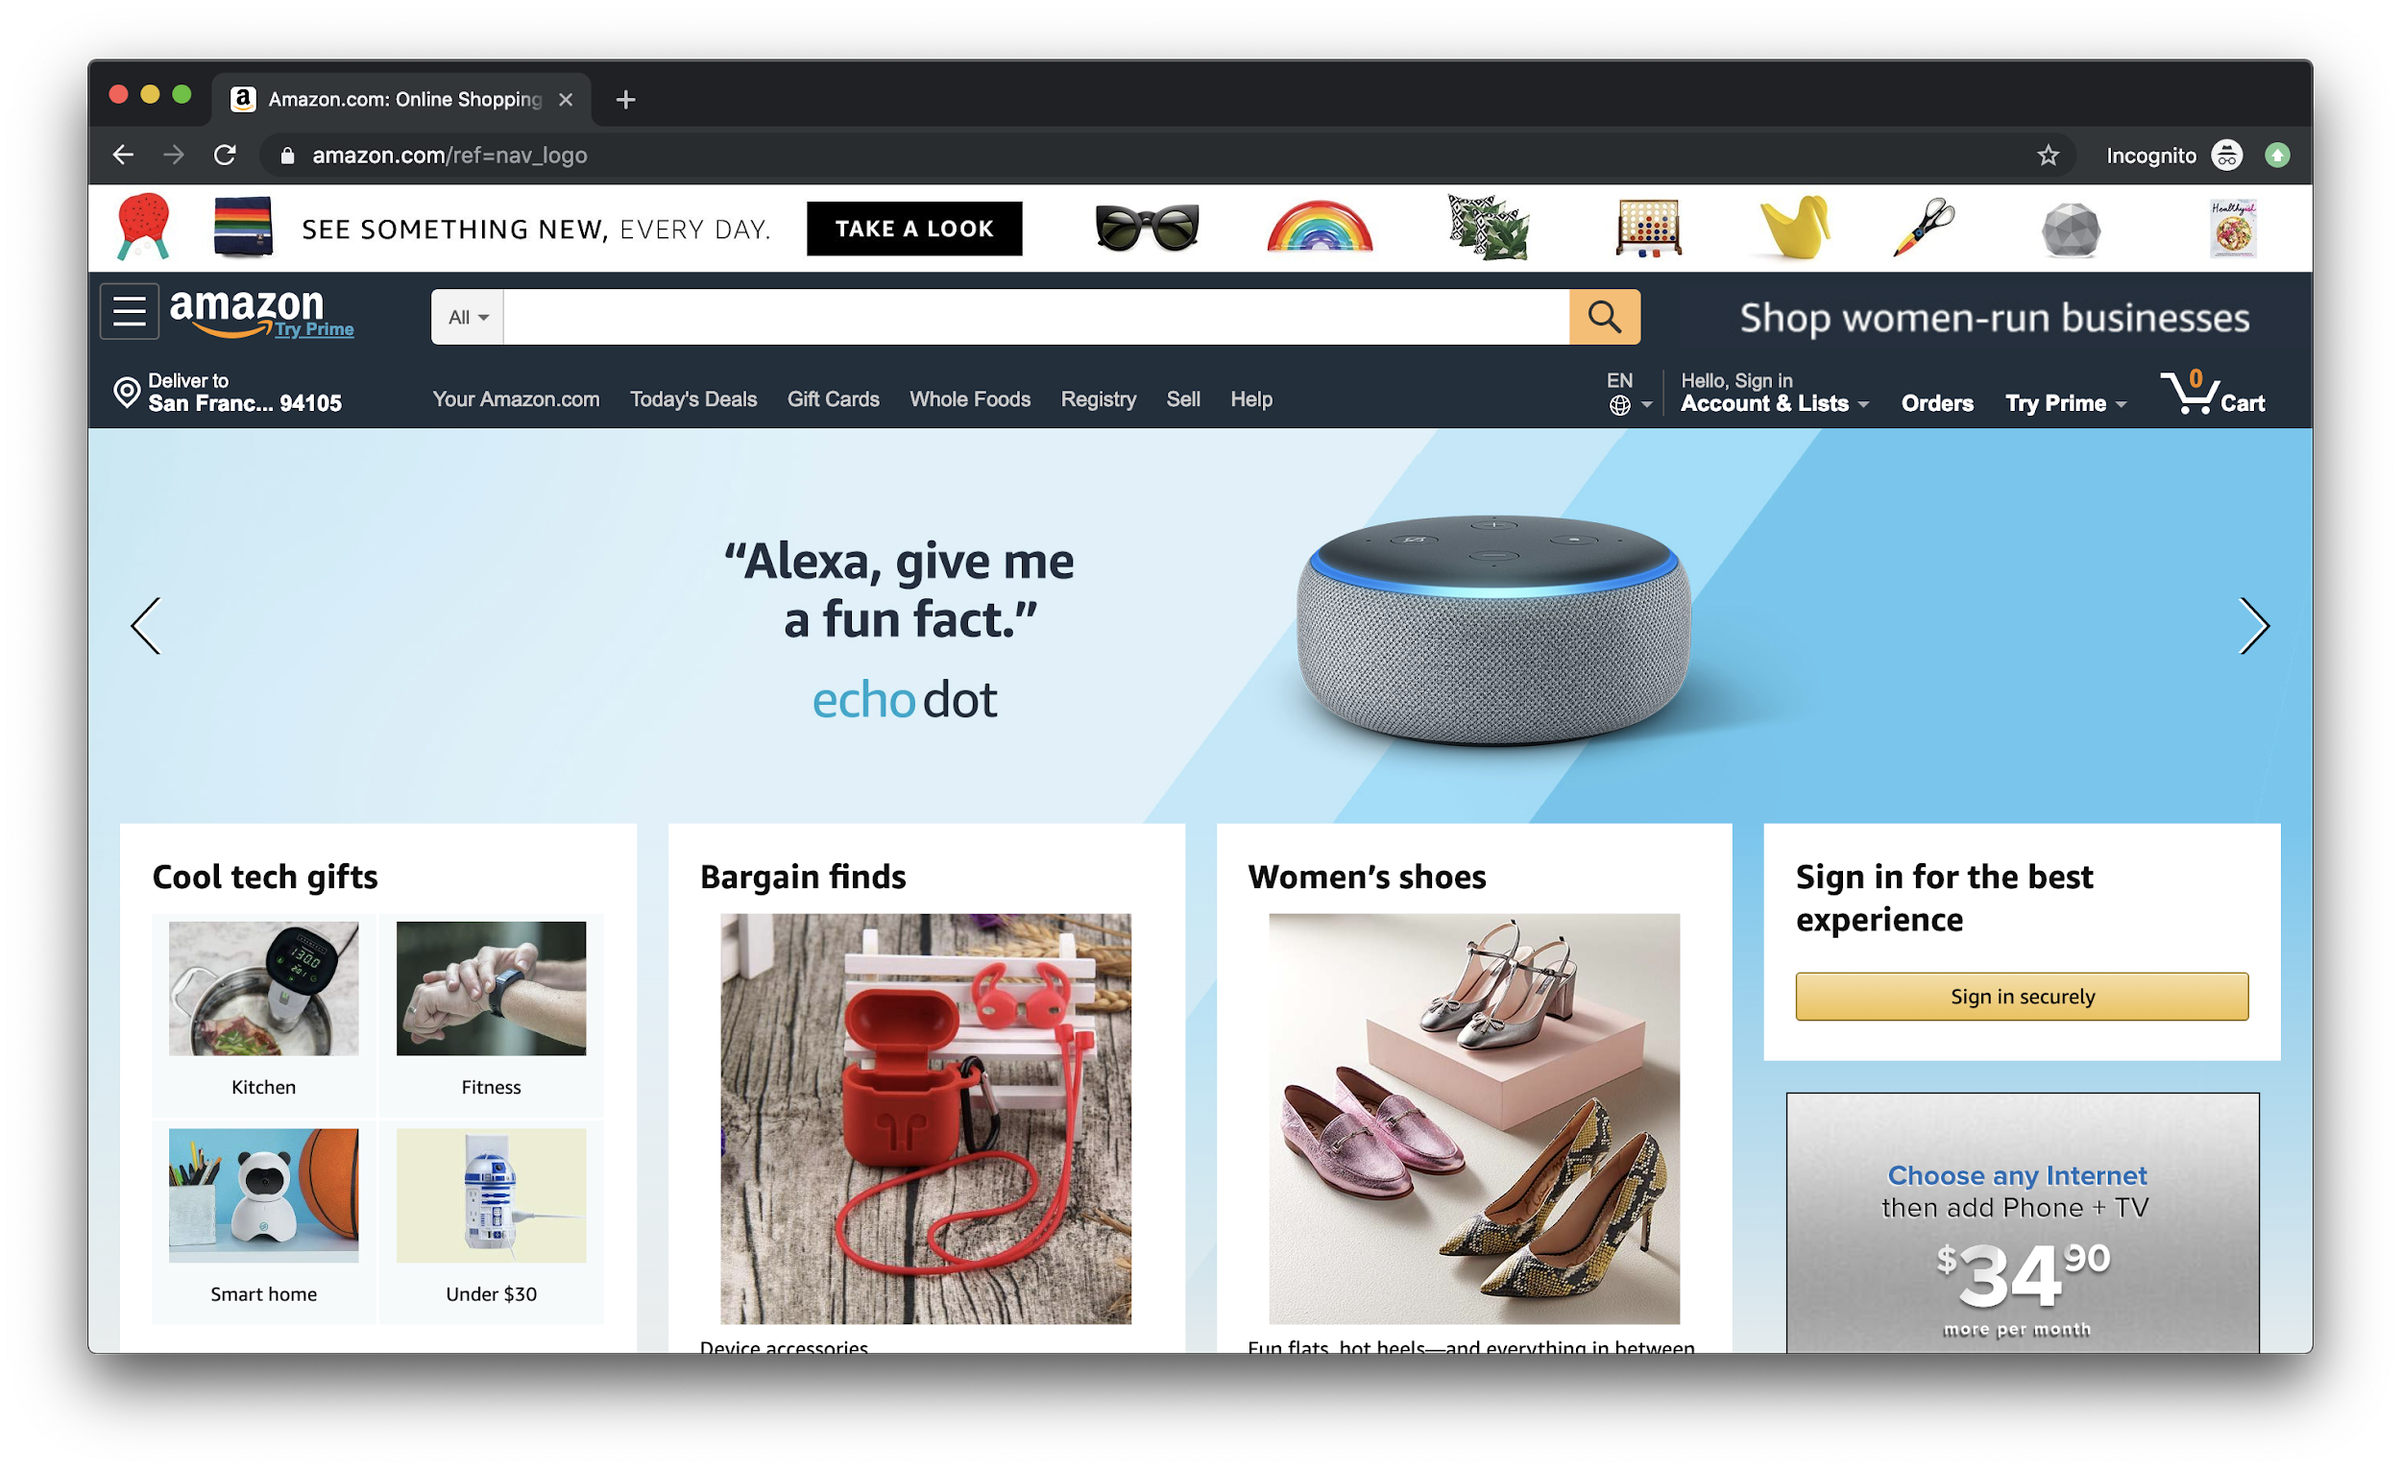
Source: JavaScript Absolute Beginner’s Guide by Kirupa Chinnathambi
FOX
MIS

Slide 8
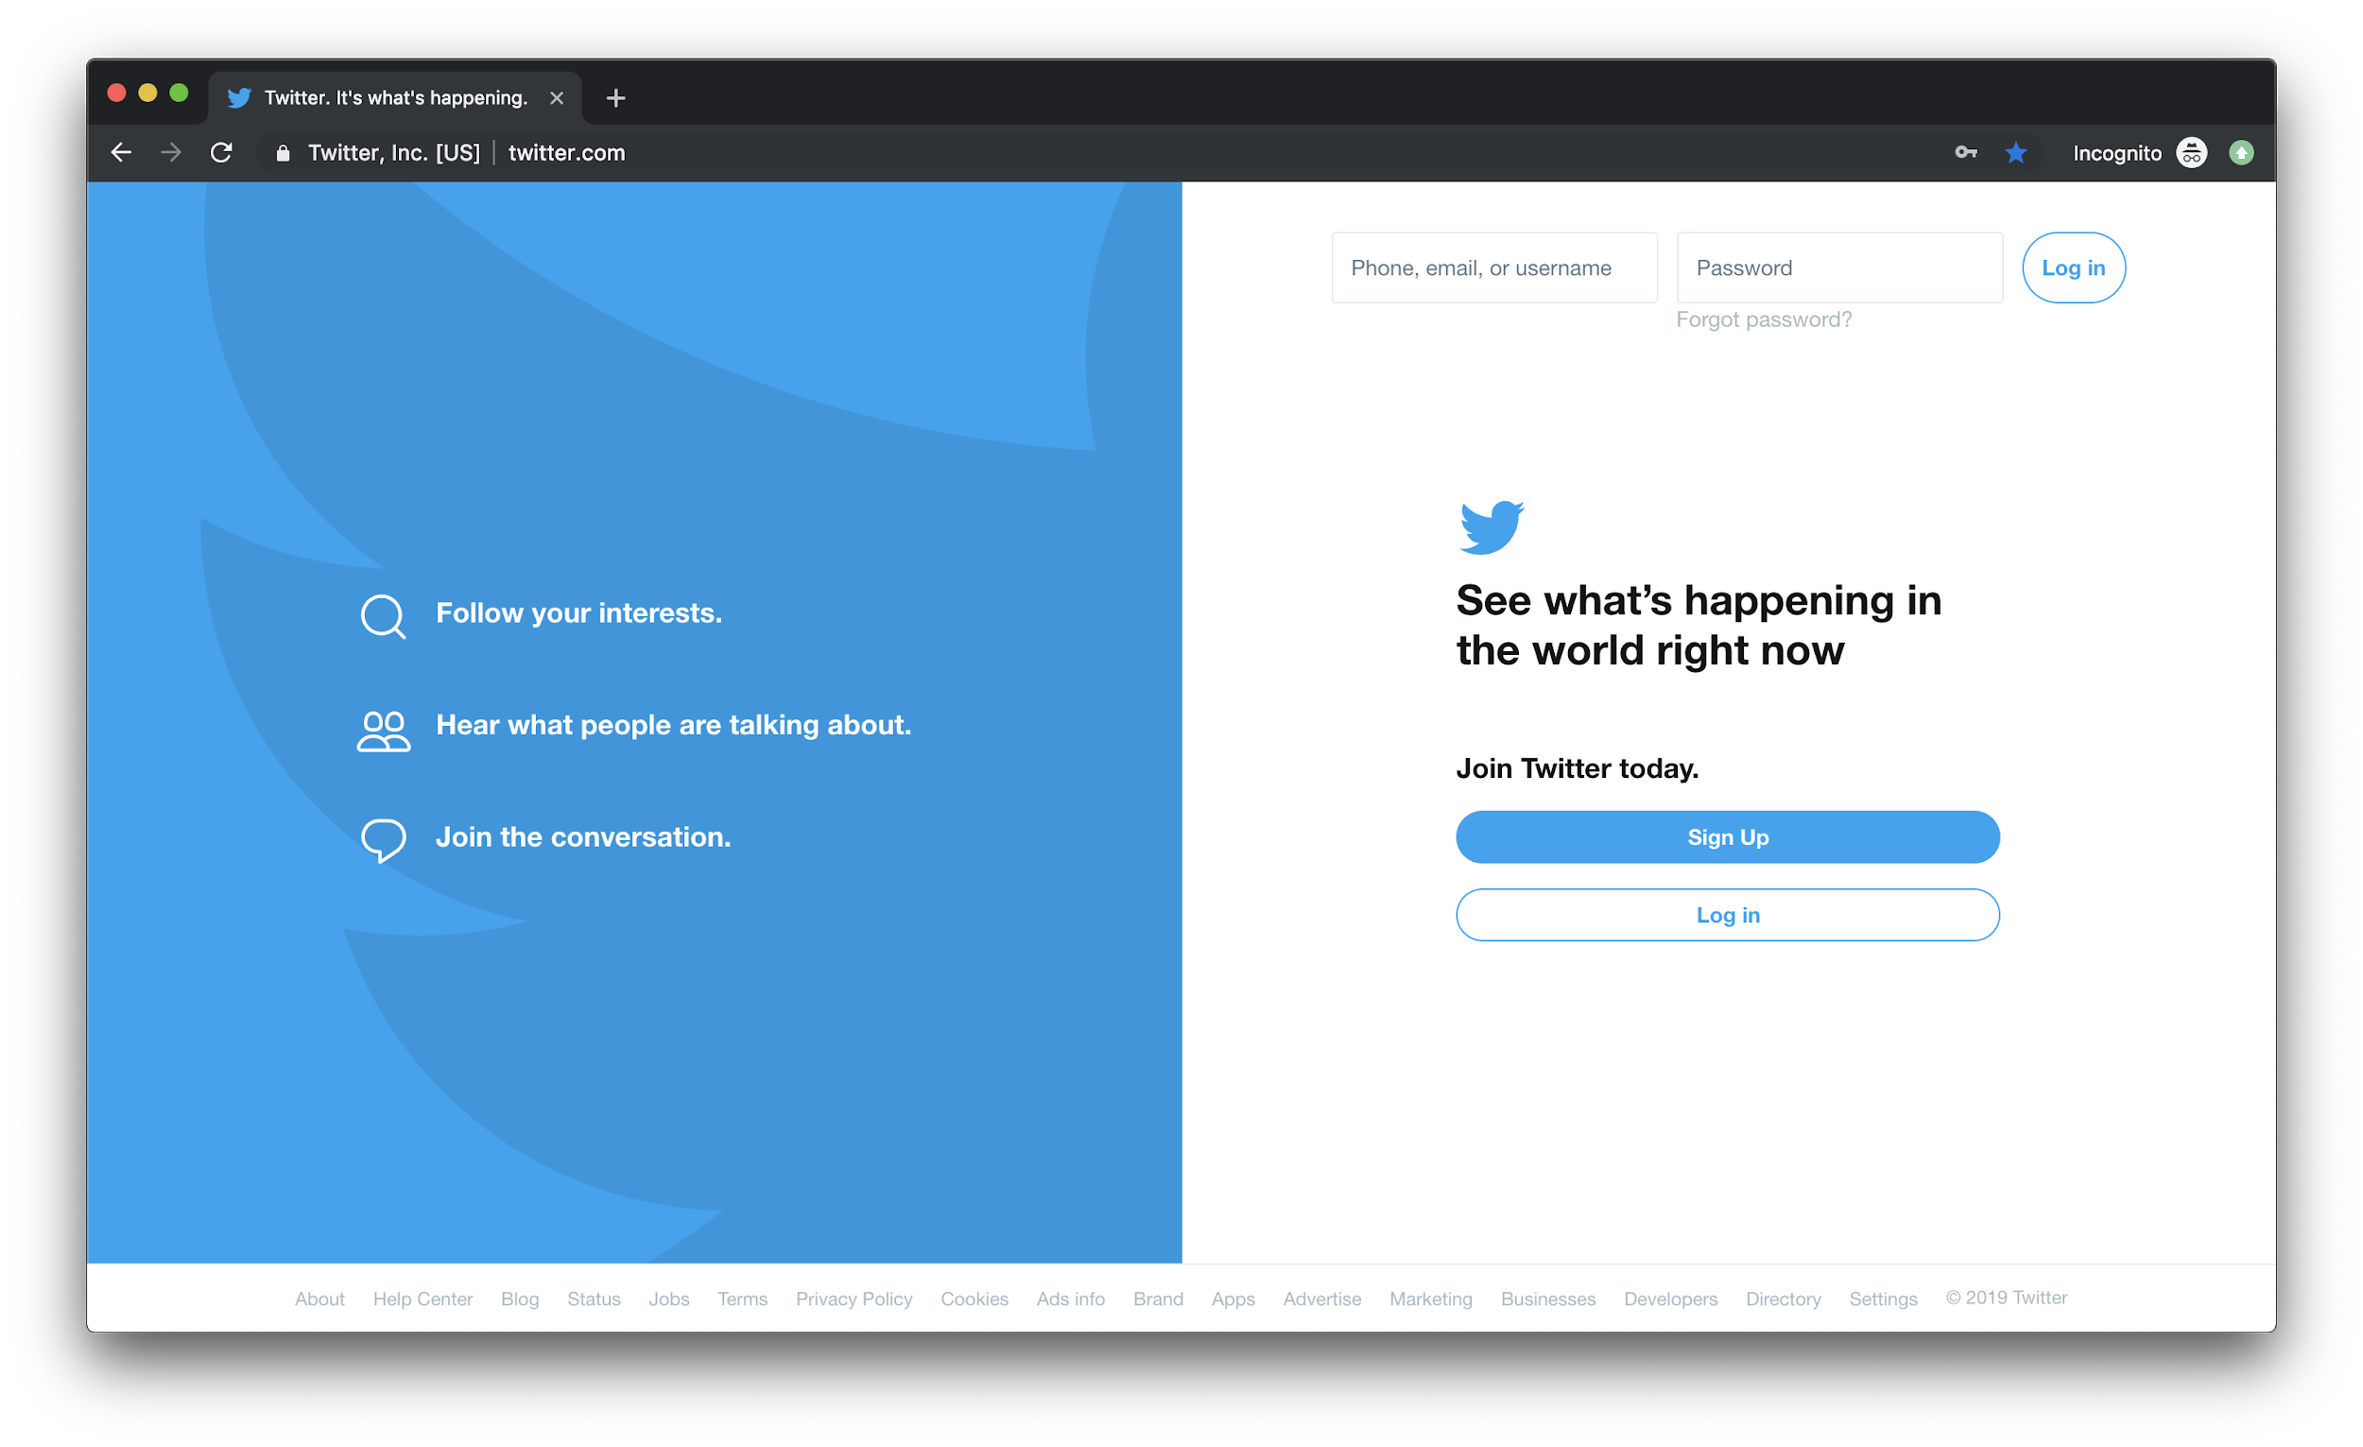
Source: JavaScript Absolute Beginner’s Guide by Kirupa Chinnathambi
FOX
MIS

Slide 9
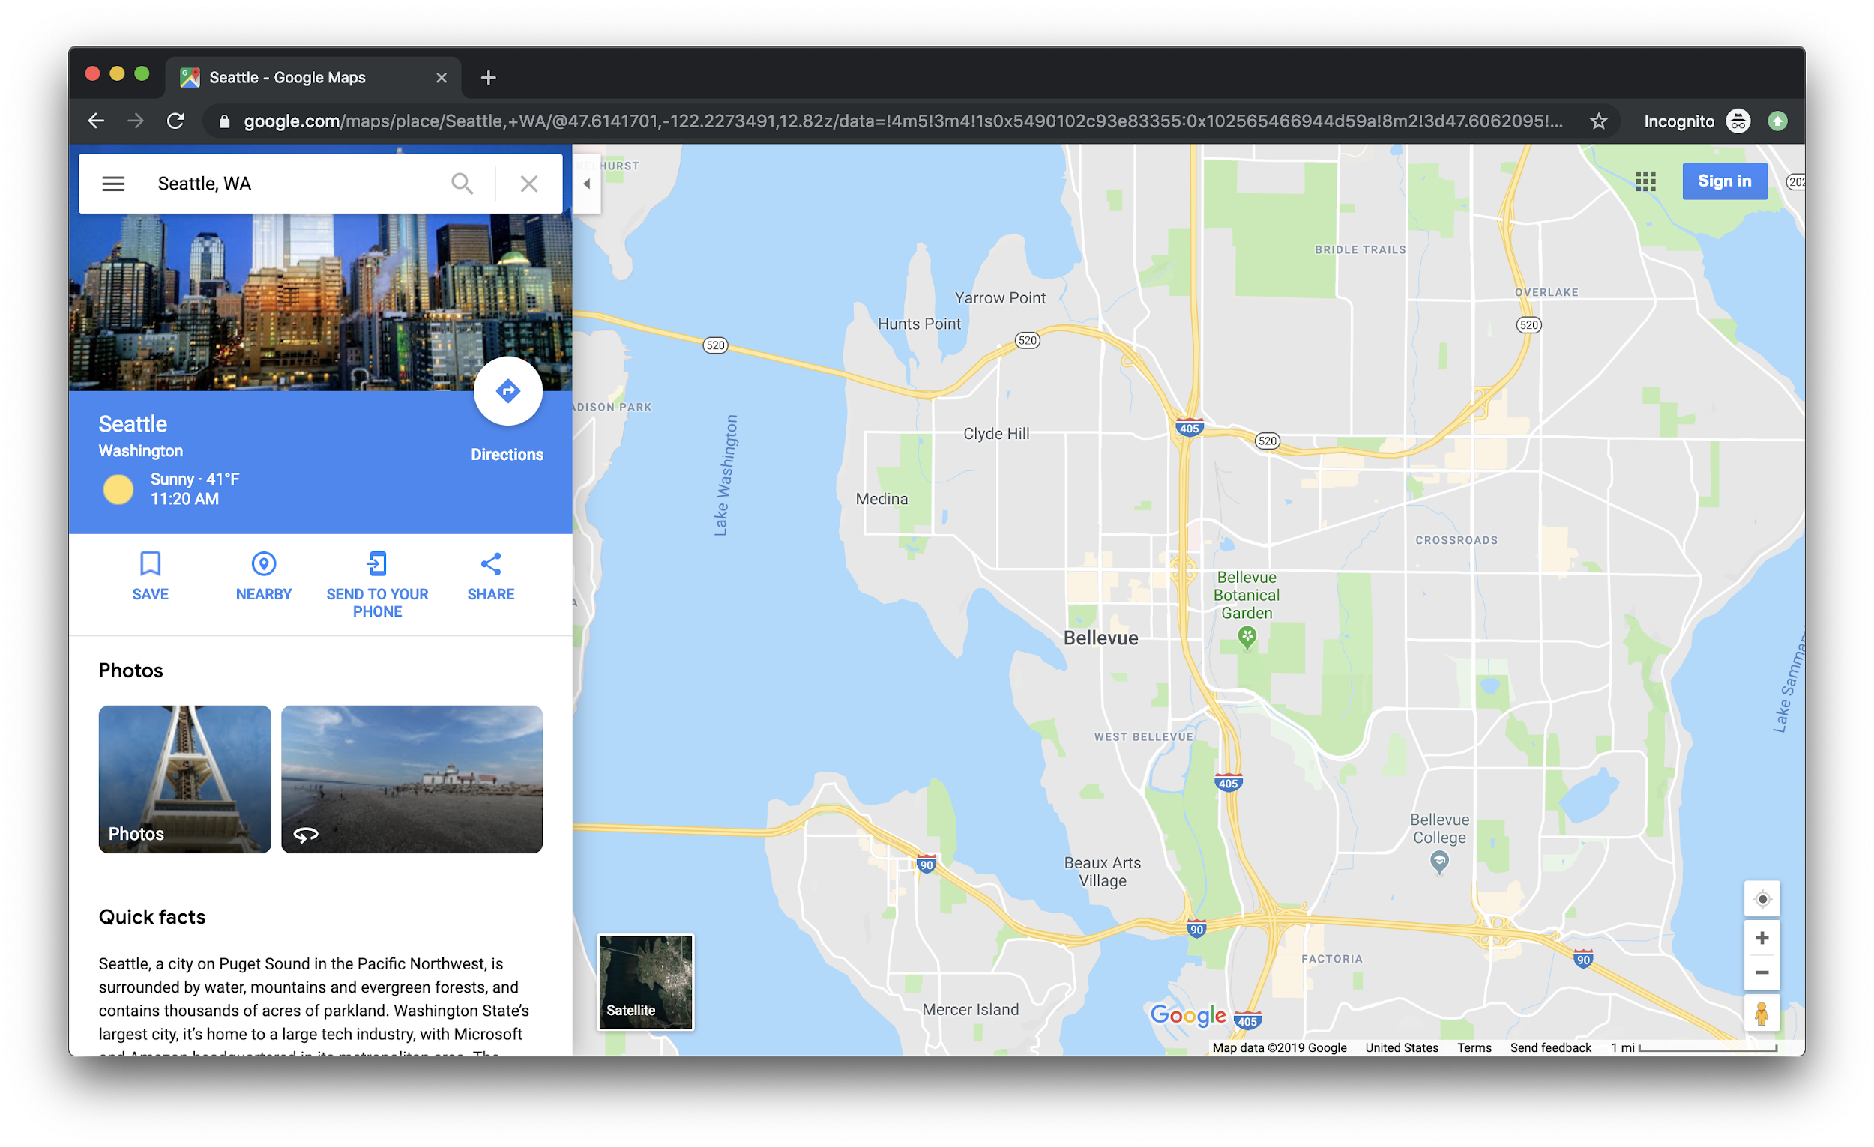
Source: JavaScript Absolute Beginner’s Guide by Kirupa Chinnathambi
FOX
MIS

Slide 10
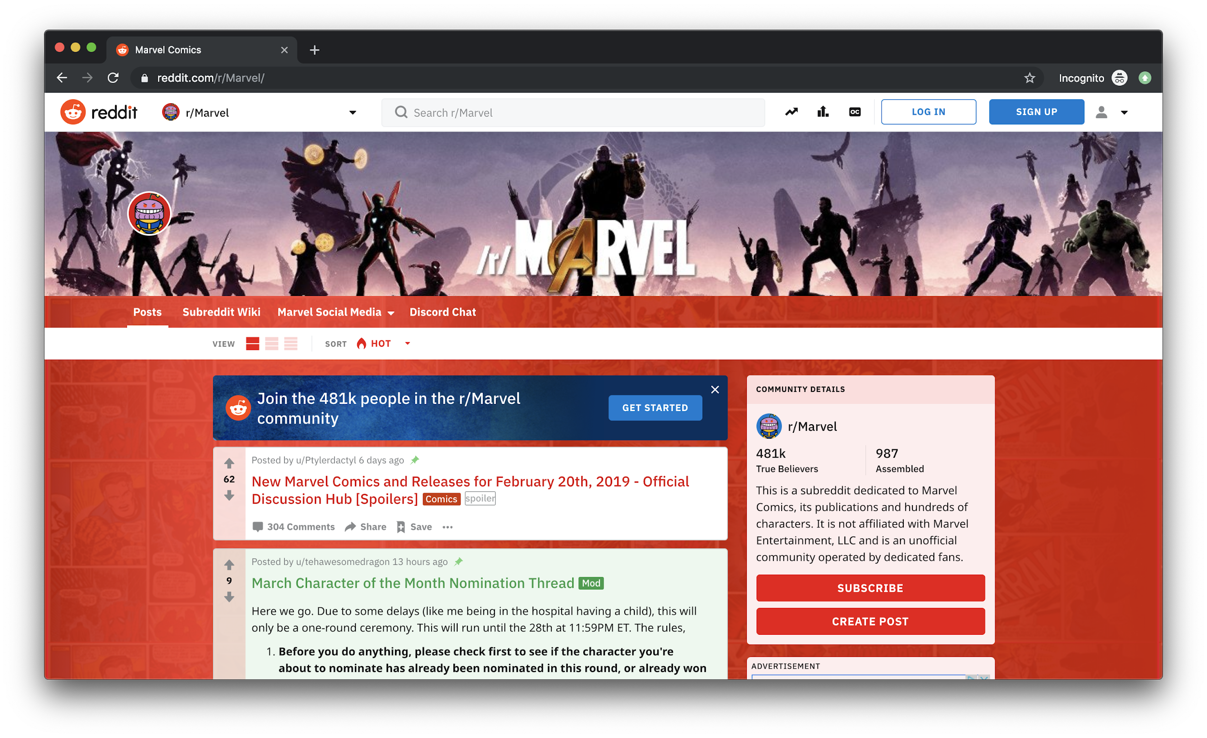
Source: JavaScript Absolute Beginner’s Guide by Kirupa Chinnathambi
FOX
MIS

Slide 11
Without interactivity, so much of the internet just won’t work. This interactivity is provided by JavaScript.
FOX
MIS

Slide 12
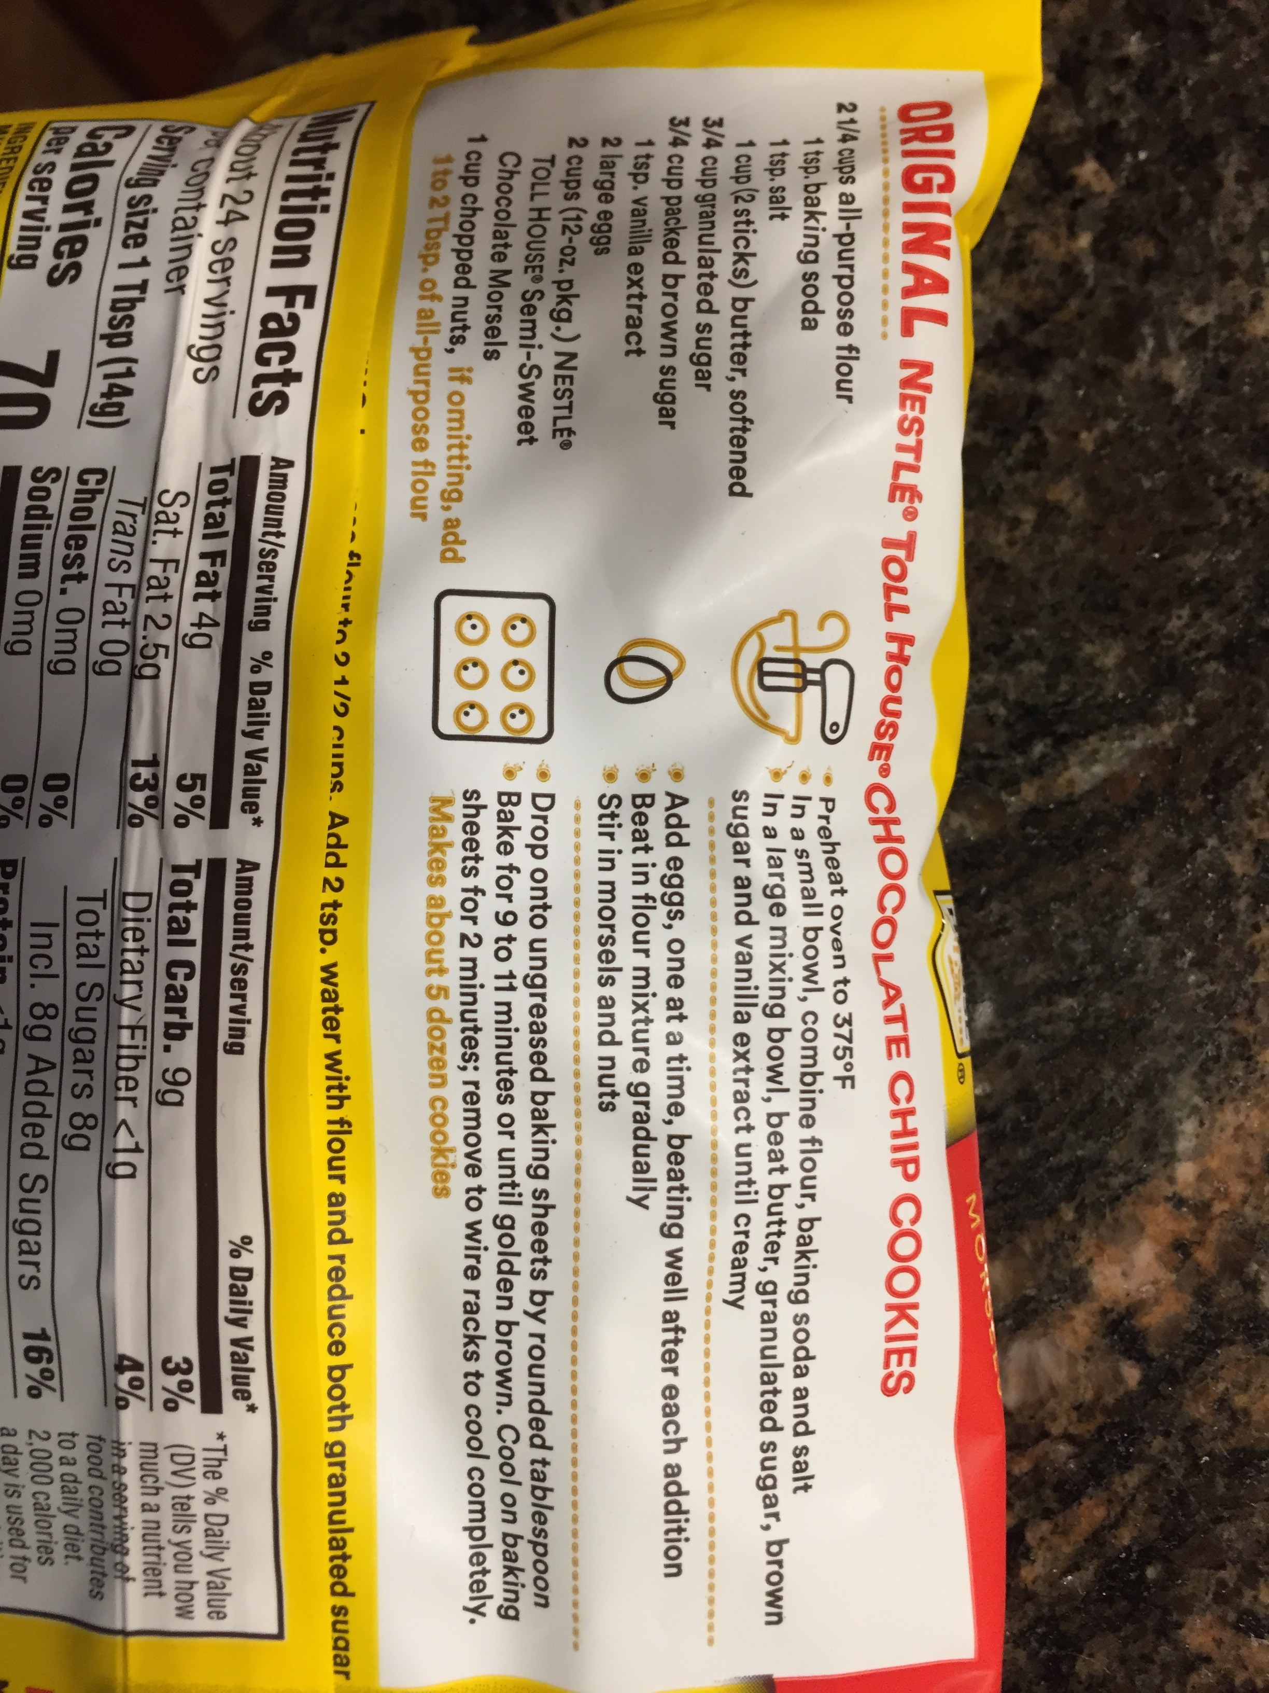
What exactly is a program?
Source: https://lh3.googleusercontent.com/ZcDhYsffPS_f2HRcyXUenTLZm9EeoVwHGlxcMrlw7G4HsGcCE_7o3HcToGjynKLosbP2EQ=s114
Source: https://www.wvxu.org/sites/wvxu/files/styles/x_large/public/201802/Algorithm.jpeg
FOX
MIS

Slide 13
JavaScript (commonly shortened to just JS) is a programming language made up of English-looking words arranged in a particular way to tell your browser to do something.
FOX
MIS

Slide 14
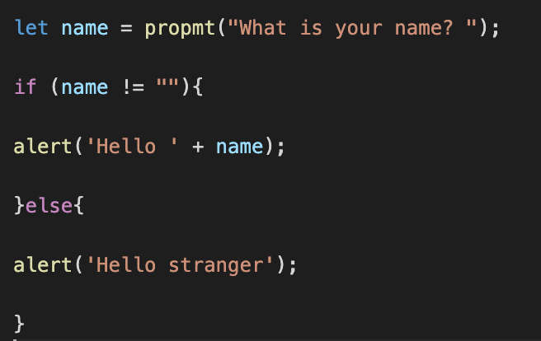
All JavaScript and no HTML or CSS
Open HelloWorld2.html from the files you worked on
FOX
MIS

Slide 15
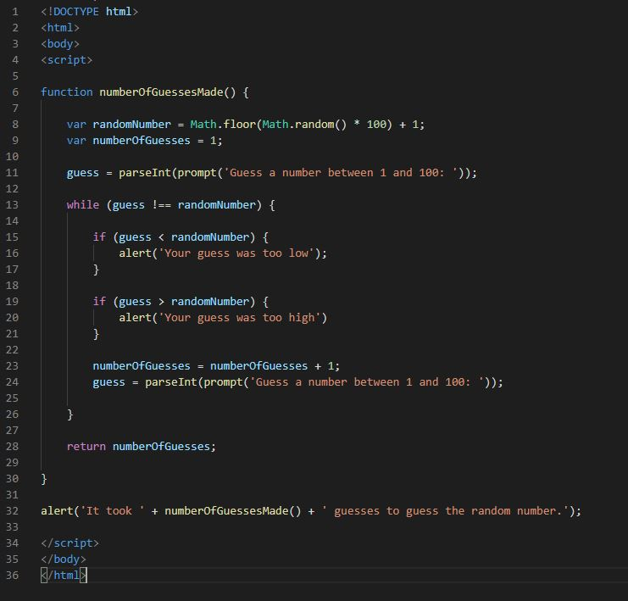
All JavaScript and no HTML or CSS
Open GuessANumber.html from the files you worked on
FOX
MIS

Slide 16
JavaScript is “Event Driven”, that is, interactive. It waits for the user to do something and then executes code.
But how does your code get access to the information typed on the form?
FOX
MIS

Slide 17
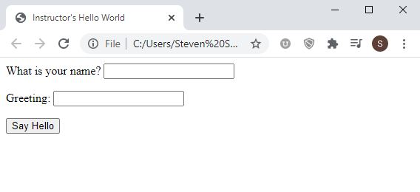
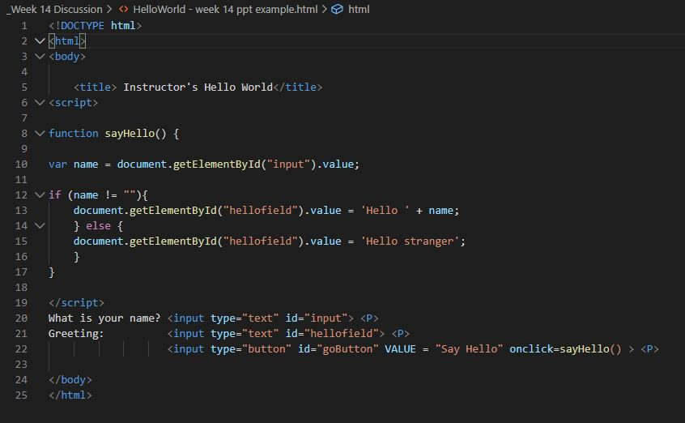
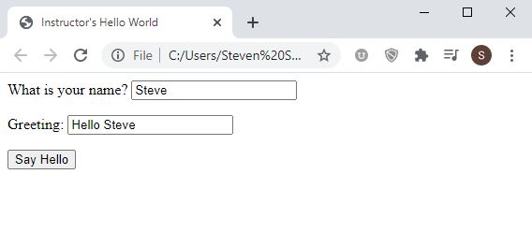
JavaScript with a Little HTML
FOX
MIS

Slide 18
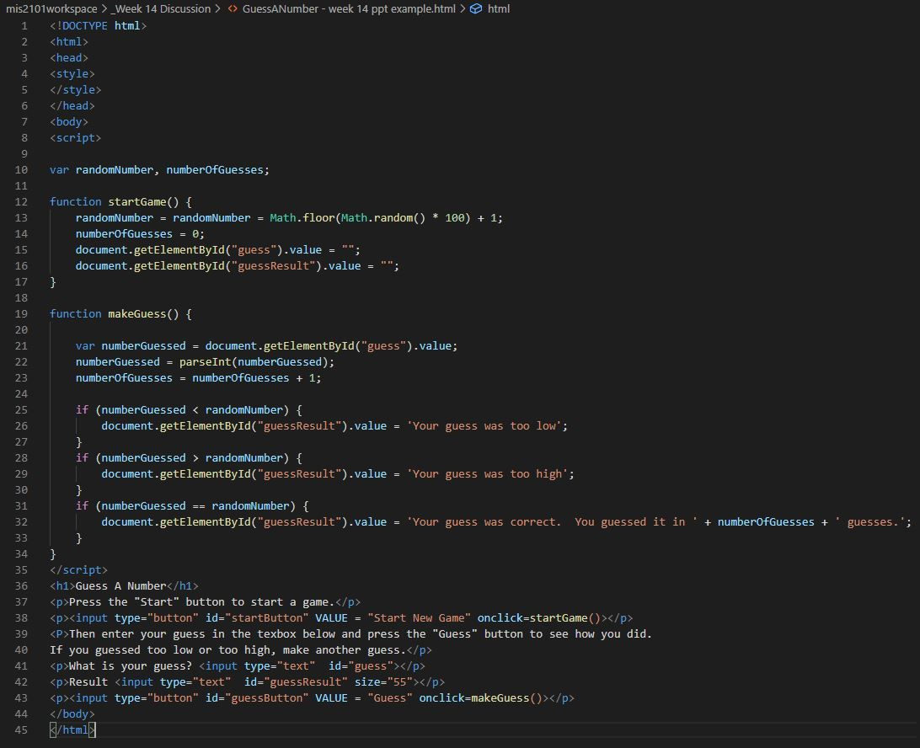
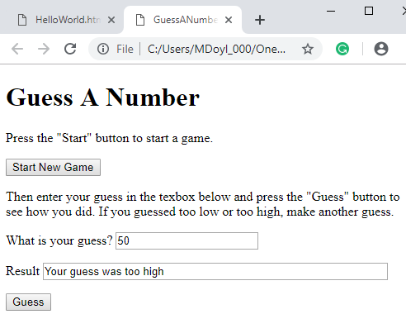
How do we display the results?
How do we get access to what was typed in?
What code gets executed when you press these buttons?

Slide 19
CSS is all about making your page look good
CSS stands for Cascading Style Sheets
Describes how HTML elements are to be displayed on the screen
Inline – Using style attributes in each HTML element
Internal – Using a <style> element in the <head> section
External – Using an external CSS file
Saves a lot of work and can control the layout of multiple pages all at once
FOX
MIS

Slide 20
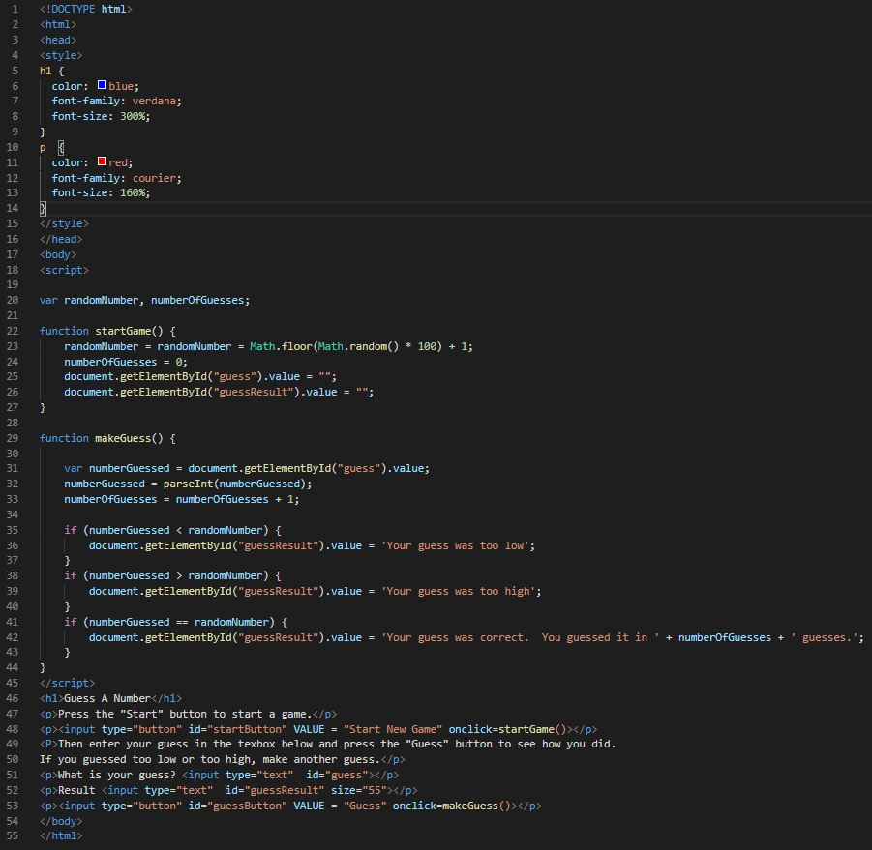
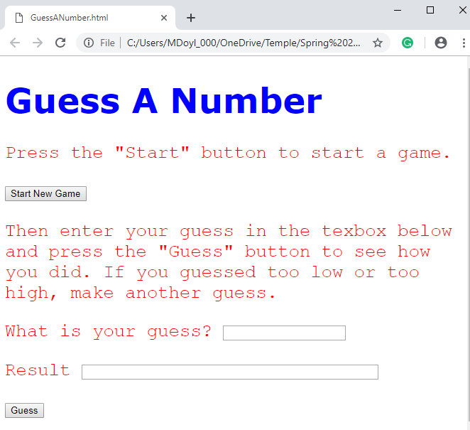
FOX
MIS

Slide 21
Time for “Challenges”!
FOX
MIS

Slide 22
Challenges – Start with your old programs and add a web interface
Unit 1 – Profits
Unit 1 – TotalPurchases
Unit 2 – SalesTax
Unit 2 – MaleAndFemalePercentages
Unit 3 – RomanNumerals
Unit 3 – MagicDates
Unit 4 – PenniesForPay
FOX
MIS

Slide 23
Diamond Peer Teacher Ariella Izbinsky
Profits HTML Coding Walkthrough
FOX
MIS

Slide 24
Profits
Open up the profits program we did earlier and try to add the textboxes and buttons to it. Once you done with it, try adding a style tag to define the fonts, color for the header and paragraph tags.
FOX
MIS

Slide 25
Diamond Peer Teacher Ariella Izbinsky
Total Purchases HTML Coding Walkthrough
FOX
MIS

Slide 26
Total Purchases
Open up the TotalPurchases challenge that we did earlier, instead of using prompts try using textboxes to get the input and display the data using textboxes after the user clicks the button.
FOX
MIS

Slide 27
Diamond Peer Teacher Lauren Quinn
Sales Tax HTML Coding Walkthrough
FOX
MIS

Slide 28
Sales tax
Open up the sales tax program we did earlier and try to add the textboxes and buttons to it. Again, get the amount using textboxes and display the total with salestax.
FOX
MIS

Slide 29
Diamond Peer Teacher Quinten Powers
Male And Female Percentages HTML Coding Walkthrough
FOX
MIS

Slide 30
Final is on: MM/DD
Good luck on the finals!

