Slide 1
TEMPLE MIS
community.mis.temple.edu
Joseph Allegra
Senior Associate Director
jallegra@temple.edu

Slide 2
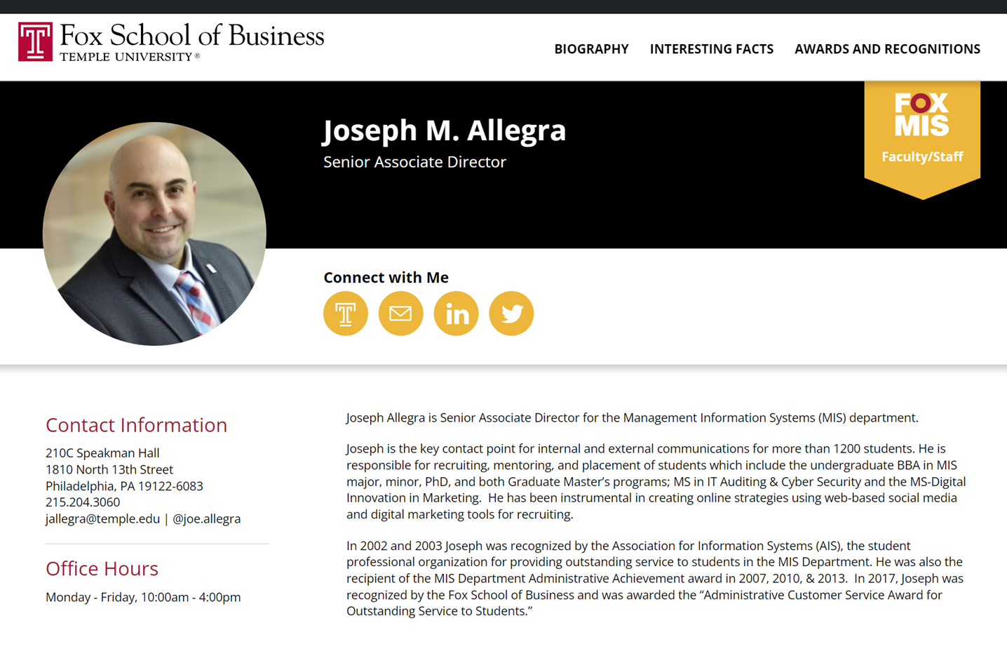

Slide 3
WHAT IS MIS?
MIS is about “solving business problems and creating new opportunities with technology.”
Understanding how to design and build business information systems differentiates us.
From other business disciplines
From computer science

Slide 4
THE MIS MAJOR
MIS produces digital leaders who design, architect, and manage API-driven, cloud-based software that
Achieve business goals
Meet requirements
Deliver positive user experiences
Execute reliably at scale

Slide 5
TEMPLE MIS STUDENTS HAVE ACCESS TO…
Exclusive scholarships
Career Counseling
Direct job placement & industry connections
Mentoring program with industry professionals
Professional development opportunities
Nationally connected SPO
STEM

Slide 6
WHAT AN MIS MAJOR DOES
BUILD
SECURE
DESIGN
DEPLOY
ANALYZE
web-based, API-driven business applications
applications and businesses against cyber-threats
1
2
3
4
5
applications using state-of-the-art UX techniques
APIs on robust cloud infrastructure
business data using analytics and navigate rational and NoSQL data stores

Slide 7
REQUIRED MIS COURSES
DATA &
ANALYTICS
WEB APPLICATION DEVELOPMENT
USER EXPERIENCE DESIGN
CLOUD ARCHITECTURE
WEB SERVICE PROGRAMMING
MANAGING ENTERPRISE CYBERSECURITY
Use relational and NoSQL databases; analyze and present insights from data
Develop software applications for the web that use cloud services
Describe, scope, and build a complete user experience
Design and build cloud infrastructure for scalable application deployment
Create and deploy a complete, ene-to-end, web-based cloud application
Secure the enterprise against cyber-threat

Slide 8
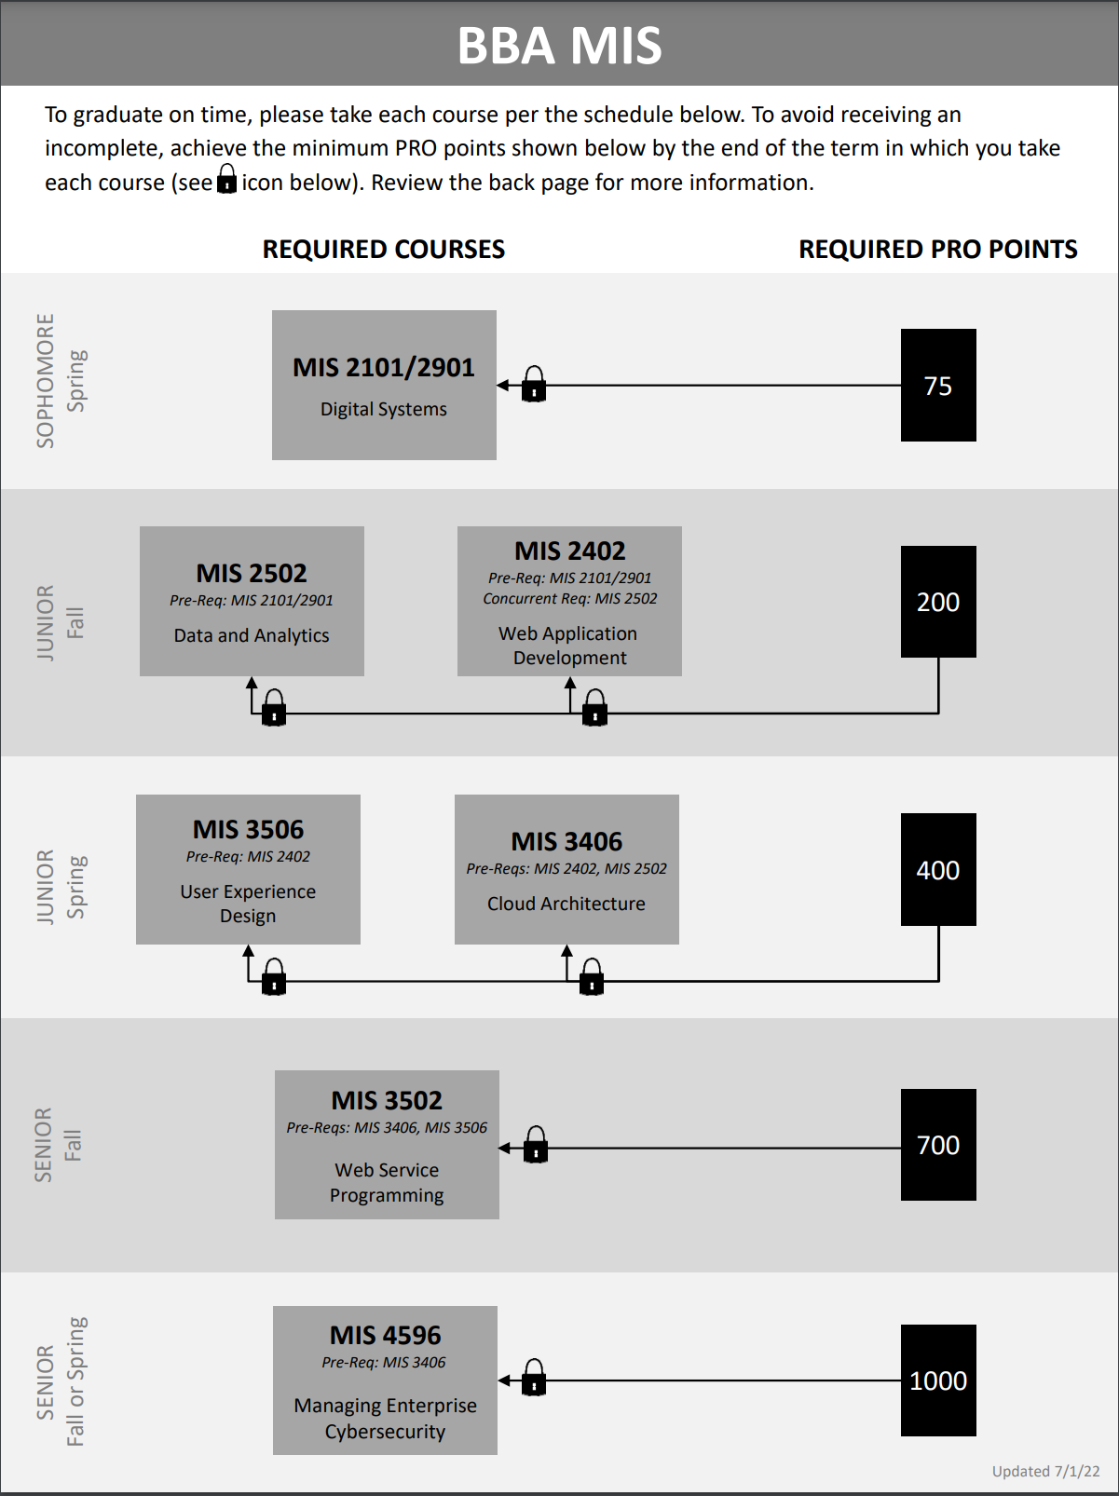

Slide 9
MIS COURSES
MAJOR
MINOR
CERTIFICATE
6
3
3
Data & Analytics
User Experience
Web Development
Cloud Architecture
Web Services
Cybersecurity
Data & Analytics
Digital Design
MIS Elective
Digital Systems
Data & Analytics
MIS Elective

Slide 12
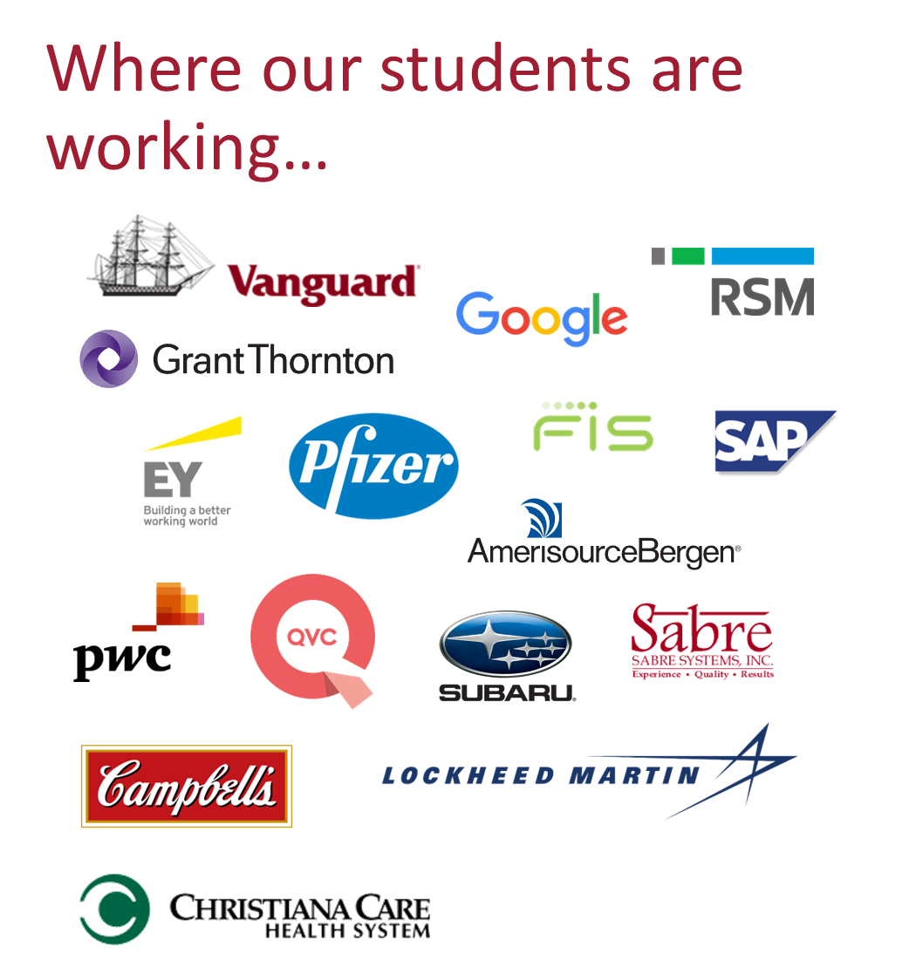
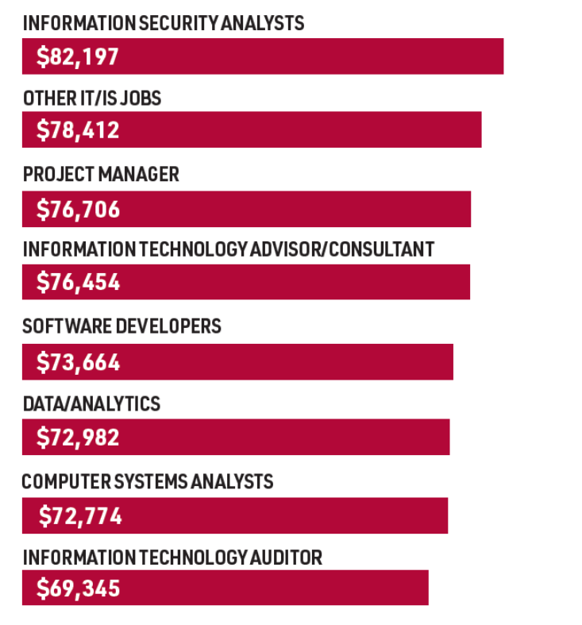
Source: IS Job Index, http://isjobindex.com

Slide 17
