Slide 1
Digital Systems
ICA#17: Practice Exam
FOX
MIS

Slide 2
ROADMAP
Week 1:
Introduction & Systems Analysis
Course Description
Systems Thinking
Assignments #01 & 02
Week 2:
Digital Product Management & Introduction to Process Mapping
Max Labs 1a & 1b
Systems & Processes
Swim Lane Diagrams
Assignment #03
Week 3:
Data Modeling with Entity Relationship Diagrams
Swim Lane Diagrams
ERD Diagrams
Assignment #04
Week 4:
Digital Systems – Learn IT! #1
ERD Diagrams
Learn IT Kickoff
Exam Prep
Assignment #05
Week 5:
Exam #1,
Information
Systems: Part I & II
CRM & ERP
Assignment #06
START
Week 9:
Exam #2
& JavaScript Unit #1
Parts I & II
Hello World, Variables
Week 8:
Information Systems & Cybersecurity
Protection Protocols
Artificial Intelligence
Assignment #08
Week 7:
Platforms & Digital Business Models: Part I & II
Platforms & Digital Models
APIs
Extra Credit (optional)
Week 6:
Information
Systems: Parts I - III
Data Analytics
SCM
Assignment #07
Week 10:
JavaScript Unit #2 Functions
Values & Variables
Operator types
Strings
Assignment #9
Week 11:
JavaScript Unit #3 Logical Operators & Conditional Logic
Logical Operators
Conditional Types
Week 12:
JavaScript Unit #4 Loops
Intro to Loops
While and Do
Assignment #10
Week 13:
JavaScript Unit #4 Working with Loops &
HTML & CSS Unit
Writing the code
HTML & CSS Basics
Week 14:
Exam Prep
SFF
Exam #3
Assignments #11
FINISH
Notes:
Last Assignment due on Monday May 1!

Slide 3
Final Exam is on: Friday May 5 From 1-2 pm
Bring: Calculator & pencil #2

Slide 4
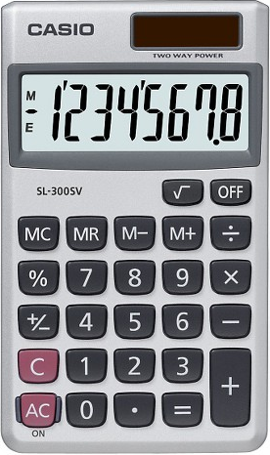
Exam will Cover Discussions from week 9-14
Total of 20 multiple choice questions
Readings and Lectures (50% - 10 questions)
Values & Variables
Functions
Logical Operators
Conditional Logic
Loops
CSS, HTML and JavaScript basics
Coding – Demonstrate your ability to apply (50% - 10 questions)
Code Analysis & Diagnosis
You can use a CALCULATOR
Source: https://target.scene7.com/is/image/Target/GUEST_a97f68d0-6348-4802-9d47-89b3a854a20e?wid=488&hei=488&fmt=pjpeg
Source: https://ccesnews.org/opinion/2018/04/23/10-tips-for-exam-preparation/#photo
Note: there may be “none of the above” answer as part of the multiple choices
FOX
MIS

Slide 5
Sample Question:
A loop cannot start with a negative number?
Refer to the example below:
for (let i = -10; i <= 30; i=i+5) {
True or False
FOX
MIS

Slide 6
Sample Question:
A loop cannot start with a negative number?
Refer to the example below:
for (let i = -10; i <= 30; i=i+5) {
True or False
FOX
MIS
Notes:
Additional question: how many times will the loop run? 9 times!

Slide 7
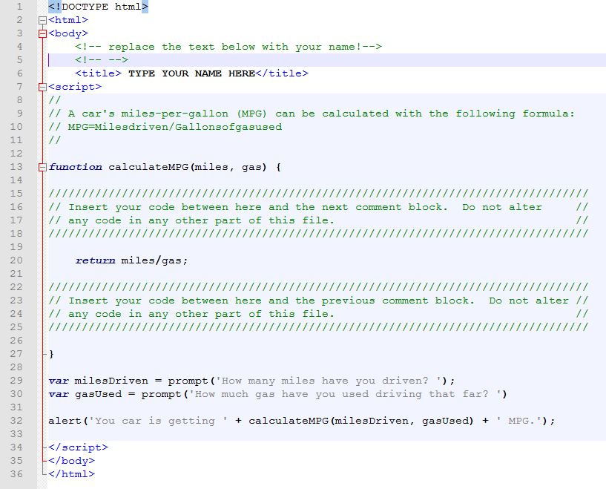
Sample Question:
What is your MPG if you have driven 320 Miles and used 20 Gallons of gas? (analyze the code)
A. 15
B. 16
C. 20
D. 32
FOX
MIS
Notes:
Bring a #

Slide 8
Sample Question:
What is your MPG if you have driven 320 Miles and used 20 Gallons of gas? (analyze the code)
A. 15
B. 16
C. 20
D. 32
(320/20)
FOX
MIS
Notes:
Bring a #

Slide 9
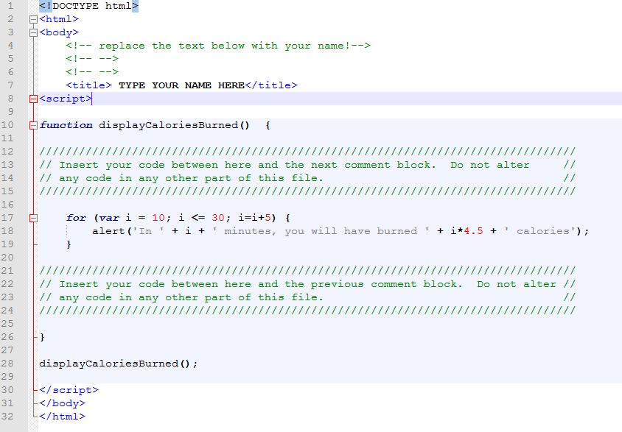
Sample Questions:
1. After 10 minutes, how many calories have you burned?`
A. 0 B. 45 C. 67.5
2. After 30 minutes, how many total calories have you burned?`
A. 112.5 B. 135 C. 450 D. 1350
3. If we change the initial value of i to 20 how many times does the function run and how many total calories are burned?
A. 3, 90 B. 5, 135 C. 3, 135 D. Does not run
4. If we change i <= 30 to i <=40 how many times does the function run and how many total calories are burned?
A. 5, 135 B. 7, 180 C. 7, 225 D. Does not run
FOX
MIS
Notes:
Bring a #

Slide 10
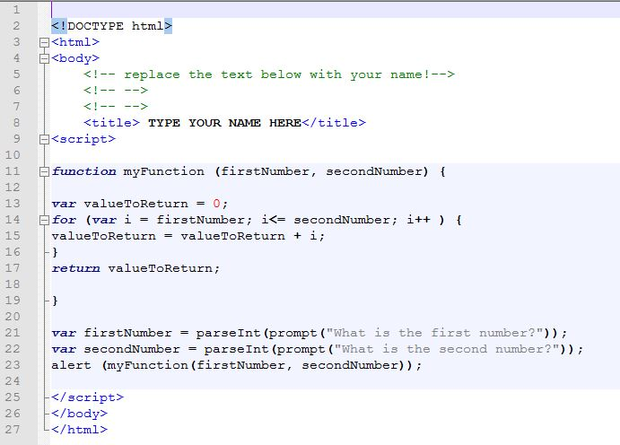
Sample Questions:
Using the program myFunction.html, what is displayed when you pass 11 as the first number and 14 as the second number?
a. 1114
b. 25
c. 1411
d. 50
e. None of the above
FOX
MIS

Slide 11
Sample Questions:
Using the program myFunction.html, what is displayed when you pass 11 as the first number and 14 as the second number?
a. 1114
b. 25
c. 1411
d. 50
e. None of the above
(11+12+13+14)
FOX
MIS

Slide 12
Sample Question:
What’s wrong with the statement listed below?
let 365days = prompt (“How many days are in a year?");
FOX
MIS

Slide 13
Sample Question:
What’s wrong with the statement listed below?
let 365days = prompt (“How many days are in a year?");
Variable name cannot begin with a number!
FOX
MIS

Slide 14
Individual Practice Exam:
Open the file on canvas (In Class Activity #17)
Fill out your answers
Upload your updated file
FOX
MIS

Slide 15
ICA Answers
1. D
2. B
3. C
4. B
5. A
6. A
7. D
8. A
9. E (The correct answer is 22)
10. B

Slide 16
Enter the exit code
1639
FOX
MIS

Slide 17
Please Fill out SFF
(Student Feedback Form)
FOX
MIS

Slide 18
Exam Review Session on Friday hosted by
Rahman
FOX
MIS

Slide 19
No Class on Monday!
Complete all Challenges Week 9-14
Complete your Final Assignment
Prepare for the Exam!
FOX
MIS

