Slide 1

MIS 2101 Exam 1 Review

Slide 2

Exam Will Cover Discussions: week 1 through 4
Readings, Videos and Lectures (60%, 15 questions)
  Information Systems
  Systems Analysis/Systems Architecture
  Swim Lane
  ERD
  Digital Identity
Mini-Case – Demonstrate your ability to apply (40%, 10 questions)
  Swim Lane Diagram
  ERD
  Note: The same narrative/Swim Lane and ERD is used for ALL questions from 16-25
Source: https://ccesnews.org/opinion/2018/04/23/10-tips-for-exam-preparation/#photo
FOX
MIS
Notes:
25 questions
Readings /Videos & Lectures: 15 questions (there are 6 questions about Maxlab) – none about Max Lab 2 & 3)
Swim Lane/ERD : 10 questions

Slide 3



Advice
Review the slide decks
Review the assigned readings/videos
Review / Add your notes
How to prepare…

Slide 4
Introduction & Systems Analysis
Topics and Required Reading:
What is an Information System?
Systems Architecture
Systems Analysis
What is Software Development Lifecycle (SDLC)
Review
Weekly PowerPoint slides

Slide 5

Collection of Systems
Systems = People + Process + Technology
Manipulation of information = value
Managed by MIS professionals
Systems surround us 24/7
Application Program Interface (API’s)
“Information System – an integrated set of components for collecting, storing, and processing data and for providing information, knowledge and digital products.” This ensure the successful completion of business objective.

Slide 6



Collection of Technologies
Including:
Hardware
Software
Policies
Education Tools
API’s
In MIS we train people to use technology to solve day-to-day business problems.

Slide 7
Systems Analysis
What is “Systems analysis?”: Problem solving technique that “decomposes” a system into its component pieces for the purpose of studying how well these parts work & interact to accomplish their purpose

Slide 8

Software Development Cycle (SDLC) Methodologies (Model)
Waterfall
Agile / Iterative
Lean
Scrum / Iterative
DevOps

Slide 9
DPM & Introduction to Process Mapping
Topics and Required Reading
What is a product manager? A complex, cross-functional role in IT
An Introduction to Swim Lane Diagrams
Review
Weekly PowerPoint slides

Slide 10

Why Salesforce?
A great platform to deliver cloud-based systems products
Salesforce’s computers run the software and store your data
Enables & Enhances Business
Used by Industry Fortune 100’s
  Across all business function areas
Enabling Organizations
Technology enables organizations to work faster/smarter/more efficient
  See how it works
  Understand how it used by industry

Slide 11

Digital Product Manager
DPMs have a complex role with a wide range of responsibilities including:
Meeting with customers and clients to determine product requirements
Balance multiple stakeholders & understand all needs
Deliver products that align with Business Goals
Sourcehttps://wac-cdn.atlassian.com/dam/jcr:84dd83c0-f954-477e-b157-b591da20d3cf/0_diagram.png?cdnVersion=464
Notes:
Discuss the concept of DPM Soft skills This is an exam question!!!
Reference article: https://www.cio.com/article/221885/what-is-a-product-manager-a-complex-cross-functional-role-in-it.html
Ask why these are so important and what do they mean?

Slide 12

Digital Product Manager
DPMs require a unique set of soft skills including:
Emotional Intelligence (EQ)
Relationship Management
Self-awareness
Self-management
Social awareness
Source: https://assets.website-files.com/5d6d271d0b802026e5355799/5e00bebf15637fdb21b78a11_woman-office-manager-cc.jpg
Notes:
Discuss the concept of DPM Soft skills This is an exam question!!!
Reference article: https://www.cio.com/article/221885/what-is-a-product-manager-a-complex-cross-functional-role-in-it.html
Ask why these are so important and what do they mean?

Slide 13

Process Mapping
What
Visual Representation
Why
Identify Problems
How
Draw the “as-is”

Slide 14
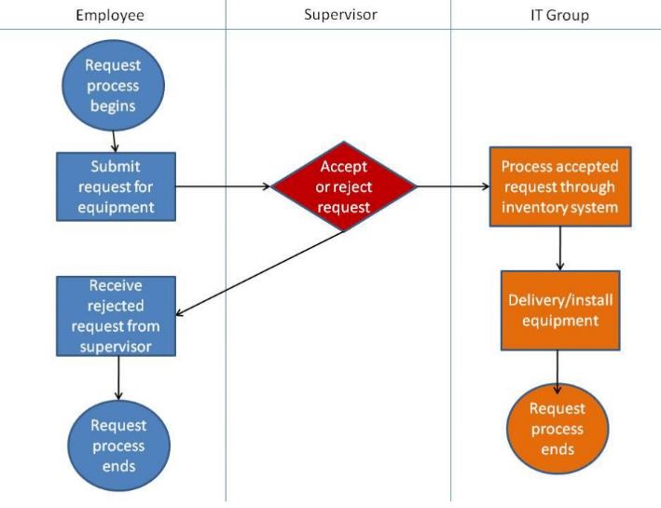
Swim Lane Diagrams
Identifies who does what & in what order
  Logical & Chronological
  Indicates hand-offs
Advantages:
  Helps see opportunity for improvements
  Helps eliminating duplications
  Basis for developing new solutions
  Useful Training tool

Slide 15
Swim Lane Diagrams - Symbols
Circle : signifies the starting and ending of an event in the process
Rectangle : represents an activity in the process
Diamond : represents a decision that must be made
Arrow : indicates the flow of the process
Cylinder : represents stored data

Slide 16
ERD & Digital Identity
Topics and Required Reading/Videos
What is an Entity Relationship Diagram?
Entity Relationship Diagram
What is Entity Relationship Diagram (ERD)
How AI is deciding who gets hired
What hiring managers look for in your social media profile
Review
Weekly PowerPoint slides

Slide 17
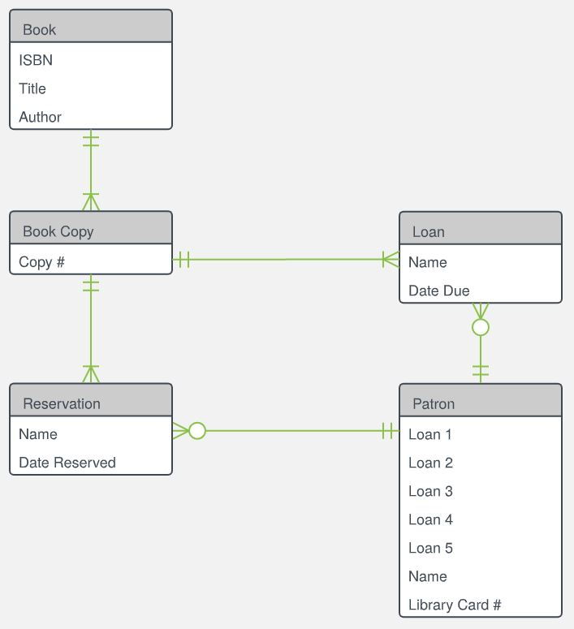
What is an Entity Relationship Diagram?
An Entity Relationship Diagram (ERD) is a visual representation of different data using conventions that describe how these data are related to each other.
Source:https://d2slcw3kip6qmk.cloudfront.net/marketing/pages/chart/examples/libraryerdiagram.svg

Slide 18
Primary ERD Symbols: Chen’s Database Notation
Entity = noun
ex: shopper, item
Attribute = adjective/characteristic
ex: item price
Relationship = verb
ex: buys

Slide 19
Entity Relationship Diagram: ERD tables
Crow’s Foot Database Notation

Slide 20



Cardinality in Data Modeling: Relationships
Cardinality describes a fundamental characteristic of the relationship between two entities.
  1:1 = a one to one relationship
  1:m = a one to many relationship
  m:m = a many to many relationship

Slide 21
Digital Identity Management
Digital identity & profile
Digital portfolio
Build a professional network
Assess with analytics
Professional achievement program
(MIS majors only)
What is SEO?
Process of maximizing the number of visitors to a particular website by ensuring that the site appears high on the list of results returned by a search engine
Make sure to watch this video!
What hiring managers look for in your social media profile
FOX
MIS
Notes:
***These are all the components of the digital identity management assignment.
SEO : search en·gine op·ti·mi·za·tion
the process of maximizing the number of visitors to a particular website by ensuring that the site appears high on the list of results returned by a search engine.

Slide 22

Remember!!
Review the slide decks
Review the assigned readings/videos
Review your notes
How to prepare…
On Exam Day Bring:
TUID card (digital)
#2 Pencil
2 Highlighters

