Slide 1
Digital Systems
Exam 3 Study Guide
FOX
MIS

Slide 2
Exam 3
Bring: Calculator & pencil #2

Slide 3
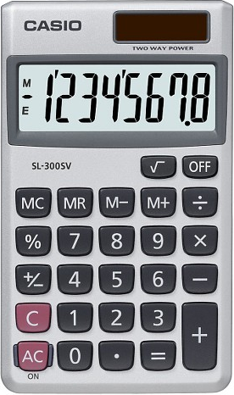
Exam will Cover Discussions from week 9-14
Total of 20 multiple choice questions
Readings and Lectures (50% - 10 questions)
Values & Variables
Functions
Logical Operators
Conditional Logic
Loops
CSS, HTML and JavaScript basics
Coding – Demonstrate your ability to apply (50% - 10 questions)
Code Analysis & Diagnosis
You can use a CALCULATOR
Source: https://target.scene7.com/is/image/Target/GUEST_a97f68d0-6348-4802-9d47-89b3a854a20e?wid=488&hei=488&fmt=pjpeg
Source: https://ccesnews.org/opinion/2018/04/23/10-tips-for-exam-preparation/#photo
Note: there may be “none of the above” answer as part of the multiple choices
FOX
MIS

Slide 4
Consider the following guidelines:
Your variables can be as short one character, or they can be as long as you want - think thousands and thousands...and thousands of characters.
Your variables can start with a letter, underscore, or the $ character. They can't start with a number.
Outside of the first character, your variables can be made up of any combination of letters, underscores, numbers, and $ characters. You can also mix and match lowercase and uppercase to your heart's content.
Spaces are not allowed.
Naming Variables
FOX
MIS
Notes:
Consistency is the key here.

Slide 5
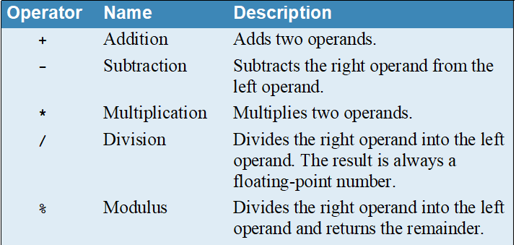
Arithmetic operators
WARNING! This is not a complete list.
FOX
MIS
Notes:
Basic mathematical operators that you learn in school. How you use in excel. This will come in handy in the upcoming applications.

Slide 6
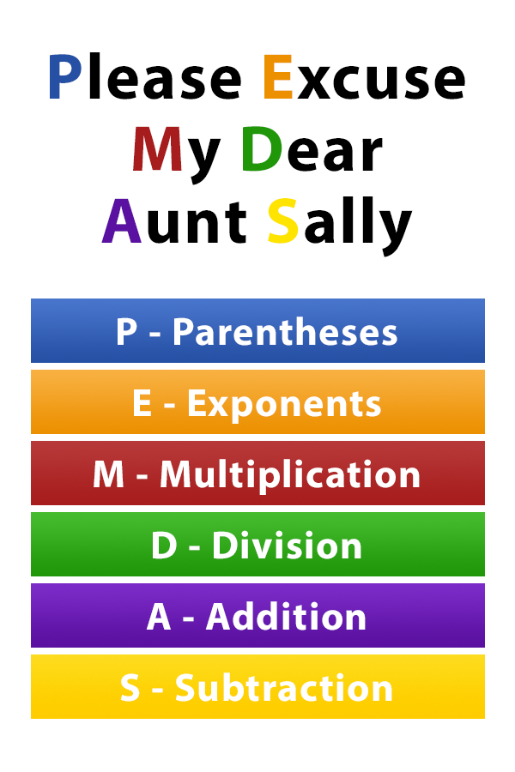
The Order of Operations
Why is it important to remember PEMDAS while coding?
Because JavaScript follows these rules!
Source: https://www.pinterest.com/pin/10344274128829700/

Slide 7
Operator | When it is true...
== | If the first expression evaluates to something that is equal to the second expression.
>= | If the first expression evaluates to something that is greater or equal to the second expression
> | If the first expression evaluates to something that is greater than the second expression
<= | If the first expression evaluates to something that is lesser or equal to the second expression
< | If the first expression evaluates to something that is less than the second expression
!= | If the first expression evaluates to something that is not equal to the second expression
&& | If the first expression and the second expression both evaluate to true
|| | If either the first expression or the second expression evaluate to true
! | Flips the value from false to true or true to false
Relational Operators
Logical Operators
FOX
MIS
Notes:
Relational operators are used to compare two values. Logical expressions are used connect relational expressions using the rules of formal logic. When using to check is something has the same value, be careful between using = and ==, one is an assignment operator the other is a relational.
The exclamation point “!” means “not” so “!=“ is “not equal to”
Logical operators: People who know electronics might know logic gates,
&&: The AND operator, evaluates two expressions, if both are true then it returns true
||: The OR operator, evaluates two expression, if one of then is true then it returns true
!: The NOT operator, if the expression is true, it returns FALSE

Slide 8
The For Loop
i++ is
increasing count by 1
And short for i=i+1
for (let i = 0; i < 10; i++)
{
alert("Hello World!");
}
Step 1
Step 2
Step 3
Variable
Boolean Expression
Counter
FOX
MIS
Notes:
This would me much more easier than writing the same thing 10 times.
So this is called a for loop, we execute all the code between the curly braces and the for() dictates how many times we do it.
”for” is a keyword, usually used for calculations
Inside the parenthesis there are three parts:
part 1: gets executed once and only once. Here we create a variable or container called i and initialize it with a value of zero. Close with a semi colon
part 2: the next part is a Boolean expression, here is 0 which is less than 10, once the expression is false the loop breaks
part 3: add the counter of the loop, first run is one, second run is two and so on.
This loop can be translated as:
Create a for loop with i=0, I should be less than 10, and every time the loop runs value of i increases by one. The first time loop runs show hello world, then increase value of i to 1, which is less than 10, now again display hello… and so on until I = 10 and I is not less than zero.
We’ll start here with the classic for loop. Here's the syntax:
for (statement 1; statement 2; statement 3) { code block to be executed }
And here’s what happens when it runs: Statement 1 is executed before the loop (the code block) starts. Statement 2 defines the condition for running the loop (the code block). Statement 3 is executed each time after the loop (the code block) has been executed.
Heads up! As you can see, the classic for loop has three components, or statements.

Slide 9
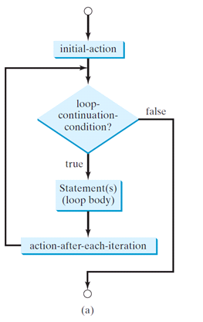
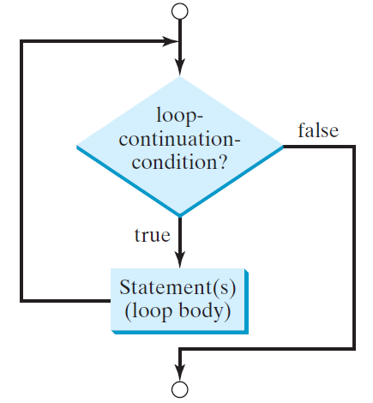
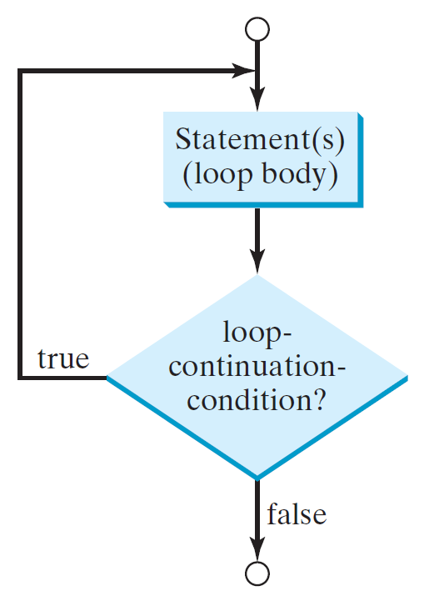
Summary Loop Flow-chart
for Loop
while Loop
do-while Loop

Slide 10
- HTML is all about displaying content. - CSS is all about making content look good. - JavaScript adds the interactivity.
You need all three to create nifty looking sites!
FOX
MIS
Notes:
We will add HTML and CSS to our programs this week. You get the aesthetics from the HTML and CSS but no interaction
The information displayed on your page, its all in the HTML. The prettiness and the formatting comes from CSS. Interacting with pages, like page next etc. is all done by JavaScript.

Slide 11
Sample Question:
A loop cannot start with a negative number?
Refer to the example below:
for (let i = -10; i <= 30; i=i+5) {
True or False
FOX
MIS

Slide 12
Sample Question:
A loop cannot start with a negative number?
Refer to the example below:
for (let i = -10; i <= 30; i=i+5) {
True or False
FOX
MIS
Notes:
Additional question: how many times will the loop run? 9 times!

Slide 13
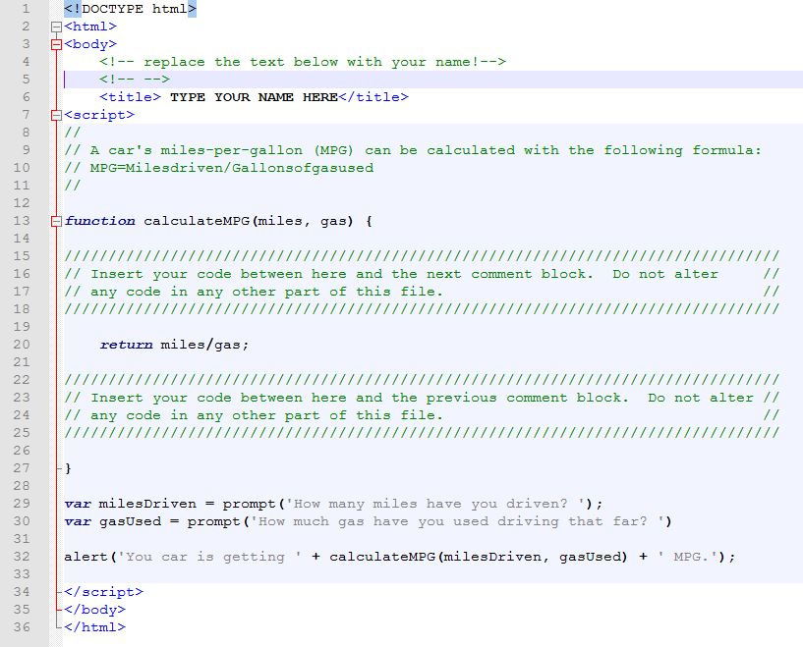
Sample Question:
What is your MPG if you have driven 320 Miles and used 20 Gallons of gas? (analyze the code)
A. 15
B. 16
C. 20
D. 32
FOX
MIS
Notes:
Bring a #

Slide 14
Sample Question:
What is your MPG if you have driven 320 Miles and used 20 Gallons of gas? (analyze the code)
A. 15
B. 16
C. 20
D. 32
(320/20)
FOX
MIS
Notes:
Bring a #

Slide 15
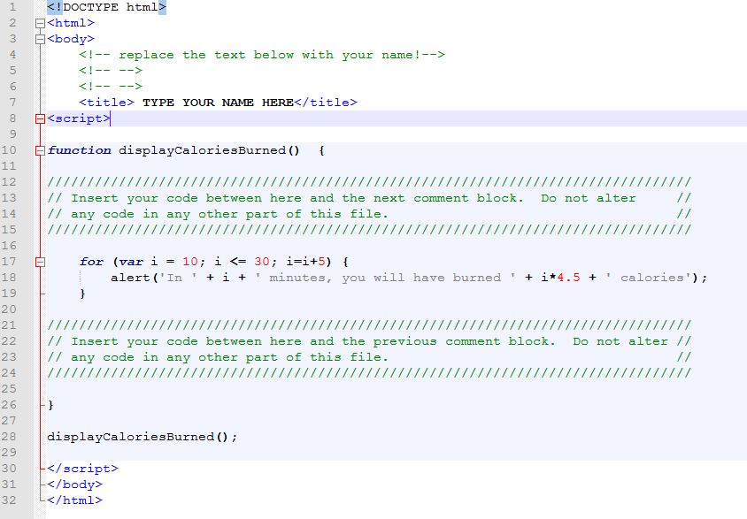
Sample Questions:
1. After 10 minutes, how many calories have you burned?`
A. 0 B. 45 C. 67.5
2. After 30 minutes, how many total calories have you burned?`
A. 112.5 B. 135 C. 450 D. 1350
3. If we change the initial value of i to 20 how many times does the function run and how many total calories are burned?
A. 3, 90 B. 5, 135 C. 3, 135 D. Does not run
4. If we change i <= 30 to i <=40 how many times does the function run and how many total calories are burned?
A. 5, 135 B. 7, 180 C. 7, 225 D. Does not run
FOX
MIS
Notes:
Bring a #

Slide 16
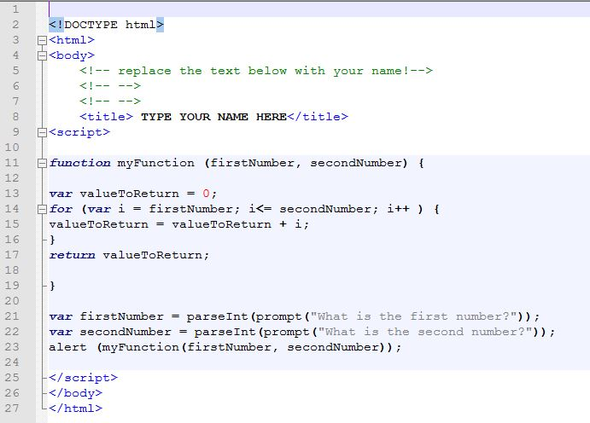
Sample Questions:
Using the program myFunction.html, what is displayed when you pass 11 as the first number and 14 as the second number?
a. 1114
b. 25
c. 1411
d. 50
e. None of the above
FOX
MIS

Slide 17
Sample Questions:
Using the program myFunction.html, what is displayed when you pass 11 as the first number and 14 as the second number?
a. 1114
b. 25
c. 1411
d. 50
e. None of the above
(11+12+13+14)
FOX
MIS

Slide 18
Sample Question:
What’s wrong with the statement listed below?
let 365days = prompt (“How many days are in a year?");
FOX
MIS

Slide 19
Sample Question:
What’s wrong with the statement listed below?
let 365days = prompt (“How many days are in a year?");
Variable name cannot begin with a number!
FOX
MIS

