Slide 1
Digital Systems
7.1 Platforms & Digital Business Models, including API’s
FOX
MIS
Notes:
Our focus this week is Platforms & Digital Business Models, including API’s

Slide 2
Attendance Please login to Canvas and “Check-In”
Attendance is not a part of your grade for this class. The university has mandated that we take attendance for all classes, face-to-face, online and hybrid, to assist in contact tracing should an outbreak of Covid-19 occur.
FOX
MIS

Slide 3
ROADMAP
Week 1:
Introduction & Systems Analysis
Course Description
Systems Thinking
Assignments #01 & 02
Week 2:
Digital Product Management & Introduction to Process Mapping
Max Labs 1a & 1b
Systems & Processes
Swim Lane Diagrams
Assignment #03
Week 3:
Data Modeling with Entity Relationship Diagrams
Swim Lane Diagrams
ERD Diagrams
Assignment #04
Week 4:
Digital Systems – Learn IT! #1
ERD Diagrams
Learn IT Kickoff
Assignment #05
Week 5:
Exam #1,
Max Labs & Information
Systems: Part I & II
CRM & ERP
*Exam: check course site
Assignment #06
START
Week 9:
Exam #2 & JavaScript Unit #1
- Part I & II
Hello World, Variables
*Exam: check course site
Week 8:
Cybersecurity & AI – Part I & II
Protection Protocols
Artificial Intelligence
Assignment #08
Week 7:
Platforms & Digital Business Models: Part I & II
Platforms & Digital Models
APIs
Week 6:
Information Systems: Part III & IV
Data Analytics
SCM
Assignment #07
Week 10:
JavaScript Unit #2 Functions
Operator types
Strings
Assignment #9
Week 11:
JavaScript Unit #3 Logical Operators & Conditional Logic
Logical Operators
Conditional Types
Week 12:
JavaScript Unit #4 Loops
Intro to Loops
While and Do
Assignment #10
Week 13:
JavaScript Unit #4 Working with Loops
Writing the code
Week 14:
HTML & CSS Unit
HTML basics
CSS basics
Course Reflection
Assignments #11
FINISH

Slide 4
Digital Platforms?
“…facilitates commercial interactions between at least two different groups…”
What are some core functions of a platform?
Audience Building
Matchmaking
Providing Core Tools & Services
Source: https://thumbor.forbes.com/thumbor/960x0/https%3A%2F%2Fblogs-images.forbes.com%2Fpeterbendorsamuel%2Ffiles%2F2018%2F03%2FDigital-Platform-Strategy-913629568.jpg
FOX
MIS
Notes:
How many of you have interacted with a platform today?
ex) I chatted with my friends on What’s App.
Get the students thinking about platforms and the impact of Digital Platforms on Business.
"A platform business makes money from services delivered via apps and APIs on a scalable technical foundation that customers and suppliers can integrate into their operations, incorporate into their offerings, and extend through their contributions.“ (***relate this story back to the Max Labs and what she is producing***)
https://www.forbes.com/sites/joemckendrick/2019/01/23/once-they-were-companies-now-they-are-platform-businesses/#7602a7132773

Slide 5
Digital Platforms Definition
From the reading: “Digital platforms are online businesses that facilitate commercial interactions between at least two different groups—with one typically being suppliers and the other consumers.”
Think of it as an on-line place for interactions: a marketplace or a place to gather together
Examples: eBay, Instagram, TikTok, Facebook Marketplace, large parts of Amazon. But not regular online retail

Slide 6
Digital Platforms
What are the benefits?
For Companies?
For Consumers?
For Industry?
Source: https://www.arup.com/-/media/arup/images/perspectives/themes/cities/how-can-cities-benefit-from-becoming-digital-platforms-2000x833.jpg
FOX
MIS
Notes:
what are some of the benefits of Digital Platforms?
Make it easier for companies to find customers (and vice versa)
Monetize underutilized assets
Reduce transaction costs
Reduce barriers to entry for many smaller companies to coexist with the “big fish” (increases choice = price reduction)
Reduce Search costs
We no longer have to visit multiple stores to find one item. For example, if you moved from Philly to LA in the mid 2000’s and wanted to buy Herr’s chips or a Tastycake, you were hard pressed to find them. Sure you could order them direct or find that one specialty store that sold Philly goodies but that was it! With digital platforms you can reach buyers and sellers globally…now I can buy Tastycakes anywhere!

Slide 7
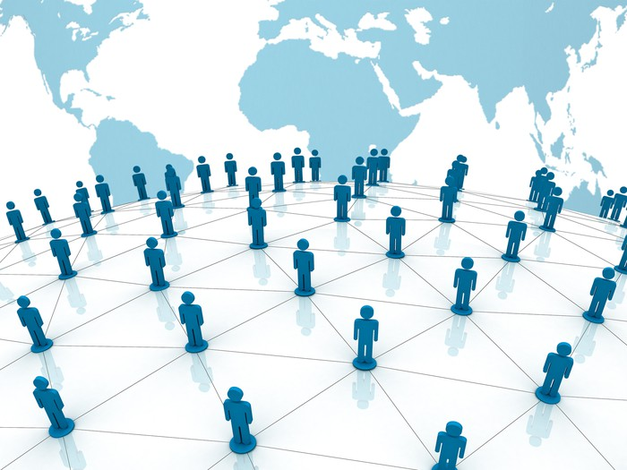
Network Effects
What is the impact of Network Effects on the different types of platforms?
Source: https://www.snapsuites.com/wp-content/uploads/2017/05/o-SMARTPHONE-NIGHT-facebook.jpg
Source:
https://g.foolcdn.com/image/?url=https%3A%2F%2Fg.foolcdn.com%2Feditorial%2Fimages%2F428448%2Fthe-network-effect-getty.jpg&w=700&op=resize
FOX
MIS
Notes:
Think about Tinder or Match, if I’m the only one on the network, there’s really no value there for me (or the marketing team)…once we start adding users, we begin to add value.
Who can provide an example of a Network Effect from their own experience?

Slide 8
APIs defined and described
An API is a digital service that is provided through the internet. Usually by another company, but a lot of organizations also develop APIs for internal use. Some APIs are free, many of them have to be paid for.
Example: you manage a restaurant and you want the website to have a clickable map that shows your restaurant’s location. You could build the map yourself, but instead you ask Google Maps for that service. And it is free. You simply add a line of code to your webpage with some instructions, and your address. Whenever a customer looks for the location, that line of code calls the Google Maps API, and Google provides the map.
Another Example: You have taken a ride with Uber. At the end of the ride, Uber has to get the payment from you, using the credit card information you provided. Uber does not process that payment itself. Instead it sends a request to the company Braintree, which takes the information and processes the payment. Uber pays Braintree a fee for this.
The benefit to Uber is that it can focus on its core competency: matching drivers and passengers. It does not have to write the code for processing the payments.

Slide 9
APIs defined and described, part 2
API stands for Application Programming Interface. It specifies the format in which you can request a service from the software behind the API, and it lets you know what kind of data you will get back from the service (e.g. a payment confirmation in a particular format). These days, API refers to both the interface and the software behind it. So for instance, the Weather Underground API is not just the format in which you request weather data, but it is now also the service itself.
Using APIs saves companies a lot of time and effort as they develop their applications. They usually have to pay for the services provided by the APIs, but that is still much cheaper than doing it themselves, and it allows them to focus. For instance, Uber’s core capability is matching up riders and drivers. There is no other company with a convenient API that will do it for them.
APIs have become so popular that some companies have now reorganized some of their applications so that they can be accessed as APIs for internal use. For instance, they might have an old but still important database. Instead of rebuilding it they can add some code to it so that it acts as an API and can easily be used in any application that needs it.

Slide 10
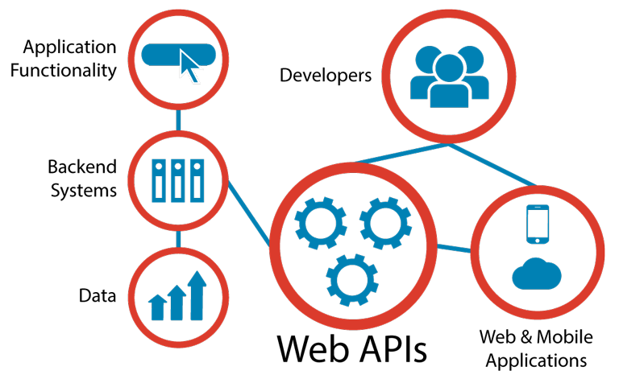
API’s: Application Programming Interface
What is an API?
Connect computer software components
Contract for Data Interaction
Facilitates interactions between front & backend IT systems (Web API’s)
Can you think of any examples???
Hint…think smartphones and IoT.
Source: https://www.apiacademy.co/assets/2015/04/Web-APIs-v5_0.png
FOX
MIS
Notes:
***Time permitting, here is a great video from PNC explaining API’s…at a minimum we recommend that you watch this 4:31 minute video:
https://youtu.be/EUI0SdHbcLk
Here is another API overview articles for Instructor’s to get familiar with the concepts: https://www.upwork.com/hiring/development/intro-to-apis-what-is-an-api/
Walk through each of the points listed on the slide. More information on this list is provided below (and was extracted from the following links: https://www.apiacademy.co/lessons/2015/04/api-strategy-lesson-101-what-is-an-api & https://news.codecademy.com/what-to-know-about-apis/)
APIs (application programming interfaces) provide a way to connect computer software components. Broadly speaking, APIs make it possible for organizations to open their backend data and functionality for reuse in new application services.
An API achieves this by facilitating interactions between code modules, applications and backend IT systems. The API specifies the way in which these different software components can interact with each other and enables content and data to be shared between components.
The API is not a new concept. But as the complexity of computer systems has increased, the need for APIs has increased, as evidenced by their prevalence in operating systems, programming languages and networks – including the Web.
As more and more organizations have adopted the Web as the primary network for systems integration and have started seeking ways to connect their information technology assets to online portals and mobile apps, adoption of APIs has grown rapidly.
When people talk about APIs today, they are more often than not referring to these “Web APIs”. On a technical level, a Web API can be defined as any software interface exposed over the HTTP protocol in order to facilitate the development of Web, mobile and cloud applications.
Web APIs are particularly important in social media – for example, a network might publish an API that allows developers to create client applications for posting status updates from mobile devices. However, Web APIs are becoming increasingly vital to organizations across all sectors.

Slide 11
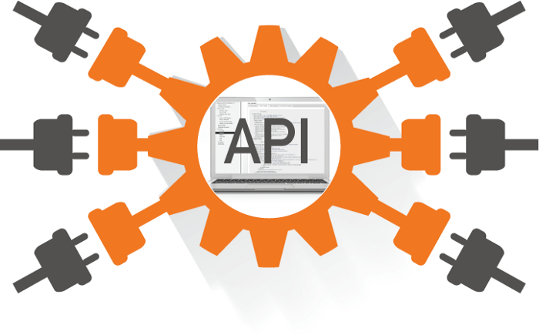
API’s: “…a strategic business imperative”
API’s Key Considerations
Extract more value from existing assets
Drive new innovations
Easier access across multiple ecosystems
API’s are Products – “building blocks”
“live beyond any one project”
“reusable assets”
Source: https://miro.medium.com/max/700/1*6K4eQYf0R7cPCzukMCtu7Q.png
FOX
MIS
Notes:
Walk through each of the points listed on the slide. More information on this list is provided below (and was extracted from the following readings: https://deloitte.wsj.com/cio/2018/03/27/api-imperative-from-it-concern-to-business-mandate/ & https://www.cio.com/article/3218155/how-the-api-economy-is-igniting-a-cultural-shift-in-businesses.html )
APIs (application programming interfaces) provide a way to connect computer software components. Broadly speaking, APIs make it possible for organizations to open their backend data and functionality for reuse in new application services.
“A successful internal API economy requires IT to decentralize and democratize application development and data access to the business as a whole. In addition, central IT needs to invest in enabling a broader set of developers internally to discover, use and self-serve these assets, so the business can deliver more of their own projects. This changes the relationship between IT and the business.”
“To win in the digital era, companies need to play a larger role in the API economy. We’re all used to the instant connectivity that puts the world at our fingertips. Today, it’s difficult to imagine standing in a long line at the bank to cash a check, or waiting more than 10 minutes for our taxi to arrive. Whereas a mere five years ago that would have been a normal part of our daily lives.”
“The unsung hero of our connected world is the modern API. It’s what makes possible all the interactivity that we’ve come to expect and rely upon. It helps drive the speed with which new technology products can be brought to market faster than the competition, establish new market presences quickly and change processes and workflows to fit evolving consumer tastes.”

Slide 12
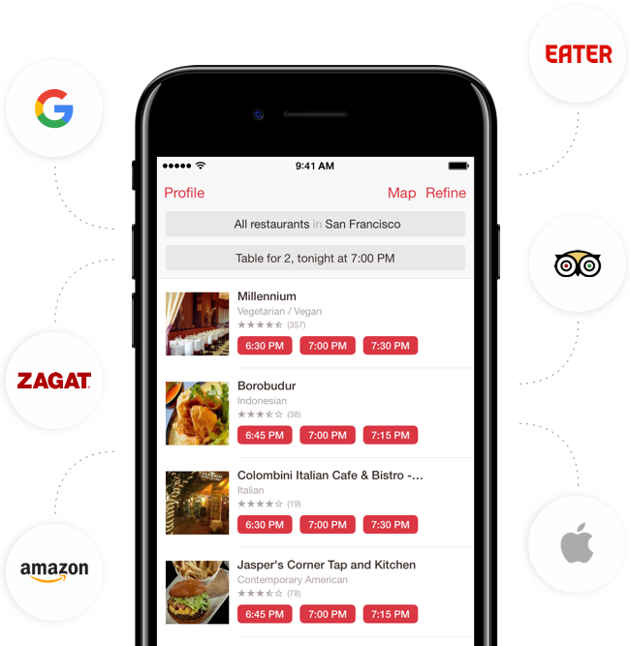
API’s: Application Programming Interface
API Case Study: OpenTable
What happens when you search for a restaurant?
What types of data is being retrieved?
Source: https://restaurant.opentable.com/assets/fg/g/opentable-iphone-app-partner-logos.png
FOX
MIS
Notes:
More information on this list is provided below (and was extracted from the following sites: https://restaurant.opentable.com/restaurant-groups , https://dev.opentable.com/ & https://platform.opentable.com/documentation/#authorization)
Linking to Individual Restaurants on OpenTable.com
The process of linking to each restaurant’s reservation page involves using the natural_profile_url value contained in the JSON response of the Directory API for each restaurant, along with your unique referral ID which is provided by OpenTable: https://www.opentable.com/boulevard-san-francisco?ref=zzzz
The Directory API returns a complete directory of restaurants that accept online reservations via OpenTable so that will need to first be called. The restaurant directory will be returned by the API in JSON format. The links can then be built using the data returned by the Directory API. The restaurant data is refreshed nightly, so it is recommended to call the API at least once a day to get the most current restaurant directory data.

Slide 13
What Is Cloud Computing?
Simply put, cloud computing is the delivery of computing services—including servers, storage, databases, networking, software, analytics, and intelligence—over the Internet (“the cloud”) to offer faster innovation, flexible resources, and economies of scale. You typically pay only for cloud services you use, helping you lower your operating costs, run your infrastructure more efficiently, and scale as your business needs change.
You can use commercial, public clouds like AWS, Microsoft Azure, and Google Cloud. Or you can run your own private cloud.

Slide 14
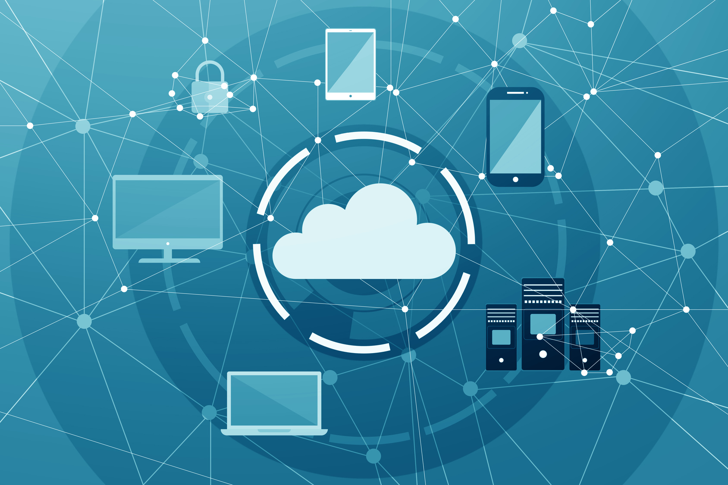
Cloud Computing
Pros
Collaboration
Scalability
Cost
Ease of use
Cons
Security
Data Integrity
Availability
Privacy
Source: http://blog.ionixxtech.com/wp-content/uploads/2017/09/Image_1-2.jpg
FOX
MIS
Notes:
Review the Pros & Cons with the students ask them to elaborate on each
http://blog.ionixxtech.com/taking-a-look-at-the-pros-and-cons-of-cloud-computing/
Cloud computing pitfalls to consider/discuss with the students:
Downtime – Network availability is an issue; outages do happen. So do incorrect access policies and other mistakes that can lead to the inability to access critical data. Contracts called Service Level Agreements between the provider and the customers that spell out guaranteed levels of service are meant to address these types of problems.
Device security – Employees lose mobile devices and fail to use strong passwords; updated malware and antivirus definitions, timely patches and updates are critical.
Data integrity – Potential problems that affect the integrity of a company’s data include corruption, misplacement, accidental deletion, physical accidents, malicious acts, hardware failures and a lack of proper policies.
Privacy & confidentiality of data – Data is vulnerable while being transmitted outside of the corporate firewall and once in the data center, it has to be kept separate from other companies’ data. Reliable identity authentication is also extremely important. Whether you choose a public or private cloud influences how much you have to worry about security issues. In some cases, a hybrid cloud may be the answer to your concerns. It is up to you to make sure that your cloud service provider has adequate safeguards in place to protect critical applications and sensitive data in case of hardware failures, natural disasters, cyber crime or data breaches.

Slide 15
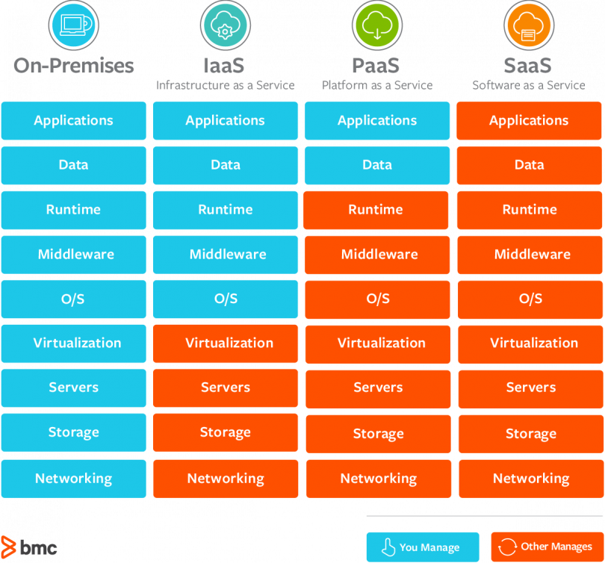
Cloud Computing
3 Basic Service types to Consider
Infrastructure as a Service (IaaS)
Provide an example?
Platform as a Service (PaaS)
Provide an example?
Software as a Service (SaaS)
Provide an example?
Source: https://blogs.bmc.com/wp-content/uploads/2017/09/saas-vs-paas-vs-iaas-810x754.png
FOX
MIS
Notes:
CLOUD-BASED SERVICES:
iaaS: Amazon Web Services – they host Capital One and Netflix
PaaS: Google App Engine – Google is the engine for the app Snapchat
SaaS: Salesforce – cloud based software – CRM
---------------------------------------------------------------------------------------------------
IaaS: “host” – you pay for the infrastructure but you are responsible for all application development and deployment and support activities.
PaaS: “build” – you pay for the infrastructure and for a developing platform that supports many areas of deployment so you can just focus on programming your application.
SaaS: “consume” – you pay for an entire solution that is fully built, deployed, and distributed over the web for you to consume on demand. You have no infrastructure, development, deployment, or support responsibilities.

Slide 16
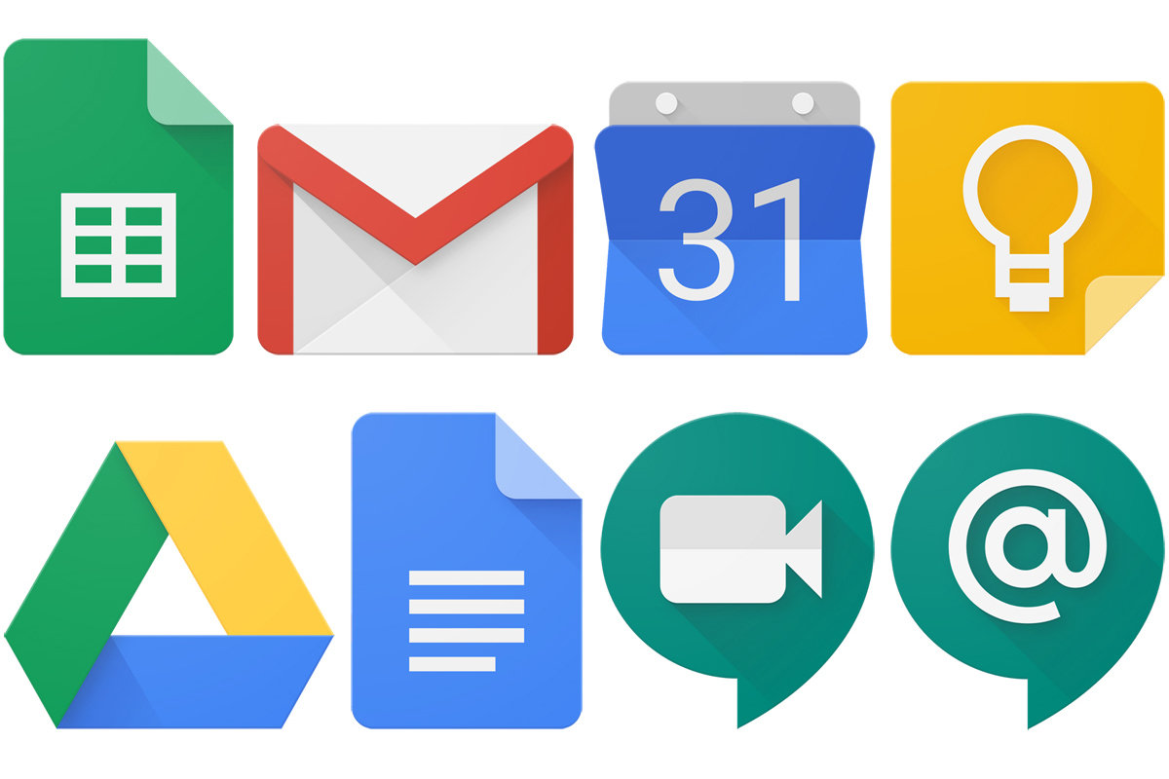
SaaS (Software as a Service)
Case Study: G Suite
Third Party Provider
Subscription based
OS-agnostic
Runs its software on its own servers in the cloud,
Reduced risk of piracy
Source: https://empireflippers.com/9-saas-examples/
Source: https://images.idgesg.net/images/article/2018/11/g-suite-logos-8-rows-100781657-large.jpg
FOX
MIS
Notes:
SaaS: G-Suite- case study – no video…other examples include Slack and Dropbox
https://empireflippers.com/9-saas-examples/
https://getnerdio.com/academy/10-popular-software-service-examples/
Walk through each of the 5 points listed on the slide. More information on this list is provided below (and was extracted from the following link: https://empireflippers.com/9-saas-examples/)
SaaS is where a third party provides an application, which is hosted on its own servers and delivered via the internet, typically through your web browser.
SaaS, on the other hand, is sold on a subscription basis, which is either monthly or yearly.
The biggest benefit of a SaaS is that it is OS-agnostic, meaning it doesn’t care what OS you are running. Usually delivered via the browser (referred to as a thin client), a SaaS service doesn’t require any special software installation or hardware to run. If your computer can run an internet browser, you’re good to go.

Slide 17
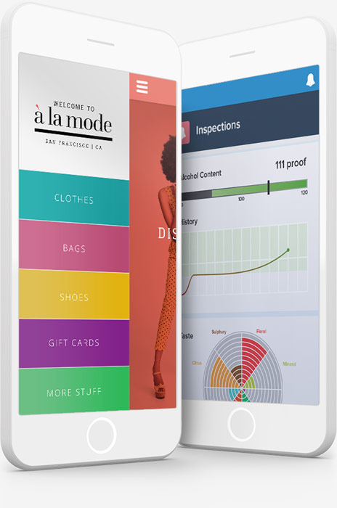
PaaS (Platform as a Service)
Case Study: Salesforce
Mobile Software Development
Rich Developer Environment
Fully managed cloud database
Point-and-click app building
Multi-language development
Cloud app marketplace
Source: https://www.salesforce.com/ap/learning-centre/tech/paas/
Source: https://c1.sfdcstatic.com/content/dam/web/en_us/www/images/app-cloud/products-mobile-open-source-applications.jpg
FOX
MIS
Notes:
PaaS: Microsoft Azure, Google App Engine & Salesforce - case study – Azure video link: https://youtu.be/ZFEw7nSWi6Y (1:26 no commentary)
https://www.salesforce.com/ca/paas/
https://azure.microsoft.com/en-us/migration/migration-program/
https://www.salesforce.com/ap/learning-centre/tech/paas/
https://azure.microsoft.com/en-us/overview/what-is-paas/
https://cloud.google.com/appengine/
Walk through each of the 5 points listed on the slide. This is a great connection to Max as a Product Developer. More information on this list is provided below (and was extracted from the following link: https://www.salesforce.com/ap/learning-centre/tech/paas/)
Mobile Software Development Kit (SDK) ‐ more and more business is being done over mobiles. The number of different handset manufacturers and models makes it imperative to use all the opportunities available and make sure what you build works well on the range of devices in use. A good PaaS option will support you in this. For example, Salesforce mobile SDK is an open source suite of familiar technologies – like REST API and OAuth 2.0 – that makes it easy to build mobile apps. It supports 3 development approaches to building mobile apps: native, HTML 5, hybrid
Rich developer environment ‐ as well as allowing developers to build engaging, customer-facing apps, a high-quality PaaS solution gives developers everything they need to iterate quickly, helping with testing and debugging. With a rich developer environment, they can make changes and deploy them instantly, scale with ease, and get full control, infinite capacity, and independent scaling for each component of an app. It assists with short-cuts, helped by complete and open APIs plus libraries and code created internally or externally. You can also expect to find IDE, Sandbox and ALM tools for app management.
Fully managed cloud database ‐ a good PaaS solution should provide you with fully managed infrastructure that can scale beyond your current needs. Being fully managed also means that it will be secure and meet the trust requirements of organizations that need mandatory data privacy and regulatory compliance.
Point-and-click app building ‐ an advanced PaaS solution isn’t just for developers. PaaS empowers business users without coding skills to deliver their own solutions. Support for business-level services includes drag-and-drop page layouts, point-and-click field creation plus reporting dashboards. It helps business users rapidly create apps that don't add to the IT backlog yet remain compliant with your other app development.
Multi-language development ‐ Multi-language support means developers can use and build on their existing skills, with apps written in the language that best suits their delivery and business goals. Platforms like Salesforce Heroku can handle languages like Python, Ruby on Rails, Node.js, Scala, Java and all JVM languages and more. Integration with existing workflow strategies including Git, Continuous Integration and DevOps mean there’s no need to add more processes.
Cloud app marketplace ‐ an app marketplace is a single source for thousands of valuable shortcuts for businesses – here you can find the tools to help you customize and extend your PaaS services. Rather than build your own, you can rely on the thousands of reviews to find trusted apps to do what you need. And because they’re on your PaaS provider’s common platform, you know they will integrate easily giving you a unified user experience.
…additional concepts to consider include:
Build and deploy applications to the web quickly and without the significant capital expenditures and complexity of investments in infrastructure and support layers
Platform includes security layers, databases, operating systems, and developing/execution environments
Rapid deployment
Automatic Scaling
Integration with developing tools
Pay for what your application consumes

Slide 18
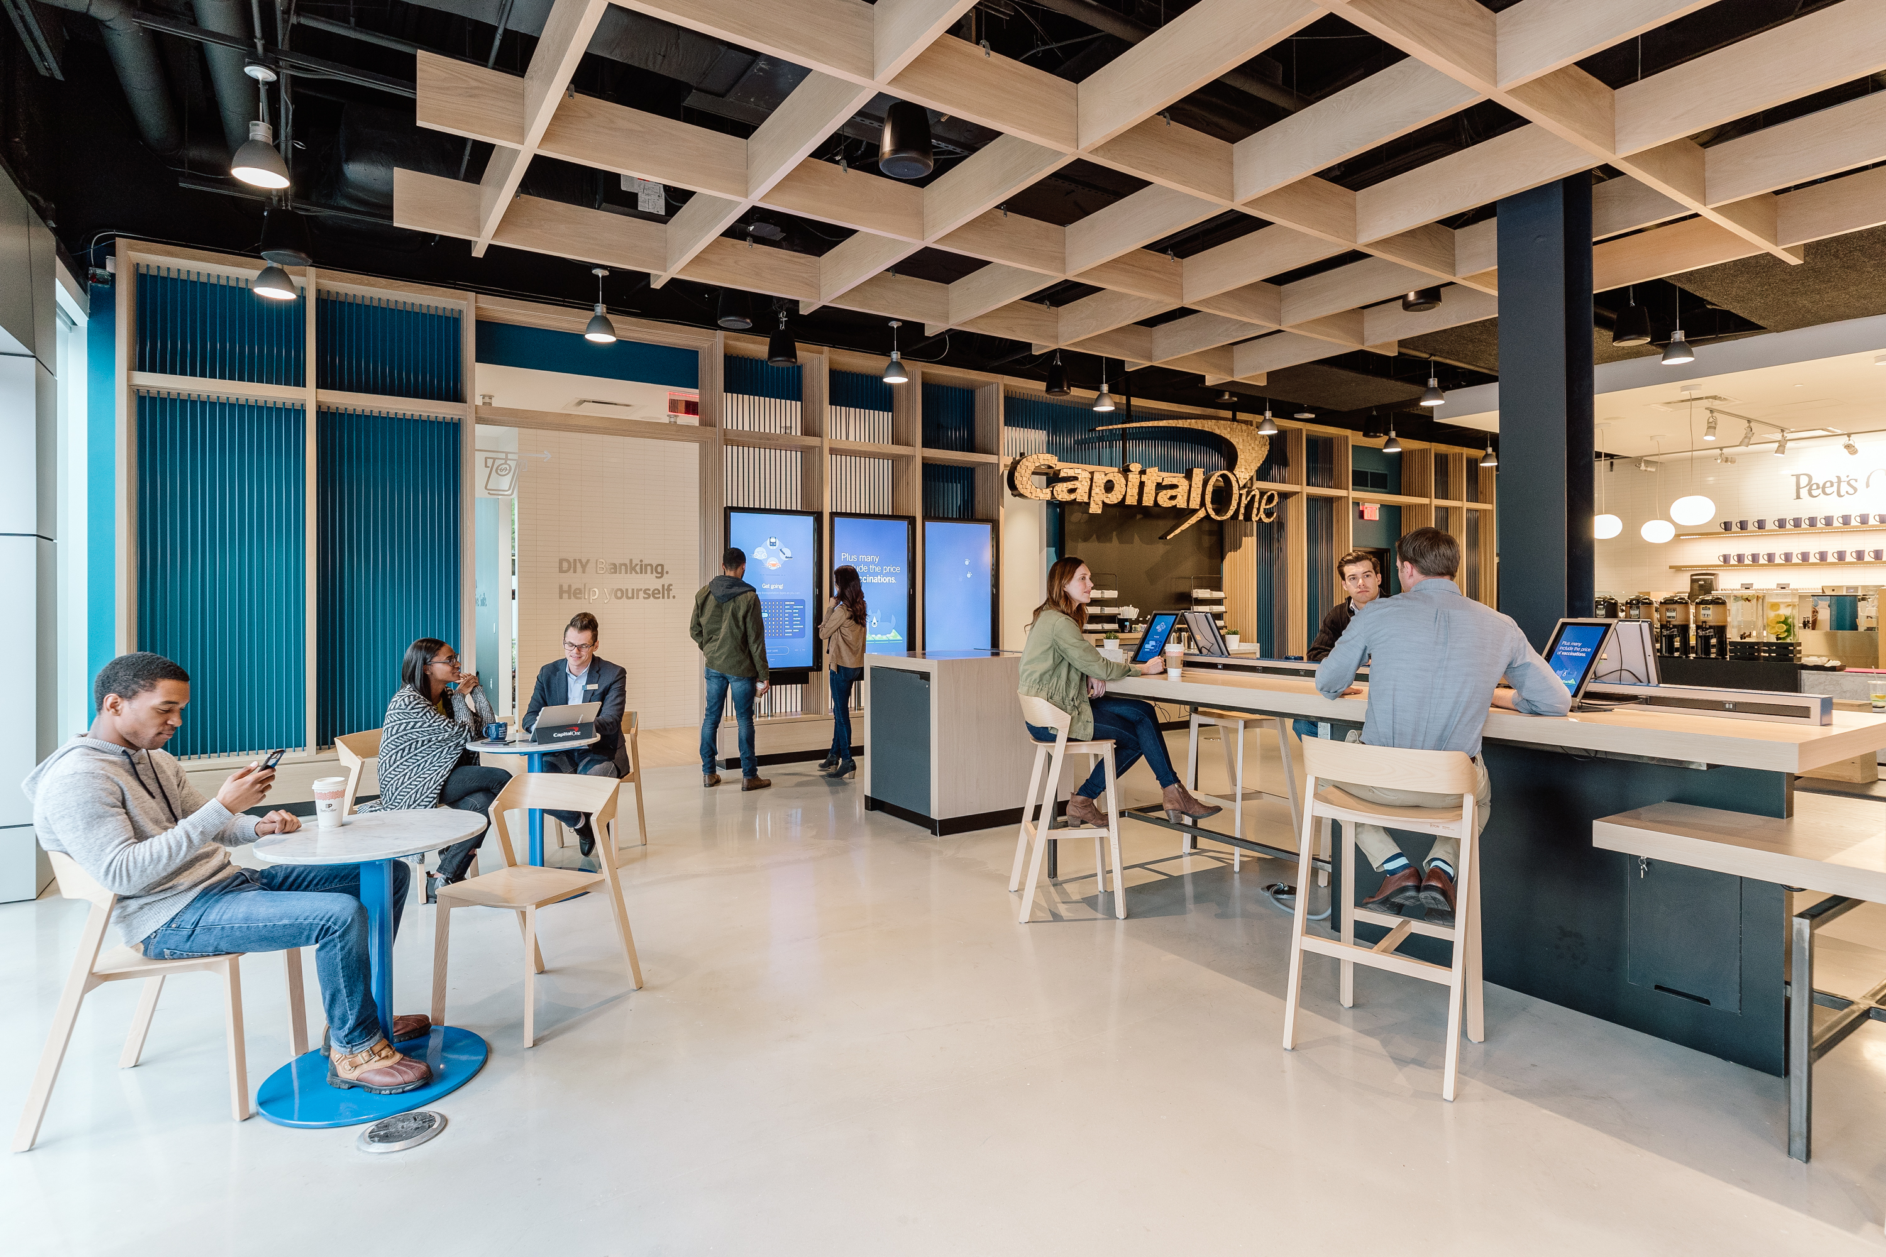
IaaS (Infrastructure as a Service)
Case Study: AWS and Capital One
Run any application anywhere
Bring products to market quickly
More resilient architecture around systems
Design for customer needs
Protect customer assets
Source: https://d1.awsstatic.com/case-studies/US/Capital%20One%20Cafe.bb6b7a7a133a573f381e9bb4e6860f68c00fea8c.jpg
FOX
MIS
Notes:
IaaS: Amazon Web Services – Capital One - case study – click on image to play video (4:26)
https://aws.amazon.com/solutions/case-studies/
Discuss the video with students…additional concepts to consider include:
“Online services that abstract user from the detail of infrastructure like physical computing resources, location, data partitioning, scaling, security, backup, etc.”
The user is responsible for installing and maintaining the operating system and the application software.
Resource Pooling
Pay for resources allocated and consumed, much like a utility service

Slide 19
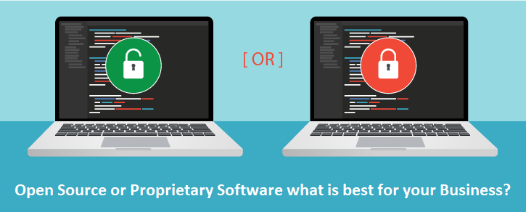
Platform Business Models
Proprietary vs. Shared
Examples?
Advantages?
Disadvantages?
Source: https://www.esds.co.in/blog/wp-content/uploads/2018/04/OPEN-SOURCE-OR-PROPRIETARY-SOFTWARE.png
FOX
MIS
Notes:
Proprietary vs. Shared
Examples
Proprietary: iOS, Microsoft, Adobe
Shared (think open-source) : Ubuntu (Microsoft open-source alternative) Inkscape (Adobe Illustrator alternative)
What are the advantages?
Proprietary: Larger market share, simplified user experience, product stability
Shared: Flexibility and Agility – allows freedom, speed and cost-effective
What are the disadvantages?
Proprietary: can’t be tweaked by users…think google forms, limited capacity to change the template provided, iOS can only operate on iPhone (not android!), overall dependency of the user
Shared: Reduced competitive advantage – impacts the revenue model, free tech-support is not always the fastest.
https://www.esds.co.in/blog/open-source-proprietary-software-best-business/#sthash.qJWrmvDB.dpbs
https://smallbusiness.chron.com/advantages-three-disadvantages-proprietary-system-vs-open-platform-38010.html

Slide 20
More to Come
Prepare with Readings & Videos before our next class!!!

