Slide 1
Digital Systems
1.1 Introduction to MIS
FOX
MIS

Slide 2
Welcome!
Spring 2024
FOX
MIS

Slide 3


Introduction to Instructor
Marie-Christine Martin
20+ years of experience in the IT industry
E-mail: mcmartin@temple.edu
Office: Speakman 209J
Office Hours:
  By appointment
FOX
MIS

Slide 4



My Background
Education
  BS Industrial Engineering
  MBA, Finance
Pre-Temple
  IBM (Canada, USA & Singapore)
  HP Global
  Oracle, USA
  Self Employed Consultant
Adjunct Faculty
  Temple University, MIS
Full-Time Faculty Temple University
  Undergraduate - MIS
  Graduate - FOX Business School MBA and Master In Management (MiM)
  Academic Director, ITACS BNAI Master Program, MIS
  AIS Faculty Advisor
FOX
MIS

Slide 5



FOX
MIS

Slide 6




2023 Summer was amazing!

Slide 7


Course Support: Information Technology Assistants (ITAs)
Tina Le
Email: le.tina@temple.edu
Office Hours: by appointment
Deepya Paramata
Email: deepyaparamata@temple.edu
Office Hours: by appointment
FOX
MIS

Slide 8
“Tell me and I forget. Teach me and I remember. Involve me and I learn.”
- Benjamin Franklin
Notes:
This is a great quote & really an extension of our syllabus contract
We will review our course learning contract at the end of class today
Our class is interactive…your job is to read the articles & watch the videos BEFORE CLASS & my job is to facilitate the discussion.
You will learn from me & your classmates too…your involvement/interaction is key!
This is definitely a more fun approach to learning!

Slide 9
Managing Expectations
This class is unique!
We will work through challenges together…plan on it!
You will find the class engaging and fun!
You will acquire knowledge and skills that you will use in future classes and your career!!!
FOX
MIS
Notes:
Nobody teaches an intro class like this in Fox or in any other colleges!

Slide 10
Course Highlights
Systems Analysis
Process Mapping (Modeling with swim lanes & entity relationship diagrams)
Digital Product Management
Information Systems CRM & ERP, Data Analytics & SCM
Platforms & Digital Business models, including API’s
Cyber security and the Enterprise plus AI
Programming including JavaScript, HTML & CSS
FOX
MIS
Notes:
MIS – Management Information Systems – “The Language of Business”
API: An application programming interface is a connection between computers or between computer programs. It is a type of software interface, offering a service to other pieces of software. A document or standard that describes how to build or use such a connection or interface is called an API specification.

Slide 11
Course Objectives
Explore the systems which organizations use to create their digital products
Explore the platforms which these digital systems are built upon
Explore the API ecosystems by which systems extend their reach and capability.
Discuss cyber security including risks & responses surrounding digital products
Introduction to the creation of software
Learning the basics of programming in JavaScript
FOX
MIS
Notes:
MIS – Management Information Systems – “The Language of Business” --- technology is EVERYWHERE!
API: Application Programming Interface, which is a software intermediary that allows two applications to talk to each other.

Slide 12
Graded Components
Component | Percentage
Attendance via Qwickly App (approximately 20 +/-) * must be present in class to earn credit **you can miss up to classes without penalty | 10%
Assignments (11 total) including Learn IT! and Max Labs ** two weeks after a grade is posted, the grade will be considered “final | 30%
Exam #1 (50 minutes) | 20%
Exam #2 (50 minutes) | 20%
Exam #3 (60 minutes – held during finals week) | 20%
*In-Class activities must be submitted while in class. ( Exceptions will be provided for Covid-19 mandatory quarantines)
**Completed assignments will not be returned in class. Assignment grades will be posted to canvas and overall course scores posted to the gradebook.
FOX
MIS
Notes:
*Qwickly Attendance must be submitted while in class. (you can miss two without penalty)
( Exceptions will be provided for Covid-19 mandatory quarantines)

Slide 13
Extra Credit Opportunity
EARN
EXTRA
CREDIT
Onetime opportunity!!!
Improve your final score
Complete the Certificate Program Course
  Certify your skills
  Stand out from the crowd
  Earn 1-point added to your final score
Details will be provided on canvas after Exam #1
FOX
MIS
Notes:
There is one opportunity for extra credit this semester. It is open after exam #1 and will close the last day of class. Details will be explained after exams #1 & 2. Don’t miss out on this one time offer for 1-point added to your final score.

Slide 14


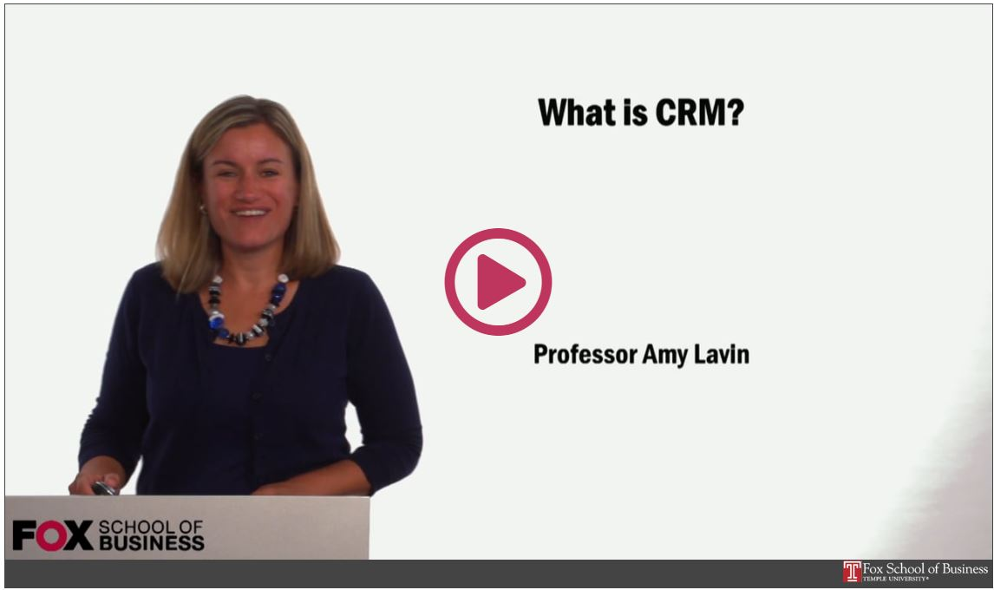
Readings & Videos – Part 1
No required texts the first 2/3’s of the semester!
Engaging collection
Current content
Available for Free!!!
FOX
MIS
Notes:
Life as a business professional does not have a textbook that you can turn to for the
answers. This is how you will learn what you need to be successful in the real world.
What you will love!
How much does the typical textbook cost?
No publisher that constantly changes editions so you can’t sell your old textbook
How old is the majority of the material in a traditional textbook?
What you may dislike!
Lots of different articles from:
Different authors
Different audiences
Different formats
No author, editors & reviewers making the connections for you

Slide 15

Readings & Videos – Part 2
JavaScript
  Create simple JavaScript programs
  Prompt users for input
  Utilize loops
  Process Information
  JavaScript Absolute Beginner's Guide, 2nd Edition
FOX
MIS

Slide 16

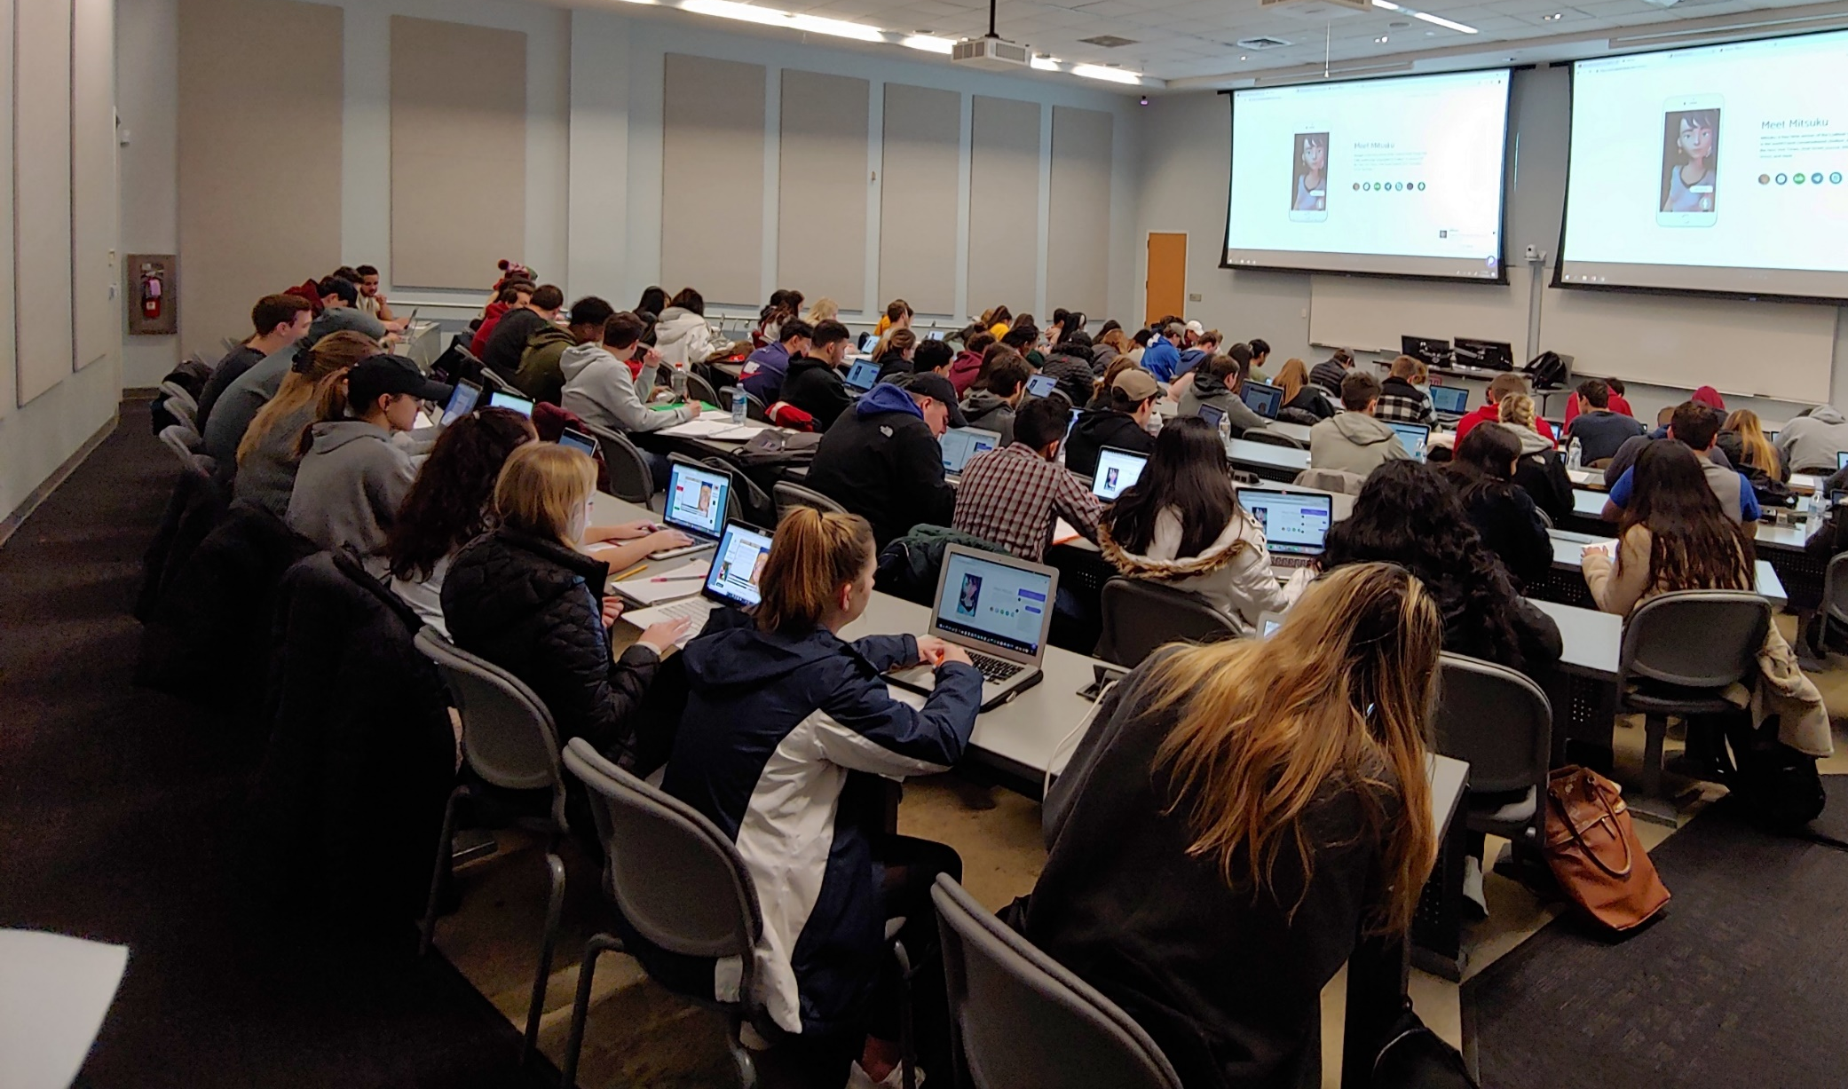
Lecture vs. Activities
Source: https://www.theodysseyonline.com/11-things-college-lecture-hall
3 Hours of zzzzzzzzz’s
1 Hour Discussion
2 Hours of Activity
FOX
MIS
Notes:
Active Learning is the Key (refer back to the Ben Franklin quote & contract)

Slide 17
Active Learning Components
TECHNOLOGY
CONTENT
ACTIVITY
FOX
MIS
Notes:
These are the components of Active Learning

Slide 18
The Active Learning Funnel
CONTENT
TECHNOLOGY
ACTIVITY
ENHANCED LEARNING ENVIRONMENT
FOX
MIS
Notes:
With our Enhanced Learning Environment we can more effectively work together and Solve Business Problems

Slide 19
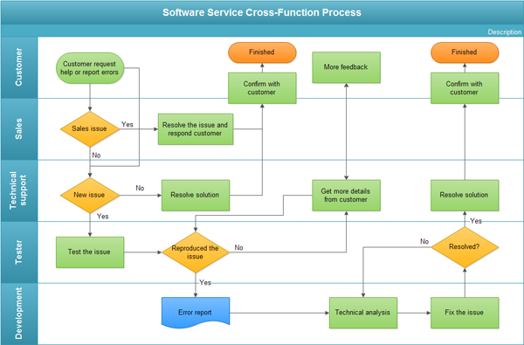
The In-class Activity
Process Diagrams
  Swim lane diagram
Real life scenarios
Knowledge Application
Problem Solve
Synthesize & Optimize Solutions
FOX
MIS
Notes:
Ask the class…Who knows what this is?
It’s a swim lane diagram (a type of process diagram)
A step-by-step process how an organization completes a task
Looks at efficiencies
Allows you to identify pain-points too
Business processes are crucial to any organization.
Business processes vary from one organization to the next, even if they are trying to accomplish the same thing.
Swim lanes are a graphical “model” of a process.
With this “model” we can identify issues and address them by changing the bad parts of the process.
Most organizations never take the time to model their business processes!

Slide 20
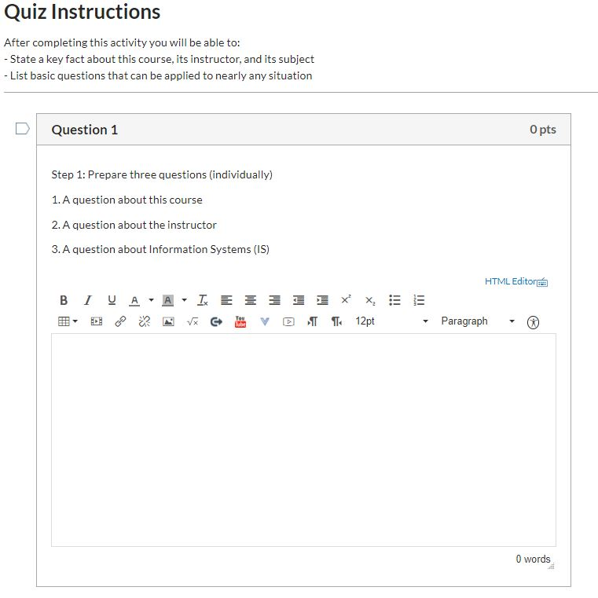
The In-class Activity – Canvas
Reinforce assigned materials
  Readings
  Videos
  Lecture
Exam Preparation
Work in teams
Must be present in class
FOX
MIS

Slide 21

FOX
MIS

Slide 22
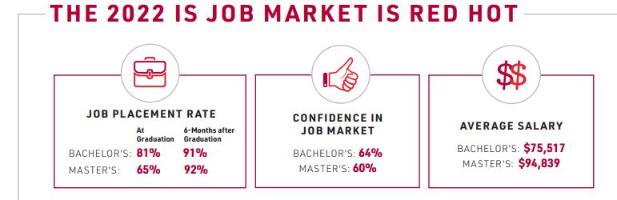

Based on 1408 recent graduates from 36 universities across the U.S.
FOX
MIS
Notes:
Discuss our department’s job placement rate. Pre-covid it was 100% for 7-years in a row. Now it hovers around 80%!
Check IBIT site for national statistic updates

Slide 23
ROADMAP
Week 1:
Introduction & Systems Analysis
Course Description
Systems Thinking
Assignments #01
Week 2:
Digital Product Management
Max Labs 1a & 1b
Systems & Processes
Assignment #02
Week 3:
Introduction to Process Mapping
Swim Lane Diagrams
Assignment #03
Week 4:
Data Modeling with Entity Relationship Diagrams
ERD Diagrams
Assignment #04
Week 5:
Exam #1 &
Digital Systems & Information Systems: Part I & II
Learn IT #1
ERP & CRM
*Exam: check course site
Assignment #05
START
Week 9:
Exam #2 & JavaScript Unit #1
Parts I & II
Hello World, Variables
*Exam: check course site
Week 8:
Cybersecurity & AI
Cybersecurity
Protection Protocols
Artificial Intelligence
Assignment #08
Week 7:
Information Systems: Part IV Platforms & Digital Business Models
SCM
Platforms & Digital Models
Assignment #07
Week 6:
Information
Systems: Parts II & III
CRM
Data Analytics
Assignment #06
Week 10:
JavaScript Unit #2 Functions
Values & Variables
Operator types
Strings
Week 11:
JavaScript Unit #3 Logical Operators & Conditional Logic
Logical Operators
Conditional Types
Week 12:
JavaScript Unit #4 Loops
Intro to Loops
While and Do
Week 13:
JavaScript Unit #4 Working with Loops &
HTML & CSS Unit
Writing the code
HTML & CSS Basics
Assignment #9
Week 14 + 1:
HTML & CSS Unit
(continued)
HTML & CSS Basics
Course Reflection
Exam #3
Assignments #10 & #11 *Final Exam: check course site
FINISH

Slide 24
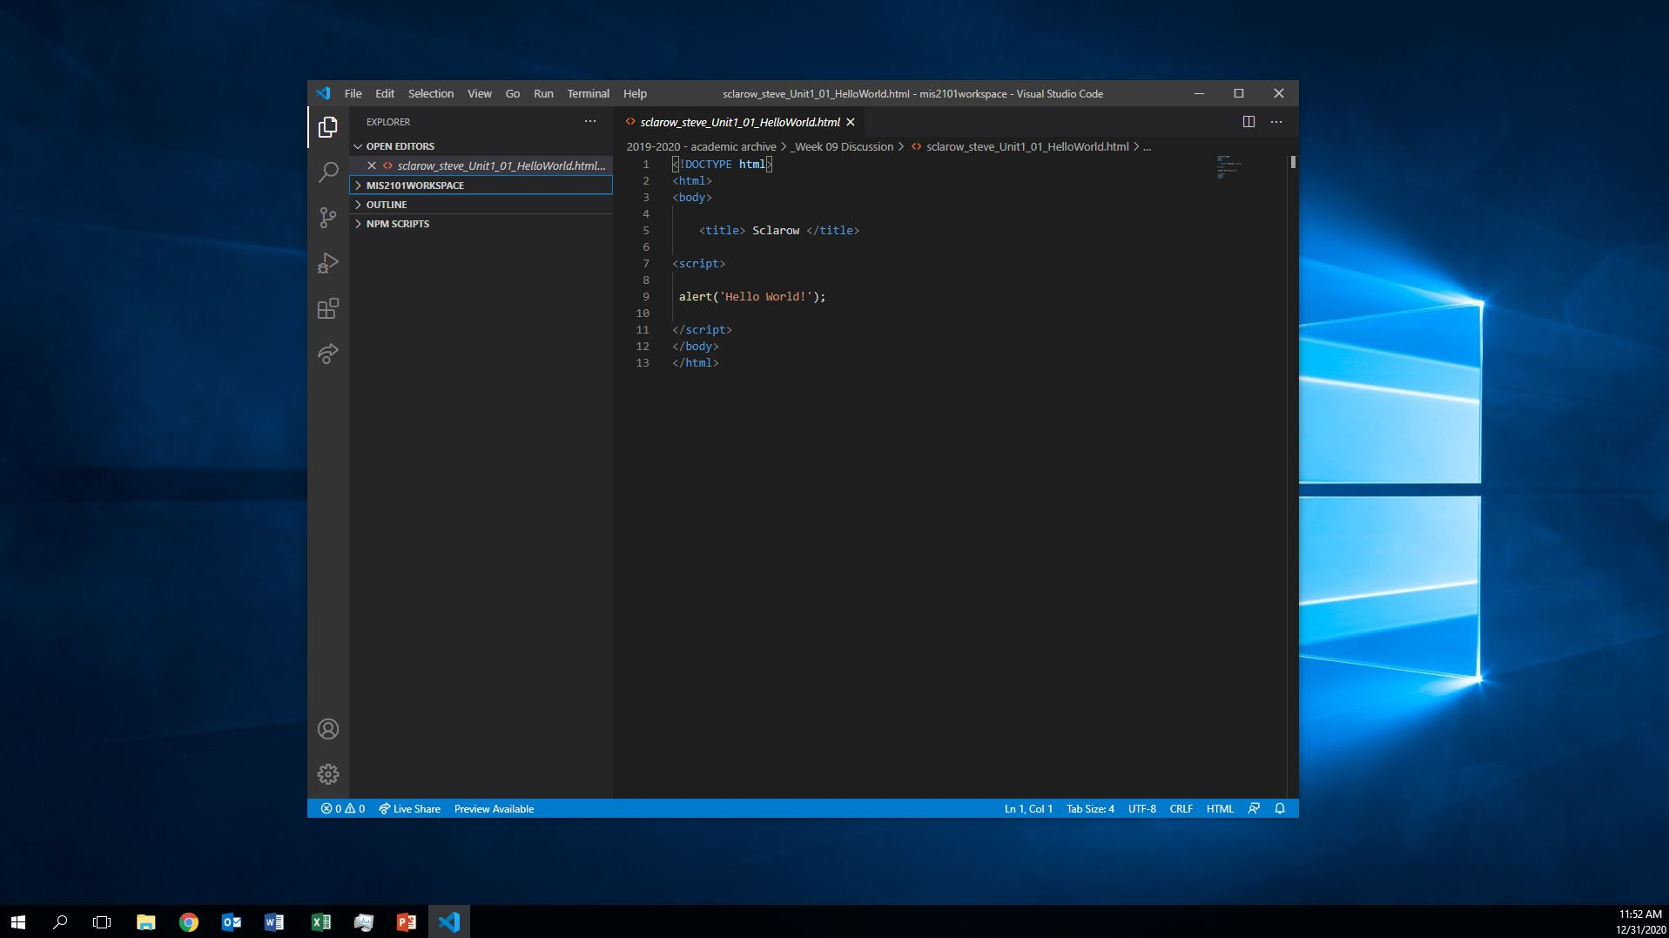
Course Intro Videos (5)
Due Thursday
Assignment #1
FOX
MIS
Notes:
This is your first assignment…due tomorrow….
5 short videos (total <15 min)

Slide 25
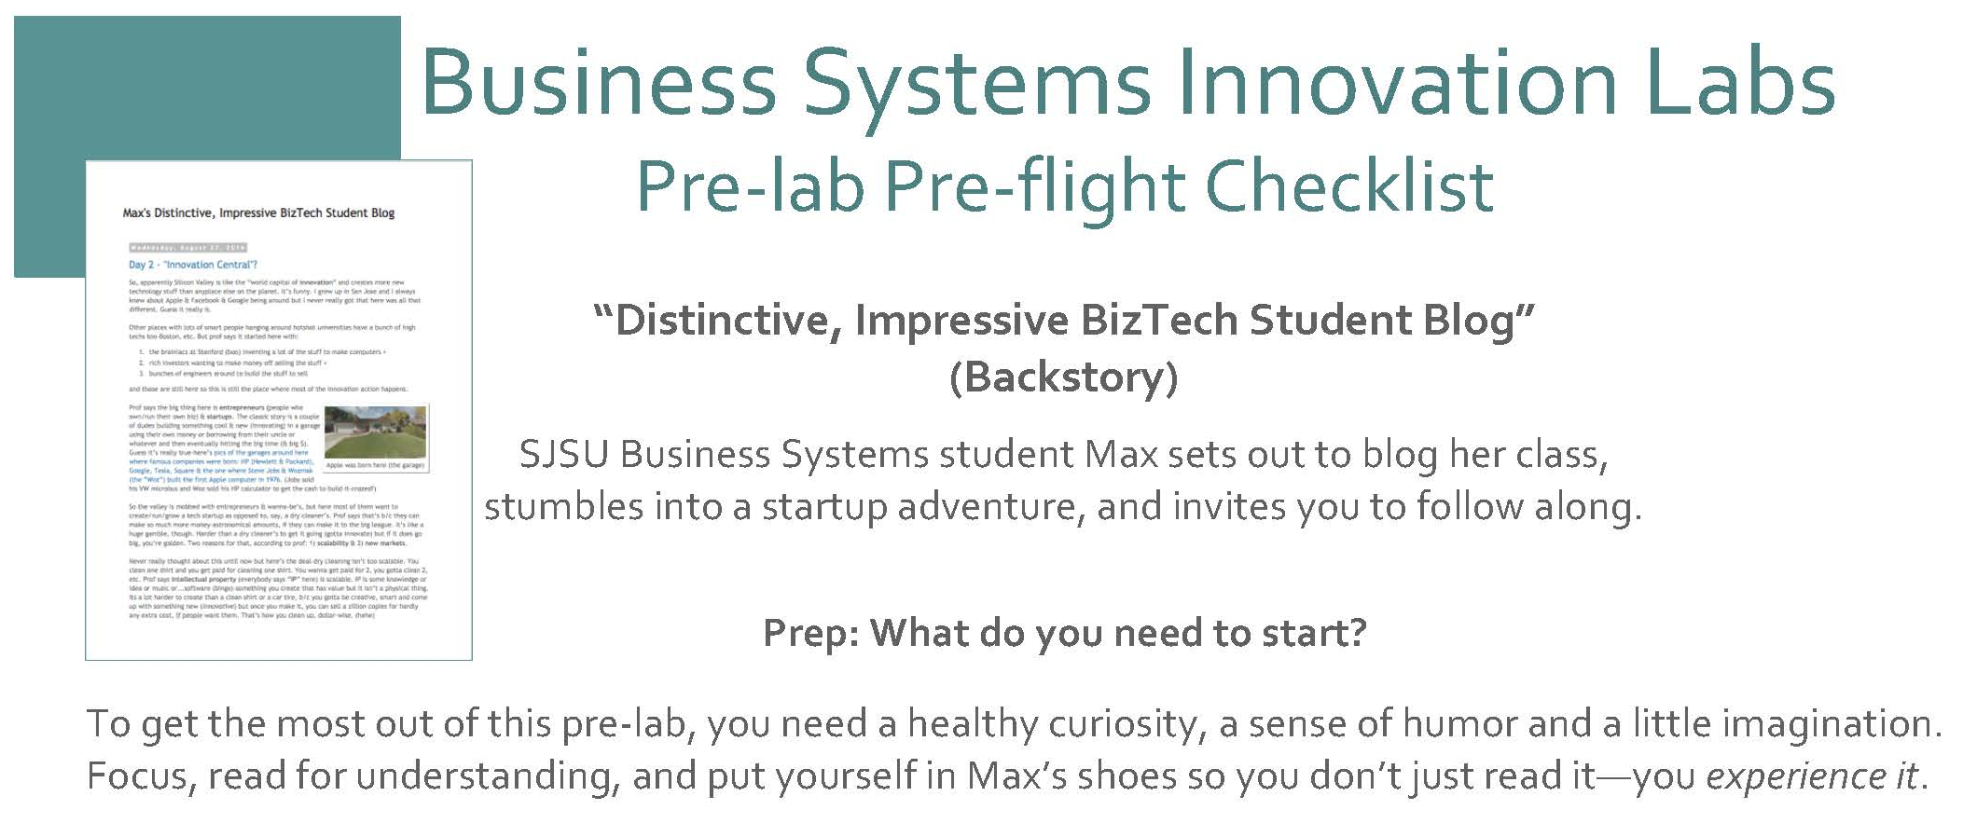
Max Lab Pre-Flight (Lab 0) Assignment due on Monday
Assignment #2
FOX
MIS
Notes:
This assignment is purely reading- read it! The other Max Labs are based off this reading.
You will need to submit a screen shot as part of this assignment!!!
Follow hyper link to course site.
We will discuss MaxLab in week 3
Cost of Max labs is $19.99 (don’t skip ahead)
PRE-FLIGHT= easiest assignment ever…read and take a screenshot

Slide 26
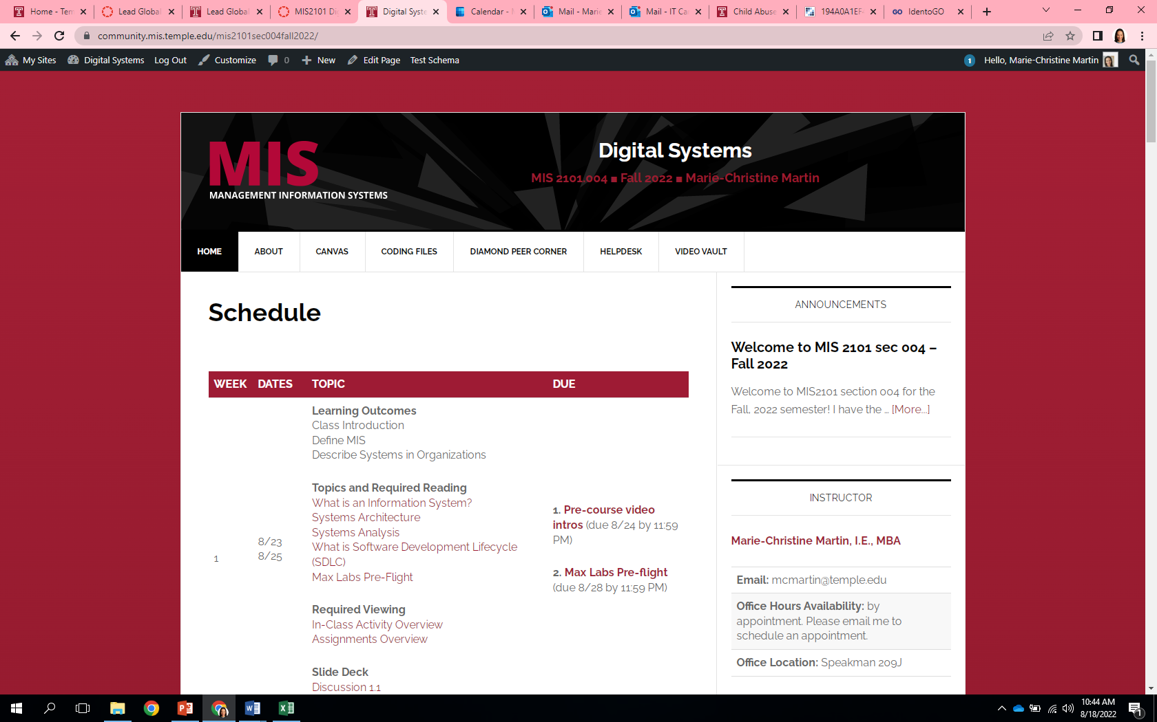
Class Site Review
https://community.mis.temple.edu/mis2101sec008spring2024/
FOX
MIS
Notes:
Our Course is different…
Everything you need to know is on our MIS Course Site…
Let’s look at the calendar
Video vault
Course Structure
Course Materials
Use of Canvas

Slide 27
In-Class Activity #1
1.1a Intro to Information Systems in Organizations
FOX
MIS

Slide 28
Digital Systems
1.2 What are Systems?
Focus this week: System Analysis
FOX
MIS
Notes:
Our focus this week is Systems Analysis

Slide 29
ROADMAP
Week 1:
Introduction & Systems Analysis
Course Description
Systems Thinking
Assignments #01
Week 2:
Digital Product Management
Max Labs 1a & 1b
Systems & Processes
Assignment #02
Week 3:
Introduction to Process Mapping
Swim Lane Diagrams
Assignment #03
Week 4:
Data Modeling with Entity Relationship Diagrams
ERD Diagrams
Assignment #04
Week 5:
Exam #1 &
Digital Systems & Information Systems: Part I & II
Learn IT #1
ERP & CRM
*Exam: check course site
Assignment #05
START
Week 9:
Exam #2 & JavaScript Unit #1
Parts I & II
Hello World, Variables
*Exam: check course site
Week 8:
Cybersecurity & AI
Cybersecurity
Protection Protocols
Artificial Intelligence
Assignment #08
Week 7:
Information Systems: Part IV Platforms & Digital Business Models
SCM
Platforms & Digital Models
Assignment #07
Week 6:
Information
Systems: Parts II & III
CRM
Data Analytics
Assignment #06
Week 10:
JavaScript Unit #2 Functions
Values & Variables
Operator types
Strings
Week 11:
JavaScript Unit #3 Logical Operators & Conditional Logic
Logical Operators
Conditional Types
Week 12:
JavaScript Unit #4 Loops
Intro to Loops
While and Do
Week 13:
JavaScript Unit #4 Working with Loops &
HTML & CSS Unit
Writing the code
HTML & CSS Basics
Assignment #9
Week 14 + 1:
HTML & CSS Unit
(continued)
HTML & CSS Basics
Course Reflection
Exam #3
Assignments #10 & #11 *Final Exam: check course site
FINISH

Slide 30
Max Lab Pre-Flight (Lab 0)
Assignment due on Monday
Assignment #2
FOX
MIS
Notes:
This assignment is purely reading- read it! The other Max Labs are based off this reading.
You will need to submit a screen shot as part of this assignment!!!
Follow hyper link to course site.
We will discuss MaxLab in week 3
Cost of Max labs is $19.99 (don’t skip ahead)
PRE-FLIGHT= easiest assignment ever…read and take a screenshot

Slide 31
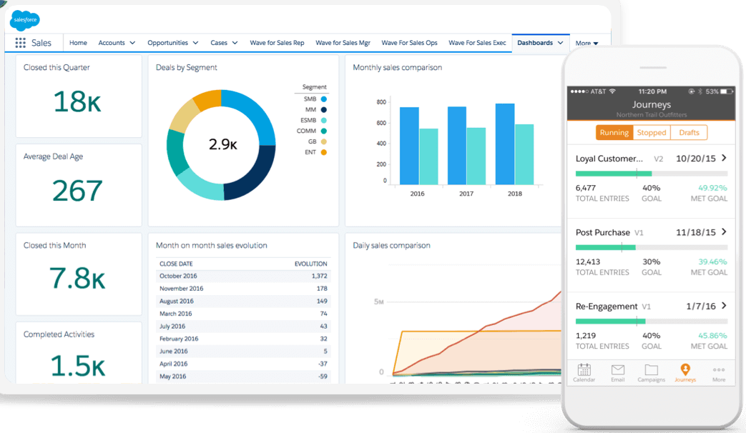

What is MIS?
Using Information Technology to solve business problems.
MIS is not Computer Science
It’s about business where we train people to do what?
Use technology to solve day-to-day business problems
Sources: https://c1.sfdcstatic.com/content/dam/web/en_us/www/images/products/what-is-salesforce/whatis-jumbo-astro-product.png
https://www.kindpng.com/picc/m/568-5683178_real-cash-stack-100-dollar-bill-hd-png.png
FOX
MIS
Notes:
MIS is not computer science. It's about business. This is where we train people to use technology to solve the day-to-day business problems that organizations have.
And as we're going to talk about, businesses have many problems. MIS is the primary tool that they use to help address organizational issues.
IT today drives all business. As we understand as living today in a digital world, IT is the key enabler of the global economy. It is driving all of the rapid change that we're seeing today in business.

Slide 32

World View – A collection of “Systems”
Systems = people + process + technology
Manipulation of information = value
Managed by MIS professionals
Systems surround us 24/7
Application Programming Interface (API’s)
Source: https://www.aecom.com/ca/management-information-systems-mis/
FOX
MIS
Notes:
Ask students: What is this slide really talking about?
Systems are all around us. They range from completely manual to completely automated.
***See the world as a series of components***
See everything through the lens of all products are components of a larger whole.
Let’s look at two examples in the next few slides

Slide 33
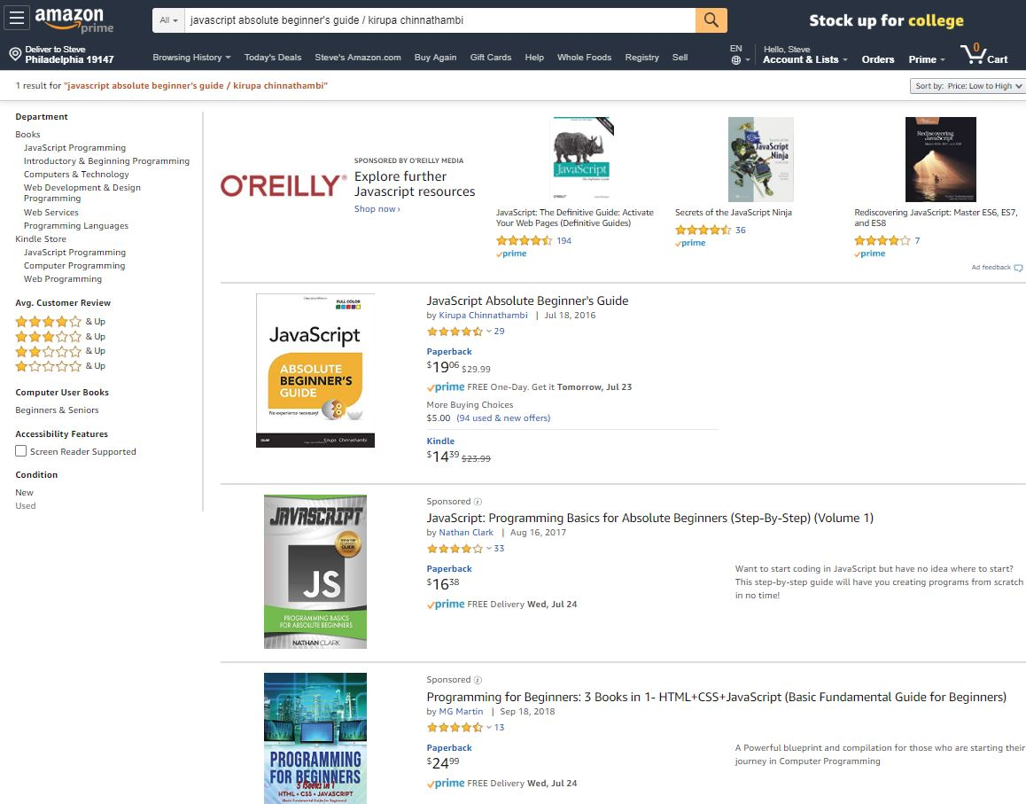
Understanding Systems
Buying textbooks on Amazon
What is part of that system… what are the steps?
Log-in (multiple steps)
Search
Shopping Cart
Purchase (Multiple steps)
What else???
FOX
MIS
Notes:
Ask the students:
Who has purchased a text book on Amazon?
Next ask the question…What was part of the system?
Let them discuss ideas with you before scrolling through the animation…keep working with them to consider all of the System Users (internal and External to the organization)
Fun facts…How is this all maintained:
Amazon – 49% of US e-commerce market
5% of all retail
More than 12 million different products sold
95 million Prime Accounts
$1.4k – average spend per person/per year
Shipped over 50 Billion products in 2017
647,500 employees
30 Million average monthly users
2 million sellers
45,000 robots
In 2017, 35 orders per second
Follow up with…we will look at this system in more detail in just a bit

Slide 34
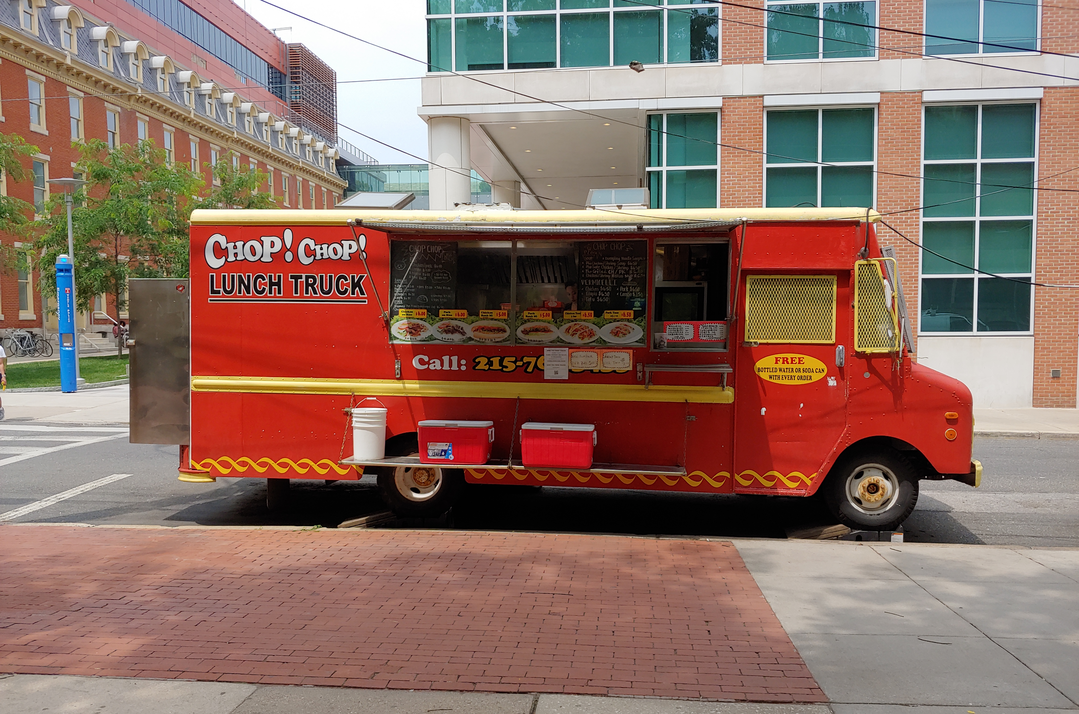
Understanding Systems (cont.)
Buying lunch
What is part of that system… what are the steps?
Take the order
Hand order to cook
Prep to-go bag
Order cooked (multiple steps)
What else???
FOX
MIS
Notes:
Is this the most efficient system?
(only technology is the order pad and pencil used to write the order, maybe the phone too for call-in orders)
Would technology help?
How?

Slide 35
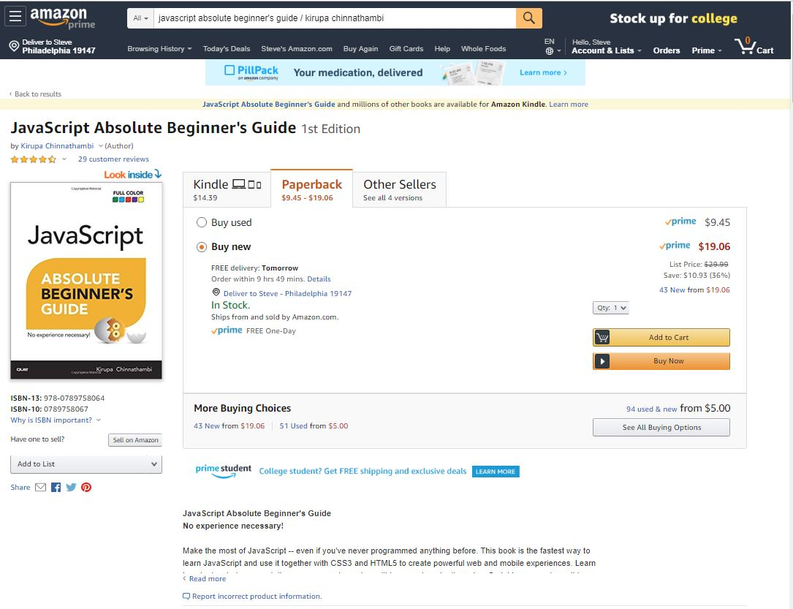
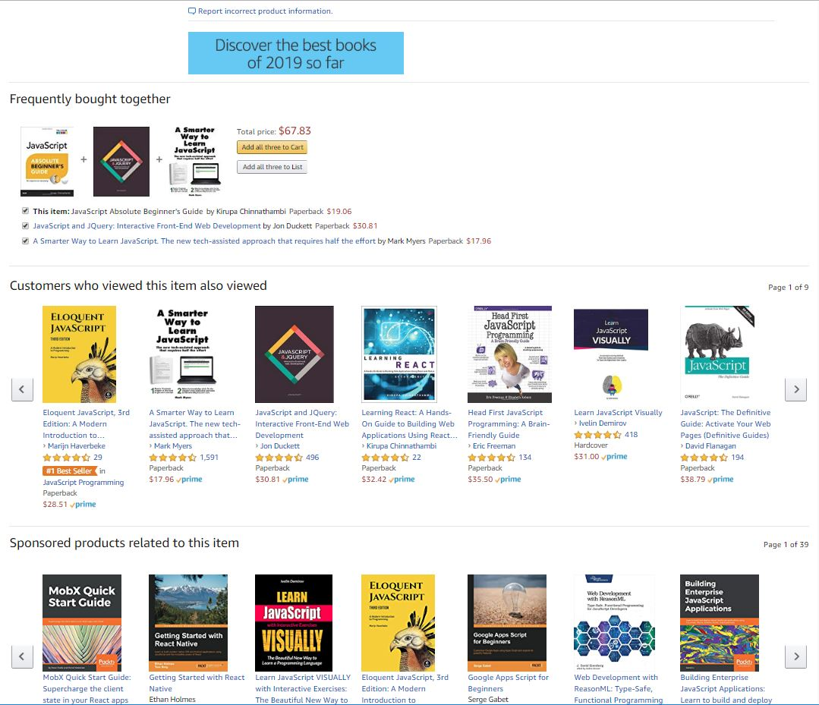
Understanding Systems (cont.)
Describe the Process of Ordering
What keeps info accurate?
  Data
Who is involved?
  Customer ♦ Store ♦ Warehouse Mgr. ♦ Admin ♦ UPS driver…
How much effort?
  None…it’s automated!
  Technology !!!
FOX
MIS
Notes:
Ask the students:
Who can describe the Process of Ordering a text book on Amazon?
What keeps information about inventory current & accurate? (DATA!)
Discuss with them who is involved in the process
Pause on the effort question and ask them to really think about it. Why none??? It’s automated, Technology!!!

Slide 36
“information system – an integrated set of components for collecting, storing, and processing data and for providing information, knowledge, and digital products.”
- Encyclopedia Britannica
Source: https://www.britannica.com/topic/information-system/Management-support
Notes:
We need to start understanding what a System is
Organizations rely on Information…it’s a critical asset
So, What is an Information System? What does this definition really mean?

Slide 37
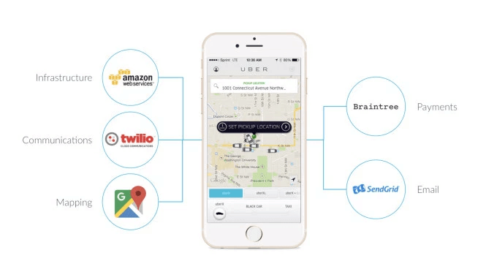
API’s Case Study: UBER
Requesting a ride?
Describe what happens...
  What are these systems?
  How do they work?
Source: https://www.okta.com/security-blog/2019/05/how-uber-takes-advantage-of-the-api-economy/
FOX
MIS
Notes:
Used to achieve Organizational Goals

Slide 38
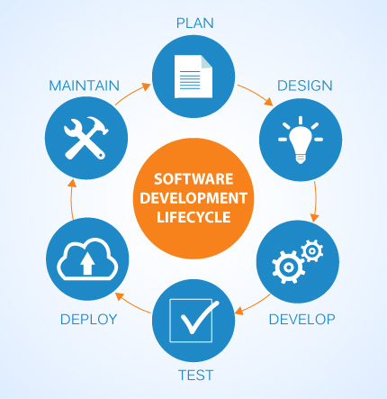
SDLC methodologies
Waterfall
Agile
Lean
Scrum
DevOps
Image: http://www.xanadutec.com/software-as-a-service.html
FOX
MIS
Notes:
Waterfall – oldest approach. It is sequential, non-iterative. (still good for large unwieldy projects)
Agile – iterative approach (opposite of waterfall). Work is completed in 2-4 week “sprints”. More flexible and leads to more innovation.
Lean – The agile and lean approaches are closely interconnected, as they both focus on delivery speed and continuous improvement. In contrast, the lean model is rooted in manufacturing best practices where excess waste and effort are seen as the largest risk to an organization.
Scrum – A framework that enables you to implement Agile. Consists of a series of events incorporating a form of task board to track the progress to establish ownership and build consensus
DevOps – “DevOps is one of the newest SDLC methodologies and is being adopted by many software companies and IT organizations. As its name suggests, the premise of DevOps is to bring development teams together with operational teams in order to streamline delivery and support.
The advantages of such an approach are that changes become more fluid, while organizational risk is reduced. Teams must have flexible resources in order for a DevOps arrangement to succeed.”
https://www.innovativearchitects.com/KnowledgeCenter/basic-IT-systems/8-SDLC-models.aspx

Slide 39
“Once a Product Manager / Technologist understands the business problem, they can architect a solution.”
- Mart Doyle

Slide 40
System Analysis --- Process Decomposition!
INPUTS: credit card, address, e-mail, phone, shipping preferences, etc.
Purchase Text
OUTPUTS: textbook, packing slip, delivery box
Single entity
Subsystem
Select Text
Check Out
Deliver Text
Shipping address
Payment method
Review Items
Shipping
Change
Add cards
Select card
Reward points
Use method
FOX
MIS
Notes:
Discuss the Amazon Text ordering Process and Decompose the steps
Ask the students to define another system in Fox/Temple that they can decompose (Registering for class)
Each piece could be an (API) or software product

Slide 41
“Systems Architecture is a response to the conceptual and practical difficulties of the description and the design of complex systems.”
- Boris Golden

Slide 42
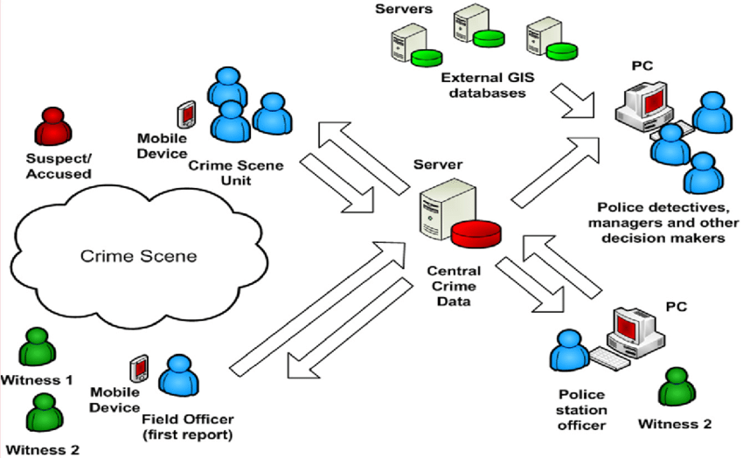
Systems Architecture
Conceptual Diagram
Structural components
Identify/Solve Problems
Existing or New
Communication tool
Source: https://www.researchgate.net/figure/Conceptual-System-Architecture_fig2_327987580
FOX
MIS
Notes:
The Fundamental Organization of a System!!!
Conceptual Design – (Abstract Diagram)
High level, provides picture of overall purpose of solution
Logical Design – (More detailed, includes major components)
More detailed for typical audience of developers or other systems architects
Does not include physical server names, but does include business services, application names and details
Physical Design – (Has all major components – leads to implementation)
Has everything, including specific server names and locations
Includes all known details such as operating systems and version numbers, constraints
They all have different systems or API’s that communicate with one another

Slide 43
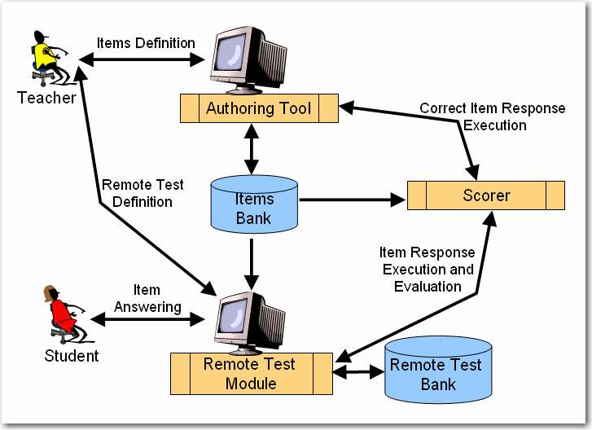
Systems Architecture
Test question defined
  Authoring tool
Remote test created
  Test module
Student responses
  Test module
Execution & Evaluation
Source: http://spmarchitecture.com/systems-architecture/system-architecture-learning-environment-for-automatic-rating-64721-2/
FOX
MIS
Notes:
Diagram of People, Process & Tech – this is conceptual!
The Specifications to build the System
This is an ERP philosophy…how could we improve this API’s

Slide 44
Recap:
1. What is “Systems analysis?”:
Problem solving technique that “decomposes” a system into its component pieces for the purpose of studying how well these parts work & interact to accomplish their purpose
2. What is “Systems Architecture?”:
Representation of the system & all of its parts/components
Notes:
Recap:
1. What is “Systems analysis?”:
Problem solving technique that “decomposes” a system into its component pieces for the purpose of studying how well these parts work & interact to accomplish their purpose
2. What is “Systems Architecture?”:
Representation of the system & all of its parts/components

Slide 45
In-Class Activity #2
1.2 What are Systems?
FOX
MIS

Slide 46
Prepare for week 2 – complete before our next class:
- Read articles
- Watch videos
- Take notes!

