Slide 1
Digital Systems
ICA#20: Practice Exam
FOX
MIS

Slide 2
ROADMAP
Week 1:
Introduction & Systems Analysis
Course Description
Systems Thinking
Assignments #01
Week 2:
Digital Product Management
Max Labs 1a & 1b
Systems & Processes
Assignment #02
Week 3:
Introduction to Process Mapping
Swim Lane Diagrams
Assignment #03
Week 4:
Data Modeling with Entity Relationship Diagrams
ERD Diagrams
Assignment #04
Week 5:
Exam #1 &
Digital Systems & Information Systems: Part I & II
Learn IT #1
ERP & CRM
Assignment #05
START
Week 9:
Exam #2 & JavaScript Unit #1
Parts I & II
Hello World, Variables
Week 8:
Cybersecurity & AI
Cybersecurity
Protection Protocols
Artificial Intelligence
Assignment #08
Week 7:
Information Systems: Part IV Platforms & Digital Business Models
SCM
Platforms & Digital Models
Assignment #07
Week 6:
Information
Systems: Parts II & III
CRM
Data Analytics
Assignment #06
Week 10:
JavaScript Unit #2 Functions
Values & Variables
Operator types
Strings
Week 11:
JavaScript Unit #3 Logical Operators & Conditional Logic
Logical Operators
Conditional Types
Week 12:
JavaScript Unit #4 Loops
Intro to Loops
While and Do
Week 13:
JavaScript Unit #4 Working with Loops &
HTML & CSS Unit
Writing the code
HTML & CSS Basics
Assignment #9
Week 14 + 1:
HTML & CSS Unit
(continued)
HTML & CSS Basics
Course Reflection
Exam #3
Assignments #10 & #11
FINISH

Slide 3
Extra Credit Opportunity
LAST CHANCE TO EARN
EXTRA
CREDIT
Onetime opportunity!!!
Improve your final score
Complete two Certificate Program Courses
Certify your skills
Stand out from the crowd
Earn 1-point added to your final score
Canvas closes on Monday
FOX
MIS
Notes:
There is one opportunity for extra credit this semester. It is open after exam #1 and will close the last day of class. Don’t miss out on this one time offer for 1-point added to your final score.

Slide 4
Exam 3 is on: May 7 from 10:30-11:30 am in our regular classroom
Bring: Calculator & pencil #2

Slide 5
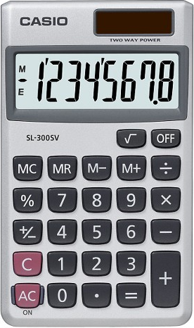
Exam will Cover Discussions from week 9-14
Total of 20 multiple choice questions
Readings and Lectures (50% - 10 questions)
Values & Variables
Functions
Logical Operators
Conditional Logic
Loops
CSS, HTML and JavaScript basics
Coding – Demonstrate your ability to apply (50% - 10 questions)
Code Analysis & Diagnosis
You can use a CALCULATOR
Source: https://target.scene7.com/is/image/Target/GUEST_a97f68d0-6348-4802-9d47-89b3a854a20e?wid=488&hei=488&fmt=pjpeg
Source: https://ccesnews.org/opinion/2018/04/23/10-tips-for-exam-preparation/#photo
Note: there may be “none of the above” answer as part of the multiple choices
FOX
MIS

Slide 6
Sample Question:
A loop cannot start with a negative number?
Refer to the example below:
for (let i = -10; i <= 30; i=i+5) {
True or False
FOX
MIS

Slide 7
Sample Question:
A loop cannot start with a negative number?
Refer to the example below:
for (let i = -10; i <= 30; i=i+5) {
True or False
How many times will the loop run?
FOX
MIS
Notes:
Additional question: how many times will the loop run? 9 times!

Slide 8
Sample Question:
A loop cannot start with a negative number?
Refer to the example below:
for (let i = -10; i <= 30; i=i+5) {
True or False
How many times will the loop run? 9
FOX
MIS
Notes:
Additional question: how many times will the loop run? 9 times!

Slide 9
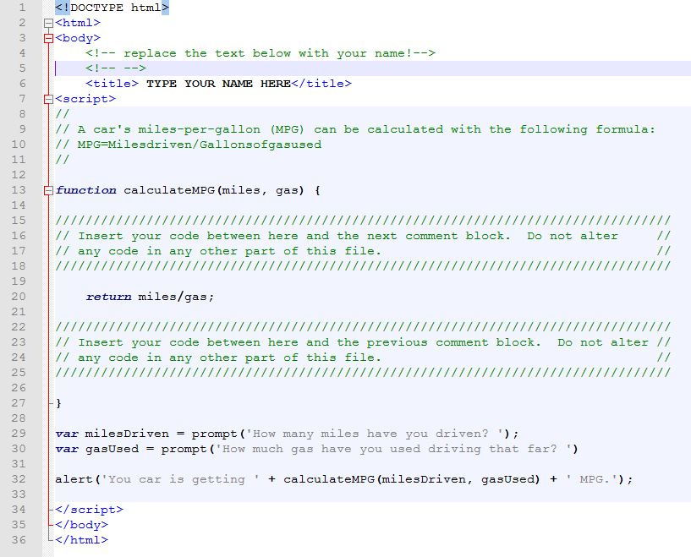
Sample Question:
What is your MPG if you have driven 320 Miles and used 20 Gallons of gas? (analyze the code)
A. 15
B. 16
C. 20
D. 32
FOX
MIS

Slide 10
Sample Question:
What is your MPG if you have driven 320 Miles and used 20 Gallons of gas? (analyze the code)
A. 15
B. 16
C. 20
D. 32
(320/20)
FOX
MIS
Notes:
Bring a #

Slide 11
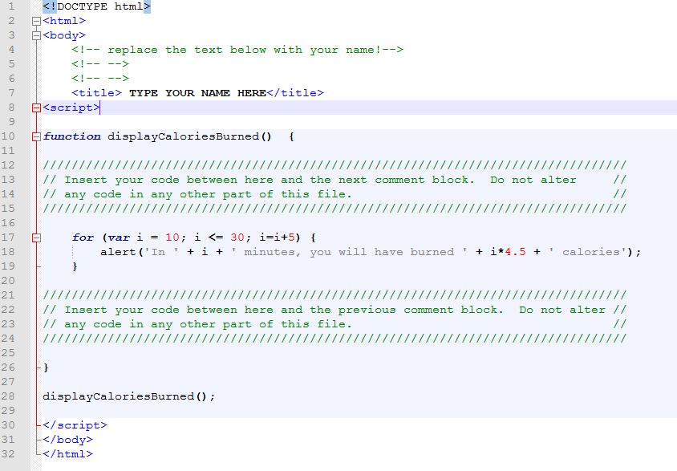
Sample Questions:
1. After 10 minutes, how many calories have you burned?`
A. 0 B. 45 C. 67.5
2. After 30 minutes, how many total calories have you burned?`
A. 112.5 B. 135 C. 450 D. 1350
3. If we change the initial value of i to 20 how many times does the function run and how many total calories are burned?
A. 3, 90 B. 5, 135 C. 3, 135 D. Does not run
4. If we change i <= 30 to i <=40 how many times does the function run and how many total calories are burned?
A. 5, 135 B. 7, 180 C. 7, 225 D. Does not run
FOX
MIS
Notes:
Bring a #

Slide 12
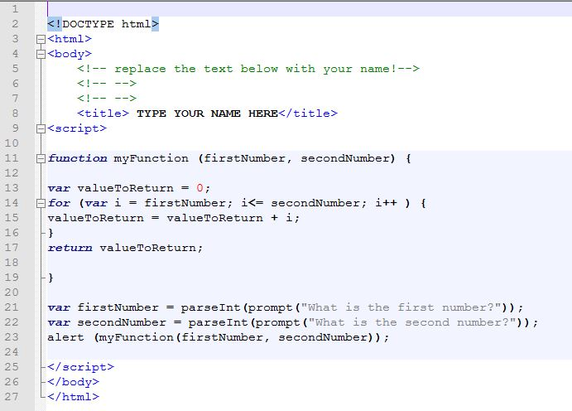
Sample Questions:
Using the program myFunction.html, what is displayed when you pass 11 as the first number and 14 as the second number?
a. 1114
b. 25
c. 1411
d. 50
e. None of the above
FOX
MIS

Slide 13
Sample Questions:
Using the program myFunction.html, what is displayed when you pass 11 as the first number and 14 as the second number?
a. 1114
b. 25
c. 1411
d. 50
e. None of the above
(11+12+13+14)
FOX
MIS

Slide 14
Sample Question:
What’s wrong with the statement listed below?
let 365days = prompt (“How many days are in a year?");
FOX
MIS

Slide 15
Sample Question:
What’s wrong with the statement listed below?
let 365days = prompt (“How many days are in a year?");
Variable name cannot begin with a number!
FOX
MIS

Slide 16
Individual Practice Exam:
Open the file on canvas (In Class Activity #22)
Fill out your answers
Upload your updated file
FOX
MIS

Slide 17
ICA Answers
1. D
2. B
3. C
4. B
5. A
6. A
7. D
8. A
9. E (The correct answer is 22)
10. B

Slide 18
Please Fill out SFF
(Student Feedback Form)
FOX
MIS

Slide 19
No Class on Thursday!
Complete all Challenges Week 9-14
Complete your Final Assignment
Prepare for the Exam!
Fill out SFF by EOD April 30
FOX
MIS

