Slide 1
Information Systems in Organizations 2.1 Analyzing Organizations as Systems and Processes 2.1.1 Modeling Processes with Swimlane Diagrams

Slide 2
Roadmap
Week 1: Intro to MIS
Week 2: Systems Analysis
Week 2: Systems Analysis
Week 3: Systems Analysis
Week 3
Swimlanes
ERDs
Decision Trees
Architecture Diagrams
Exam #1
Learn IT! #1
Max Labs 0
What is MIS?
Week 4: Organizational Systems
Week 4: Organizational Systems
Week 5: Organizational Systems
Week 5
Decision Support
SDLC
Exam #2
ERP
Knowledge Management
Digital Innovation
Max Labs 1a & 1b
Week 6: Organizational Systems
Week 6: Organizational Systems
Platforms
Week 7: Organizational Systems
Week 7
Customer Relationship Management Systems
Cloud Computing
Artificial Intelligence
Exam #3 Prep
Supply Chain Management Systems
Week 7: Organizational Systems
Max Labs 3a & 3b
Learn IT! #2
Max Labs 2a & 2b

Slide 3
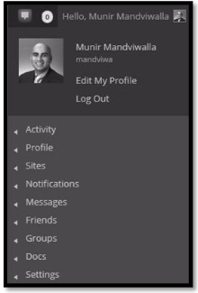
Learn IT! #1 Digital Identity Management
Due week 9/8
4 Parts
Part 1: Digital Identity (Create a profile on eportfolio site)
Part 2: Digital Portfolio
Part 3: Analytics
Part 4: Build a Professional Network
DO NOT COMPLETE : Part 5
Upload to OWLbox from the course site

Slide 4
Max Labs 0
This assignment is purely reading- read it! The other Max Labs are based off this reading.

Slide 5
Tools for Discussing: Processes, Information, Business Rules, & Systems
2.1 Analyzing Organizations as Systems Processes
Systems Analysis
Systems Architecture
2.1.1 Modeling Processes with Swimlane Diagrams
2.1.2 Data Modeling with ERDs
2.1.3 Modeling Business Rules with Decision Trees
2.1.4 Conceptual Architecture Diagrams

Slide 6
Required Reading
Wikipedia, Systems Analysis
Wikipedia, Systems Architecture
Systems Architecture Fundamentals – Conceptual, Logical, Physical Designs
A Guide to Process Mapping
An Introduction to Swimlane Diagrams

Slide 7
MIS People View the World as a Collection of “Systems”
All “Systems” are a mix of people, process and technology
All “Systems” manipulate information to create value
MIS professionals create and manage these “Systems”
Some are simple…some are complex!

Slide 8
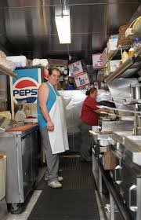
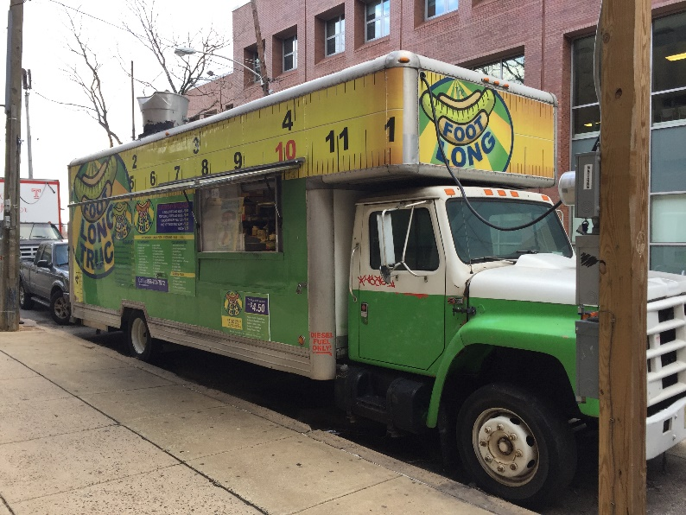
Some “Systems” are simple and don’t use much technology
All “Systems” are a mix of people, process and technology
All “Systems” manipulate information to create value
MIS professionals create and manage these “Systems”
Can you describe the people, process and technology? What information is required?

Slide 9
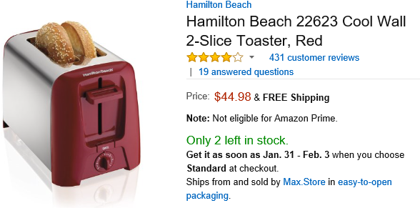
Some “Systems” are complex and use lots of technology
All “Systems” are a mix of people, process and technology
All “Systems” manipulate information to create value
MIS professionals create and manage these “Systems”
Can you describe the people, process and technology? What information is required?

Slide 10
Required Viewing 1/2

Slide 11
?
Problem Solving Technique
Business Process
What is the problem?
What is “systems analysis”?
What is “systems architecture”?
What is the solution?
Modeling
Decomposition

Slide 12
Wikipedia, Systems Analysis
Discuss:
1. What was this article about?
2. Why should you care?
Systems analysis is a problem solving technique that decomposes a system into its component pieces for the purpose of studying how well those component parts work and interact to accomplish their purpose.
All business professionals work with systems every day and need to be able to understand how things work in order to be successful in their role.

Slide 13
Wikipedia, Systems Architecture
Discuss:
1. What was this article about?
2. Why should you care?
Systems architecture provides a plan from which solutions to business problems can be procured or developed.
As a business professional, you will be involved in the creation of systems to solve problems. You must understand the structure of these systems and how they work to solve the problems that you are facing.

Slide 14
Systems Architecture Fundamentals – Conceptual, Logical, Physical Designs
Discuss:
1. What was this article about?
2. Why should you care?
We use a variety of tools to document how a system is going to be built and work.
Business professionals and IT professionals use these tools to communicate how systems which will solve business problems will work.

Slide 15
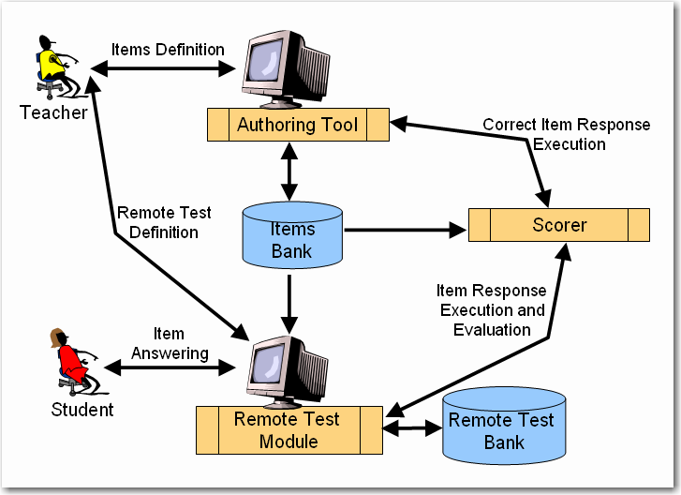
Example of system architecture : Learning environment for automatic ratings notions
An item is a question that is defined by a teacher by means of the Authoring Tool.
Once defined, the items may be included in a remote test by means of the Remote Test Module.
The students introduce the responses to the items of a remote test by means of the Remote Test Module. These responses are sent to the corresponding scorer to be executed and evaluated.

Slide 16
Systems Analysis
“the process of studying a procedure or business in order to identify its goals and purposes and create systems and procedures that will achieve them in an efficient way”
– Merriam-Webster Dictionary

Slide 17
Systems Architecture
Systems Architecture is a generic discipline to handle objects (existing or to be created) called "systems", in a way that supports reasoning about the structural properties of these objects. Systems Architecture is a response to the conceptual and practical difficulties of the description and the design of complex systems. – Boris Golden
Once a systems analyst understands the business problem, they architect a solution

Slide 18
Tools for Discussing: Processes, Information, Business Rules, & Systems
2.1 Analyzing Organizations as Systems Processes
Systems Analysis
Systems Architecture
2.1.1 Modeling Processes with Swimlane Diagrams
2.1.2 Data Modeling with ERDs
2.1.3 Modeling Business Rules with Decision Trees
2.1.4 Conceptual Architecture Diagrams

Slide 19
A Guide to Process Mapping
Discuss:
1. What was this article about?
2. Why should you care?
We need to be able to model business processes to ensure that we understand how they work.
Business processes are how work gets done in an organization. If you can’t model the process, odds are you do not really understand the process. If you don’t understand the process then you will not be successful trying to improve the process.

Slide 20
An Introduction to Swimlane Diagrams
Discuss:
1. What was this article about?
2. Why should you care?
Swimlane diagrams are very simple yet effective tools for documenting how a business process is performed.
Almost everything you do at work is part of a business process. By modeling these business processes you can study how they are performed and improve these business processes, creating value for our organizations.

Slide 21
Required Viewing 2/2

Slide 22
?
How is a process performed?
What happens after?
When do they do it?
What is a “swim lane diagram”?
What happens before?
Who does what?

Slide 23
What is a swim lane diagram?
A type of process flow diagram that features divisions or "lanes.“
Each lane is assigned an actor (which may be an individual, department, division, group, machine, entity, and so on), or even a phase or stage in a process, that is responsible for the activity or work described in the lane.

Slide 24
How to map a swim lane diagram
A circle signifies the starting and ending of an event in the process
A rectangle represents an activity in the process.
A diamond represents a decision that must be made.
Arrows indicate the flow of the process.
A cylinder represents stored data.

Slide 25
Order to Cash (O2C)
The process starts when the customer contacts Sales to place an order. The person in Sales creates the sales order. As part of doing this the person in sales first checks to see if the customer has enough available credit to cover the order. They do this by looking up the customer’s credit on a report that is generated by Accounting and sent to Sales every Monday morning. If the customer doesn’t have enough available credit then the person in sales notifies the customer who can then either update or cancel their order. Next the person in sales checks to see if the items being ordered are in stock. They do this by checking a report on inventory that the Warehouse created at the end of each day. If the items being ordered are not in stock then the person in Sales notifies the customer who can then update or cancel their order. If the report indicates the items are in stock then the order goes to the Warehouse where the workers there will pick the order. Since Sales is looking at a report that is only updated at the end of each day, there is a chance that they accepted an order for an item that is not really in stock. If that is the case the Warehouse notifies Sales who then notifies the customer who can update or cancel their order…

Slide 26
Order to Cash (O2C)
…Once the people in the warehouse pick the order, the people in Accounting have to make sure that the customer actually has enough credit to cover the order. Since the people in Sales use a credit report that is generated on Monday morning, there is a chance that the information on the credit report is old. If the customer doesn’t have enough available credit then Accounting notifies Sales who then notifies the customer who can then choose to update or cancel their order. If the customer has enough available credit then their available credit is reduced by the total cost of the order and the warehouse is notified and they pack and ship the order. As soon as the order is shipped the people in the warehouse notify accounting and accounting generates and sends the invoice to the customer. When the customer pays the invoice the people in Accounting increase the customer’s available credit by the amount of the payment, they post the payment and we’re done.

Slide 27
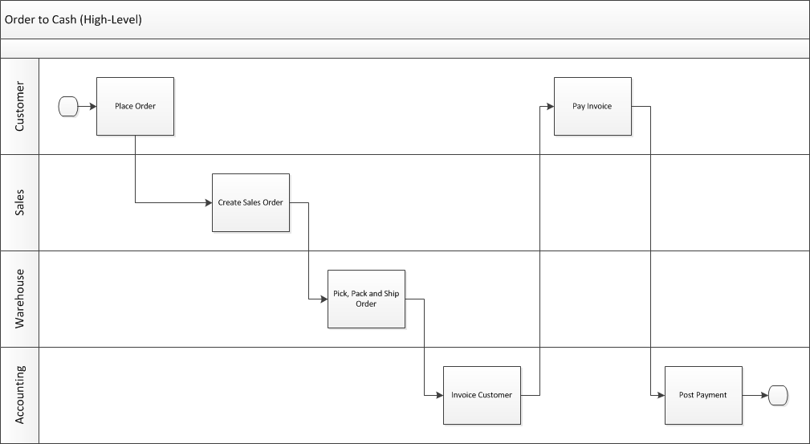
Swim Lane Diagram Who does what and when?

Slide 28
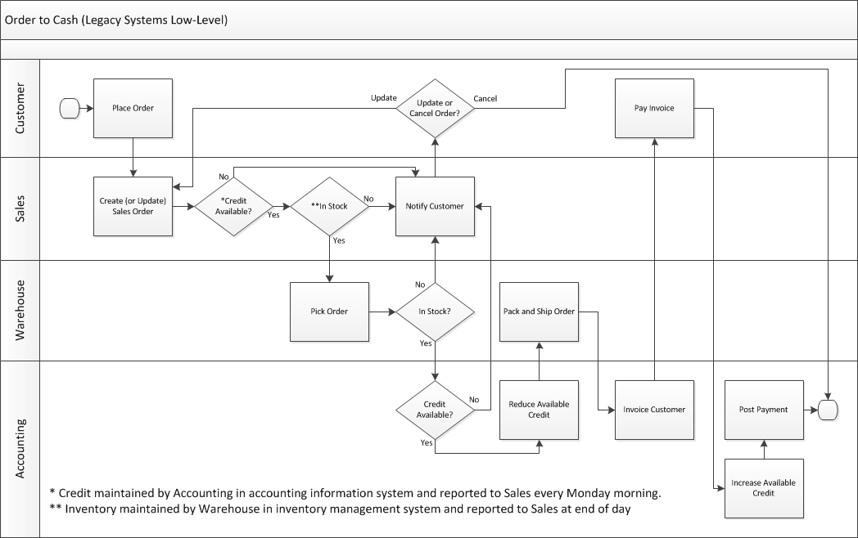

Slide 29
?
Give me a process and let’s make a swim lane diagram…

Slide 30
Roadmap
Week 1: Intro to MIS
Week 2: Systems Analysis
Week 2: Systems Analysis
Week 3: Systems Analysis
Week 3
Swimlanes
ERDs
Decision Trees
Architecture Diagrams
Exam #1
Learn IT! #1
Max Labs 0
What is MIS?
Week 4: Organizational Systems
Week 4: Organizational Systems
Week 5: Organizational Systems
Week 5
Decision Support
SDLC
Exam #2
ERP
Knowledge Management
Digital Innovation
Max Labs 1a & 1b
Week 6: Organizational Systems
Week 6: Organizational Systems
Platforms
Week 7: Organizational Systems
Week 7
Customer Relationship Management Systems
Cloud Computing
Artificial Intelligence
Exam #3 Prep
Supply Chain Management Systems
Week 7: Organizational Systems
Max Labs 3a & 3b
Learn IT! #2
Max Labs 2a & 2b

