Slide 1
Digital Systems
1.1 Introduction to MIS
FOX
MIS

Slide 2
Welcome!
Spring 2024
FOX
MIS

Slide 3


Introduction to Instructor
Marie-Christine Martin
20+ years of experience in the IT industry
E-mail: mcmartin@temple.edu
Office: Speakman 209J
Office Hours:
  By appointment
FOX
MIS

Slide 4



My Background
Education
  BS Industrial Engineering
  MBA, Finance
Pre-Temple
  IBM (Canada, USA & Singapore)
  HP Global
  Oracle, USA
  Self Employed Consultant
Adjunct Faculty
  Temple University, MIS
Full-Time Faculty Temple University
  Undergraduate - MIS
  Graduate - FOX Business School MBA and Master In Management (MiM)
  Academic Director, ITACS BNAI Master Program, MIS
  AIS Faculty Advisor
FOX
MIS

Slide 5



FOX
MIS

Slide 6




2023 Summer was amazing!

Slide 7

Course Support: Information Technology Assistants (ITAs)
Name: Cole Roberts
Email: cole.alexanders@temple.edu
Office Hours: by appointment
FOX
MIS

Slide 8
“Tell me and I forget. Teach me and I remember. Involve me and I learn.”
- Benjamin Franklin
Notes:
This is a great quote & really an extension of our syllabus contract
We will review our course learning contract at the end of class today
Our class is interactive…your job is to read the articles & watch the videos BEFORE CLASS & my job is to facilitate the discussion.
You will learn from me & your classmates too…your involvement/interaction is key!
This is definitely a more fun approach to learning!

Slide 9
Managing Expectations
This class is unique!
We will work through challenges together…plan on it!
You will find the class engaging and fun!
You will acquire knowledge and skills that you will use in future classes and your career!!!
FOX
MIS
Notes:
Nobody teaches an intro class like this in Fox or in any other colleges!

Slide 10
Course Highlights
Systems Analysis
Process Mapping (Modeling with swim lanes & entity relationship diagrams)
Digital Product Management
Information Systems CRM & ERP, Data Analytics & SCM
Platforms & Digital Business models, including API’s
Cyber security and the Enterprise plus AI
Programming including JavaScript, HTML & CSS
FOX
MIS
Notes:
MIS – Management Information Systems – “The Language of Business”
API: An application programming interface is a connection between computers or between computer programs. It is a type of software interface, offering a service to other pieces of software. A document or standard that describes how to build or use such a connection or interface is called an API specification.

Slide 11
Course Objectives
Explore the systems which organizations use to create their digital products
Explore the platforms which these digital systems are built upon
Explore the API ecosystems by which systems extend their reach and capability.
Discuss cyber security including risks & responses surrounding digital products
Introduction to the creation of software
Learning the basics of programming in JavaScript
FOX
MIS
Notes:
MIS – Management Information Systems – “The Language of Business” --- technology is EVERYWHERE!
API: Application Programming Interface, which is a software intermediary that allows two applications to talk to each other.

Slide 12
Graded Components
Component | Percentage
In-Class Activities & Worksheets (12) * must be present in class to earn credit | 10%
Assignments (11) ** no late assignments accepted – no exceptions! | 30%
Weekly Discussion Blogs | 30%
Quiz #1 (30 minutes) | 10%
Quiz #2 (30 minutes) | 10%
Quiz #3 (30 minutes) | 10%
*In-Class activities must be submitted while in class. ( Exceptions will be provided for Covid-19 mandatory quarantines)
**Please note that two weeks after a grade is posted, the grade will be considered “final.”
FOX
MIS
Notes:
*In-Class activities must be submitted while in class. (you are able to miss two without penalty)
( Exceptions will be provided for Covid-19 mandatory quarantines)

Slide 13
Extra Credit Opportunity
EARN
EXTRA
CREDIT
Onetime opportunity!!!
Improve your final score
Complete the Certificate Program Course
  Certify your skills
  Stand out from the crowd
  Earn 1-point added to your final score
Details will be provided on canvas after Exam #1
FOX
MIS
Notes:
There is one opportunity for extra credit this semester. It is open after exam #1 and will close the last day of class. Details will be explained after exams #1 & 2. Don’t miss out on this one time offer for 1-point added to your final score.

Slide 14


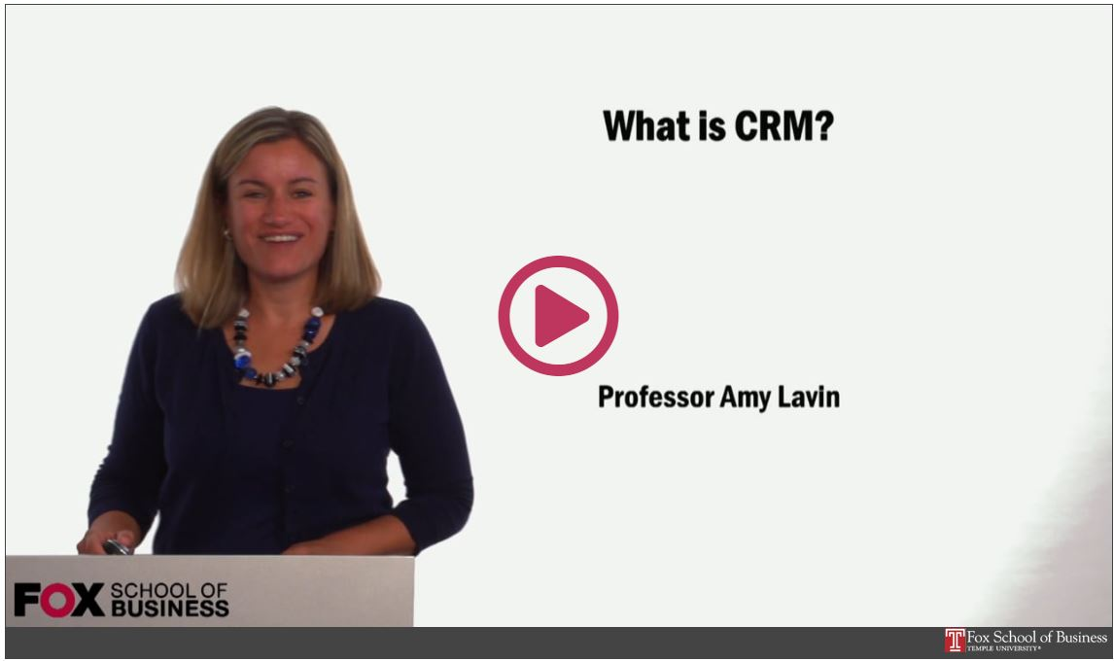
Readings & Videos – Part 1
No required texts the first 2/3’s of the semester!
Engaging collection
Current content
Available for Free!!!
FOX
MIS
Notes:
Life as a business professional does not have a textbook that you can turn to for the
answers. This is how you will learn what you need to be successful in the real world.
What you will love!
How much does the typical textbook cost?
No publisher that constantly changes editions so you can’t sell your old textbook
How old is the majority of the material in a traditional textbook?
What you may dislike!
Lots of different articles from:
Different authors
Different audiences
Different formats
No author, editors & reviewers making the connections for you

Slide 15

Readings & Videos – Part 2
JavaScript
  Create simple JavaScript programs
  Prompt users for input
  Utilize loops
  Process Information
  JavaScript Absolute Beginner's Guide, 2nd Edition
FOX
MIS

Slide 16

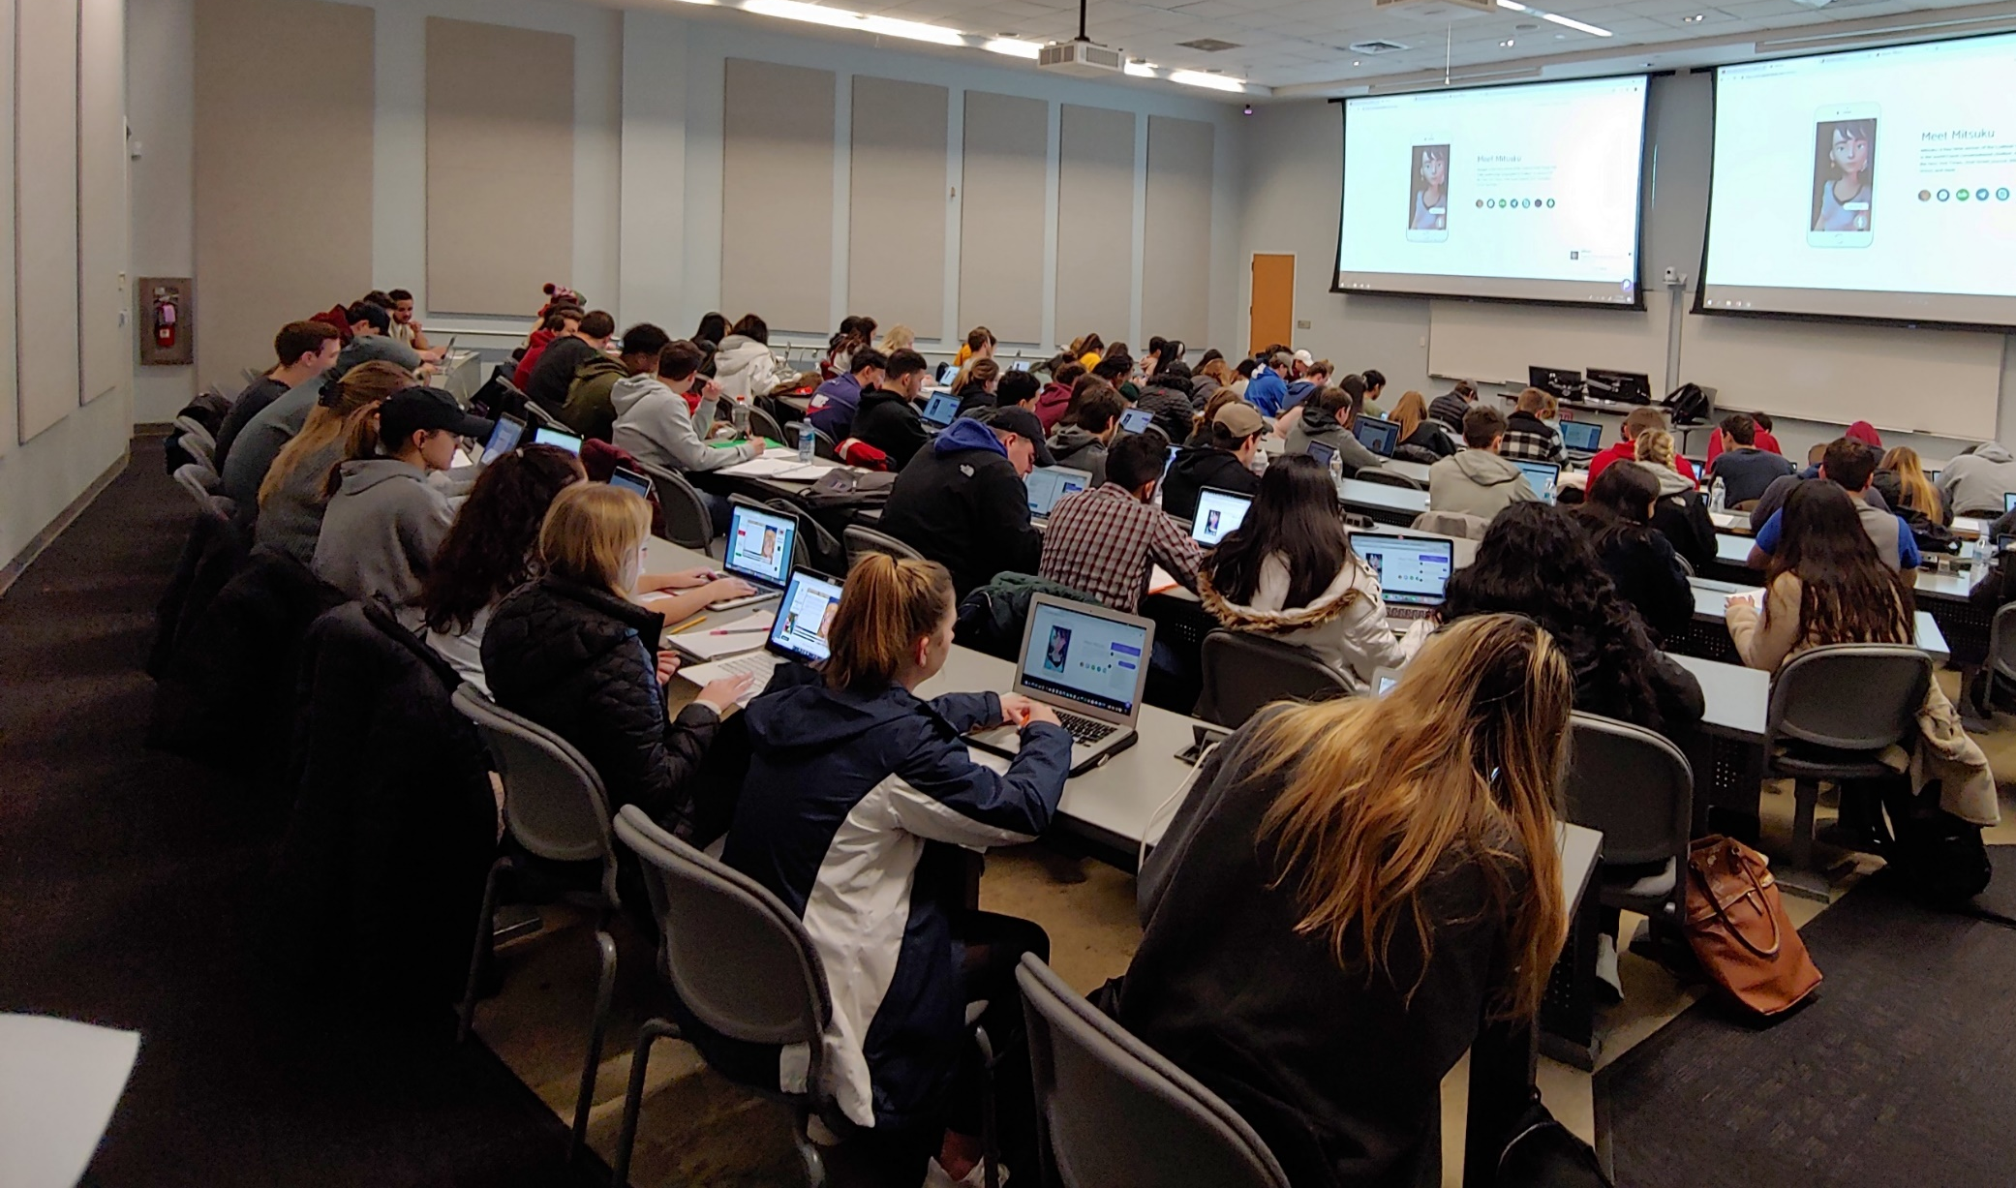
Lecture vs. Activities
Source: https://www.theodysseyonline.com/11-things-college-lecture-hall
3 Hours of zzzzzzzzz’s
1 Hour Discussion
2 Hours of Activity
FOX
MIS
Notes:
Active Learning is the Key (refer back to the Ben Franklin quote & contract)

Slide 17
Active Learning Components
TECHNOLOGY
CONTENT
ACTIVITY
FOX
MIS
Notes:
These are the components of Active Learning

Slide 18
The Active Learning Funnel
CONTENT
TECHNOLOGY
ACTIVITY
ENHANCED LEARNING ENVIRONMENT
FOX
MIS
Notes:
With our Enhanced Learning Environment we can more effectively work together and Solve Business Problems

Slide 19
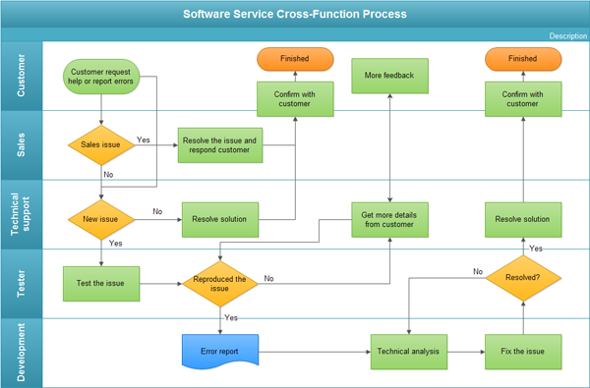
The In-class Activity
Process Diagrams
  Swim lane diagram
Real life scenarios
Knowledge Application
Problem Solve
Synthesize & Optimize Solutions
FOX
MIS
Notes:
Ask the class…Who knows what this is?
It’s a swim lane diagram (a type of process diagram)
A step-by-step process how an organization completes a task
Looks at efficiencies
Allows you to identify pain-points too
Business processes are crucial to any organization.
Business processes vary from one organization to the next, even if they are trying to accomplish the same thing.
Swim lanes are a graphical “model” of a process.
With this “model” we can identify issues and address them by changing the bad parts of the process.
Most organizations never take the time to model their business processes!

Slide 20
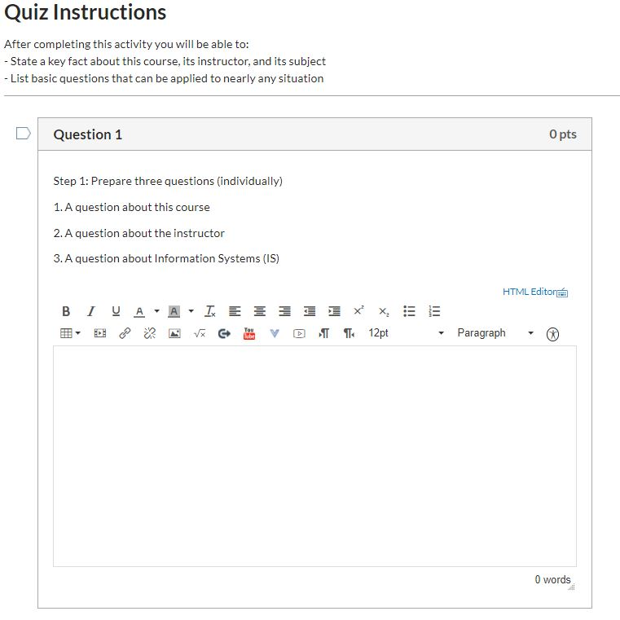
The In-class Activity – Canvas
Reinforce assigned materials
  Readings
  Videos
  Lecture
Exam Preparation
Work in teams
Must be present in class
FOX
MIS

Slide 21

FOX
MIS

Slide 22
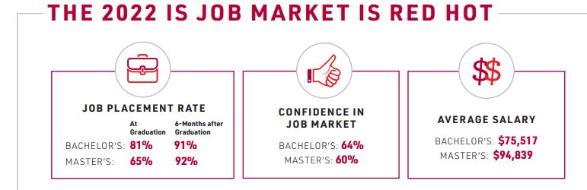
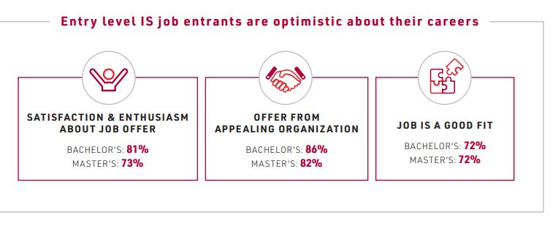
Based on 1408 recent graduates from 36 universities across the U.S.
FOX
MIS
Notes:
Discuss our department’s job placement rate. Pre-covid it was 100% for 7-years in a row. Now it hovers around 80%!
Check IBIT site for national statistic updates

Slide 23
ROADMAP
Week 1:
Introduction & Systems Analysis
Course Description
Systems Thinking
Assignments #01 & 02
Week 1:
Digital Product Management & Introduction to Process Mapping
Max Labs 1a & 1b
Systems & Processes
Swim Lane Diagrams
Assignment #03
Week 2:
Data Modeling with Entity Relationship Diagrams
Swim Lane Diagrams
ERD Diagrams
Assignment #04
Week 2:
Digital Systems – Learn IT! #1
ERD Diagrams
Learn IT Kickoff
Assignment #05
START
Week 4:
Cybersecurity & AI – Part I & II
Protection Protocols
Artificial Intelligence
Assignment #08
Week 4:
Platforms & Digital Business Models: Part I & II
APIs + Digital Business
Week 3:
Information Systems: Part III
Data Analytics
SCM
Assignment #07
Week 3:
Exam #1 canvas Information
Systems: Part I & II
CRM & ERP
Assignment #06
Week 5:
Exam #2 canvas JavaScript Unit #1
- Part I & II
Hello World, Variables
Assignment #9
Week 5:
JavaScript Unit #2 Functions
Operator types
Strings
Week 6:
Exam #2 canvas Unit #3 Logical Operators & Conditional Logic
Logical Operators
Conditional Types
Assignment #10
Week 6:
Unit #4 Loops
Intro to Loops
For Loops
While and Do
Week 7:
HTML & CSS Unit
HTML basics
CSS basics
Course Reflection
Assignment #11
Assignment #12
FINISH

Slide 24
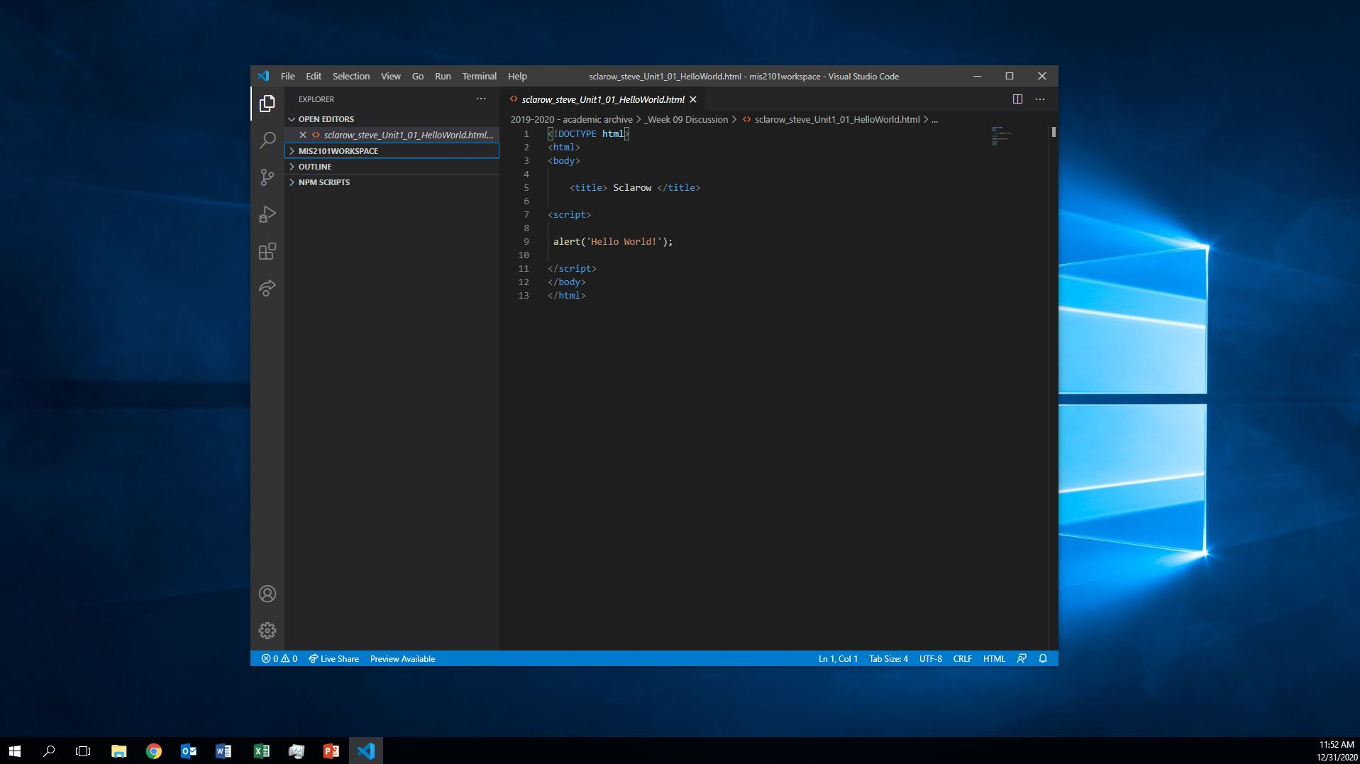
Course Intro Videos (6)
Due tonight!
Assignment #1
FOX
MIS
Notes:
This is your first assignment…due tomorrow….
6 short videos (total <20 min)

Slide 25
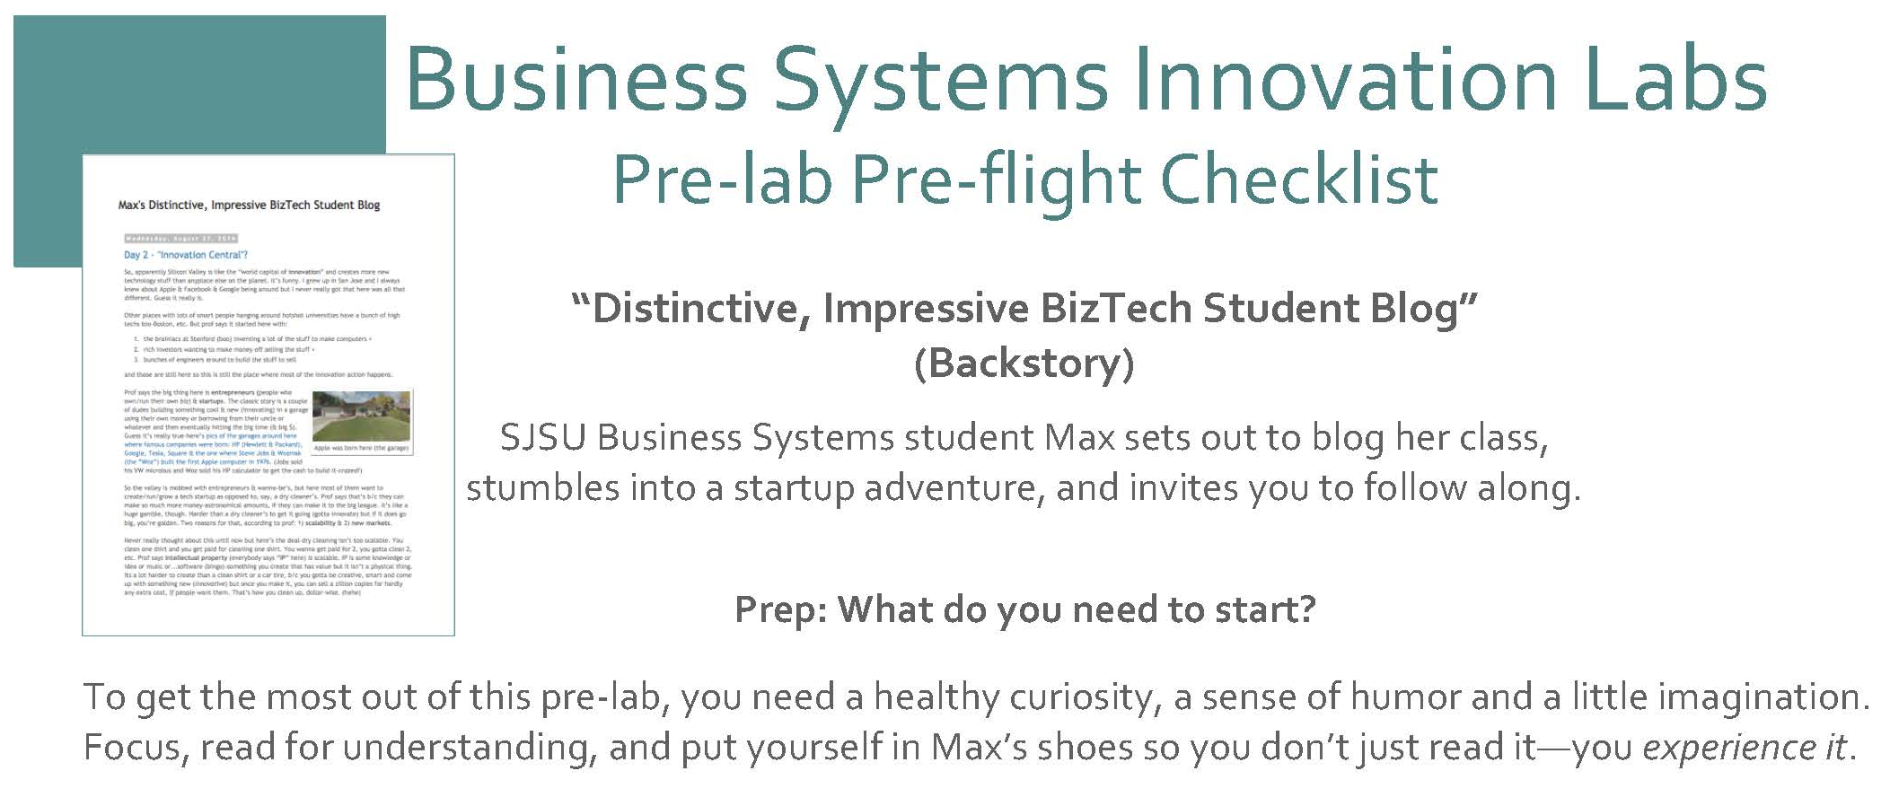
Max Lab Pre-Flight (Lab 0) Assignment due Friday
Assignment #2
FOX
MIS
Notes:
This assignment is purely reading- read it! The other Max Labs are based off this reading.
You will need to submit a screen shot as part of this assignment!!!
Follow hyper link to course site.
We will discuss MaxLab in week 3
Cost of Max labs is $19.99 (don’t skip ahead)
PRE-FLIGHT= easiest assignment ever…read and take a screenshot

Slide 26
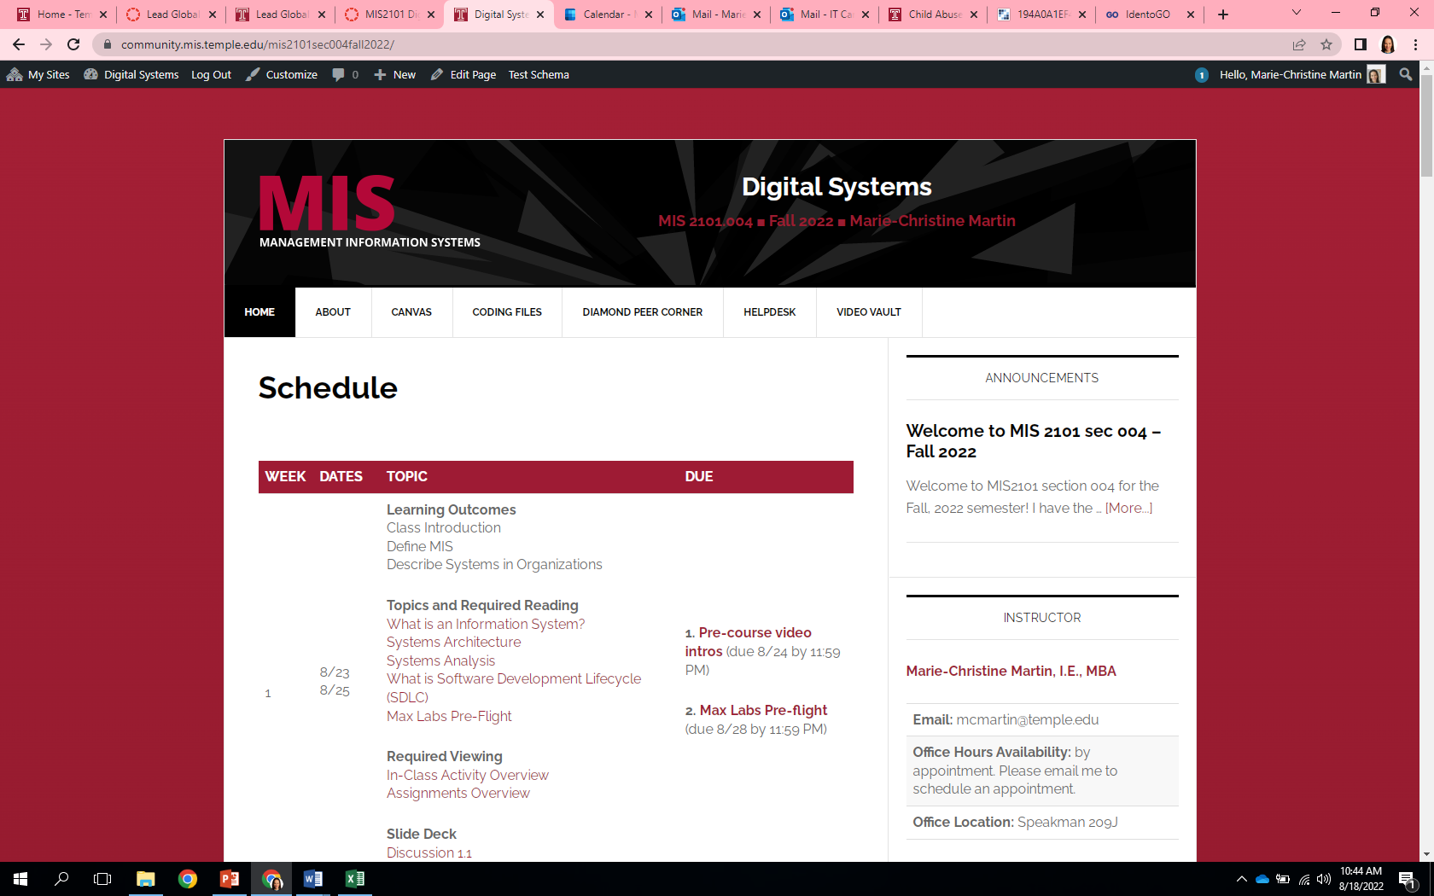
Class Site Review
https://community.mis.temple.edu/mis2101sec701spring2024/
FOX
MIS
Notes:
Our Course is different…
Everything you need to know is on our MIS Course Site…
Let’s look at the calendar
Video vault
Course Structure
Course Materials
Use of Canvas

Slide 27
In-Class Activity #1
1.1a Intro to Digital Systems
FOX
MIS

Slide 28
Digital Systems
1.2 What are Systems?
FOX
MIS
Notes:
Our focus this week is Systems Analysis

Slide 29
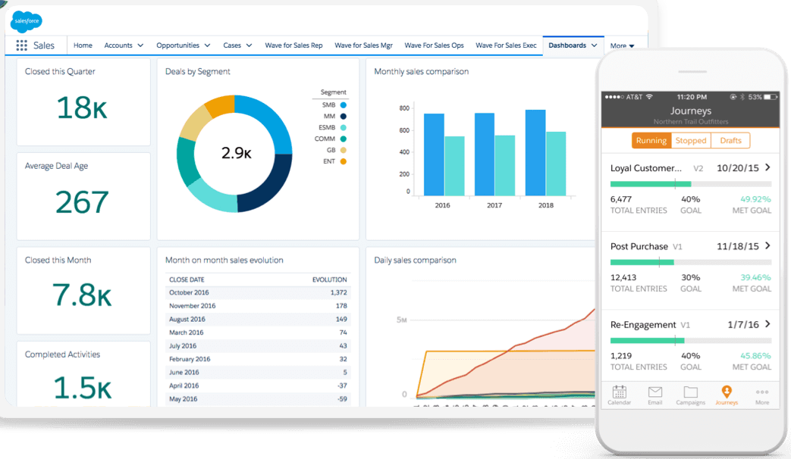

What is MIS?
Using Information Technology to solve business problems.
MIS is not Computer Science
It’s about business where we train people to do what?
Use technology to solve day-to-day business problems
Sources: https://c1.sfdcstatic.com/content/dam/web/en_us/www/images/products/what-is-salesforce/whatis-jumbo-astro-product.png
https://www.kindpng.com/picc/m/568-5683178_real-cash-stack-100-dollar-bill-hd-png.png
FOX
MIS
Notes:
MIS is not computer science. It's about business. This is where we train people to use technology to solve the day-to-day business problems that organizations have.
And as we're going to talk about, businesses have many problems. MIS is the primary tool that they use to help address organizational issues.
IT today drives all business. As we understand as living today in a digital world, IT is the key enabler of the global economy. It is driving all of the rapid change that we're seeing today in business.

Slide 30

World View – A collection of “Systems”
Systems = people + process + technology
Manipulation of information = value
Managed by MIS professionals
Systems surround us 24/7
Application Programming Interface (API’s)
Source: https://www.aecom.com/ca/management-information-systems-mis/
FOX
MIS
Notes:
Ask students: What is this slide really talking about?
Systems are all around us. They range from completely manual to completely automated.
***See the world as a series of components***
See everything through the lens of all products are components of a larger whole.
Let’s look at two examples in the next few slides

Slide 31
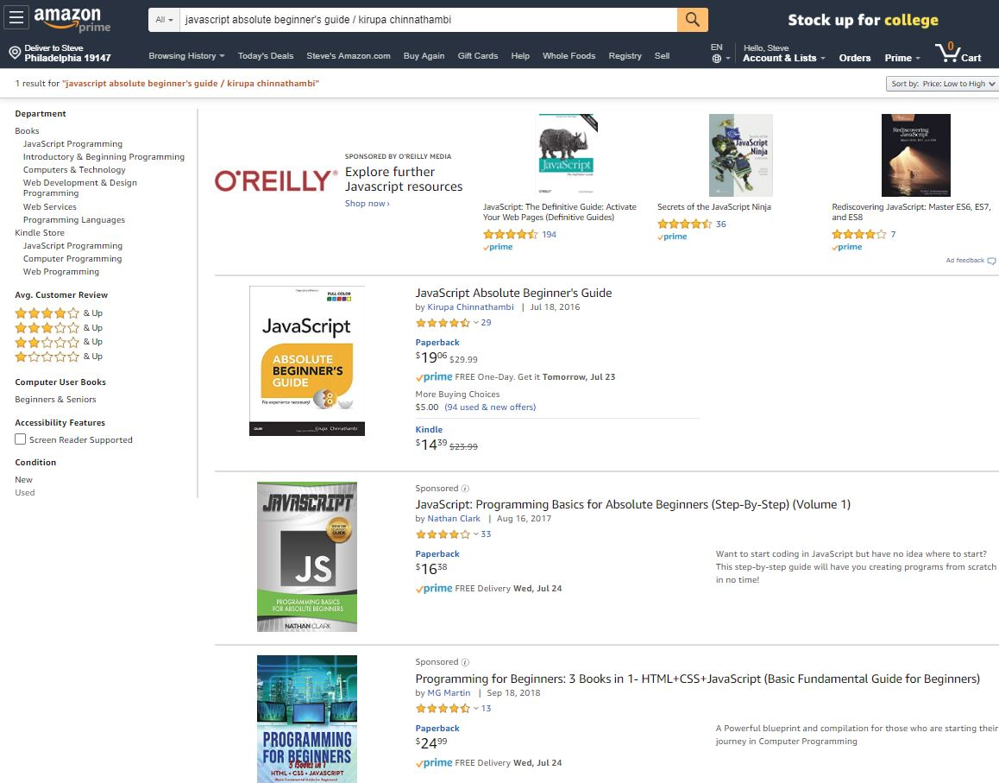
Understanding Systems
Buying textbooks on Amazon
What is part of that system… what are the steps?
Log-in (multiple steps)
Search
Shopping Cart
Purchase (Multiple steps)
What else???
FOX
MIS
Notes:
Ask the students:
Who has purchased a text book on Amazon?
Next ask the question…What was part of the system?
Let them discuss ideas with you before scrolling through the animation…keep working with them to consider all of the System Users (internal and External to the organization)
Fun facts…How is this all maintained:
Amazon – 49% of US e-commerce market
5% of all retail
More than 12 million different products sold
95 million Prime Accounts
$1.4k – average spend per person/per year
Shipped over 50 Billion products in 2017
647,500 employees
30 Million average monthly users
2 million sellers
45,000 robots
In 2017, 35 orders per second
Follow up with…we will look at this system in more detail in just a bit

Slide 32
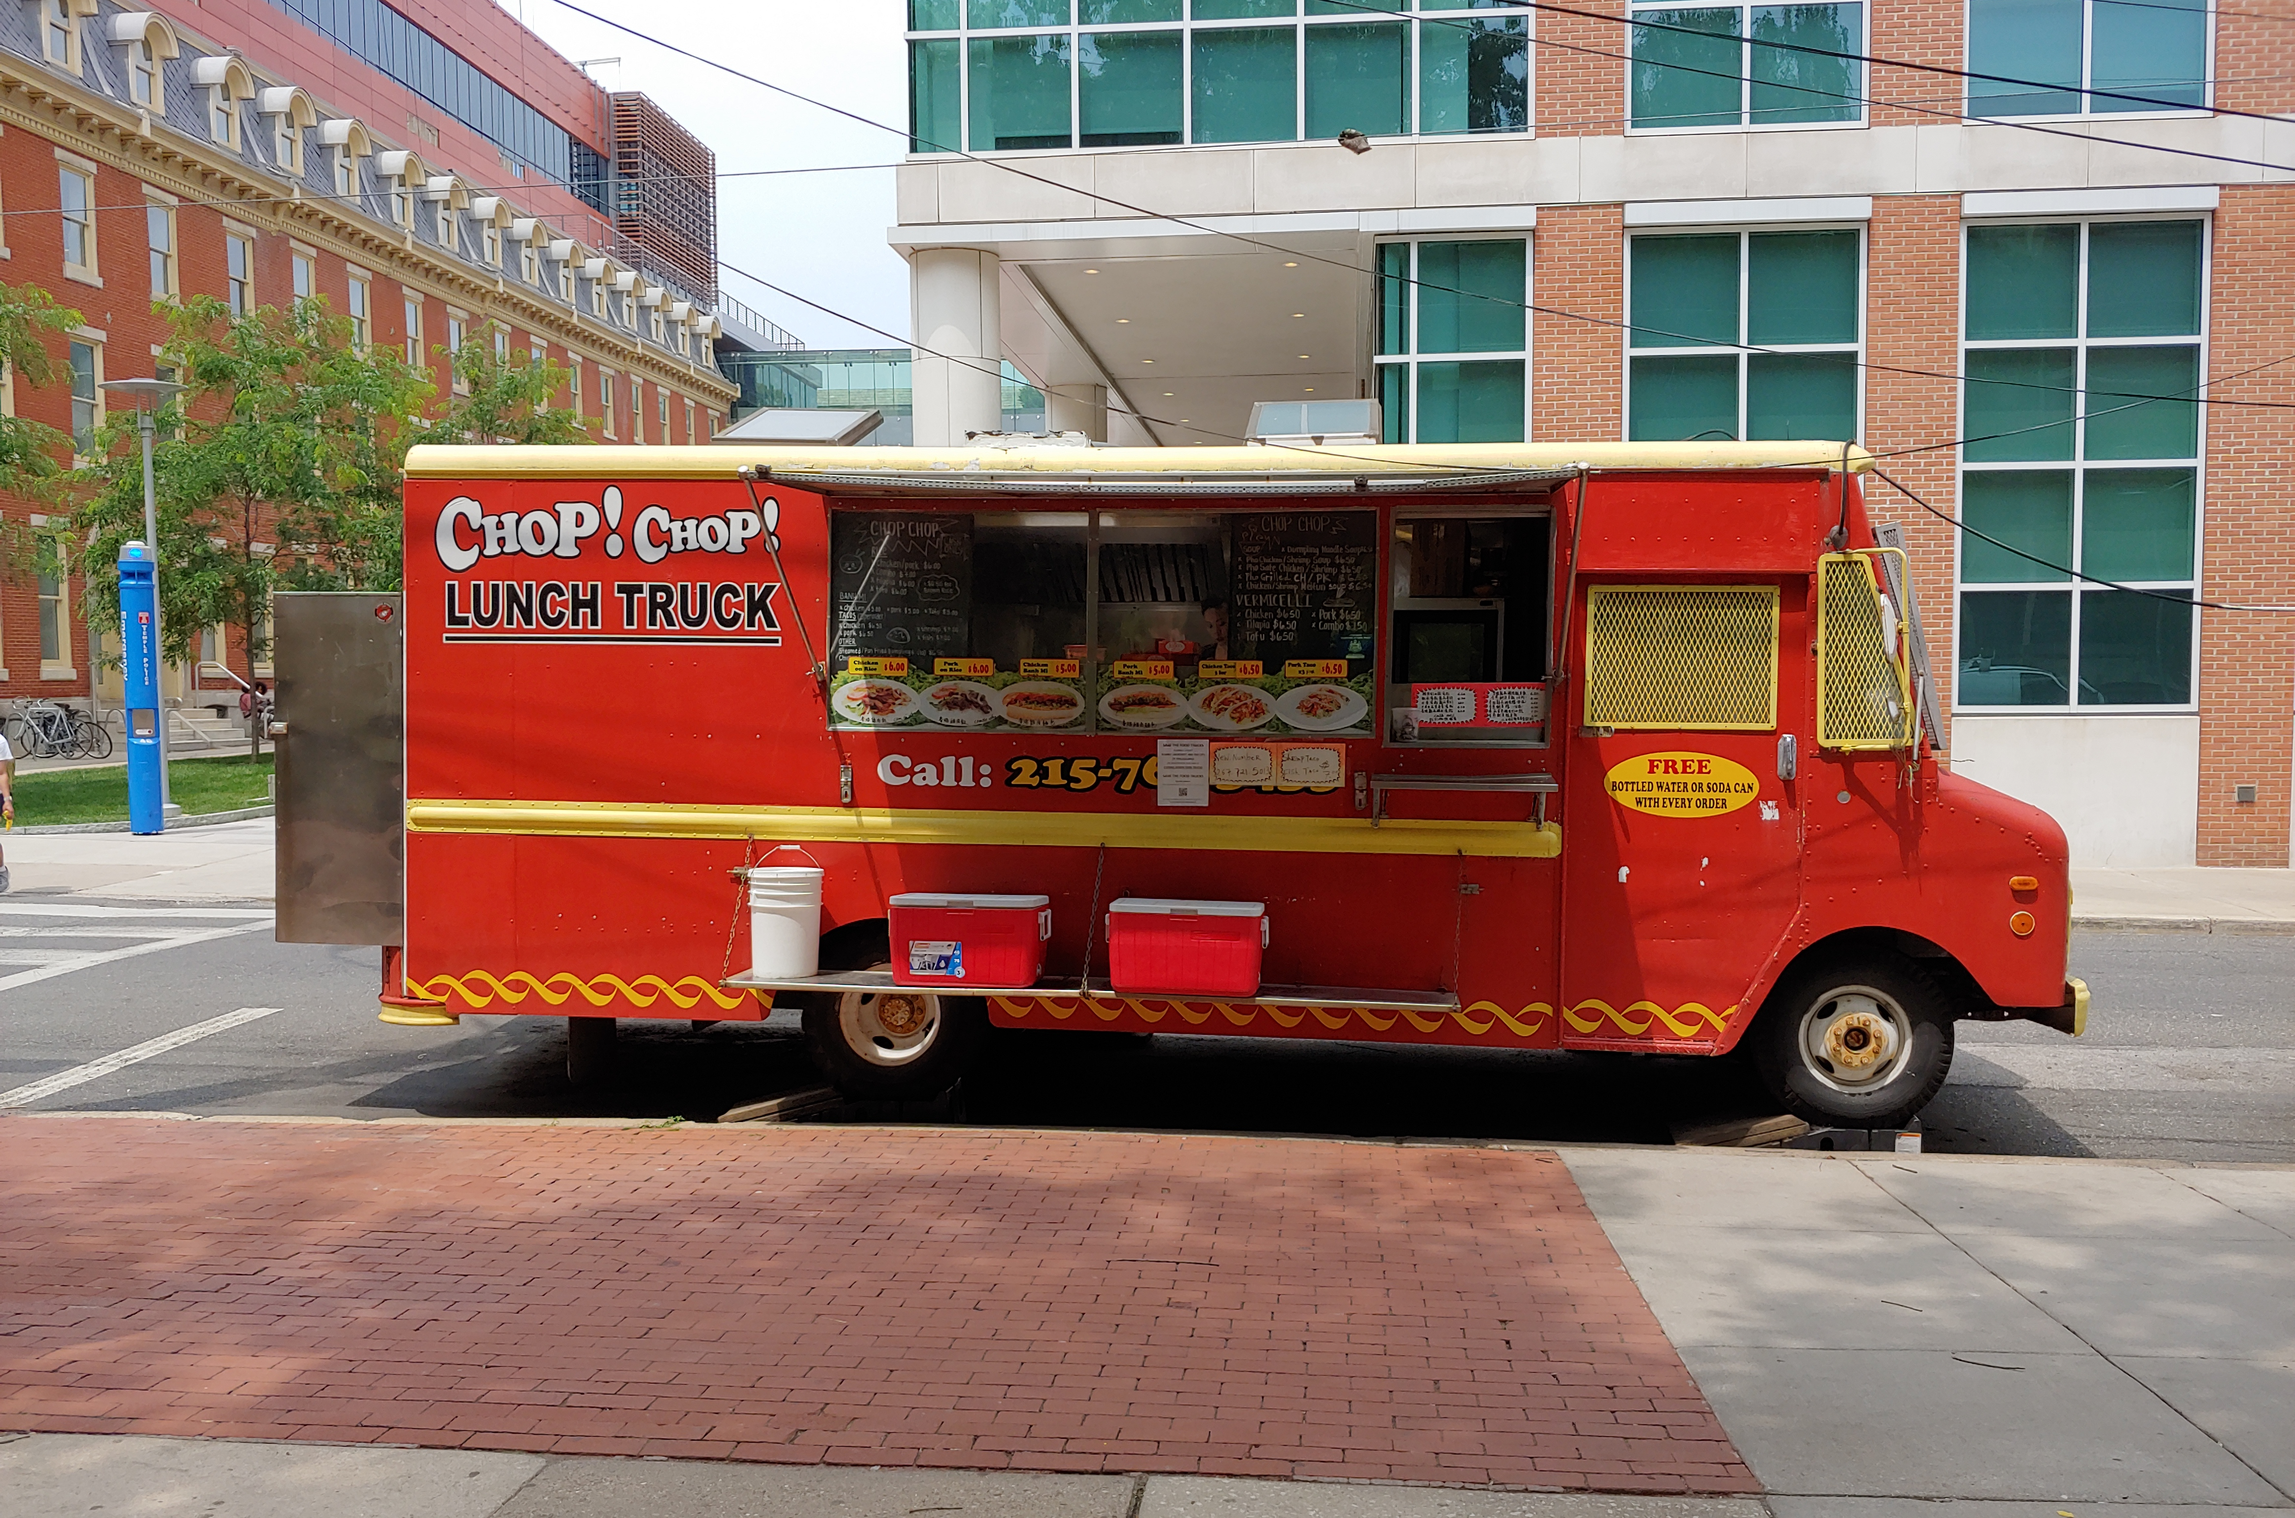
Understanding Systems (cont.)
Buying lunch
What is part of that system… what are the steps?
Take the order
Hand order to cook
Prep to-go bag
Order cooked (multiple steps)
What else???
FOX
MIS
Notes:
Is this the most efficient system?
(only technology is the order pad and pencil used to write the order, maybe the phone too for call-in orders)
Would technology help?
How?

Slide 33
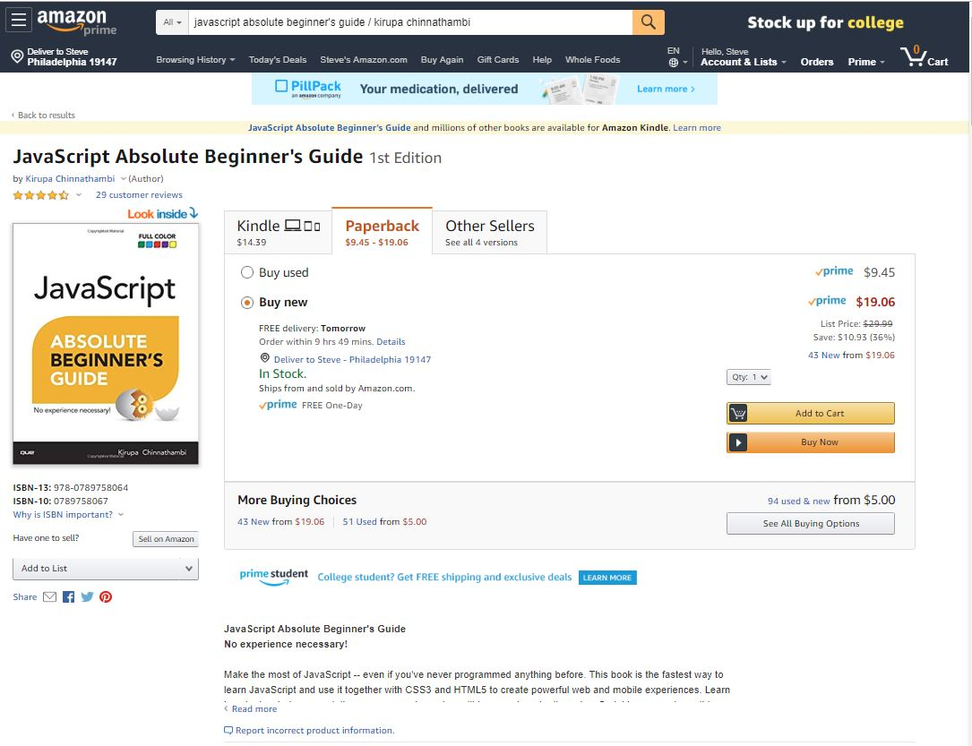
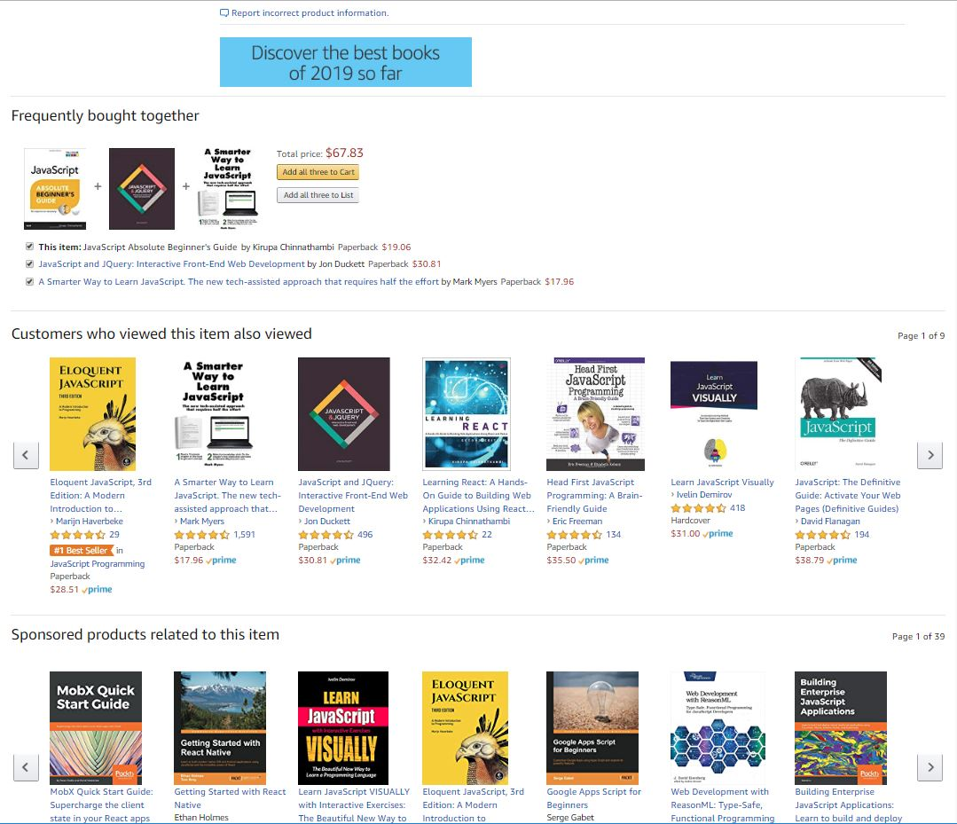
Understanding Systems (cont.)
Describe the Process of Ordering
What keeps info accurate?
  Data
Who is involved?
  Customer ♦ Store ♦ Warehouse Mgr. ♦ Admin ♦ UPS driver…
How much effort?
  None…it’s automated!
  Technology !!!
FOX
MIS
Notes:
Ask the students:
Who can describe the Process of Ordering a text book on Amazon?
What keeps information about inventory current & accurate? (DATA!)
Discuss with them who is involved in the process
Pause on the effort question and ask them to really think about it. Why none??? It’s automated, Technology!!!

Slide 34
“information system – an integrated set of components for collecting, storing, and processing data and for providing information, knowledge, and digital products.”
- Encyclopedia Britannica
Source: https://www.britannica.com/topic/information-system/Management-support
Notes:
We need to start understanding what a System is
Organizations rely on Information…it’s a critical asset
So, What is an Information System? What does this definition really mean?

Slide 35
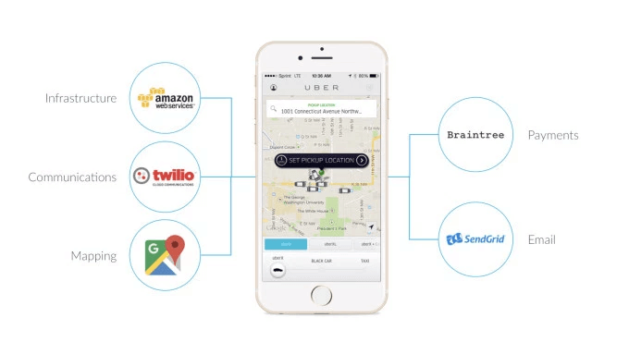
API’s Case Study: UBER
Requesting a ride?
Describe what happens...
  What are these systems?
  How do they work?
Source: https://www.okta.com/security-blog/2019/05/how-uber-takes-advantage-of-the-api-economy/
FOX
MIS
Notes:
Used to achieve Organizational Goals

Slide 36

SDLC methodologies
Waterfall
Agile
Lean
Scrum
DevOps
Image: http://www.xanadutec.com/software-as-a-service.html
FOX
MIS
Notes:
Waterfall – oldest approach. It is sequential, non-iterative. (still good for large unwieldy projects)
Agile – iterative approach (opposite of waterfall). Work is completed in 2-4 week “sprints”. More flexible and leads to more innovation.
Lean – The agile and lean approaches are closely interconnected, as they both focus on delivery speed and continuous improvement. In contrast, the lean model is rooted in manufacturing best practices where excess waste and effort are seen as the largest risk to an organization.
Scrum – A framework that enables you to implement Agile. Consists of a series of events incorporating a form of task board to track the progress to establish ownership and build consensus
DevOps – “DevOps is one of the newest SDLC methodologies and is being adopted by many software companies and IT organizations. As its name suggests, the premise of DevOps is to bring development teams together with operational teams in order to streamline delivery and support.
The advantages of such an approach are that changes become more fluid, while organizational risk is reduced. Teams must have flexible resources in order for a DevOps arrangement to succeed.”
https://www.innovativearchitects.com/KnowledgeCenter/basic-IT-systems/8-SDLC-models.aspx

Slide 37
“Once a Product Manager / Technologist understands the business problem, they can architect a solution.”
- Mart Doyle

Slide 38
System Analysis --- Process Decomposition!
INPUTS: credit card, address, e-mail, phone, shipping preferences, etc.
Purchase Text
OUTPUTS: textbook, packing slip, delivery box
Single entity
Subsystem
Select Text
Check Out
Deliver Text
Shipping address
Payment method
Review Items
Shipping
Change
Add cards
Select card
Reward points
Use method
FOX
MIS
Notes:
Discuss the Amazon Text ordering Process and Decompose the steps
Ask the students to define another system in Fox/Temple that they can decompose (Registering for class)
Each piece could be an (API) or software product

Slide 39
“Systems Architecture is a response to the conceptual and practical difficulties of the description and the design of complex systems.”
- Boris Golden

Slide 40
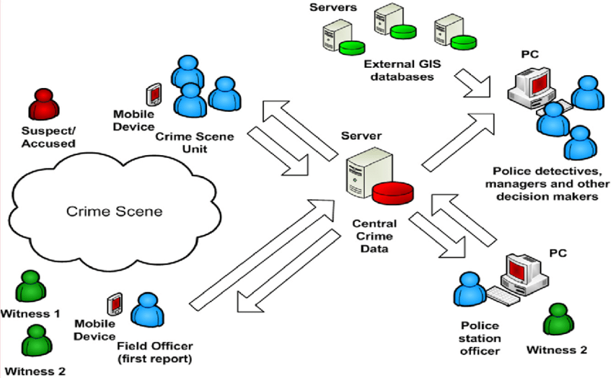
Systems Architecture
Conceptual Diagram
Structural components
Identify/Solve Problems
Existing or New
Communication tool
Source: https://www.researchgate.net/figure/Conceptual-System-Architecture_fig2_327987580
FOX
MIS
Notes:
The Fundamental Organization of a System!!!
Conceptual Design – (Abstract Diagram)
High level, provides picture of overall purpose of solution
Logical Design – (More detailed, includes major components)
More detailed for typical audience of developers or other systems architects
Does not include physical server names, but does include business services, application names and details
Physical Design – (Has all major components – leads to implementation)
Has everything, including specific server names and locations
Includes all known details such as operating systems and version numbers, constraints
They all have different systems or API’s that communicate with one another

Slide 41
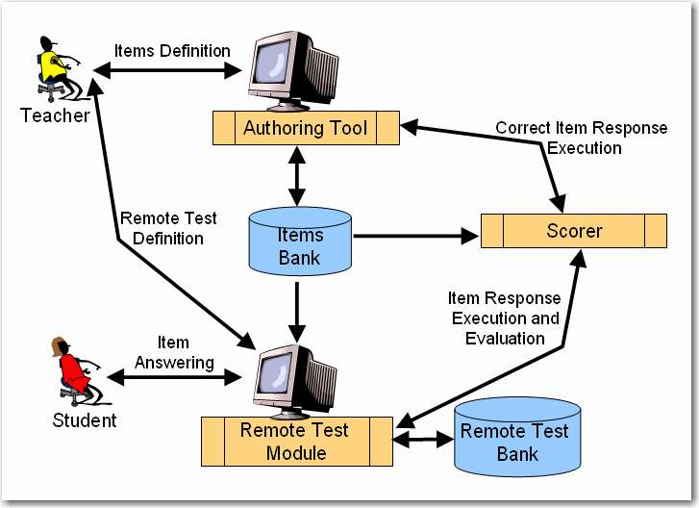
Systems Architecture
Test question defined
  Authoring tool
Remote test created
  Test module
Student responses
  Test module
Execution & Evaluation
Source: http://spmarchitecture.com/systems-architecture/system-architecture-learning-environment-for-automatic-rating-64721-2/
FOX
MIS
Notes:
Diagram of People, Process & Tech – this is conceptual!
The Specifications to build the System
This is an ERP philosophy…how could we improve this API’s

Slide 42
Digital Systems
2.1 Digital Product Management &
Max Lab 1a|1b
FOX
MIS
Notes:
Our focus this week is Digital Product Management
/*Note to Instructors
You might want to consider using the podium PC and use the projectors in "Presenter's View" so the students will see the slides up on the big-screen and you can see the notes on the monitor at the podium. I tend to print out the notes to keep them handy. This week’s presentation includes the infused new core content and concepts from our Digital Product Management perspective.
Please be certain to watch/familiarize yourself with the new videos too!
*/

Slide 43
ROADMAP
Week 1:
Introduction & Systems Analysis
Course Description
Systems Thinking
Assignments #01 & 02
Week 1:
Digital Product Management & Introduction to Process Mapping
Max Labs 1a & 1b
Systems & Processes
Swim Lane Diagrams
Assignment #03
Week 2:
Data Modeling with Entity Relationship Diagrams
Swim Lane Diagrams
ERD Diagrams
Assignment #04
Week 2:
Digital Systems – Learn IT! #1
ERD Diagrams
Learn IT Kickoff
Assignment #05
START
Week 4:
Cybersecurity & AI – Part I & II
Protection Protocols
Artificial Intelligence
Assignment #08
Week 4:
Platforms & Digital Business Models: Part I & II
APIs + Digital Business
Week 3:
Information Systems: Part III
Data Analytics
SCM
Assignment #07
Week 3:
Exam #1 canvas Information
Systems: Part I & II
CRM & ERP
Assignment #06
Week 5:
Exam #2 canvas JavaScript Unit #1
- Part I & II
Hello World, Variables
Assignment #9
Week 5:
JavaScript Unit #2 Functions
Operator types
Strings
Week 6:
Exam #2 canvas Unit #3 Logical Operators & Conditional Logic
Logical Operators
Conditional Types
Assignment #10
Week 6:
Unit #4 Loops
Intro to Loops
For Loops
While and Do
Week 7:
HTML & CSS Unit
HTML basics
CSS basics
Course Reflection
Assignment #11
Assignment #12
FINISH

Slide 44


The Max Labs Project
Overview & Startup
Source: https://www.salesforce.com/
Notes:
Let’s start off the discussion by describing what or rather who is a Digital Product Manger (DPM)
A DPM envisions, plans for, deploys and supports digital products and services which solve problems for organizations.
Digital product managers must have:
Strong technical skills
Understand the users of their products and how they interact with their systems
Have an intimate understanding of their business and the problems that their business need to solve.
With Max Labs, we are going to follow along with Max’s journey and learn first hand the tools, skill and training needed to become Digital Product Manager…let’s get started!

Slide 45

Digital Product Manager
DPMs require a unique set of soft skills including:
Emotional Intelligence (EQ)
Relationship Management
Self-awareness
Self-management
Social awareness
Source: https://assets.website-files.com/5d6d271d0b802026e5355799/5e00bebf15637fdb21b78a11_woman-office-manager-cc.jpg
FOX
MIS
Notes:
Discuss the concept of DPM Soft skills This is an exam question!!!
Reference article: https://www.cio.com/article/221885/what-is-a-product-manager-a-complex-cross-functional-role-in-it.html
Ask why these are so important and what do they mean?

Slide 46
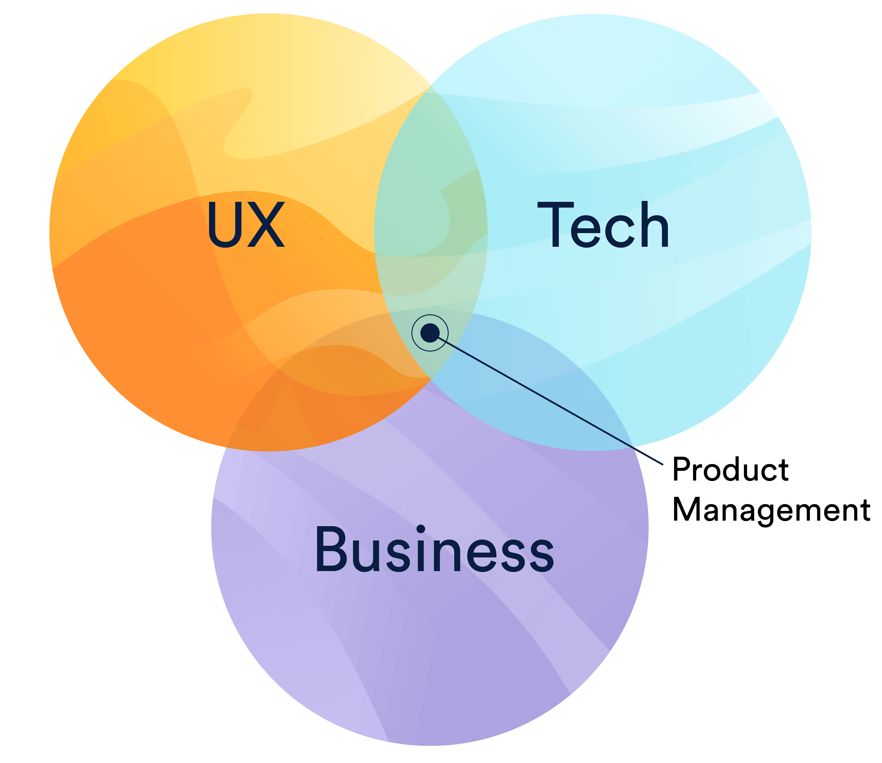
Digital Product Manager
DPMs have a complex role with a wide range of responsibilities including:
Meeting with customers and clients to determine product requirements
Balance multiple stakeholders & understand all needs
Deliver products that align with Business Goals
Sourcehttps://wac-cdn.atlassian.com/dam/jcr:84dd83c0-f954-477e-b157-b591da20d3cf/0_diagram.png?cdnVersion=464
FOX
MIS
Notes:
Discuss the concept of DPM Soft skills This is an exam question!!!
Reference article: https://www.cio.com/article/221885/what-is-a-product-manager-a-complex-cross-functional-role-in-it.html
Ask why these are so important and what do they mean?

Slide 47
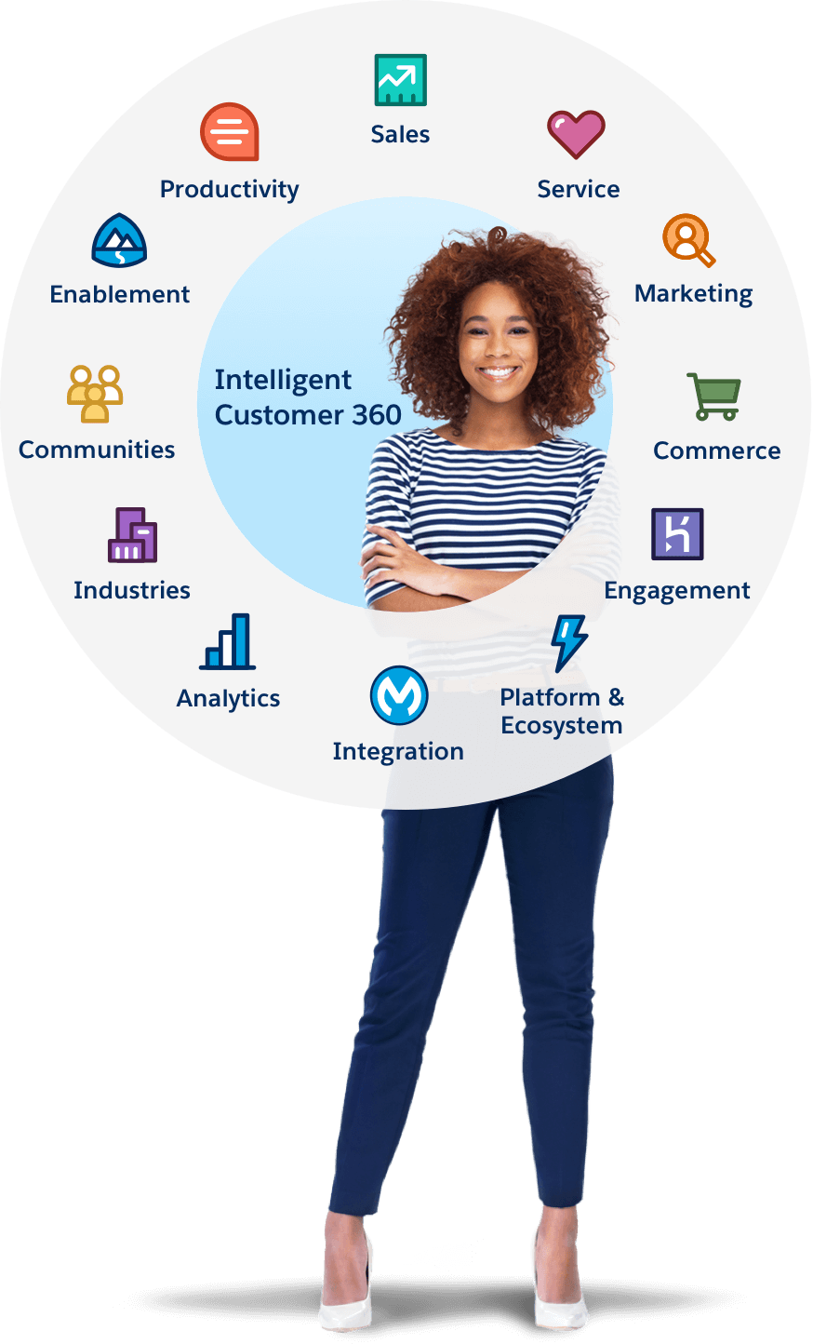
Why Salesforce?
This is not Salesforce training – it is exposure to a great platform that delivers cloud-based systems products.
Enables & Enhances Business
Used By Industry Fortune 100’s (Amazon, GM, Coke, American Express, etc.
Great Resume Builder For You!
Source: https://www.salesforce.com/
FOX
MIS
Notes:
Why Salesforce
This is not Salesforce training—it’s just a great platform for learning how to pull together functional services to deliver cloud-based systems products that enable/enhance business.
That said, Salesforce exposure can help you get an interview and/or a job:
High profile, Fortune 500, dominant player
Forbes rated Most Innovative Company year after year
Used by Amazon, Facebook, Toyota, Shazam, Fitbit, Coke, GM, American Express, Sony, GE, Verizon, Mattel, Intuit, ...
Salesforce isn't just about Marketing. It cuts across all Business functions: Accounting, Finance, Manufacturing, HR,
See www.Maxzplace.com for more

Slide 48
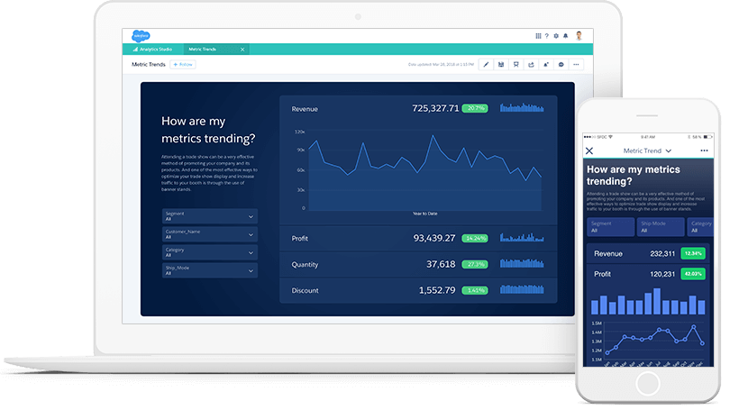
Max Labs – Enabling Organizations
Technology Enables Organizations to work faster/smarter/more efficiently
See How It Works First-Hand
Understand how Used by Industry Fortune 100’s
  Across all Business Functional Areas
See www.Maxzplace.com for more details!
Source: https://www.salesforce.com/
FOX
MIS
Notes:
Tech is key to enabling organizations to do what they do better/faster/smarter across all functional areas, eg. Finance, Operations, HR, etc. so knowing how it works “under the hood” will benefit you, whatever your job may be.
You might want to build your own work app someday—tools like Salesforce are making it easier everyday with “clicks, not code” etc.
You will want to master the work apps you’re given—you can do that better when you “get” how they work inside & what data structures they’re relying on.
You’ll be better able to work with IT support to get across what you want/need to do your job if you get where they’re coming from, what tech can do, what’s hard/easy, etc.
Bottom line: if you know tech well, you’ll be able leverage it innovatively to excel at your job.

Slide 49
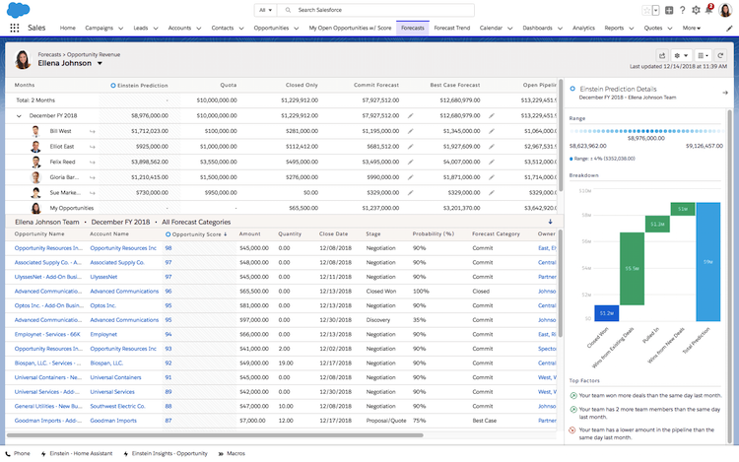
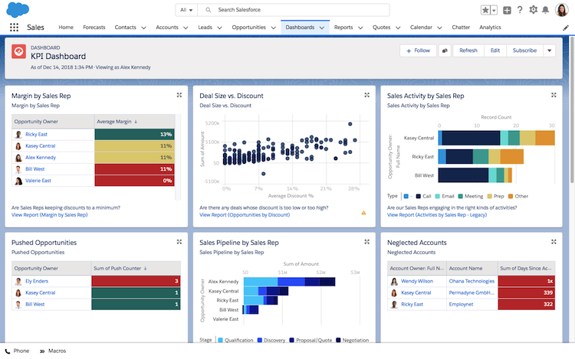
Max Labs – What do they include?
Source: https://www.salesforce.com/
FOX
MIS
Notes:
Salesforce’s powerful platform makes it easy to build high-level functionality with no coding (we’ll look at the coding component later this semester!).
Following Max’s story, you’ll build a database with apps for adding, accessing & analyzing the data to support the venture capital campaign of a Silicon Valley startup
You’ll also customize functional services within Salesforces' platform to automate business processes so the organization can scale to keep up with growth
You’ll get a chance to explore the social business features to leverage colleague’s knowledge across the organization
You’ll explore Customer Relationship Management (CRM) features to enable virtual 1-to-1 customer service at scale
You’ll embed database triggers that take actions based on business rules you specify
You’ll build and implement web-based access to your database with automated features
You’ll get a brief behind-the-scenes tour of how HTML tells browsers how to render web pages & functions and how apps “talk” to each other over the web through Application Programming Interfaces (APIs)

Slide 50

Max Labs – Tips for Your Success
READ the Pre-lab first. – Due Tomorrow!!
READ & FOLLOW every single instruction EXACTLY, in order. (You'll have no problems.)
READ the cover sheet (pre-flight) BEFORE you start every lab.
ALWAYS read stories BETWEEN instructions. (Connections to our key Course Concepts)
They’re quick: allow about 60-90 min for each lab
DO NOT get the 30-day trial account from www.salesforce.com.
The Lab 1b instructions tell you EXACTLY how to pay the lab fee. (Just follow them)
If you’re stuck, FIRST check the Help FAQ at MaxzPlace.com
DO NOT use Yahoo! for your Salesforce account email. (Use Gmail)
BE SURE to Install the Max Labs Grader App. You have an opportunity to fix your mistakes before submitting…no reason not to get a perfect score!
Max Labs will help you get a job (IF you can explain what you did/learned)
Source: https://www.maxzplace.com/what
FOX
MIS
Notes:
Tips for Your Success:
READ the Pre-lab first. (10 min to set up your entire experience.)
READ & FOLLOW every single instruction EXACTLY, in order. (You'll have no problems.)
READ the cover sheet BEFORE you start every lab. (3 min on what to learn & look out for.)
ALWAYS read the story part BETWEEN the instructions. (Connections to our key Course Concepts, That tells you the what & why.)
Allow 60-90 min for each lab. (But you can stop, logout & resume later on any device w/login.)
DO NOT get the 30-day trial account from www.salesforce.com. (Just follow instructions in 1a.)
The Lab 1b instructions tell you EXACTLY how to pay the lab fee. (Just follow them them.)
If you’re stuck, FIRST check the Help FAQ at MaxzPlace.com. (You can probably fix it yourself!)
BE SURE your name appears on every screen-capture you submit to show your progress.
DO NOT use Yahoo! for your Salesforce account email. (They don't play nice. Use Gmail)
Top 4 Ways Things go Wrong:
Quickly skim the instructions to get done fast. (You'll mess up & take way longer to fix.)
Skip the Pre-lab reading to save 10 minutes. (The rest will make little sense.)
Skip the Pre-flight Checklists to save 2 minutes. (You'll have no idea what you're learning or why.)
Skip the text in between the steps to save time. (You'll get the credit but learn next to nothing.)

Slide 51
Max Labs - Pre-Flight
Digital Product Management
FOX
MIS
Notes:
This assignment was purely reading…Who didn’t read it?
Keep in mind, the other Max Labs are based off this reading.
Let’s review and discuss in relation to our course…

Slide 52

Max Labs – Pre-Flight Discussion
What are some of your takeaways?
Professional Development
Business & Digital Business Models
Data/Databases/Apps/Platforms
Source: https://medium.com/@adpokets/creative-strategy-for-digital-marketing-with-business-ideas-b55587cdb876
FOX
MIS
Notes:
Key Takeaways:
Professional Development
(Page 2, 2nd & 3rd ¶) Introduces digital identity awareness and personal branding to convey professionalism. Encourages attention to financial literacy.
Business & Digital Business Models
(Page 3) Innovation and the Innovation industry overview w/brief history of Silicon Valley plus terminology, including "entrepreneur", "startup", "IP", "unicorns", etc.
Data/Databases/Apps/Platforms
(Page 5)
Introduces the basic concept of data and of databases as systems for managing data, serving as foundations upon which apps are built and operate
Introducing Salesforce and terminology: "B2B" vs. "B2C" and previewing the concept of CRM.
Introduces Platform Concept (we will dive deeper into in Week 7)
Tech Competence/Confidence/Initiative
Reassurance that, with good tools, non-techies leverage can tech too + modeling curious, achievement-directed attitude (this is another value of the Max Labs!)
Max models intellectual curiosity, initiative and confidence in trying out new tech
Business & Digital Business Models
(Page 6) Salesforce recognized the supply of trained admins/developers as a growth constraint for enterprise tech firms. Salesforce is an example of the PaaS and SaaS digital business model and browser/device independence as major advantages of the cloud for service delivery.
(Page 7) More on innovation industry plus reinforcing previous terminology and adding “suits”, “geeks”, MPVs, "venture capital", "angels", "unicorns" and "pitches", etc.
(Page 8) Adding "prototyping", "bootstrap funds", plus introducing contracting as model for developer services in the tech industry.

Slide 53
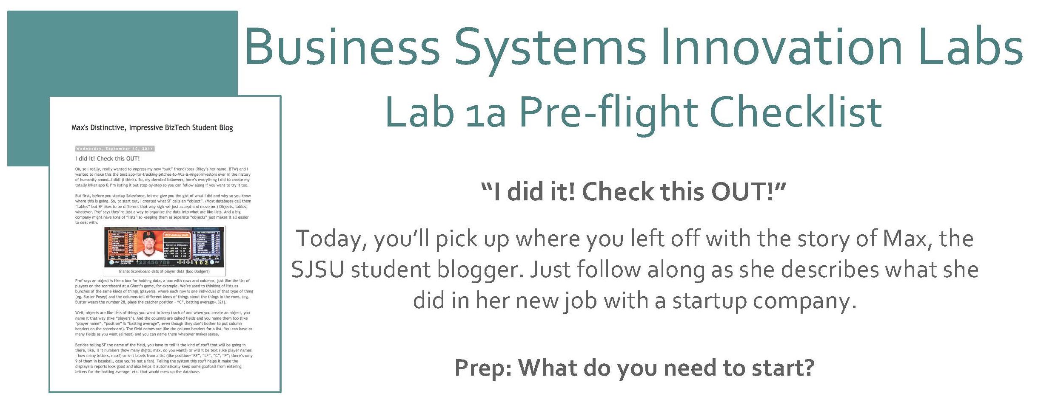
Max Labs 1a
Digital Product Management
FOX
MIS
Notes:
Cost of Max labs is $19.99 (don’t skip ahead) – wait until Max Labs 1 b!!!!

Slide 54
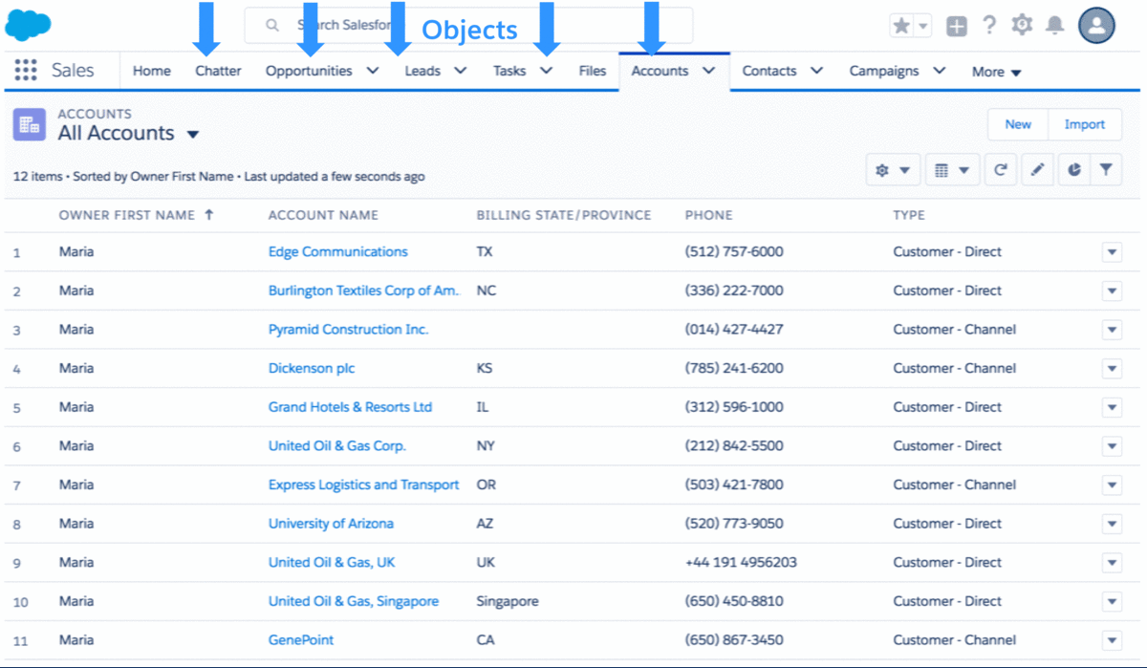
Max Labs – 1a Discussion
Creating Databases (objects)
Why do we need these lists?
Why not just use Excel?
What are we tracking?
Unique ID?
Source: https://developer.salesforce.com/blogs/developer-relations/2017/04/salesforce-data-security-model-explained-visually.html
FOX
MIS
Notes:
>>>>>>Note the image is a gif…give it a few moments to run through while you are discussing this slide<<<<<<
Pages 1 & 2
Key Takeaways:
Introducing database basics:
(Page 2) Tables as lists, records as rows, fields as columns + reinforcing databases as foundations for apps (from Pre-lab)
Data/Databases/Apps/Platforms
(Page 3) Conceptualizing unique record IDs

Slide 55
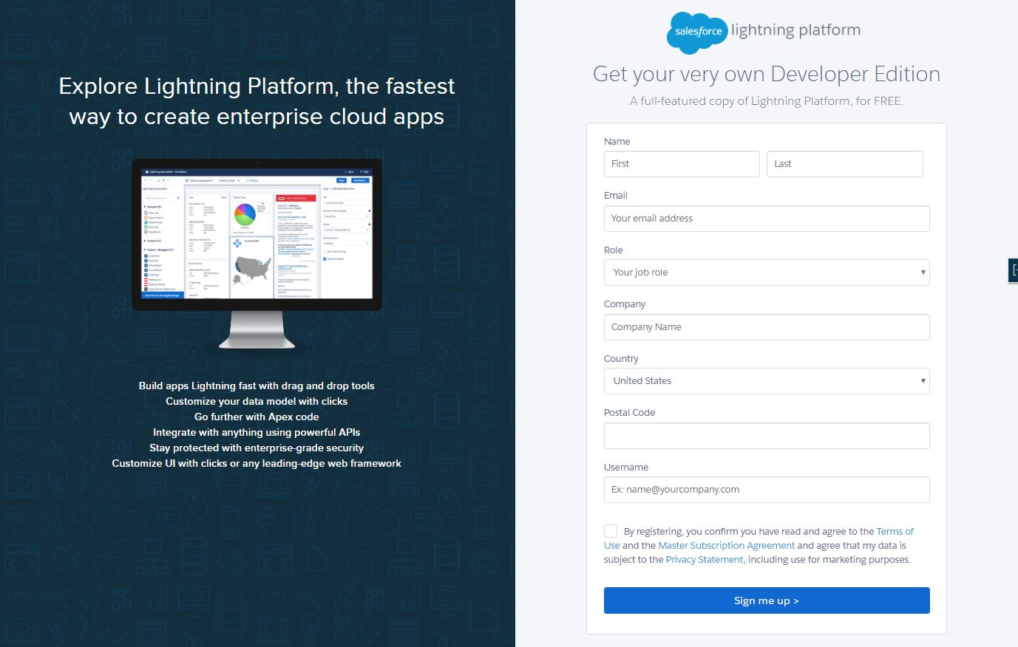
Max Labs – 1a Discussion
Getting Started
Get a Salesforce account
DO NOT get the 30-Day Free Trial Account
DO NOT use an AOL, Hotmail or Yahoo account
Do use a new Gmail account you create for this project.
Source: https://developer.salesforce.com/signup
FOX
MIS
Notes:
Pages 3 &4
Leave this slide up while you walk the class through pages 3 & 4.

Slide 56
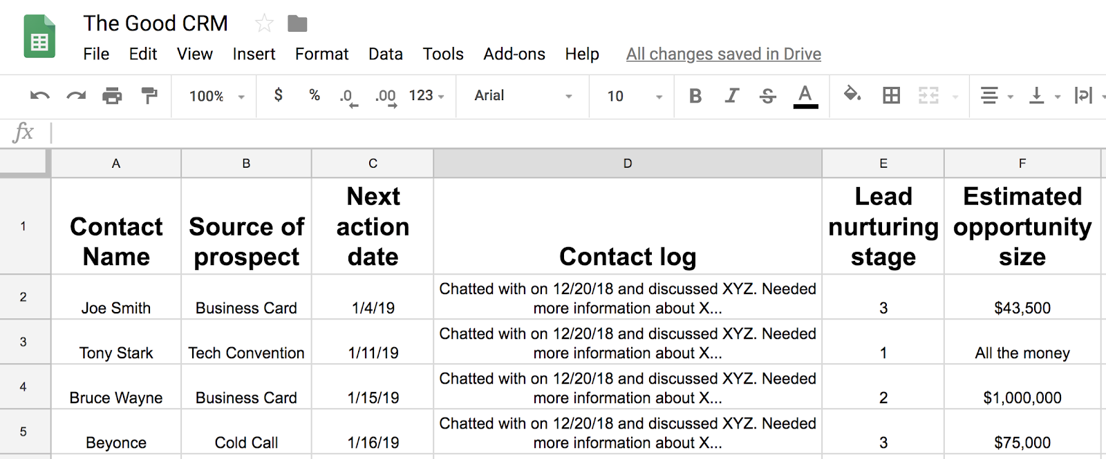
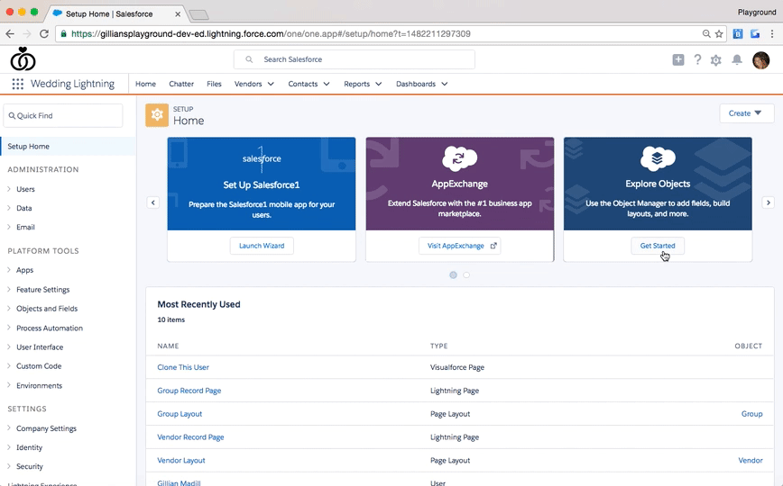
Max Labs – 1a Discussion
Determining Data Needs
What are Max’s needs for creating the “Pitch”
What data are we capturing?
What are we tracking?
How will this data be used?
Source: https://admin.salesforce.com/learn-lightning-create-edit-objects
Source: https://www.softwareadvice.com/resources/update-how-to-use-google-sheets-to-create-your-business-first-crm/
FOX
MIS
Notes:
>>>>>>Notes there is one animation before the gif image…give it a few moments to run through gif while you are discussing this slide<<<<<<
Pages 5, 6 & 7
Key Takeaways:
User Requirements / UX Design:
(Page 5) Max envisions user (Riley's) data needs to determine database specifications
(Page 6) Max envision user (Riley's) processes to derive data requirements + displays motivation to ensure user (Riley's) success (shared mission)
Data/Databases/Apps/Platforms
(Page 7) Extending field type considerations (text vs numerical)
User Requirements/UX Design
(Page 7) Reinforcing user needs/success considerations in design

Slide 57
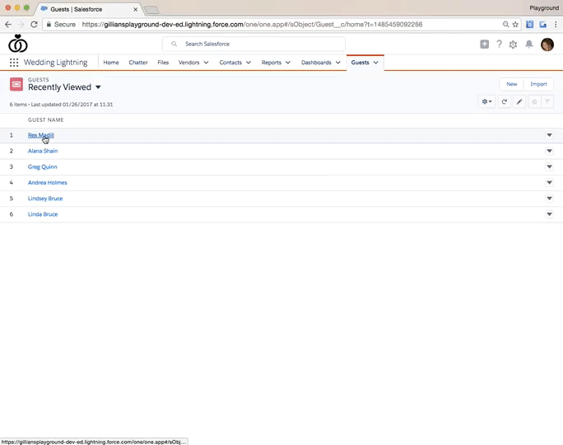
Max Labs – 1a Discussion
Page Layouts
What information do we want to show.
Why are aesthetics important?
Creating cleaner data?
Source: https://admin.salesforce.com/learn-lightning-compact-layouts
FOX
MIS
Notes:
>>>Note the image is a gif…give it a few moments to run through while you are discussing this slide<<<
Pages 8, 9 & 10
Key Takeaways:
Tech Competence/Confidence/Initiative
(Page 8)Max models initiative & tech self-reliance, exploring the environment to find promising features & giving them a try. Max continues to develop her ability to explore the environment and infer how new things work
User Requirements/UX Design
(Page 9) Introducing design aesthetic & aesthetic standards. Introducing & concretizing the hiding of unnecessary items as aesthetic principle
Data/Databases/Apps/Platform
(Page 10) Introducing the concept of enterprise systems and with multiple individuals in the Salesforce org account sharing the same data, apps, etc., customized to each one's job duties
Data/Databases/Apps/Platforms
(Page 11) Introducing the risks of bad data entry & using built-in filters to screen data entry

Slide 58
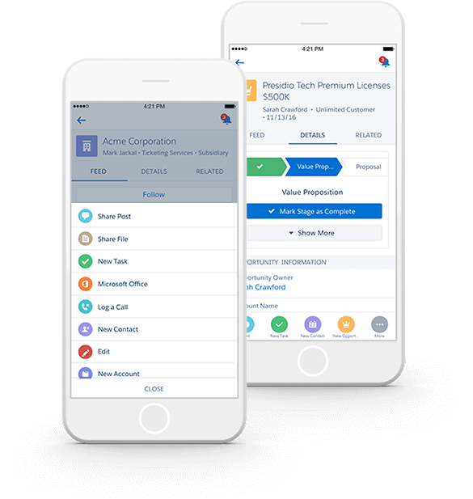
Max Labs – 1a Discussion
Mobile App
What information do we want to show.
Why are aesthetics important?
Is this an API, ERP or UX Interface?
Source: https://www.salesforce.com/eu/learning-centre/crm/mobile-crm/
FOX
MIS
Notes:
Pages 12 – 15
Key Takeaways:
User Requirements/UX Design
(Page 12) Introducing x-device interface considerations, specifically display “real estate” constraints in this case. Introducing visual effectiveness as design criteria
(Page 13) Introducing user efficiency as a design goal (minimizing clicks) to maximize user success
Tech Competence/Confidence/Initiative
(Page 15) Max displays well-earned pride in the real-world value of what she created. Max admits tech can be fun, even for non-geeks

Slide 59
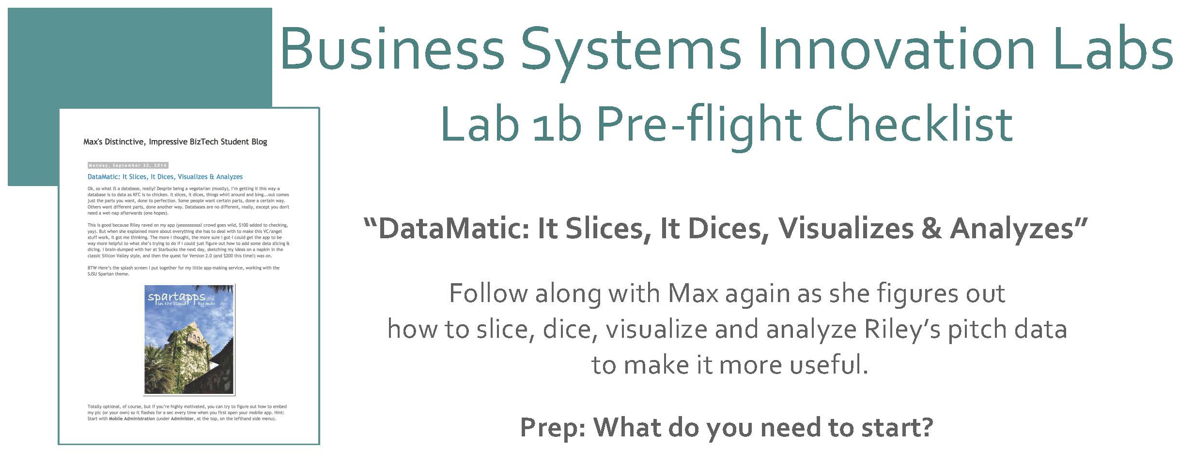
Max Labs 1b
Digital Product Management
FOX
MIS
Notes:
Cost of Max labs is $19.99 (don’t skip ahead)

Slide 60
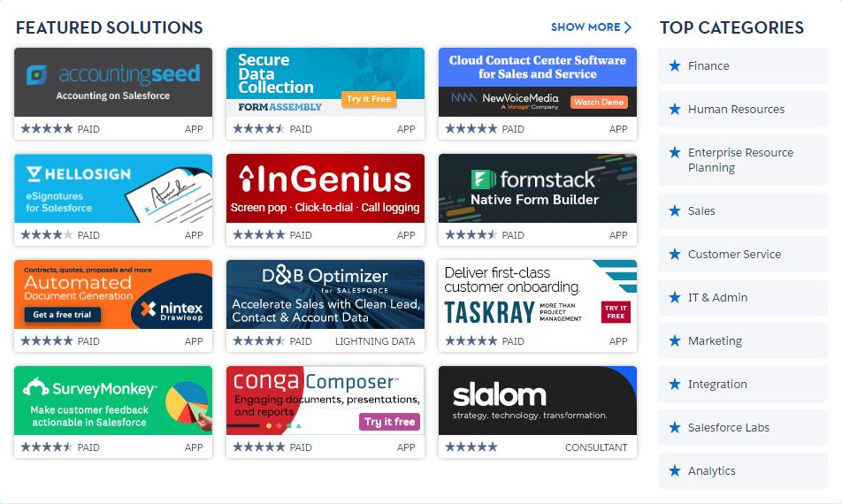
Max Labs – 1b Discussion
Digital Business Models.
Share & Communicate
Revise and Redesign
3rd Party Products (APIs)
Source: https://appexchange.salesforce.com/
FOX
MIS
Notes:
Pages 1
Key Takeaways:
User Requirements/UX Design
(Page 1) Exemplifies user communication > deeper process knowledge > augmented/refined UX design
Business & Digital Business Models
(Page 1) Highlights independent app development as a digital business model (emphasize value of API’s)

Slide 61

Max Labs – 1b Discussion
$19.99
Monetize Max’s Blog
Do Not Close Your Browser
Buy Now
Click Confirmations
Install (Launch Process)
Max’s Pitch Package
Source: https://www.themaxlabsprojectshop.com/
FOX
MIS
Notes:
(Occasionally, students will complete the payment but then close the tab before the installation, for example. Or they may say they forgot to bring a payment card or don't even have one at all, though we tell them they can always pick up a pre-paid Visa card at Walmart or the Fresh Grocer if they plan ahead)
Pages 4 & 5
Key Takeaways:
Business & Digital Business Models
(Page 4) Introduces content “monetization” (Max's blog) and provides exposure to buying/installing packaged apps/meta-data (can bridge to App Exchange)
Start the next section of tasks
Data/Databases/Apps/Platforms
(Page 5) Introduces/demonstrates data portability and data acquisition

Slide 62

Max Labs – 1b Discussion
Pitch Data File
CSV files
Organization
Viewing the Data
  Customization
Source: https://www.salesforce.com/ca/blog/2016/09/sales-search-cheat-sheet.html
FOX
MIS
Notes:
Pages 6 - 10
Key Takeaways:
Data/Databases/Apps/Platforms
(Page 6) Introduces the concept of views on the data
Data/Databases/Apps/Platforms
(Page 8) Demonstrates database features for browsing and organizing displayed data
User Requirements/UX Design
(Page 8) Reinforces design for maximizing user efficiency: setting default data view
User Requirements/UX Design
(Page 10) Considering user flexibility: providing multiple views to choose from
Data/Databases/Apps/Platforms
(Page 10) Points out that views are generated dynamically so are always up to date

Slide 63
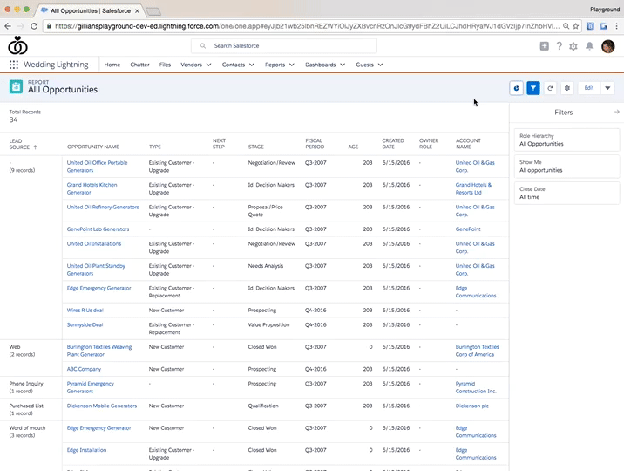
Max Labs – 1b Discussion
Generating Reports
CSV files
Organization: BU needs!
Viewing the Data
  Filtering
  Integration
Source: https://admin.salesforce.com/learn-lightning-create-reports
FOX
MIS
Notes:
>>>>>>Note the image is a gif…give it a few moments to run through while you are discussing this slide<<<<<<
Pages 10 - 13
Key Takeaways:
Strategic Value/Business Impact
(Page 10) Reports as more sophisticated views of data informing managerial perspectives.
Strategic Value/Business Impact
(Page 11) Reports providing statistical analysis to support strategic goals.
Strategic Value/Business Impact
(Page 11) Reports as bases for drawing inferences.
Strategic Value/Business Impact
(Page 12) Further refining reports by with filters (date) to glean business insights
Strategic Value/Business Impact
(Page 12) Adding data visualization to surface trends affecting with strategic value
Strategic Value/Business Impact
(Page 13) Integrating business analytic techniques to leverage the data.

Slide 64
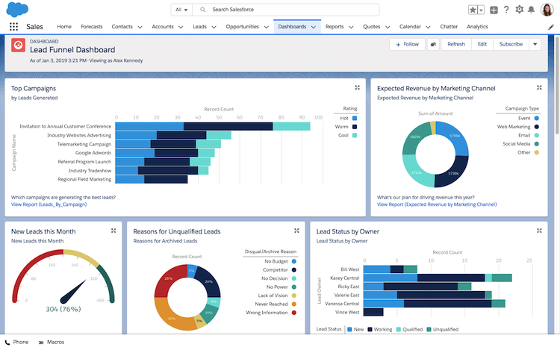
Max Labs – 1b Discussion
Dynamic Dashboards
Database
Monitoring
Collaboration
Customization
Source: https://admin.salesforce.com/learn-lightning-create-reports
FOX
MIS
Notes:
>>>>>>Note the image is a gif…give it a few moments to run through while you are discussing this slide<<<<<<
Pages 14 - 15
Key Takeaways:
Data/Databases/Apps/Platforms
(Page 14 ) Introducing database-driven dashboards
Strategic Value/Business Impact
(Page 15)Enabling real-time goal monitoring at a glance
User Requirements/UX Design
(Page 15) Highlighting user acceptance/satisfaction as a success marker

Slide 65
Digital Systems
2.2 Intro to Process Mapping
Modeling Processes with Swim Lane Diagrams
FOX
MIS
Notes:
Our focus today is Process Mapping

Slide 66

Process Mapping
What?
Visual Representation
Why?
Identify Problems
How?
Draw the “as-is” first!
Source: https://creately.com/blog/diagrams/process-mapping-guide/
FOX
MIS
Notes:
What?
Visual representation of process
Exercise to identify all steps and decisions in process
Why?
Identify problem areas
Measure how efficiently process is working
Basis for developing solutions
How?
Assemble small team of all working around process
Draw as is, not what you prefer it to be

Slide 67

What’s a Picture Worth?
How about a diagram???
How fast does the brain process images?
70% of your sensory receptors are in your eyes
50% of your brain is active in visual processing
Source: https://tax.thomsonreuters.com/blog/the-importance-of-visual-content-marketing-infographic/
Source: http://esheninger.blogspot.com/2018/08/a-picture-is-worth-thousand-words.html
FOX
MIS
Notes:
https://tax.thomsonreuters.com/blog/the-importance-of-visual-content-marketing-infographic/
Did you know?
90% of information transmitted to the brain is visual.
The brain processes visual information 60,000 times faster than text.
40% of people respond better to an image than 1,000 words.
46% say a website’s design is the Number 1 criterion for discerning a company’s credibility.
Posts with infographics grow traffic an average of 12% more than those without.
700 YouTube videos are shared on Twitter every minute.
Pinterest generates more referral traffic than Google+, YouTube and LinkedIn COMBINED.
Photos on Facebook garner more interaction than text, videos, and links.
Visitors spend 100% more time on pages that have videos on them.
Consumers who watch a product video are 85% more likely to purchase that product.

Slide 68
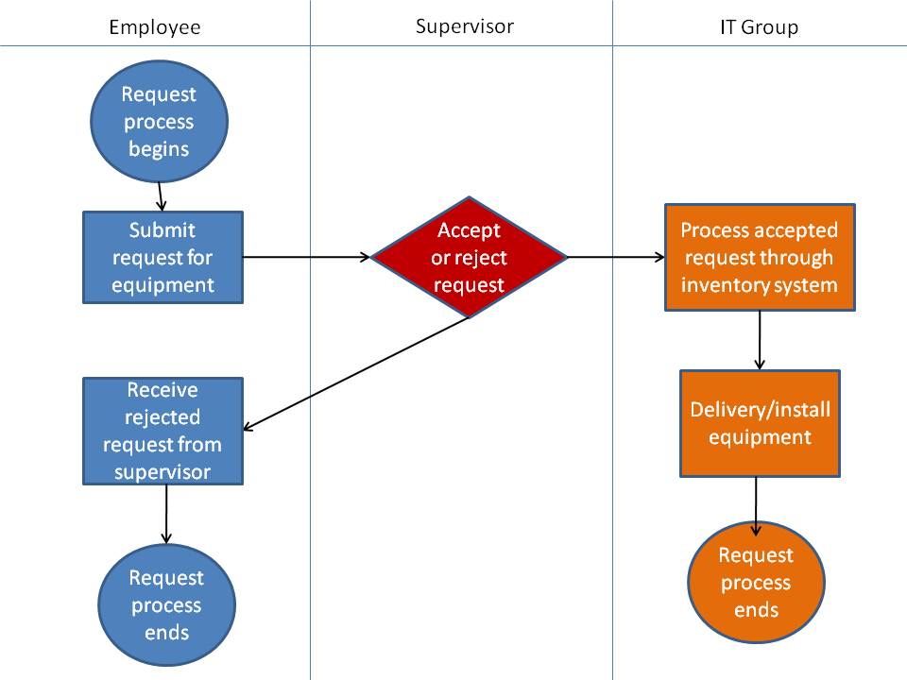
Swim Lane Diagrams
Identifies who does what & in what order
  Logical & Chronological
  Indicates hand-offs
Advantages:
  Helps see opportunity for improvements
  Helps eliminating duplications
  Basis for developing new solutions
  Useful Training tool
FOX
MIS
Notes:
Visual representation of a business process

Slide 69
Swim Lane Diagrams - symbols
A circle signifies the starting and ending of an event in the process
A rectangle represents an activity in the process.
A diamond represents a decision that must be made.
Arrows indicate the flow of the process.
A cylinder represents stored data.
FOX
MIS
Notes:
I highly recommend that you print out this slide & keep it with you throughout the semester

Slide 70
Swim Lane Diagrams – Order to Cash (O2C)
The process starts when the customer contacts Sales to place an order. The person in Sales creates the sales order. As part of doing this, the person in sales first checks to see if the customer has enough available credit to cover the order. They do this by looking up the customer’s credit on a report that is generated by Accounting and sent to Sales every Monday morning. If the customer doesn’t have enough available credit then the person in sales notifies the customer who can then either update or cancel their order. Next the person in sales checks to see if the items being ordered are in stock. They do this by checking a report on inventory that the Warehouse created at the end of each day. If the items being ordered are not in stock then the person in Sales notifies the customer who can then update or cancel their order. If the report indicates the items are in stock then the order goes to the Warehouse where the workers there will pick the order. Since Sales is looking at a report that is only updated at the end of each day, there is a chance that they accepted an order for an item that is not really in stock. If that is the case the Warehouse notifies Sales who then notifies the customer who can update or cancel their order…
FOX
MIS
Notes:
Have the students read this long, wordy narrative that describes the O2C process. This is long and boring and it is difficult to remember all of the steps, especially when you need to flip to the next slide for the second half of the process. After the students fall asleep reading this narrative then work through the swim lane diagrams and discuss which one is easier to understand and remember.

Slide 71
Swim Lane Diagrams – Order to Cash (O2C)
…Once the people in the warehouse pick the order, the people in Accounting have to make sure that the customer actually has enough credit to cover the order. Since the people in Sales use a credit report that is generated on Monday morning, there is a chance that the information on the credit report is old. If the customer doesn’t have enough available credit then Accounting notifies Sales who then notifies the customer who can then choose to update or cancel their order. If the customer has enough available credit then their available credit is reduced by the total cost of the order and the warehouse is notified and they pack and ship the order. As soon as the order is shipped the people in the warehouse notify accounting and accounting generates and sends the invoice to the customer. When the customer pays the invoice the people in Accounting increase the customer’s available credit by the amount of the payment, they post the payment and we’re done.
FOX
MIS

Slide 72
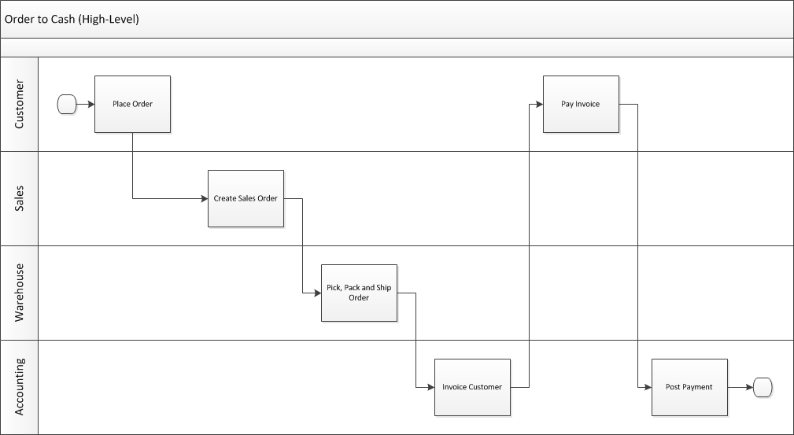
Swim Lane Diagrams – Order to Cash (O2C)
Who does What & When
Overview example
FOX
MIS
Notes:
This high-level diagram basically shows who does what and when as part of the order to cash process.
On the next slide we will have a much more detailed diagram.

Slide 73
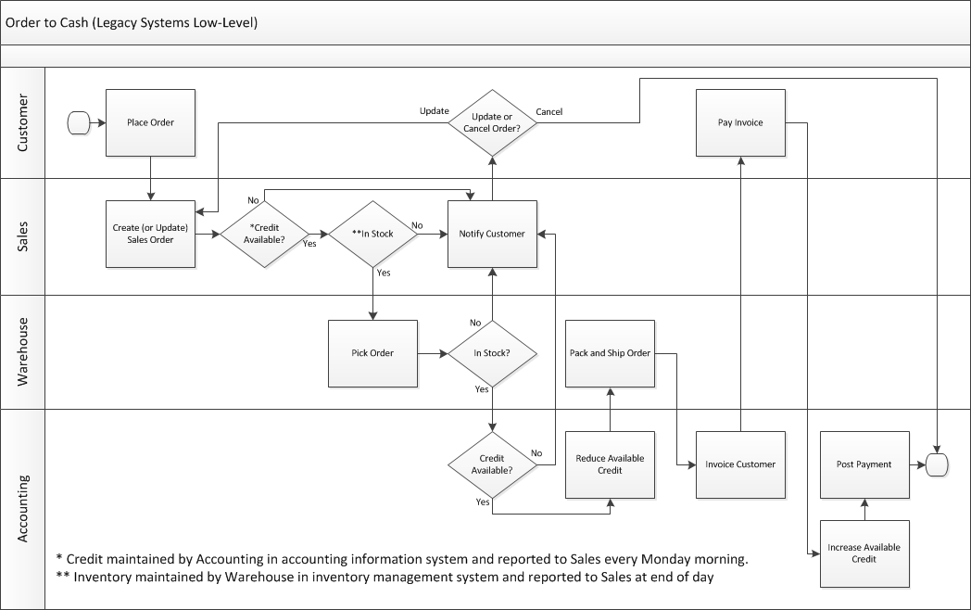
Swim Lane Diagrams – Order to Cash (O2C)
Who does What & When
Complexity added
Legacy system
FOX
MIS
Notes:
This more complex swim lane diagram represents the O2C process when they still used separate legacy systems for order processing, order fulfillment and accounting. While each of these separate systems made each team more efficient, they don’t optimize the process for the organization as a whole. There is lots of non-value added work in here which are a result of these legacy systems.
The biggest issues have to do with maintaining credit limits in the accounting information system and sending a report to Sales about credit limits every Monday morning. The credit information gets stale and Sales is possibly accepting orders and picking orders (only to be stopped before the order is packed and shipped) from customers who have over-extended their credit or denying sales to customers who have paid their bills.
The other issue is that inventory is maintained by the Warehouse in the inventory management system and sending reports to Sales at the end of every day. Sales may be selling inventory that was already sold earlier in the day.
The purpose of this slide is to show the students a more complex swim lane diagram and to show that it can clearly document a more complex process. We can introduce the story of this dysfunctional O2C process here and then come back to it throughout the course.

Slide 74
Swim Lane Diagrams
Create your own with ppt or Lucid Chart
Actors
Title of the Process you are documenting
Actor 1
Actor 2
Actor 3
Actor 4
FOX
MIS
Notes:
Open OneNote on the monitor…get interactive with the class!!!
You could use LUCID CHART too to show them how it works.
Who can describe a process where they work?
Let’s make a swim lane together
Come on up front
***we are laying the groundwork before our next in-class activity
***you will be “rock-star” swim lane diagram experts by the end of the semester!!!
***Assignment*** Pizza order swim lane…draw your own! (add this in-class, don’t post it on-line)
Ask the class to create their own swim lane based on how the pizza ordering process works near where they grew up

Slide 75
Food truck ordering example!
Actors:
  Cook
  Cashier
  Customer
Steps:
  Place Order
  Prepare Order
  Pay for Order
Decisions:
  Pay cash
  Pay with credit card

Slide 76
In-Class Activity #2
Swim Lane Diagrams #1
FOX
MIS

Slide 77
Prepare for week 2 – complete before our next class:
- Read articles
- Watch videos
- Take notes!

