Slide 1
Information Systems in Organizations
Exam#3 Review – CSS, HTML & JavaScript – Code Diagnosis
In-Class Activity
FOX
MIS

Slide 2
ROADMAP
START
Week 1:
Introduction & Systems Analysis
Course Description
Systems Thinking
Week 2:
Introduction to Process Mapping
Systems & Processes
Swim Lane Diagrams
Assignment #01
Week 3:
Digital Product Management
Max Labs 1a & 1b
Assignment #02
Week 4:
Information Systems – Part I
CRM & ERP
Max Labs 2a & 2b
Assignment #03
Week 5:
Exam #1
Midterm review
Exam Prep
*check course calendar
Week 9:
Exam #2
Midterm review
Exam Prep
*check course calendar
Week 8:
Cybersecurity & the Enterprise
Protection Protocols
Artificial Intelligence
Assignment #06
Week 7:
Platforms & Digital Business Models
API’s
Max Labs 3a & 3b
Assignment #05
Week 6:
Information Systems – Part II
Data Analytics & CRM
Learn IT #1 & 2
Assignment #04
WE ARE FINALLY HERE!!!
Week 10:
JavaScript Unit #1
Hello World, Variables
Input and Output
Assignment #07
Week 11:
JavaScript Unit #2
Operator types
Strings
Assignment #08
Week 12:
JavaScript Unit #3
Logical Operators
Conditional Types
Assignment #09
Week 13:
JavaScript Unit #4
Intro to Loops
While and Do
Assignment #10
Week 14:
JavaScript Unit #5
HTML basics
CSS basics
Assignments #’s 11 & 12
FINISH

Slide 3
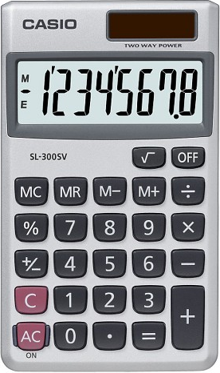
Exam Will Cover Discussions: 9.1 through 13.1
Readings, Videos and Lectures (40%)
CSS, HTML and JavaScript basics
Variables
Input & Output
Operator Types
Strings
Logical Operators
Conditional Types
Loops
Coding – Demonstrate your ability to apply (60%)
Code Analysis & Diagnosis
A CALCULATOR and WHITEBOARD will be available through Proctorio
Source: https://target.scene7.com/is/image/Target/GUEST_a97f68d0-6348-4802-9d47-89b3a854a20e?wid=488&hei=488&fmt=pjpeg
Source: https://ccesnews.org/opinion/2018/04/23/10-tips-for-exam-preparation/#photo
FOX
MIS

Slide 4
Sample Question:
A loop cannot start with a negative number?
Refer to the example below:
for (var i = -10; i <= 30; i=i+5) {
True or False
FOX
MIS

Slide 5
Sample Question:
A loop cannot start with a negative number?
Refer to the example below:
for (var i = -10; i <= 30; i=i+5) {
True or False
FOX
MIS

Slide 6
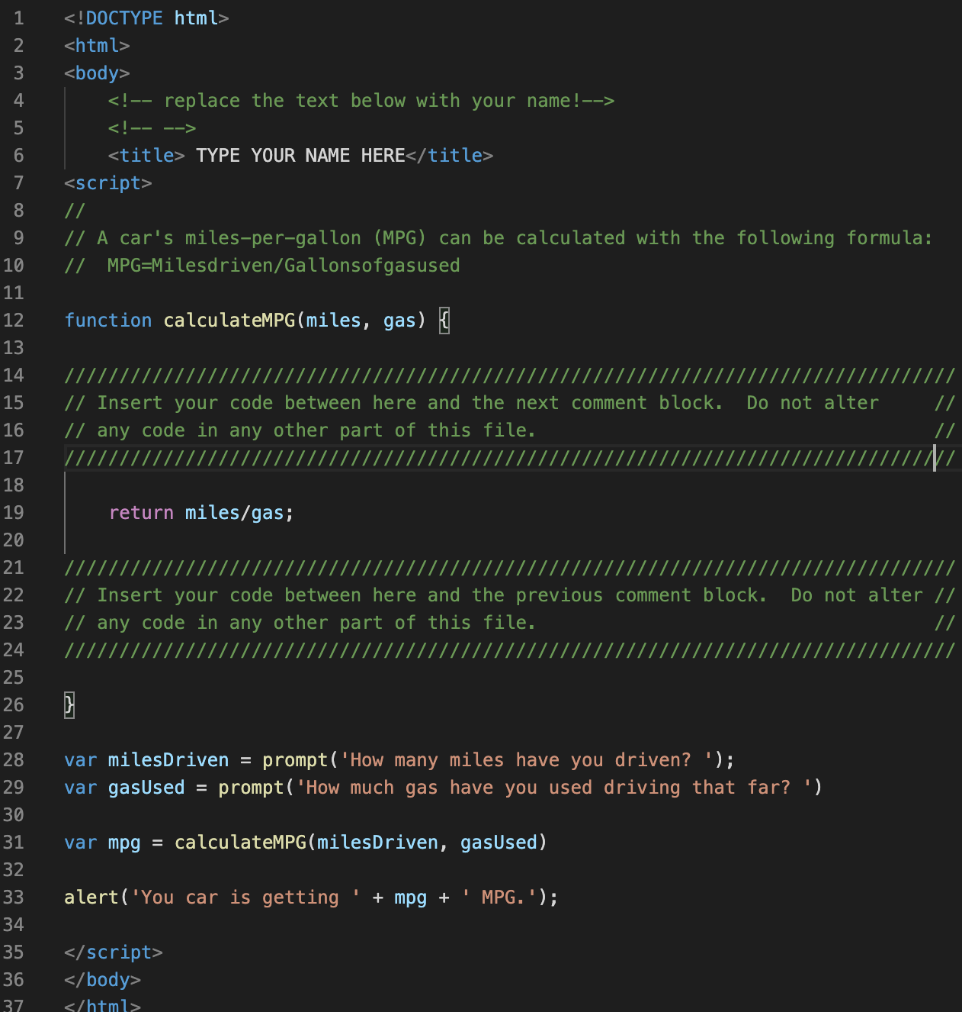
Sample Question:
What is your MPG if you have driven 320 Miles and used 20 Gallons of gas? (analyze the code)
A. 15
B. 16
C. 20
D. 32
FOX
MIS

Slide 7
Sample Question:
What is your MPG if you have driven 320 Miles and used 20 Gallons of gas? (analyze the code)
A. 15
B. 16
C. 20
D. 32
FOX
MIS

Slide 8
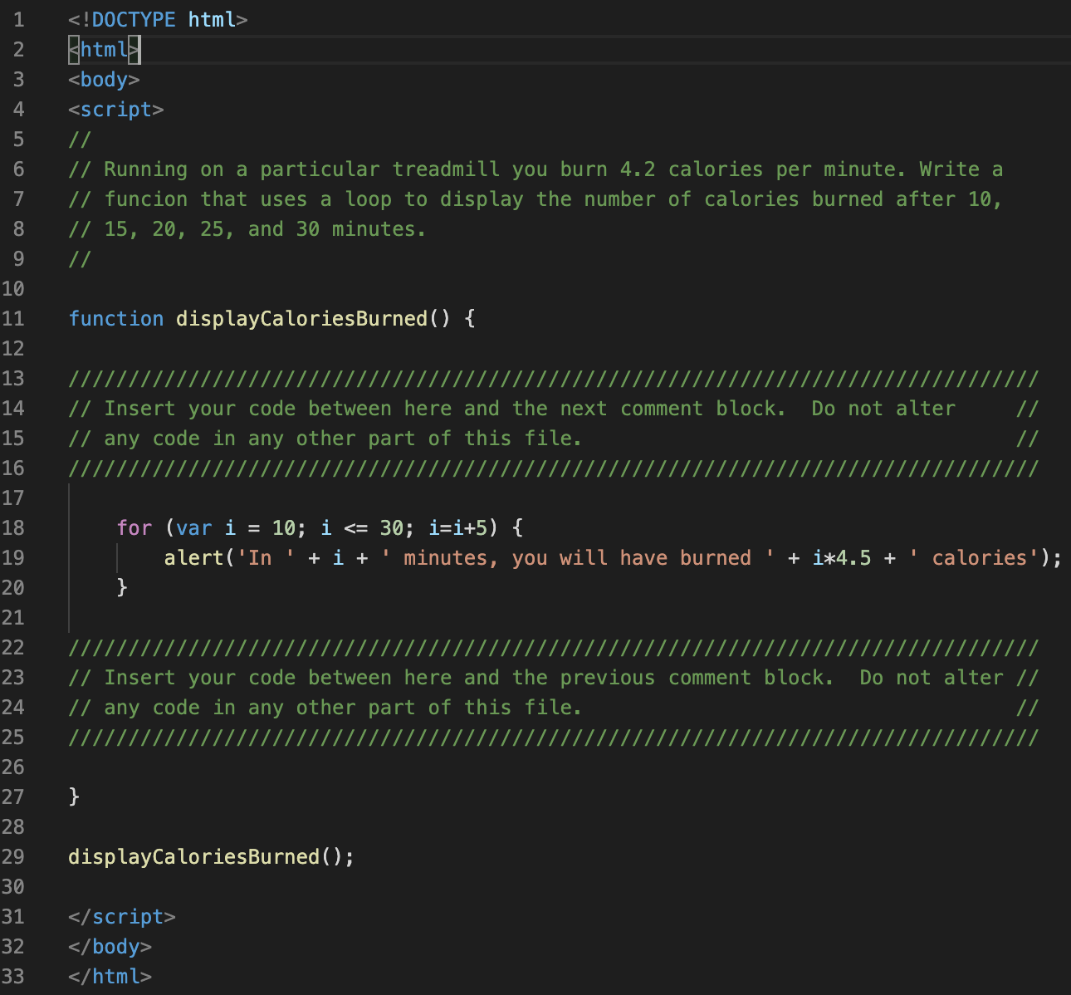
Sample Questions:
1. After 10 minutes, how many calories have you burned?`
A. 0 B. 45 C. 67.5
2. After 30 minutes, how many total calories have you burned?`
A. 112.5 B. 135 C. 450 D. 1350
3. If we change the initial value of i to 20 how many times does the function run and how many total calories are burned?
A. 3, 90 B. 5, 135 C. 3, 135 D. Does not run
4. If we change i <= 30 to i <=40 how many times does the function run and how many total calories are burned?
A. 5, 135 B. 7, 180 C. 7, 225 D. Does not run
B.45
B.135
C. 3, 135
B. 7, 180
FOX
MIS

Slide 9
Sample Question:
What’s wrong with the statement listed below?
var 365days = prompt (“How many days are in a year?");
FOX
MIS

Slide 10
Sample Question:
What’s wrong with the statement listed below?
var 365days = prompt (“How many days are in a year?");
Variable name cannot begin with a number!
FOX
MIS

Slide 11
Good Luck!!!
Study individually and in groups

