Slide 1

Introduction to JavaScript
(Variables, Expressions, Data Types)
MIS 2402
Department of MIS
Fox School of Business
Temple University

Slide 2


Today’s class…
Today’s class We will introduce some basic concepts of the JavaScript language that we will build on next week.
We will also stop periodically and run JavaScript code that illustrates a concept.
So … before we do anything else, see intro_js.zip and get it set up in Visual Studio Code.
Bug alert! The start file is supposed to write “Hello World” to the console. But it’s not. What’s wrong??

Slide 3
Agenda
A quick review of the role of JavaScript
An introduction to the developer console in Chrome
An introduction to variables, and two simple data types
Putting JavaScript to work doing some simple math
Making our output more readable with the parseInt function and the toFixed method

Slide 4
The role of JavaScript
HTML
CSS
JavaScript
JavaScript is a general purpose language.
It is commonly used to manipulate the HTML and CSS in the browser in response to an event.
But today … we are going to just focus on JavaScript itself, separating it from HTML and CSS as much as possible.

Slide 5
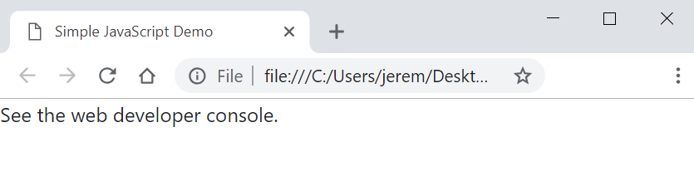
The developer console
When you preview intro_js/index.html all you will see is a message that says “See the web developer console.
Assuming you are using Chrome (and you should be!) click on the three dot icon, “More Tools” and “Developer tools”.

Slide 6
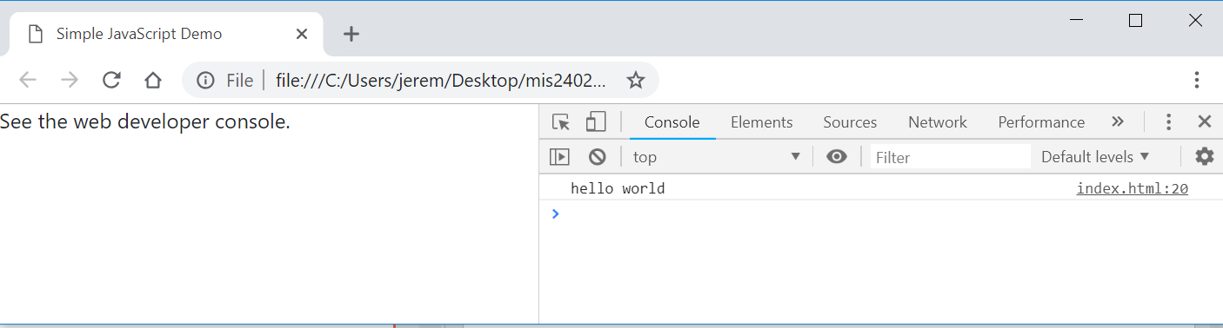
The developer console (2)
We have already started thinking about the HTML that our JavaScript can manipulate…. But not today!
Now we can see a place were JavaScript writes out content. The console! This text was generated by the JavaScript command:
console.log(“hello world”);

Slide 7
Before we begin - a quick look at the code
<!DOCTYPE html>
<html lang="en">
<head>
<meta charset="utf-8">
<meta name="viewport" content="width=device-width, initial-scale=1">
<!-- Bootstrap 4 References -->
<link rel="stylesheet" href="https://maxcdn.bootstrapcdn.com/bootstrap/4.1.3/css/bootstrap.min.css">
<script src="https://ajax.googleapis.com/ajax/libs/jquery/3.3.1/jquery.min.js"></script>
<script src="https://cdnjs.cloudflare.com/ajax/libs/popper.js/1.14.3/umd/popper.min.js"></script>
<script src="https://maxcdn.bootstrapcdn.com/bootstrap/4.1.3/js/bootstrap.min.js"></script>
<!-- Link to FontAwesome -->
<link rel="stylesheet" href="https://stackpath.bootstrapcdn.com/font-awesome/4.7.0/css/font-awesome.min.css">
<title>Simple JavaScript Demo</title>
</head>
<body>
<p>See the web developer console.</p>
</body>
<script>
"use strict";
/* some simple examples based on the material covered in class */
console.log("hello world");
</script>
</html>
The Bootstrap and FontAwesome portions are standard for this class. You don’t need to memorize those!

Slide 8
Let’s zoom in…
<script>
"use strict";
/* some simple examples based on the material covered in class */
console.log("hello world");
</script>
JavaScript is to be written inside the <script> tag.
The “use strict”; line is a best practice. We will talk about that more another day.
This is our one line of code
Notice the characters used to indicate comments in JavaScript.
/* comment goes here */

Slide 9
Now try this…
DISCUSS
What did console.clear() do?
What character does each JavaScript statement end with?
<script>
"use strict";
console.clear();
console.log("hello world");
console.log(10);
</script>
Data Types: JavaScript supports multiple data types. The two most intuitive data types are string and number. In the statement above what is string data? What is number data? How can you tell the difference?

Slide 10
Humble beginnings…
Let’s add some more code to the bottom of the script tag…
Another way to indicate a comment in JavaScript
// comment goes here
//write an expression to the console
console.log(10 + 4);
//make a variable
let a=42;
console.log(a);
let b=19;
console.log(b);
Hey look! JavaScript can do math for us!
This is called an expression. That is – we expressed a value (14) as the sum of 10 and 4.
What we just did here is remarkable! Instead of the literal values 42 and 19, we put those values into something called a variable. The let statement means make a new variable. (Or “let there be a new variable.”)
The variables are a and b. Variables are essential to make a programming language do anything useful!

Slide 11
Putting JavaScript to work (simple math)
Here we combine a string with a variable. The result is a new string.
//write expressions using variables.
console.log("The value of a is: " + a);
console.log("The value of b is: " + b);
console.log(a + b); //addition (a + b)
console.log(a - b); //subtraction (a - b)
console.log(a * b); //multiplication (a * b)
console.log(a / b); //division (a/b)

Slide 12
Order of precedence
a = 10;
b = 2;
//order of precedence
console.log(10 + a / b ); //implicit
console.log(10 + (a / b) ); //explicit
console.log( (10 + a) / b ); //explicit
We already had variables a and b so we are not using let again here. We are just reassigning them.
Discuss - One of these lines results in a different answer. Why?

Slide 13
Working with strings
//how about some strings?
console.log('Fred');
console.log("Velma"); //either single or double quotes is fine
let name_one = 'Shaggy’;
let name_two = 'Scooby';
console.log(name_one);
console.log(name_two);
//What happens when you try to add two strings together?
// Think about it - a word like 'Scooby' does not have
// a numeric value so ...
console.log(name_one + name_two);
We call this operation concatenation. The + sign does double duty in JavaScript. It represents both arithmetic addition as well as concatenation.

Slide 14
Now we’re cooking!
// convert feet to inches
let length_in_feet = 6;
let length_in_inches = length_in_feet * 12;
console.log(length_in_feet + " feet is equal to " + length_in_inches + " inches.");
Notice that we used much more meaningful variable names in this example.
We chose length_in_feet and length_in_inches instead of the less obvious names a and b.
That makes our code easier to read!

Slide 15
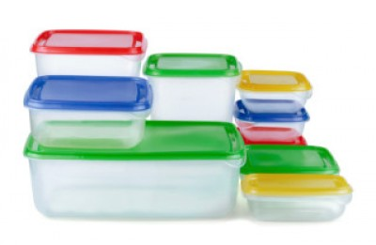
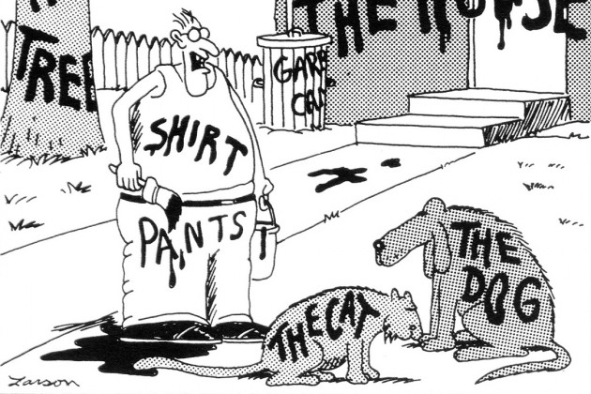
Variables

Slide 16
Rules for naming variables
Variable names are called identifiers.
Identifiers can only contain letters, numbers, the underscore, and the dollar sign.
Identifiers can’t start with a number.
Identifiers are case-sensitive.
Identifiers can be any length.
Identifiers can’t be the same as reserved words.
Avoid using global properties and methods as identifiers.
So var and console would be poor variable names!
Some examples:
subtotal
index_1
$
taxRate
calculate_click
$log

Slide 17
Camel casing versus underscore notation
Camel case notation
theCat
theDog
theHouse
Underscore notation
the_cat
the_dog
the_house
Both are fine…

Slide 18
Naming recommendations for identifiers

Slide 19
More calculations
// the area of a square
let square_side_length = 123;
let square_area = square_side_length * square_side_length;
console.log('The area of a square with a side length of ' + square_side_length + ' is ' + square_area );
// the perimeter of a square
let square_perimiter = square_side_length * 4;
console.log('The perimeter of a square with a side length of ' + square_side_length + ' is ' + square_perimiter );

Slide 20
Fahrenheit to Celsius
// convert Fahrenheit to Celsius
// The formula is: (32°F − 32) × 5/9 = 0°C
let fahrenheit = 212;
let celsius = (fahrenheit - 32) * 5/9;
console.log(fahrenheit + " degrees fahrenheit equals " + celsius + " degrees celsius.");

Slide 21
Fancier stuff
// fancier stuff - how long is the string?
console.log("How long is the string: " + name_one);
console.log(name_one.length);
// fancier stuff - changing a string to integer
let x = '1812';
console.log(parseInt(x));
let y = 'Elephant';
console.log(parseInt(y));
//fancier stuff - converting a number to string
let pi = 3.14159265359;
console.log(pi.toFixed(2));

Slide 22

On your own …
Continue working in intro_js.html. Follow the instructions in the assignment document provided by your instructor.

