Slide 1

Sending a text message (and more)
Department of MIS
Fox School of Business
Temple University

Slide 2

Today we’re going to write code that sends a text message to your phone
I don’t know how to do that!
Wait, what?
Yes, yes you do. What you already know…
HTML / CSS
JavaScript/jQuery
How to get JSON data with $.getJSON
What don’t know yet…
How to set data with $.post()
But we can fix that!

Slide 3
The jQuery post method…
This is the callback function that will execute when the Ajax call is a success.
The URL to visit
$.post(someurl, datatosend, function(result) { things to do});
The data to send
The object returned by the post method.
One or more commands.
The data in result can be used here!

Slide 4
Conventional use of GET and POST
As we’ve already seen, HTTP GET is usually used to retrieve data.
We need the jQuery $.post method because HTTP POST operations are used to send data to a system.
We will send our text message using a POST.
Web server
HTTP GET method
is used to retrieve data
Browser
JavaScript Engine
HTTP POST method
is used to send (or create) data
Database

Slide 5
What’s the plan?
For this class, we have identified an external API that can be used to send a text message. It is called Textbelt. See: https://textbelt.com/
We will make an HTML form that holds these things:
  The phone number we want to send a message to
  The text message we want to send
  A hidden field that holds our textbelt API key
  A button to initiate the action
Initially we will use the free / demo API key that textbelt gives us.
We will collect all the data on the form, get it ready, and send it to the API. This is “getting ready” process involves something called called serialization.
Once we are satisfied that this works, we will use a real API key.

Slide 6
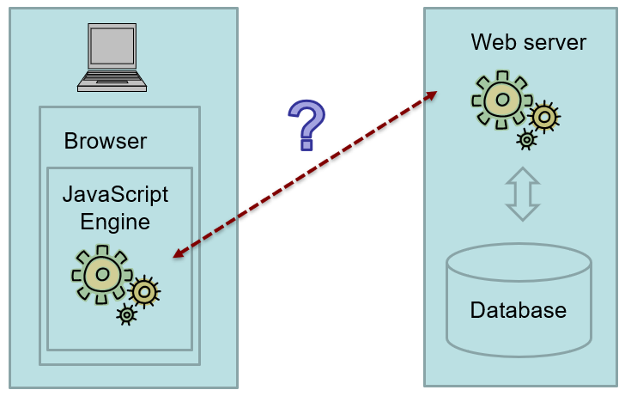

Data Serialization
Data serialization is the process of translating structured data into a format that can be stored or transmitted in one computer environment, and then later reconstructed in another computer environment.
JSON is often (but not always!) used to provide a server response.
URL Encoded data is often (but not always!) used to send a data request.
Both JSON and URL encoded data are forms of serialized data.
Let’s see some serialized data.
(demo_sms.zip)

Slide 7
What does URL encoded data look like?
key=textbelt&phone=2155551212&message=test
These are key/value pairs, separated by ampersands.
This is an example of URL encoded data.
Data requests are often sent in this manner.
In this class we will follow this pattern … send a data request as URL Encoded data and get a JSON response back.

Slide 8

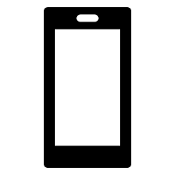
What’s the point?
API for SMS
(textbelt)
CDN
(jQuery)
API for …
the next thing!
CDN
(Bootstrap)
API for …
the next thing!
CDN
(other ?)
API for …
the next thing!

Slide 9

Try it, you’ll like it!
Use the $.post method to send the_serialized_data to the textbelt API endpoint: https://textbelt.com/text
Type in your cell phone number into the form and a message. Click “Send the text”
Once you receive the confirmation message, use the real API key.
Be sure to define a call back function that receives a variable called “data”
Use console.log(data) to inspect the contents of data as it is returned from the API.

